Slide 1
Refrigeration Challenges in the Off-Shore Fisheries Sectors
Jeffrey Abraham Yamada
National Ozone Officer
March 4, 2021

Slide 2
Outline
Fisheries on the global scale
Fisheries in the Pacific Economy
Overview of the Fisheries sector in FSM
Marine Sector Challenges for HCFC phase-out
Freezer Types on-board fishing vessels
What does it all mean?

Slide 3
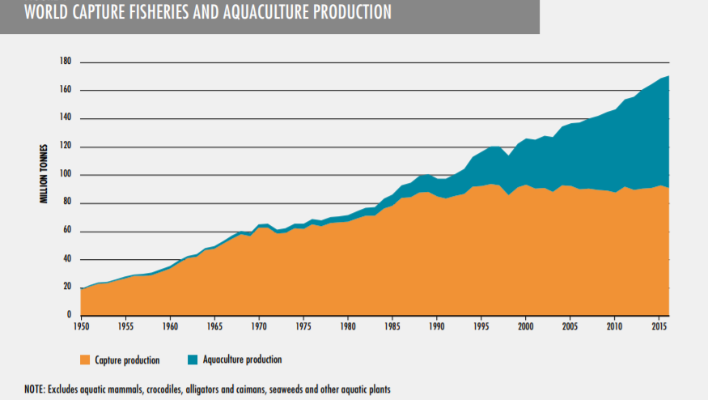
Fisheries on the Global Scale

Slide 4
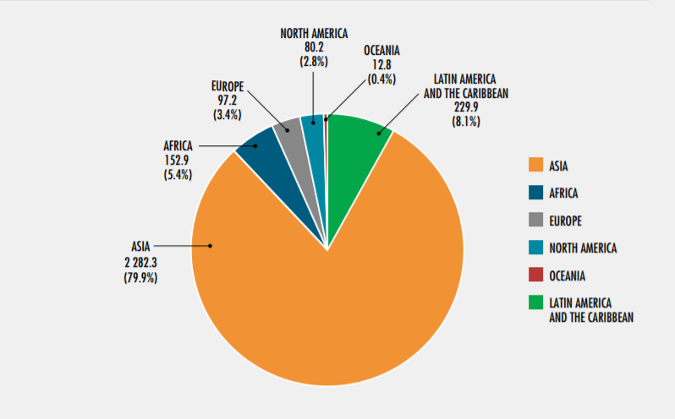
Global Distribution of Motorized Fishing Vessels (2016)
In Thousands (‘000)

Slide 5
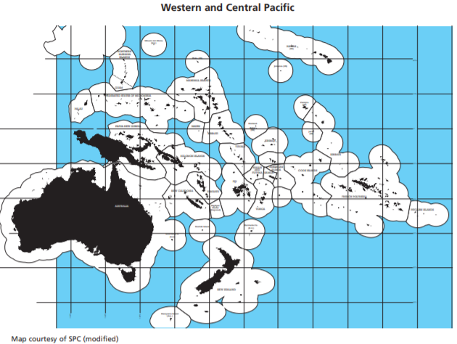
Fisheries in the Pacific Economies

Slide 6
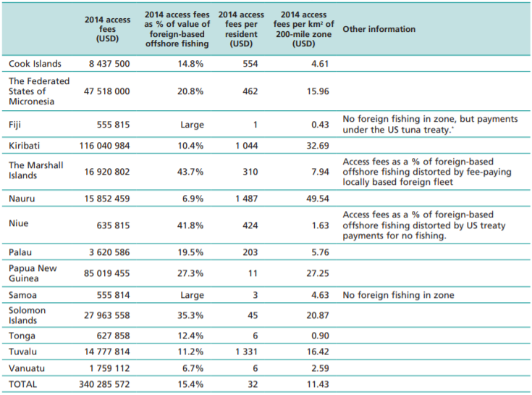
Fishing Access Fees for PIC region and contribution to GDP

Slide 7
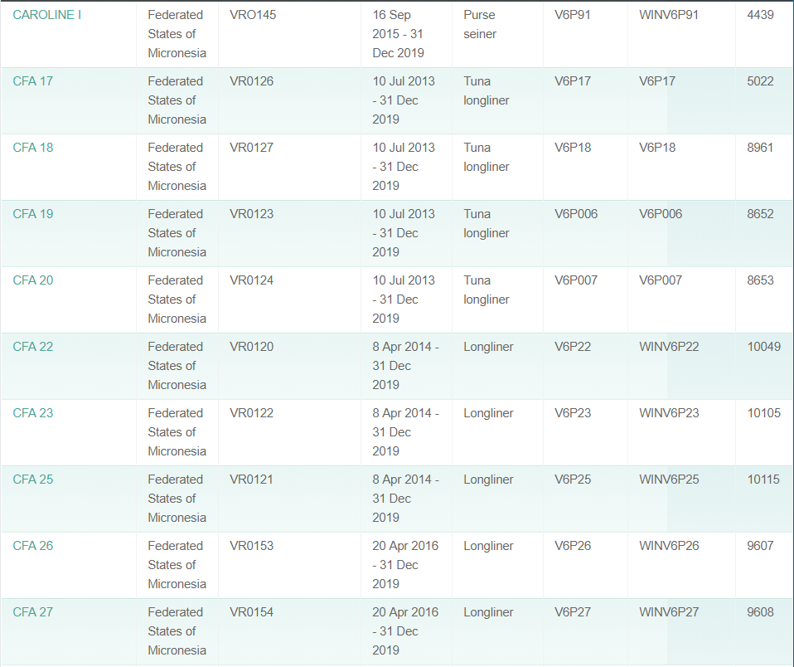
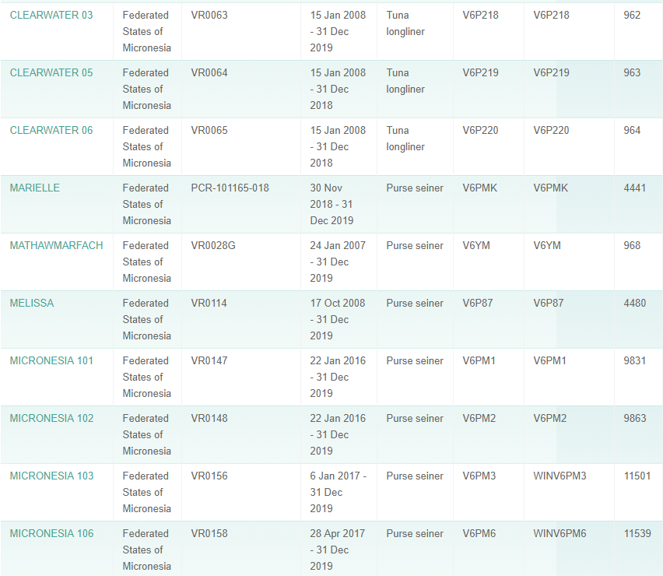
FSM’s Flagged Vessels as of 04/19

Slide 8
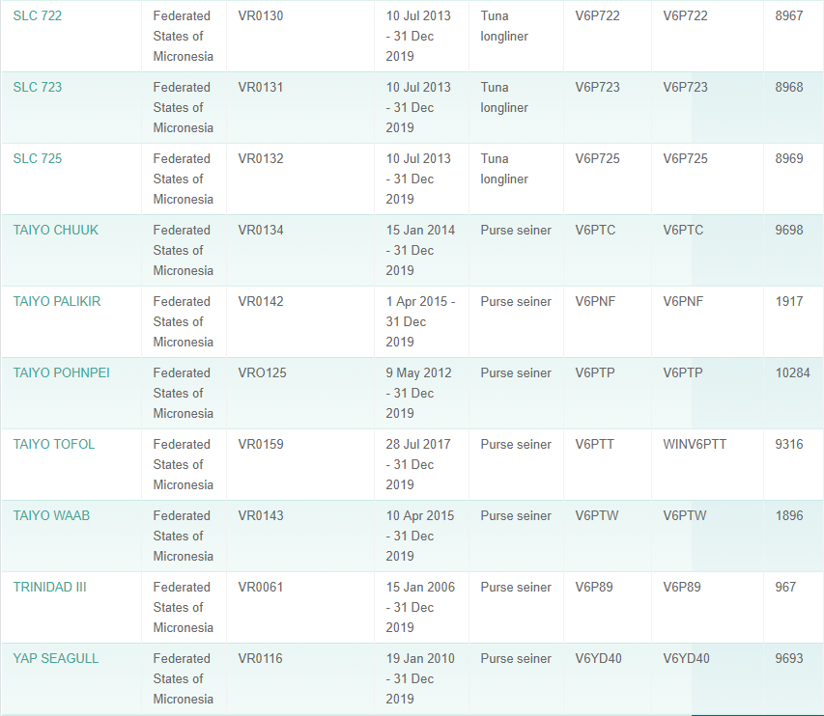
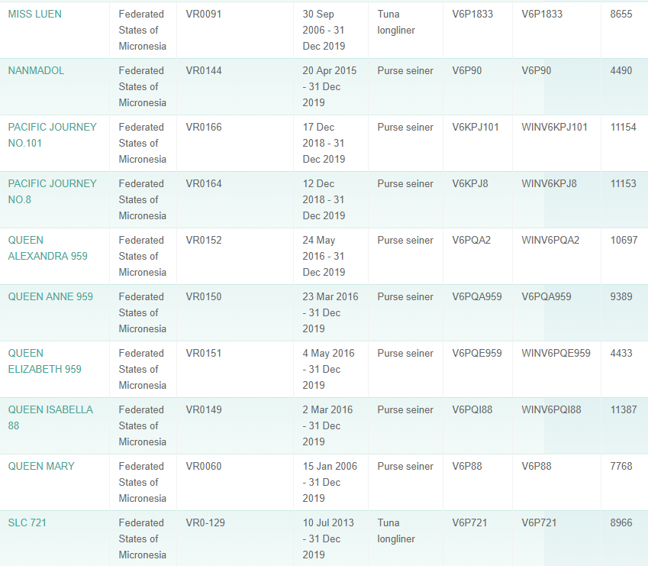

Slide 9
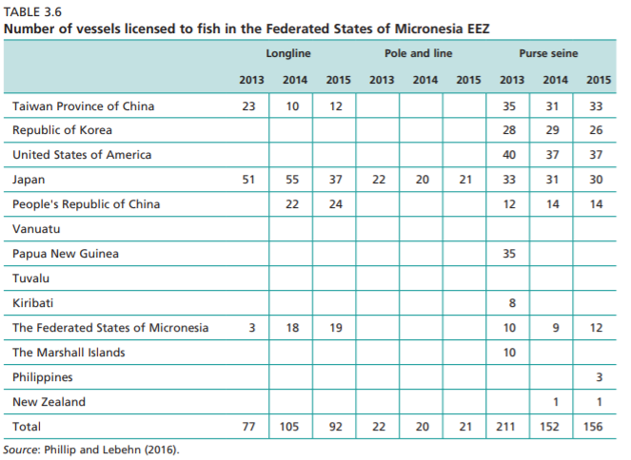
Notes:
Phillip and Lebehn (2016) -

Slide 10
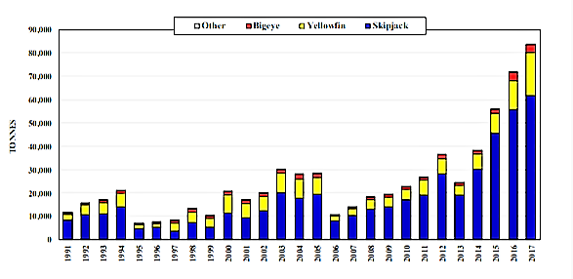
FSM’s Flagged Vessels Total Catch for all Species
Source: WCFPC 2017 Tuna Catch Yearbook

Slide 11
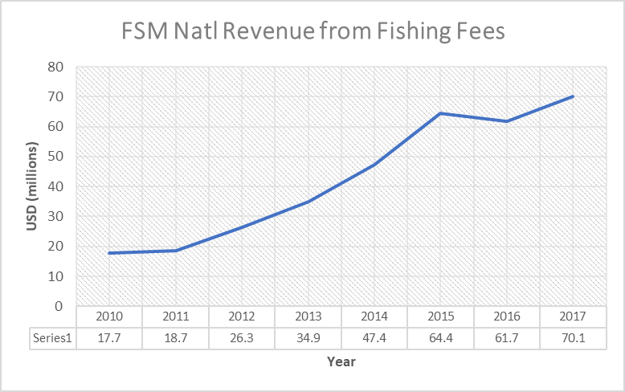
Contribution to Gross Domestic Product
Source: PITI-VITI Economic Review for Fiscal Year 2017

Slide 12
Marine Sector Challenges for HCFC phase-out
1. Flag State vs Ship Owner vs Chartered fishing vessels
Governing regional and international agreement, Regional Fisheries, MARPOL (IMO), UNLOS and MP Compliance etc.
2. Monitoring and Reporting of ODS (and non-ODS) use in Off-shore and On-Shore Marine Sectors –
Legal Interpretation of “Consumption” in Marine Sectors, & Data Reporting.
3. Service Sector Practices and Capacity Building Off- Shore and On - Shore
Multiple nationalities, who qualifies to be trained, How can the Multilateral Fund (MLF) rules be applied ?
Notes:
Issues are faced by both the developed and developing countries

Slide 13
Continued…
4. Technologies for upgrade of Ships
Who pays for upgrades is legally responsible?
5. Reefer Containers
The Low Hanging Fruit- Possible for HFC Phase-down
6. Implications of Kigali Amendment
Fleets with refrigerated systems (built in) would need to move to low GWP. (need to address old vessels and NOU providing advise to decision makers on procurement processes for new vessels)

Slide 14
Global Conventions relating to Fisheries
1958 High Seas Convention
(HSC) – Flag State duties and responsibilities
1973 International Convention for
the Prevention of Marine Pollution from Ships,
modified by the 1978 Protocol (MARPOL 73/78)
and the 1982 United Nations Convention on
the Law of the Seas (UNCLOS).
Under the 1982
Convention, the flag State is responsible for
the vessel’s compliance with international laws.
Article 217 of UNCLOS makes the flag State
primarily responsible for preventing vessel source pollution.
The Montreal Protocol has
no specific and separate decisions on the
management and reporting of ODS for Flag
States

Slide 15
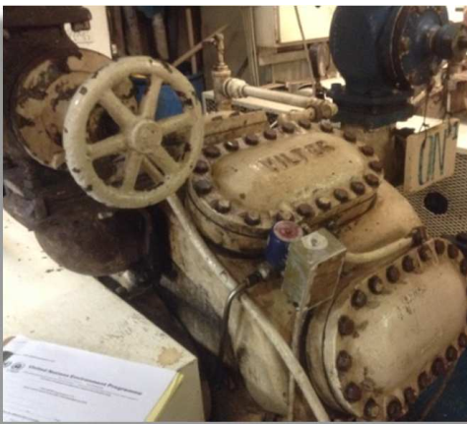
Freezer types onboard Fishing Vessels
Types that use R-22, R-717
The UNEP Montreal Protocol Technical and
Economic Assessment Panel (TEAP) reported
in October 2014 that almost 80% of fishing
fleets all over the world uses HCFC-22

Slide 16
What does this all mean?
The need to develop a plan that address each PIC country’s fisheries
A management approach to deal with the levels of HCFCs consumption onboard fishing vessels
Common understanding between the PIC and the world that the both the onshore and offshore fisheries sector is our economic lifeline
Associated costs with upgrading refrigeration units for fishing vessels are undoubtedly very costly.
Incentives for fisheries to switch, since environmental stewardship alone on part of companies may not be enough

