Slide 1
The FSM and the Montreal Protocol
Jeffrey Abraham Yamada - DECEM
March 4, 2021

Slide 2
Presentation Snapshot
What is the Ozone Layer?
What is the Montreal Protocol?
How they do these destroy the ozone?
Effects on health? Marine ecosystem? Anything under the sun?
How do refrigerants affect climate change?
Effects of climate change?
What is FSM’s HCFC Phase-out Management Plan? (HPMP)
What role does the Kosrae RAC Association and Businesses play?
Phase-out schedule and global commitments

Slide 3

What is Ozone?
Ozone is an inorganic molecule with the chemical formula O3
Only 3 molecules in every 10 million air molecules

Slide 4
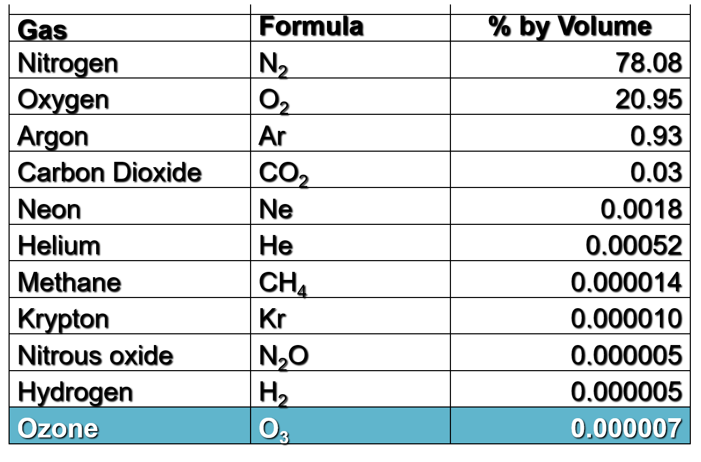
The Air We Breathe

Slide 5
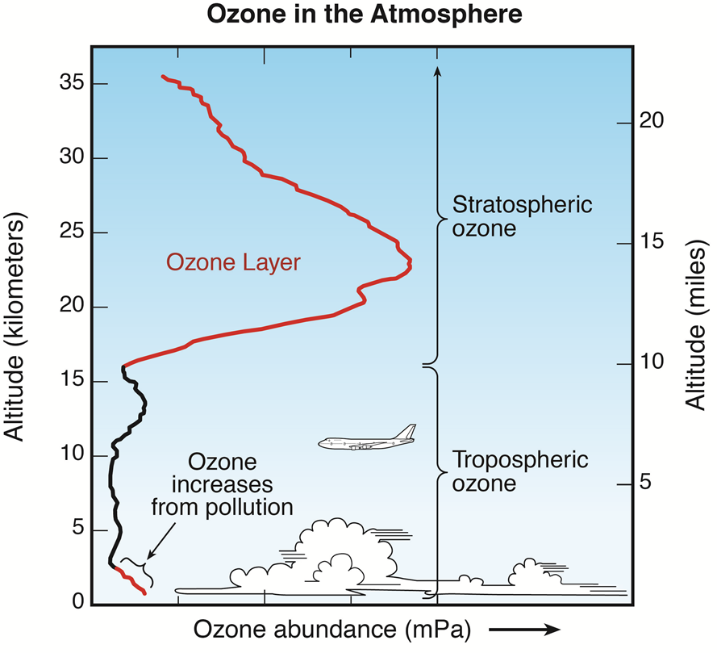
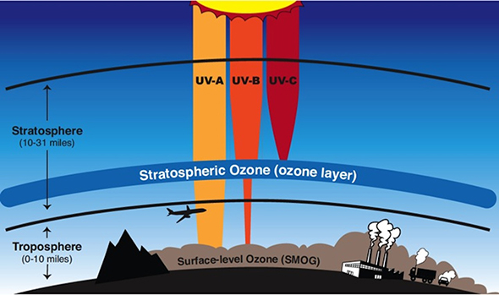
Thickness of the Ozone 3 mm = 0.1 inch

Slide 6
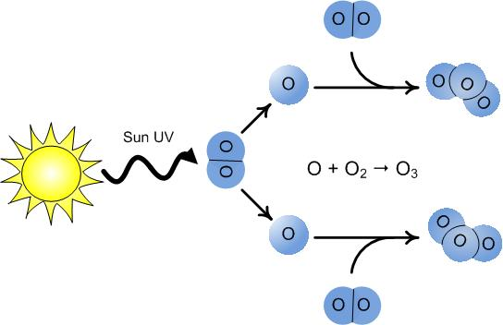
The Formation of Ozone Molecules

Slide 7
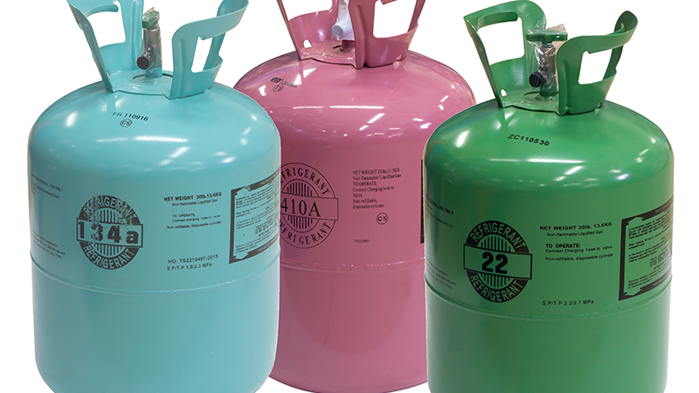
Ozone Depleting Substances

Slide 8
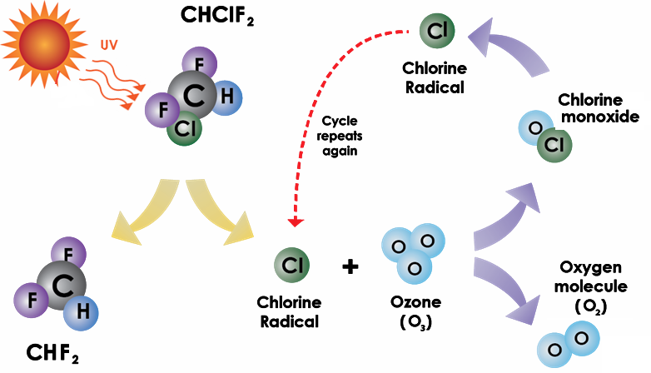
How HCFC-22 (R-22) destroy Ozone molecules

Slide 9
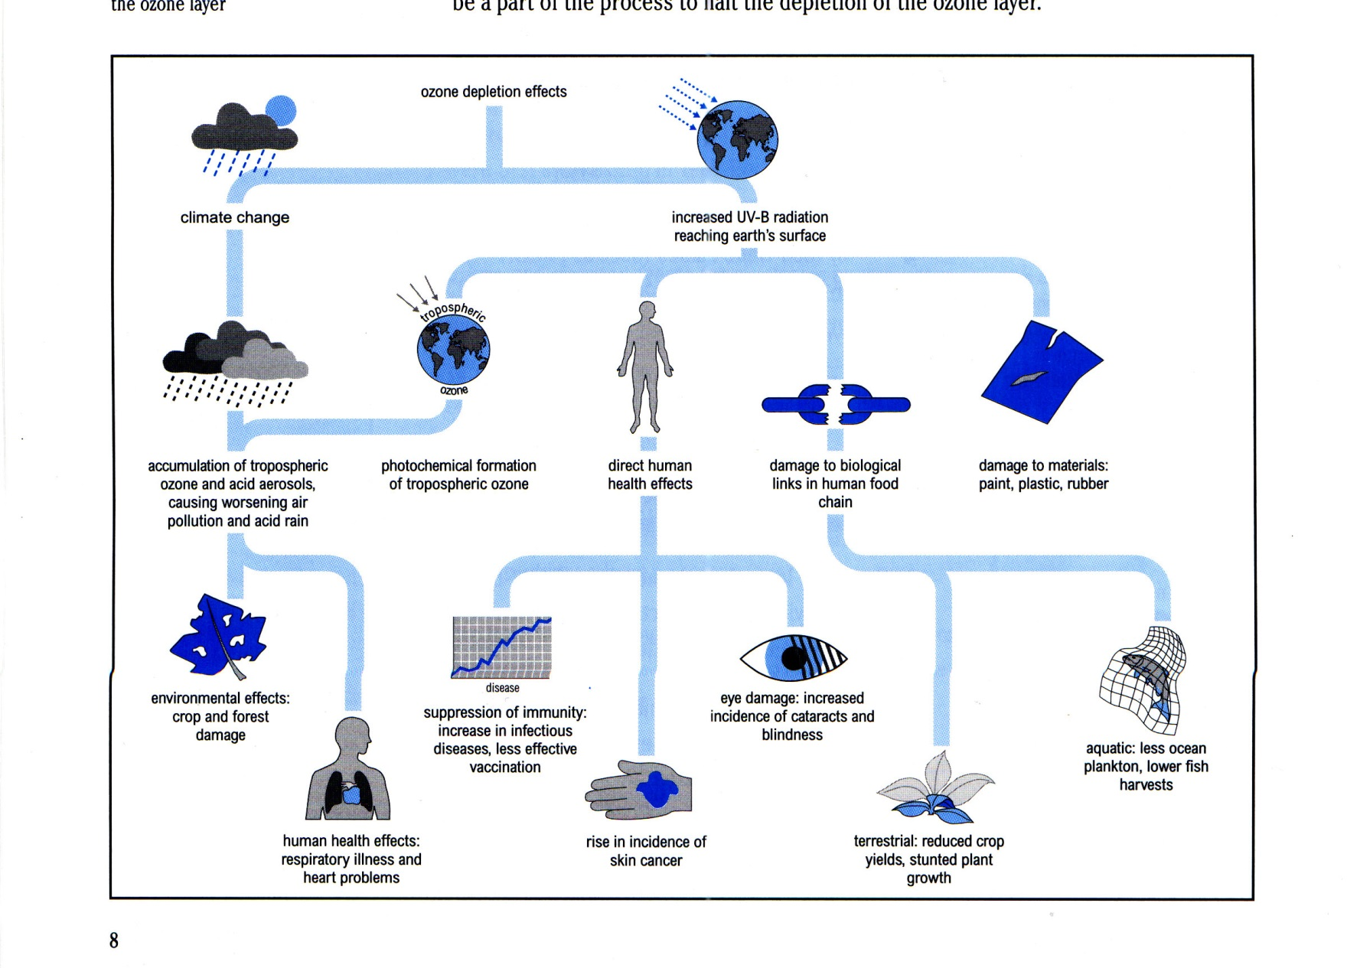
Impacts of Ozone Depletion

Slide 10
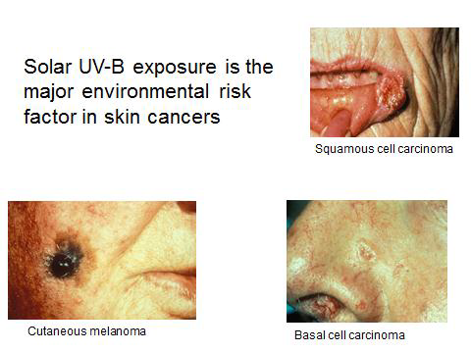
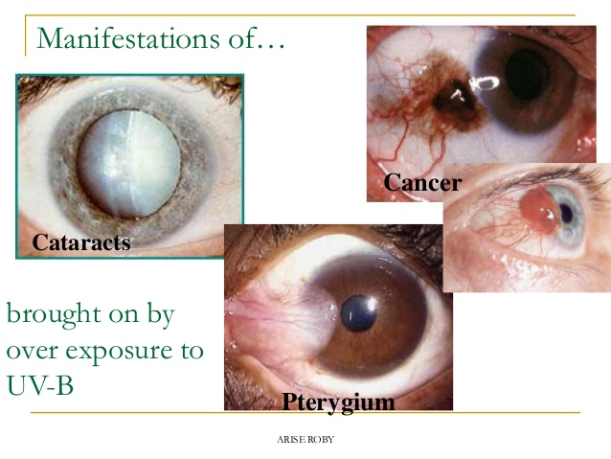
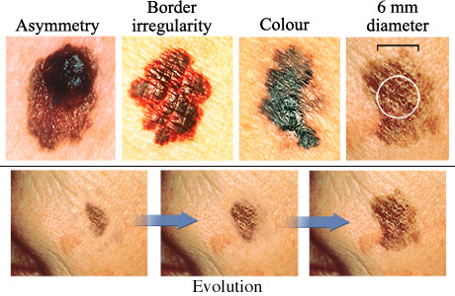

Slide 11

The Montreal Protocol

Slide 12
A Global Response to a Global Problem
The Multilateral Environmental Agreement was established in 1987 – 34 years of successful implementation
Legal frameworks under the Montreal Protocol for countries that ratify the MEA and its amendments – distinction of trade between Parties to the MP and Non- Parties
Universal ratification for all 197 countries up until the Beiing Amendment
5 amendments (London, Copenhagen, Montreal, Beijing and Kigali)
Aims to control and lower global ODS emissions

Slide 13
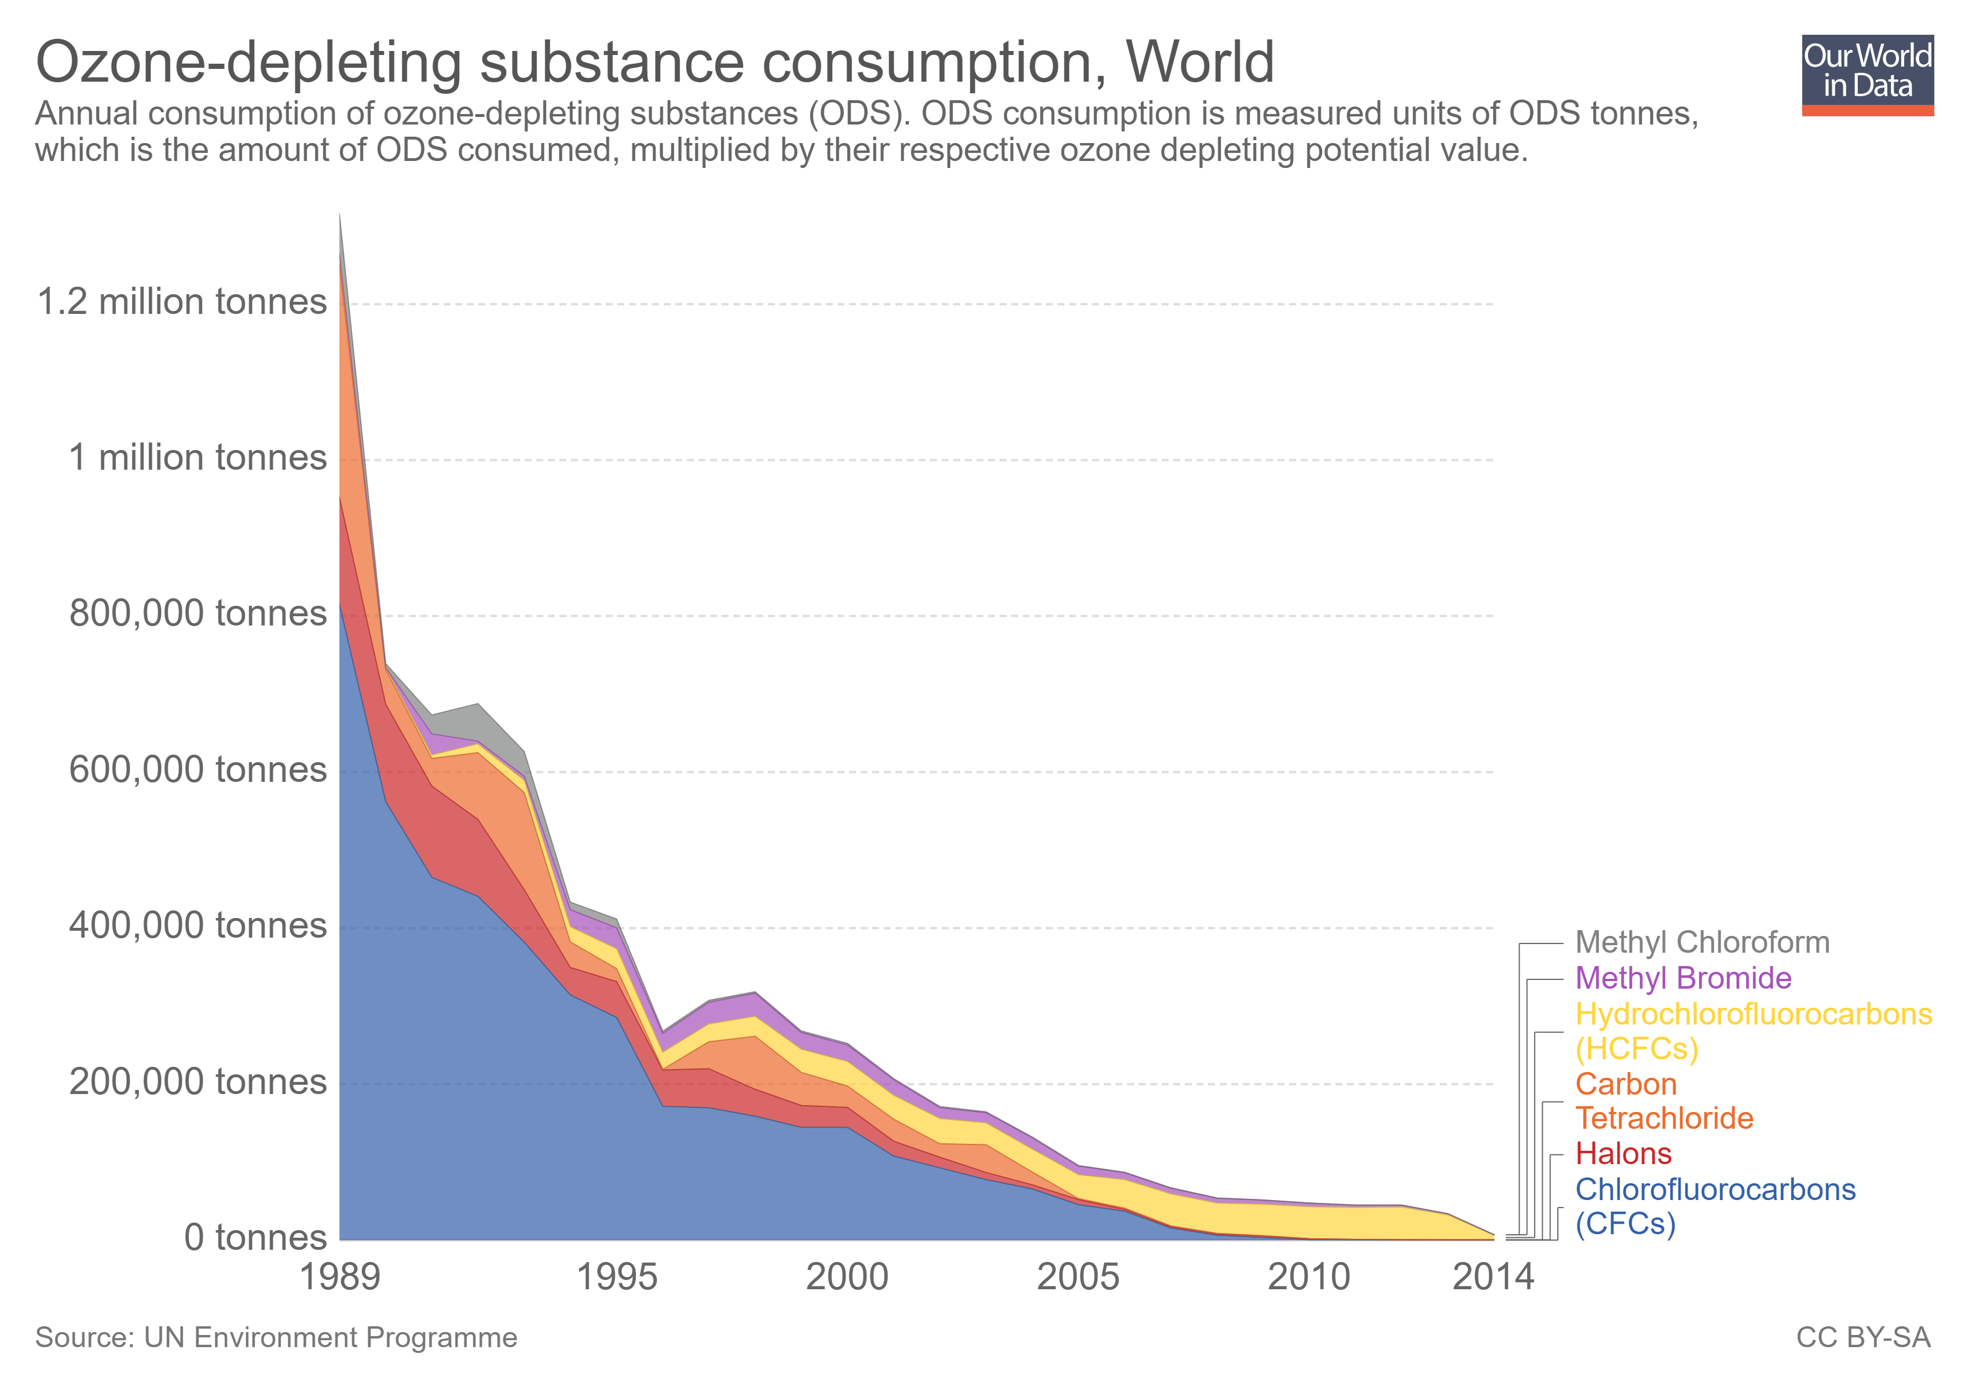

Slide 14

FSM’s Obligations under the Montreal Protocol

Slide 15
FSM HCFC Phase-out Management Plan (HPMP) Stage 1 --- 2015 - 2020
Decreasing consumption of HCFCs in FSM following a reduction schedule
Greater stakeholder involvement: Importers, RAC Retail and Service Businesses
Improving licensing and permit system to import ODS for better oversight
Continued collaboration with National and State Customs Offices on enforcement and regulations
Strengthening State RAC Associations for more skilled technicians and safer working environment

Slide 16
Permits to Import Ozone Depleting Substances
Permit system for HCFCs in | Has it been in place and operation? (Yes/No) | If yes, since when? If no, any planned date? | Requirements for Obtaining Permit | Validity of permit after issuance (year)
Handling | Yes | September 2012 | Registration fee $200 | Expired 12/31/XX
Storage | Yes | September 2012 | Registration fee $200 | Expired 12/31/XX
Sales | Yes | September 2012 | Registration fee $200 | Expired 12/31/XX

Slide 17
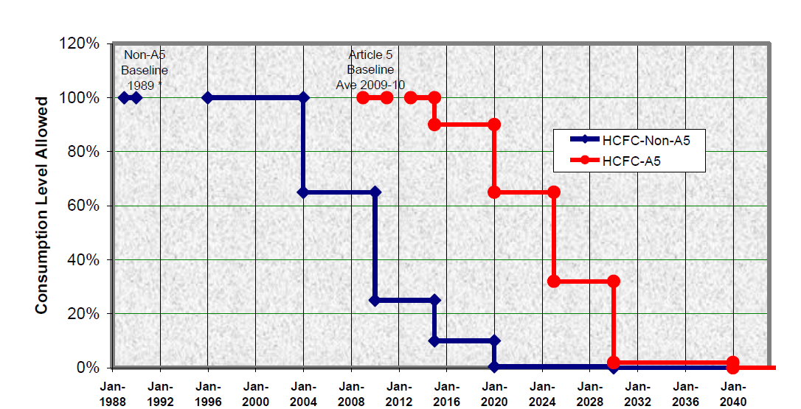
March 04
35% Cut
67.5% Cut
97.5% Cut

Slide 19
FSM HPMP Stage II Preparation

Slide 20

HPMP for 2020 -- 2025
The remaining HCFC gases are to be completely phased-out
Continuing the work of addressing the HCFC consumption via imports and equipment to phase out the remaining ~10% HCFC baseline remaining
Combining the activities of phasing-out HCFCs and phasing-down HFCs under another project --- Enabling Activities under the Kigali Amendment

Slide 21

HPMP Stage II Preparation – What type of data we will be collecting through our nationwide surveys?

Slide 22
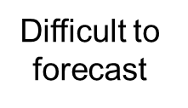
What type of data to be collected
HCFC import statistics under the licensing/quota system (Article 7)
Bottom-up
Top-down
Consumption from HCFC demand side
Land-based system
Inventory of existing HCFC-based equipment (estimation)
Import statistics of HCFC-based equipment (NOU, importers, customs)
Technical information of installation and servicing (Technicians)
HCFC usage information (Technicians)
Technical information of installation and servicing (Technicians)
Fishing Vessels
Forecast the future inventory and demand of HCFC for servicing/installation

Slide 23

What kind of information will we be collecting through surveys
Business Statistics: Imports and Equipment
Customs Statistics : Imports for 2020
RAC Technicians: Total Number and Skills
Existing energy policies and regulations relating to HCFC or HFCs
Infrastructure of RAC servicing: training center tools, equipment,

Slide 24
Steps for Preparation of Regional PIC HPMP Stage II
Country – National Activity
UN Environment – Regional Activity
informal national consultation
1st National Workshop on data collection
NOU/National consultant conducts data collection
NOU/National consultant analyses data
NOU/National consultant prepares country action plan
2nd National Workshop on feedback of draft report
Country review and agreement
UN Environment hires regional consultant
Regional consultant guides NOU/national consultant
Regional consultant guides NOU/national consultant
2nd Regional Workshop to seek feedback from countries
Regional consultant finalize HPMP Stage II
Regional consultant prepares the first draft HPMP Stage II
Finalizing HPMP Stage II Project Proposal

Slide 25

Thank You!
Any Additional Questions?

