Slide 1

Inform Project
Notes:
Check who knows about Inform project?
Intro on SOE process and effort to collect data.
Regular reporting / multiple reporting requirements.
But where does all the environmental data go? Sets on personal laptops, not shared,…
Every time, for every report, in most cases, you start all over again.

Slide 2


Environmental data management
- A national and regional challenge -
Inform project
All 14 Pacific Island Countries have data storage management and use issues
This became clear through the SOE process and others
SPREP developed a project to address this, called “Inform”
Notes:
Link with discussion on issues the day before

Slide 3
Inform title
Building National and Regional Capacity to Implement Multilateral Environmental Agreements by Strengthening Planning and the State of Environmental Assessment and Reporting in the Pacific
Referred to as the Inform project
Notes:
Background in ecology, forestry, marine conservation became more concerned about how non-sector issues effect the env sector.. Ag, fishing, urban development waste water …

Slide 4

Inform goal
Environmental data used for decision making
Notes:
Or any data -

Slide 5
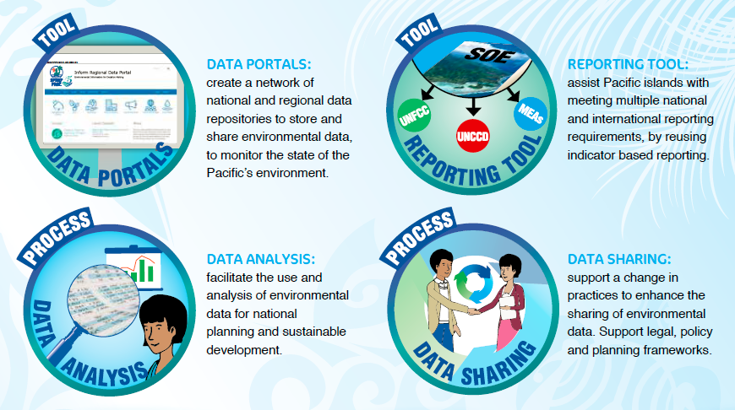
The Inform Project
Notes:
Inform has 4 products.
The data portal – ENV data management
The analysis- Indicators (SOE or other)
The reporting tool (built to reuse indicators for overlapping reporting requirements
Capacity building, improved processes, including data access and use – Change in practices
We are going to discuss some of the tools that have been developed to foster these changes – but the important point to remember is the tool are only a means to an end- to make efforts more effective and meaningful

Slide 6



Data Portal
Repository where data is stored (online database)
Backups
Sharing data on different levels (public/shared/private)
Collaborate within Groups (departments / agencies)
Publishing platform
Open source tools: DKAN Open Data Platform (https://getdkan.org/)
Cloud or in-country hosting
Other Examples:
Data.gov
Data.gov.uk
Data.gov.au
Data.gov.nz
Data.europa.eu
Etc...

Slide 7







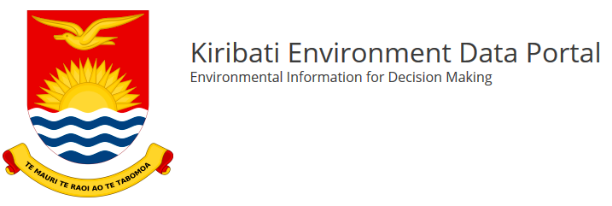



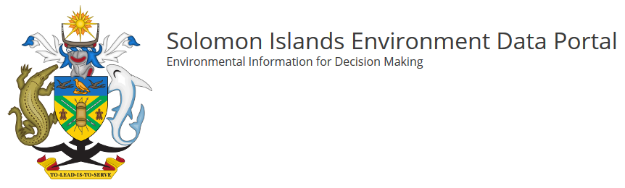
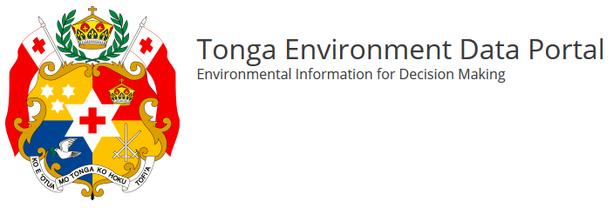
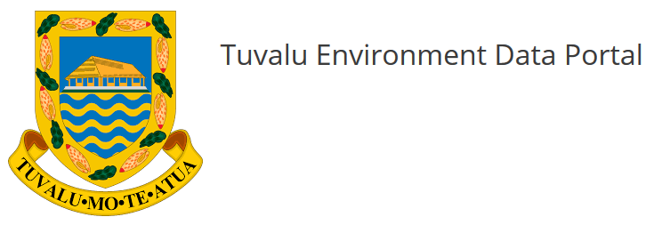
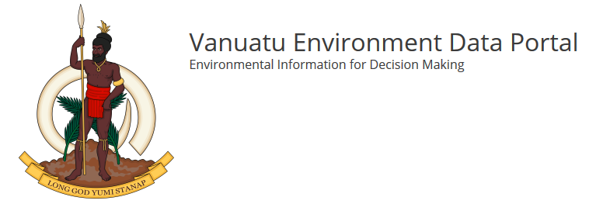
1 Regional Portal
14 National Portals
Notes:
1 Regional data portal – SPREP
14 National data portals – 1) Cook Islands, 2) Papua New Guinea, 3) Niue, 4) FSM, 5) RMI, 6) Fiji, 7) Kiribati, 8) Nauru, 9) Palau, 10) Samoa
11) Solomon Islands, 12) Tonga, 13) Tuvalu, and 14) Vanuatu

Slide 8
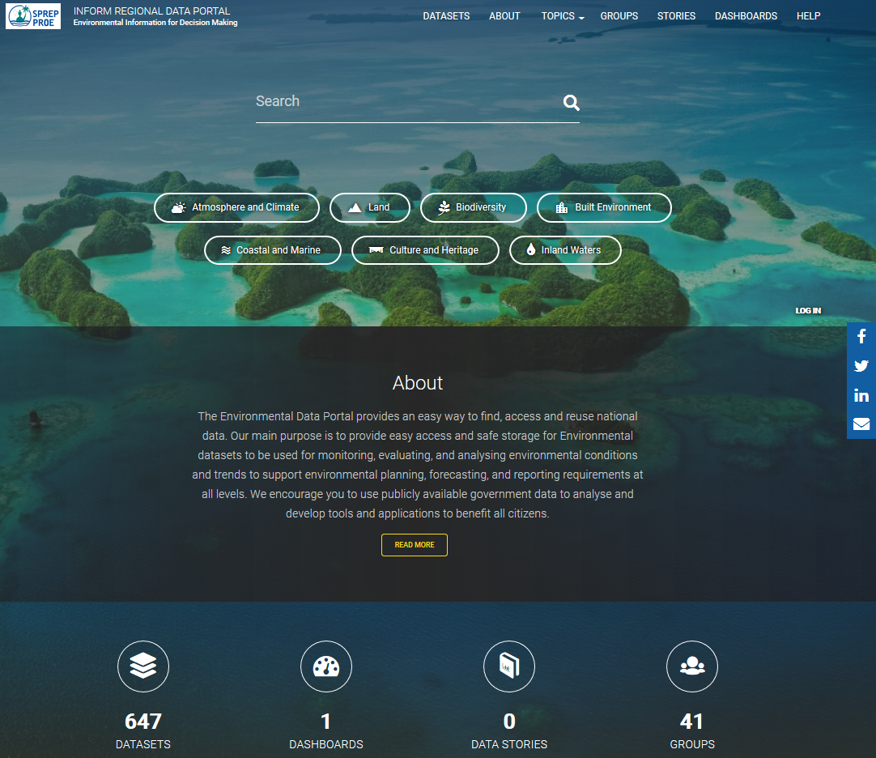
Inform Regional Data Portal
https://pacific-data.sprep.org/

Slide 9
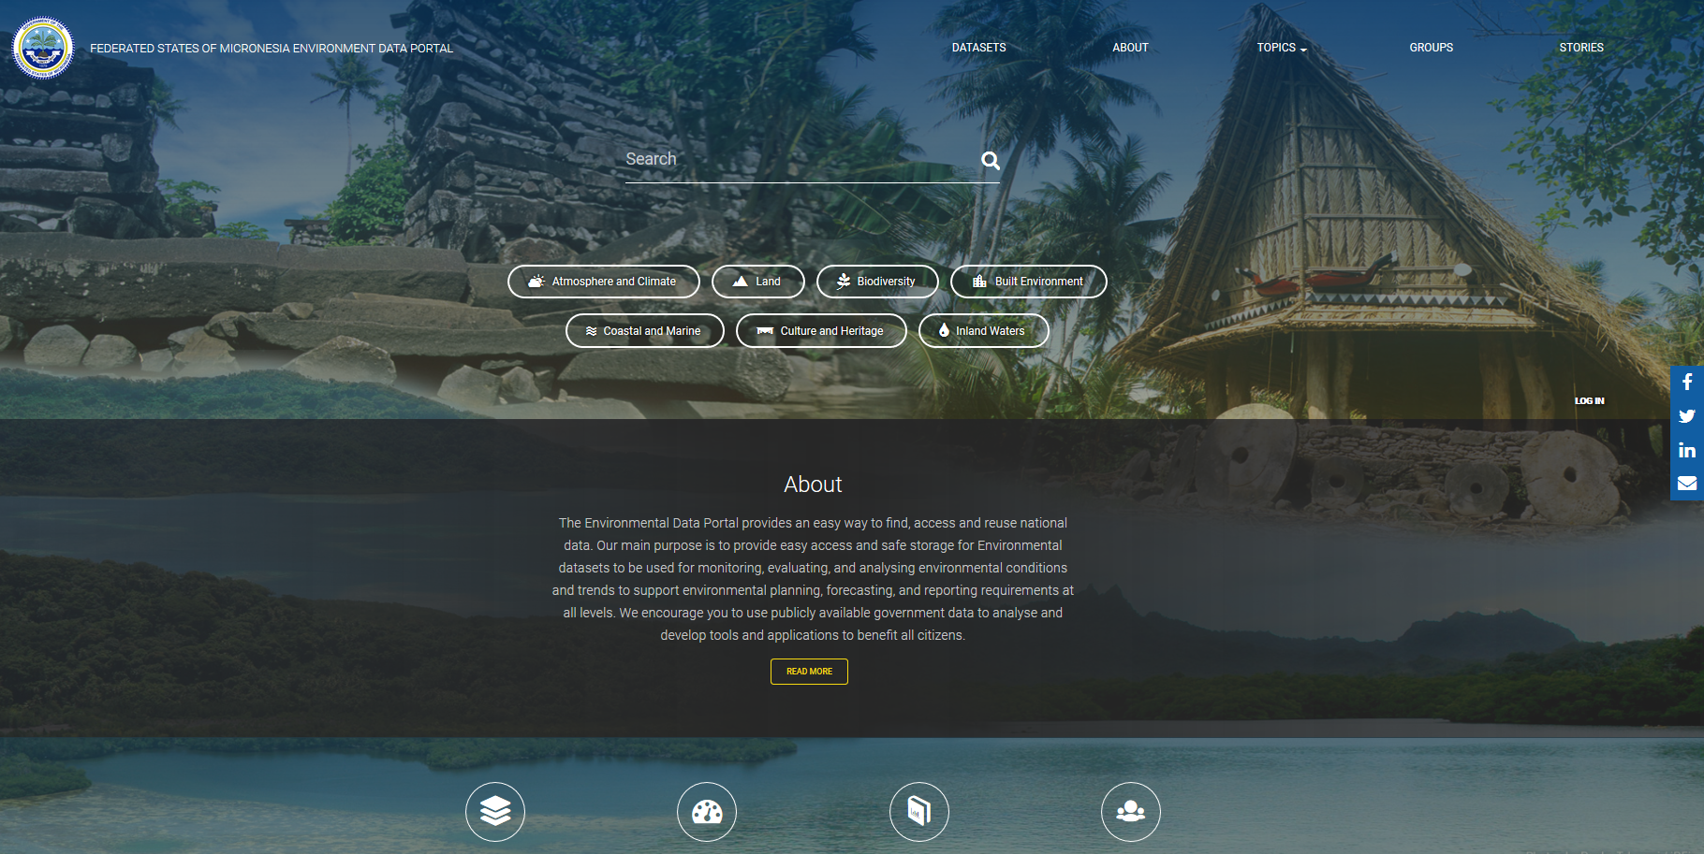
FSM Data Portal
https://fsm-data.sprep.org/

Slide 10
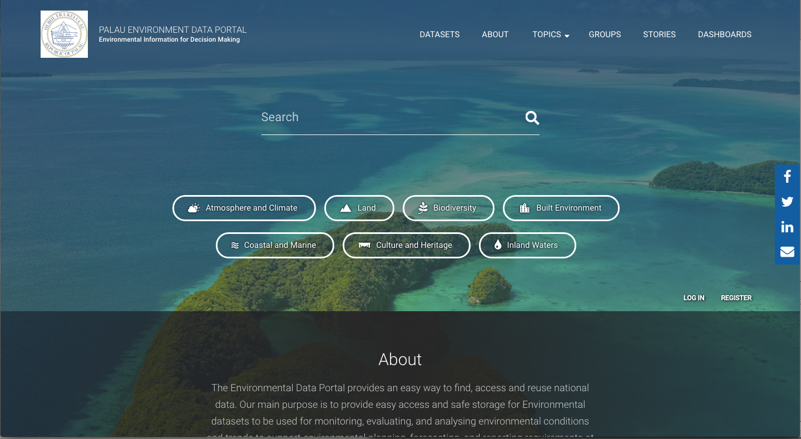
Palau Data Portal
https://palau-data.sprep.org/

Slide 11
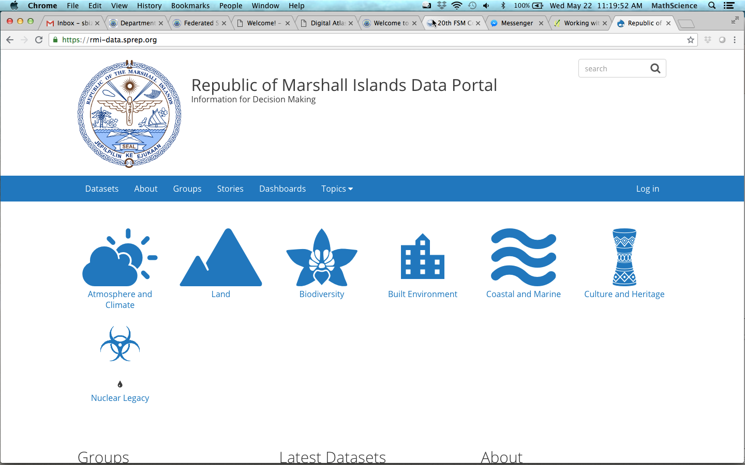
RMI Data Portal
https://rmi-data.sprep.org/

Slide 12
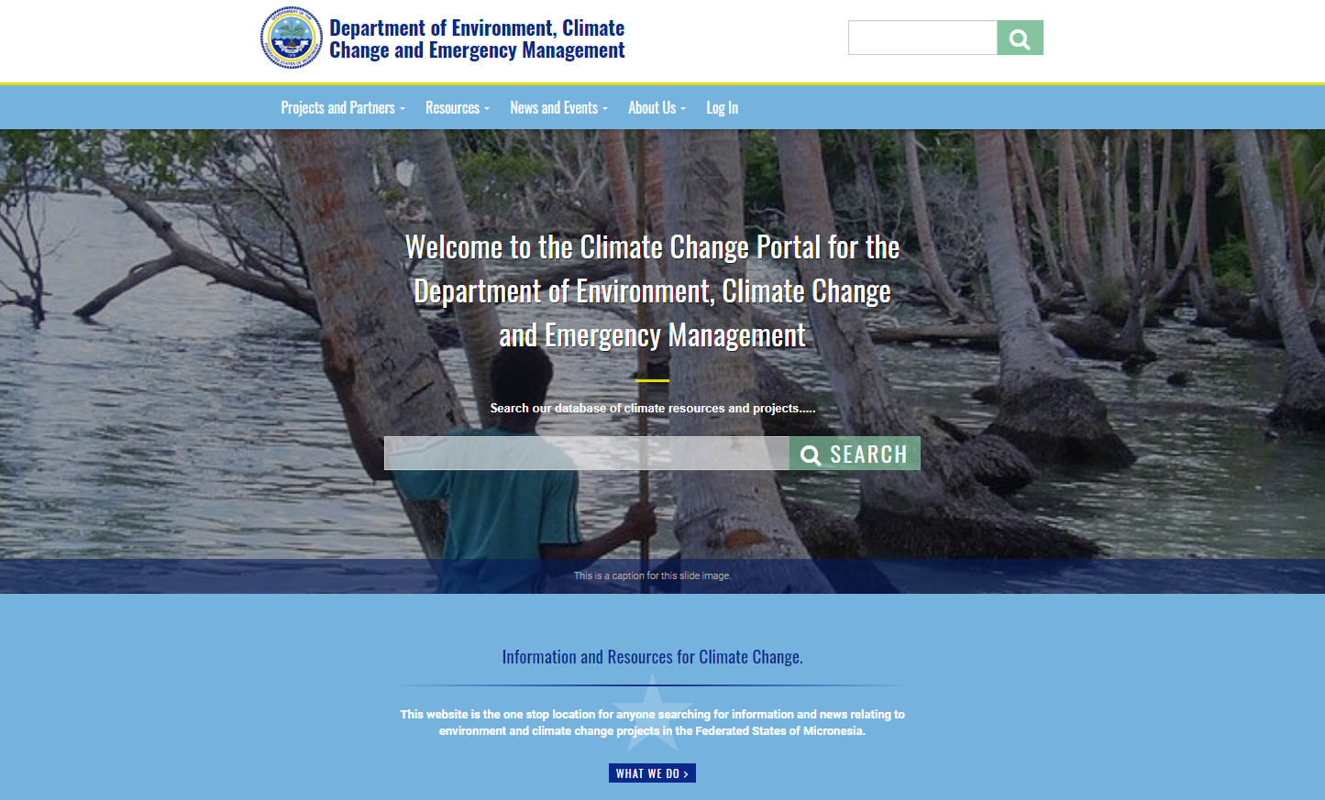
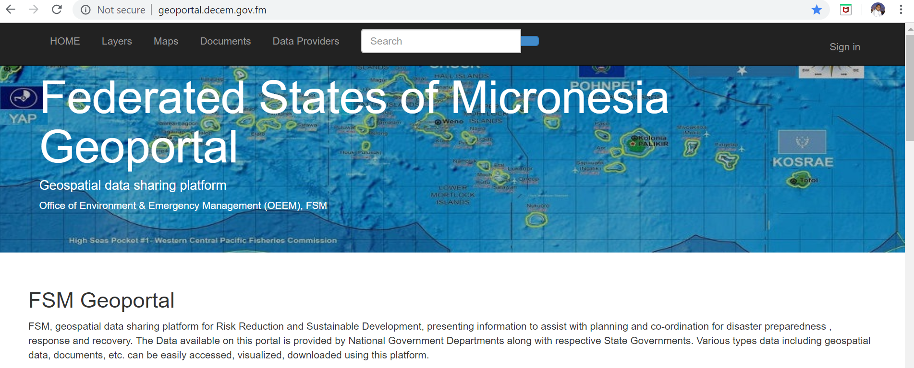

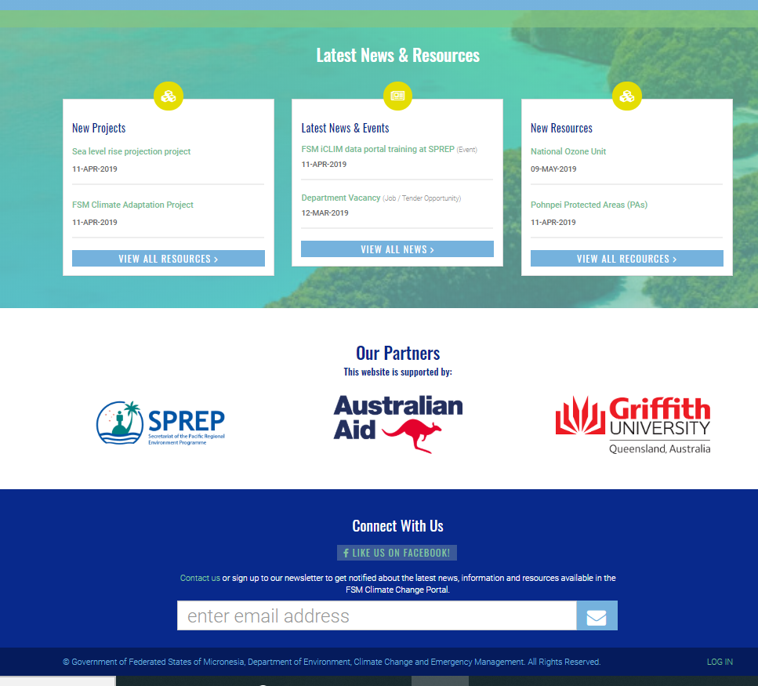
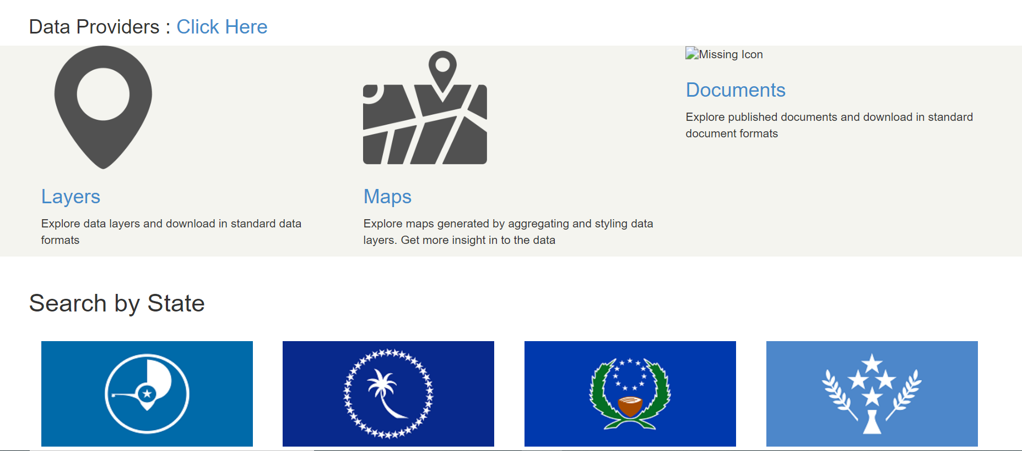
Other FSM DATA PORTALS
Aside from the INFORM data portal, FSM also has the following portals for centralizing its data and information:
FSM Climate Data Portal
(http://fsm.iclim.net/)
FSM GeoPortal
(http://www.geoportal.decem.gov.fm/)
FSM Digital Atlas of Micronesia
(http://islandatlas.org/#/)

