Slide 1
POHNPEI
Historic Preservation Office
Program Areas
By:
Pohnpei Historic Preservation
June 10,2019
Chuuk
Division of Historic Preservation Office
Department of Land & Natural Resources
Pohnpei State Government
FM 96941

Slide 2
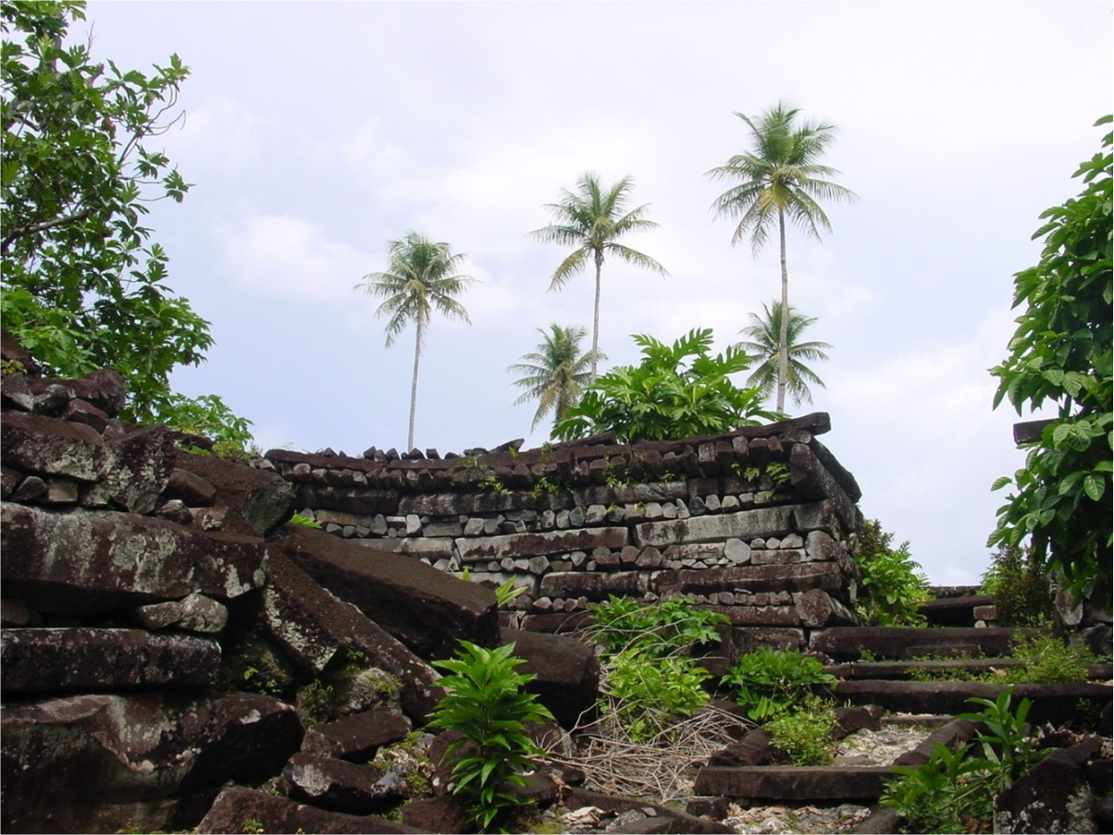
“To Identify, Preserve, and Administer places, artifacts, and information of historical and cultural importance for the benefit of the public”
Pohnpei Code Division II, Title 22
Article 7, §5 of the Pohnpei Constitution
S.L. No. 5L-88-02 §3, 1/11/03,
Historic and Cultural Preservation Act 2002

Slide 3
Program Areas
Administration
Planning
Register
Project Review
Review Board
Legislation
Development
Survey & Inventory (Archaeology and Ethnography)
Public Education

Slide 4
HPO Functional Chart
Division of Historic Preservation
Mordain David
Division Chief
Administration Unit
Professional Service Unit
Field Unit
Maintenance Unit
Facimerie Ioanis
Clerk II
Roster Lemuel
Federal Program Coordinator II
Archaeologist/ Cultural Anthropologist
(Vacant)
Alfredson Ladore
Field Researcher
Jason Lebehn
Historic Preservation Specialist IV
Jason Barnabas
Assistant Public Educator
Field Supervisor
Randy Joshwa
Marino Agripa
Laborers
Semens Silbanuz
Elson Lipai
Peterson Silbanuz
Elperson Elis
Rickson Hadley
Joseph Rosario
Historic & Cultural Preservation Review Board
PSG
HPF
Appointed Members
Legends:
Administration
Planning
Survey & Inventory (Archaeology)
Survey & Inventory (Ethnography)
Register
Project Review
Development
Public Education
Review Board
Legislation

Slide 5
Planning
Objectives and Goals
  Improvements of all Program Areas
  Continuation of Collection, Documentation and Administer of Cultural and Historic Heritages
  Identification and Registry of Potential Historical Sites and Properties
  Sustainable Management Plans
  Capacity Building
  Seek Assistant Grants and Opportunities
  Expansion of Partnership and Networking
  Implementation (Execute)

Slide 6
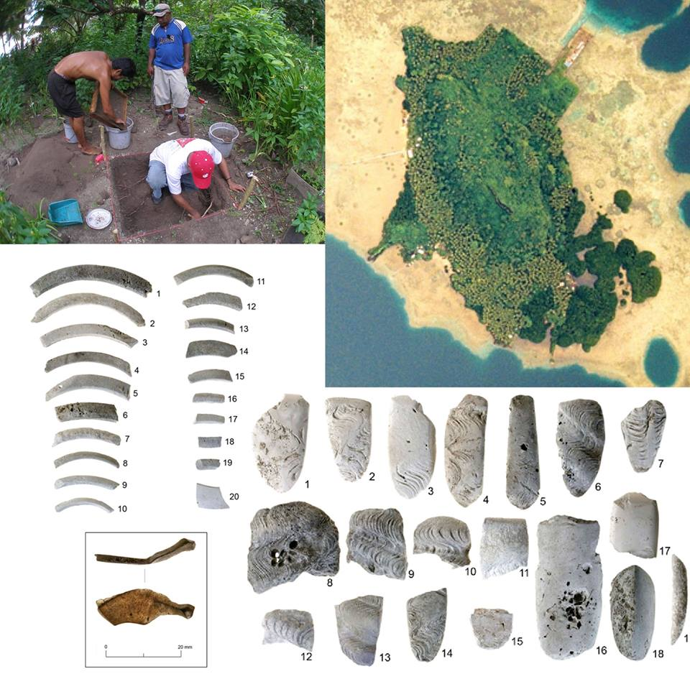
Survey & Inventory (Archaeology)
Documentation, Collection and Management of Pohnpei Archaeological Resources:
Sources
  HPF Grant ,U.S. NPS, DOI
    Provides Professional Service
    Special Project
  Interested Institutes/ Individuals
  Request and Donation
Sites/Properties
  Managed and Safeguarding
    Legislation
    MOA w/Land Owners
    Community Awareness
    Traditional and Government Support
Invitation To Training on Lenger Island
Feb. 20-27,2019
Notes:
Archaeology, or archeology, is the study of human activity through the recovery and analysis of material culture.

Slide 7
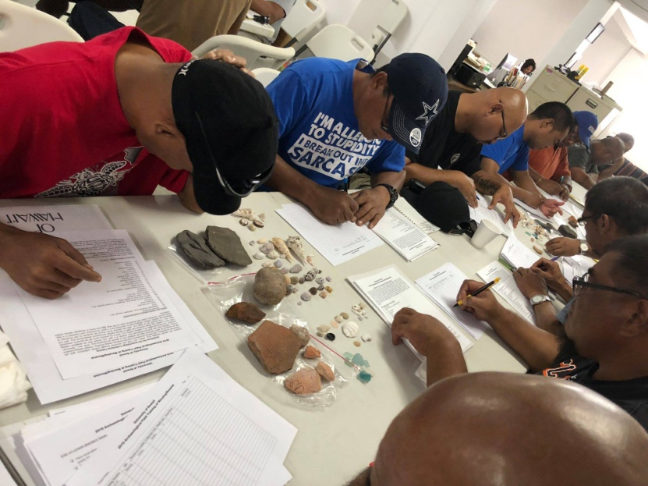
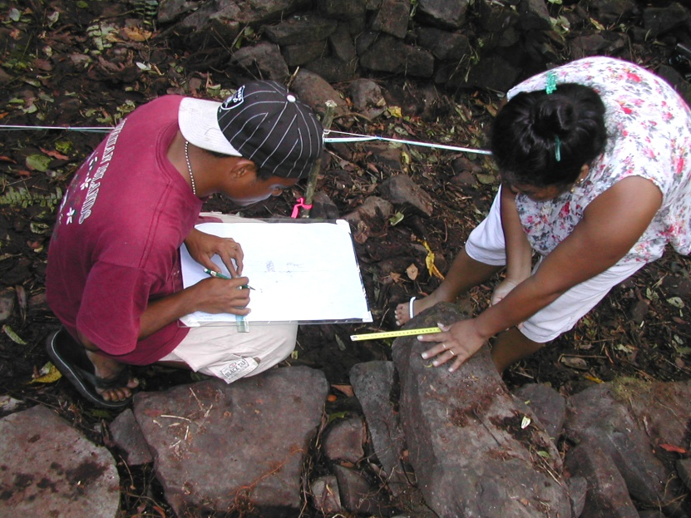
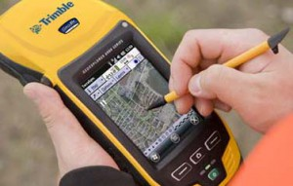
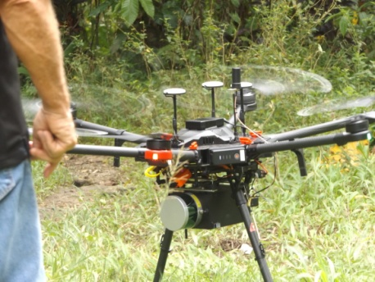
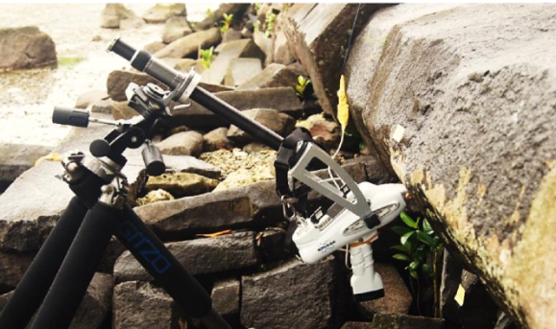
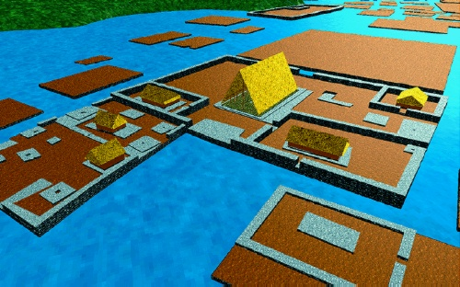
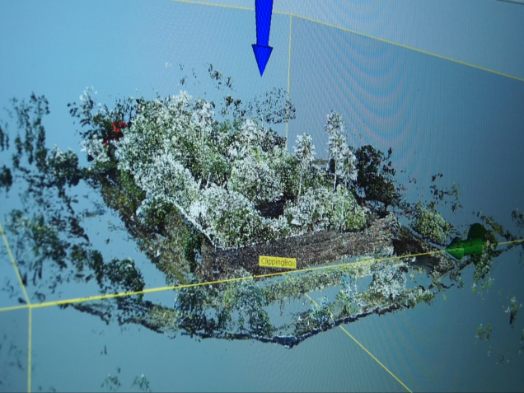
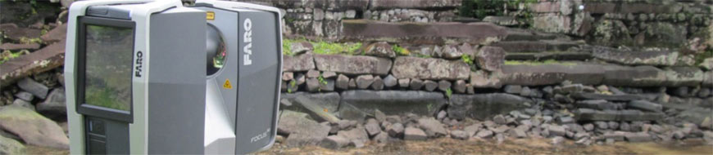
Survey & Inventory (Archaeology)
Notes:
Archaeology, or archeology, is the study of human activity through the recovery and analysis of material culture.

Slide 8
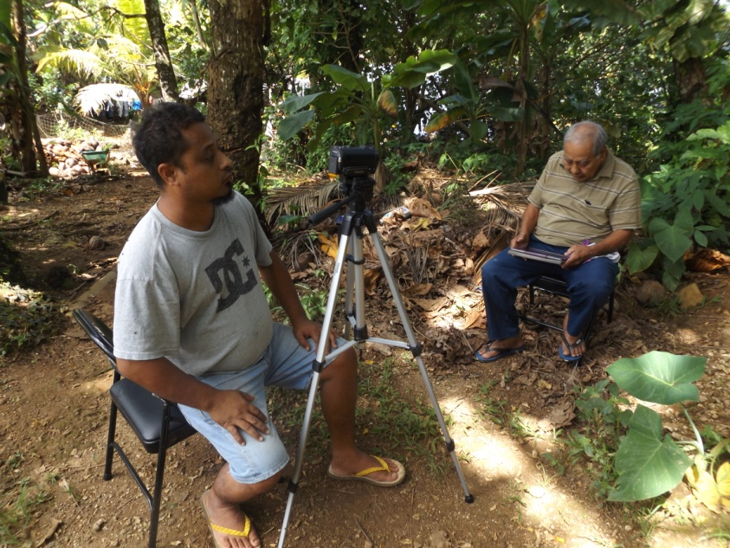
Survey & Inventory (Ethnography)
Documentation, Collection and Management of Pohnpei Ethnographical Resources:
Sources
  HPF Grant ,U.S. NPS, DOI
    Provides Professional Service
    Special Project
  Interested Institutes/ Individuals
  Request and Donation
Collection of Ethnographic Materials and Publications
  Stored and Managed for Public Information or Distribution
Notes:
Ethnography (from Greek ἔθνος ethnos "folk, people, nation" and γράφω grapho "I write") is the systematic study of people and cultures.

Slide 9
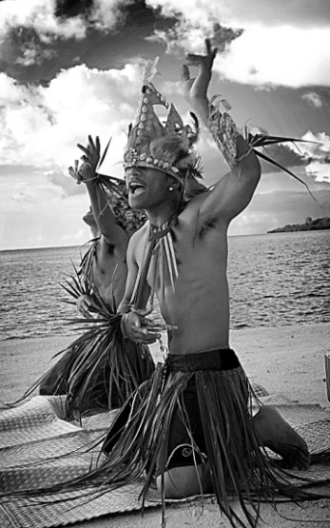

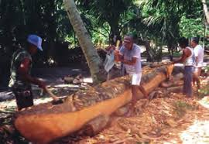
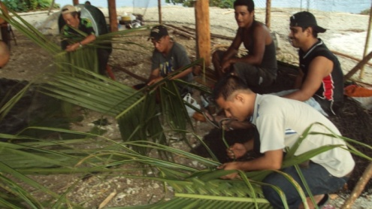
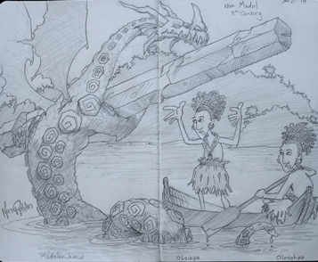
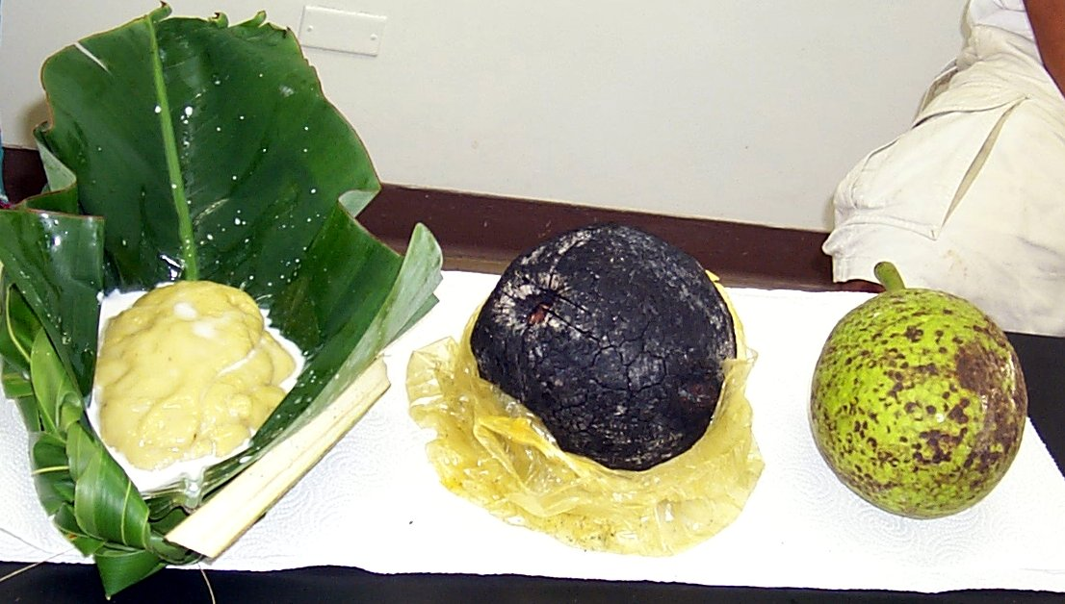
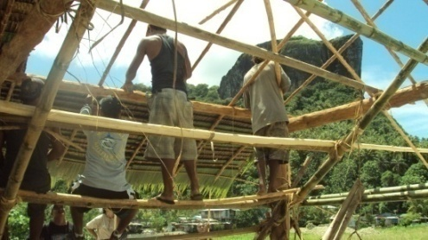
Survey & Inventory (Ethnography)
Notes:
Ethnography (from Greek ἔθνος ethnos "folk, people, nation" and γράφω grapho "I write") is the systematic study of people and cultures.

Slide 10
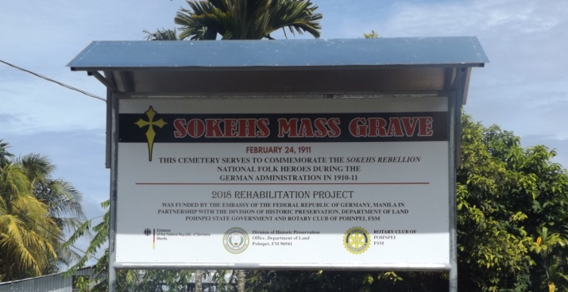
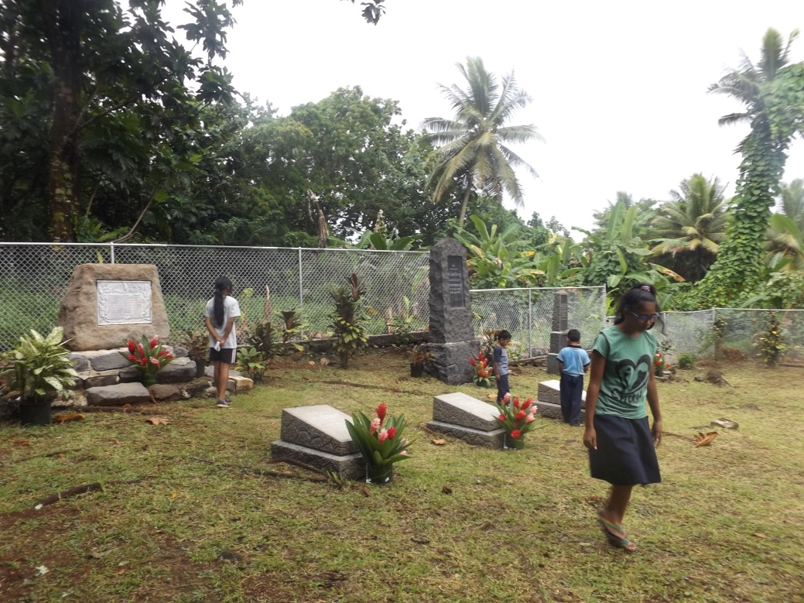
Development
The Office is currently working in collaboration with the All the respected Stake Holders and Land Owners in identifying Historical or Cultural Sites for Nomination onto the Pohnpei State Registry of Historical Properties Tourism Promotion and Attractions (Lenger Island)
Development of Sokehs Ridge, Pohndollap
  (FSM Congress)
Preservation, Restoration and/or Rehabilitation Projects
(German Ambassador)

Slide 11
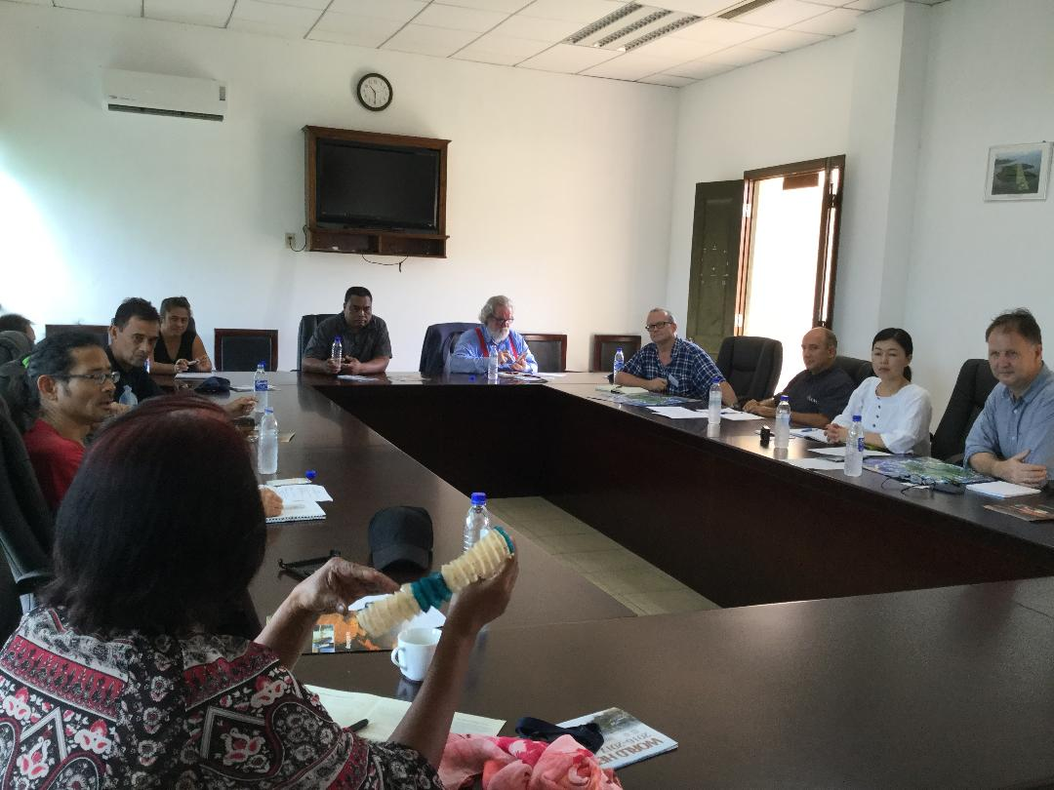
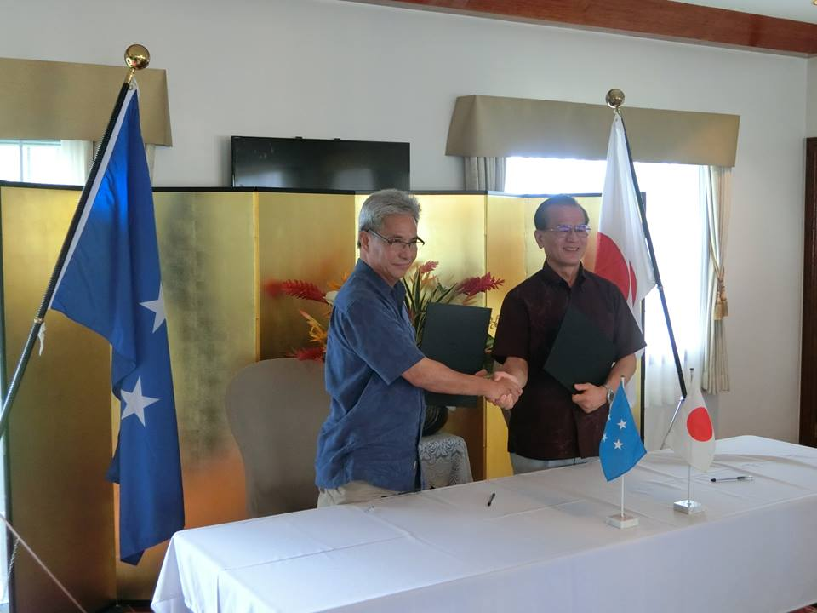
Development
Nan Madol World Heritage Site
  Sustainable Conservation of the Nan Madol World Heritage Site. (AFCP, U.S. Embassy and UNESCO)
  Nan Madol Visitor Center Project (Japan Government Grant Assistant for Cultural Grassroots Project Scheme, Japan Embassy)
HPO Maintenance Unit
  Clearing of Historical Sites and Parks

Slide 12
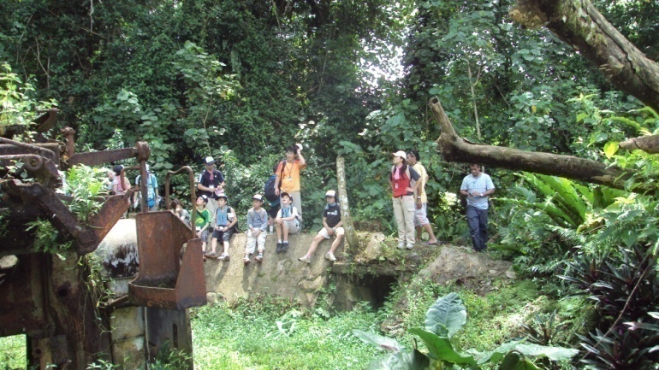
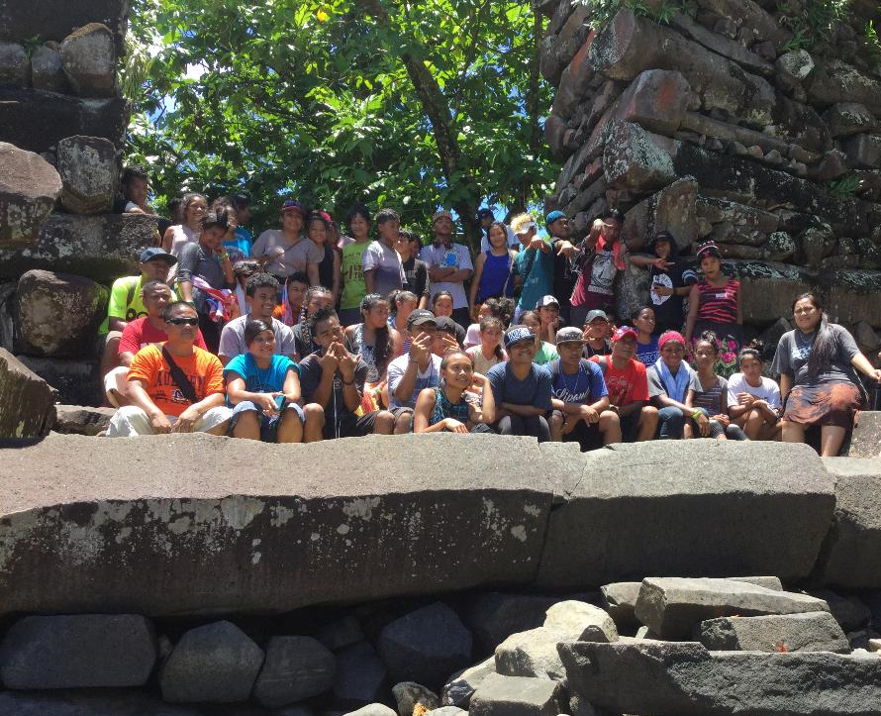
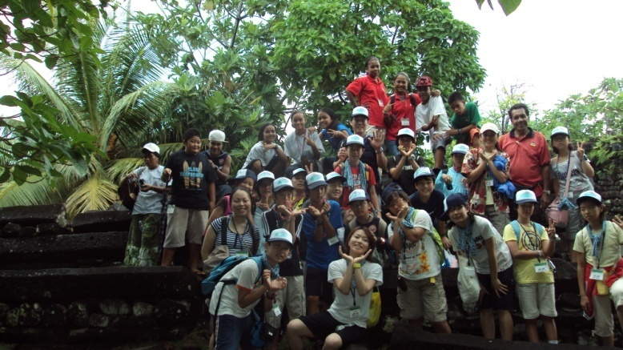
Public Education
Awareness and Outreach Via…
  Tour Guide

Slide 13
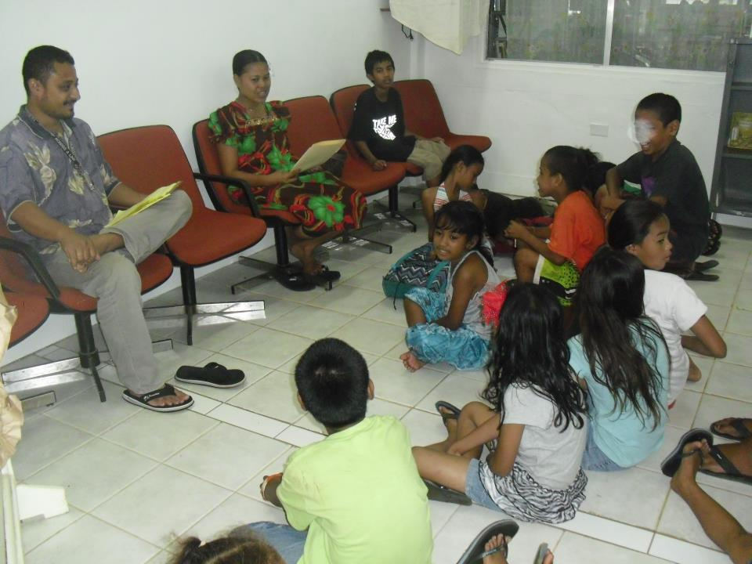
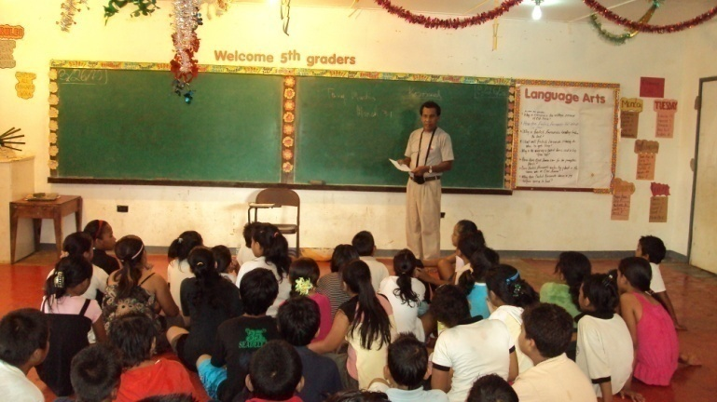
Public Education
Awareness and Outreach Via…
  Tour Guide
  School Session

Slide 14
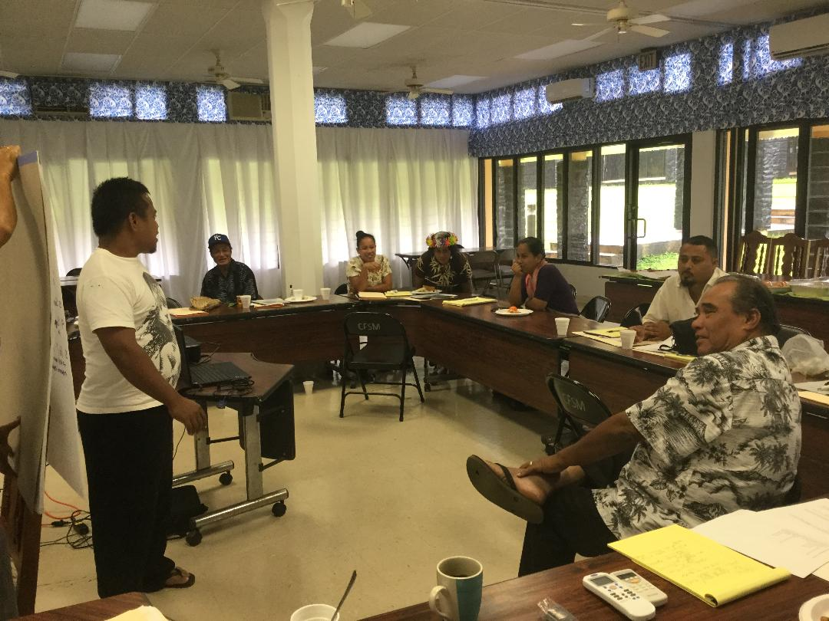
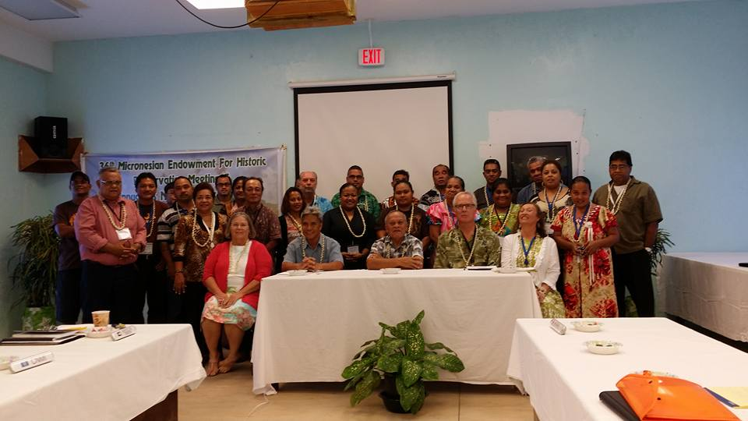
Public Education
Awareness and Outreach Via…
  Tour Guide
  School Session/
  Meetings/ Consultation/
  Workshops/Training/ Projects

Slide 15
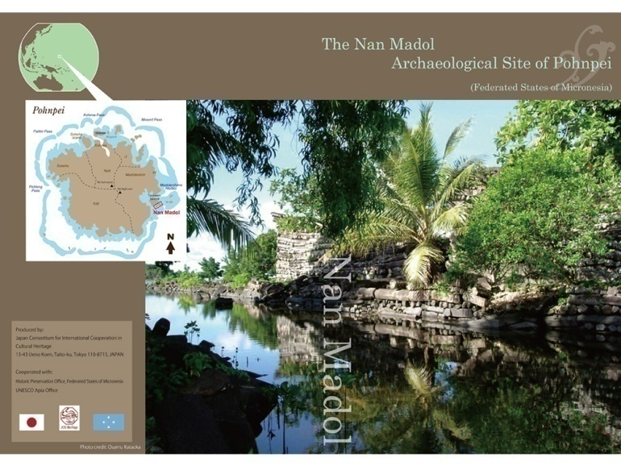
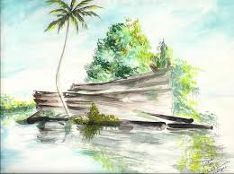
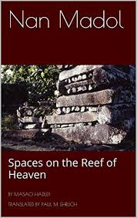
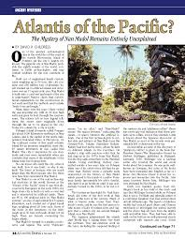
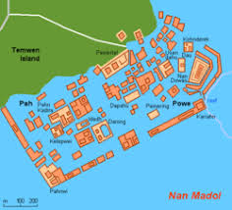
Public Education
Awareness and Outreach Via…
  Tour Guide
  School Session/
  Meetings/ Consultation/
  Workshops/Training/Projects
  Publications (Calendar, Pamphlets, Brochures, Maps , Articles etc.)

Slide 16


Public Education
Awareness and Outreach Via…
  Tour Guide
  School Session/
  Meetings/ Consultation/
  Workshops/Training/ Projects
  Publications (Calendar, Pamphlets, Brochures, Maps , Articles etc.)
  Social Media
  “Nahlikend en Leng” Radio Broadcast
  https://www.facebook.com/groups/182966081811703/

Slide 17

QUESTIONS?
KALAHNGAN
OH
KASELEHLIE MAINGKO!

