Slide 1
Data Portal
Good Practices
Notes:
Purpose of session:
Mixed public: people who have never seen or used the data poral before and people who have already used it.
That is why we give a full overview. But also new info, materials, good refresher.

Slide 2
Good practices
Data portal managers:
Do regular data portal cleaning (1x week, 1x month)
Check new datasets
Check for errors, spelling mistakes,…
Check for double data
Data portal content creators:
Use good practices when uploading data(sets)

Slide 3
Good practices
Avoid double data
Check the portal to see if the same dataset has already been uploaded
→ Do a quick search by using keywords
Maybe your new data resource is best placed under an existing dataset?
Examples:
You are uploading a new version of the same data
You found a report that provides background information on raw data in Excel already uploaded to the portal.
Notes:
Good practices when uploading a dataset.

Slide 4
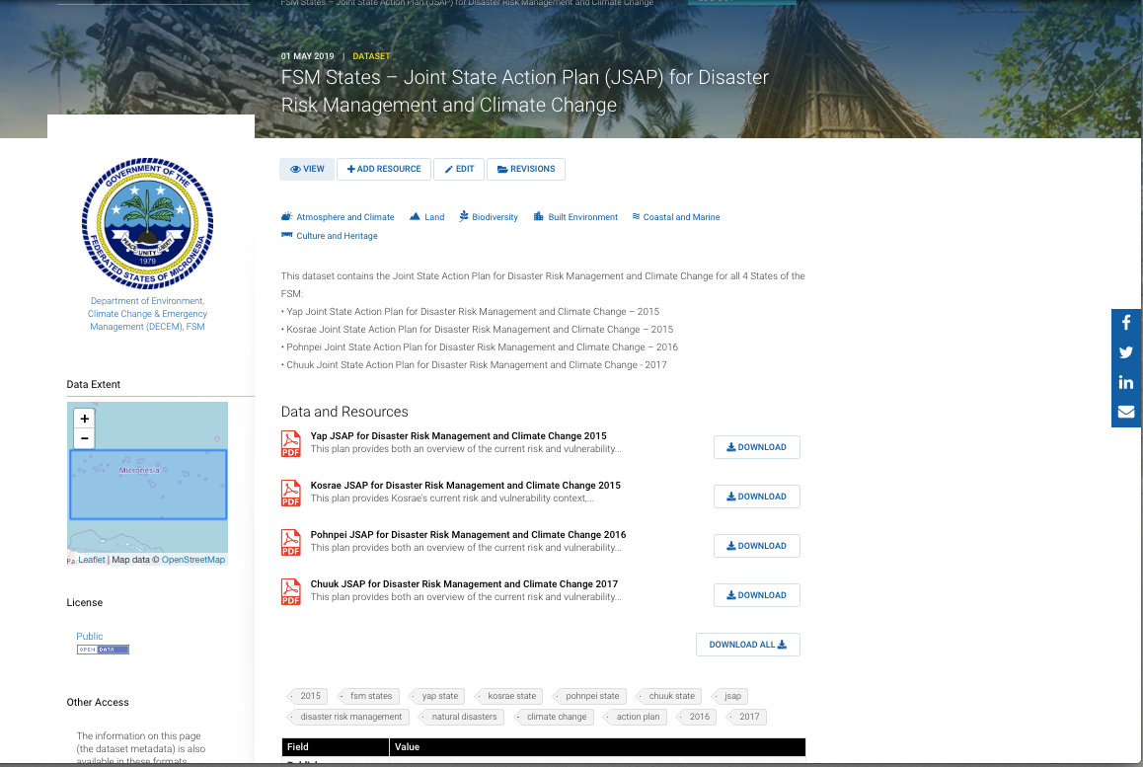
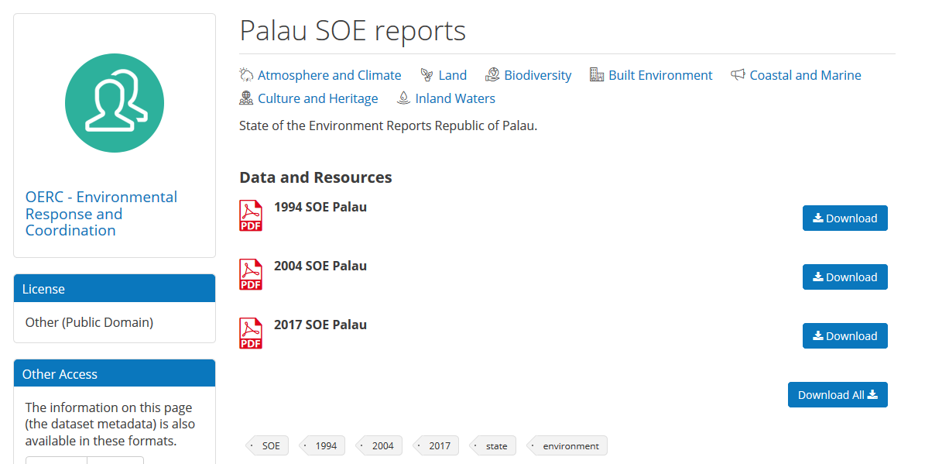
Good practices
Consider grouping your data resources
Group different resources under one dataset, when relevant
Be aware of not grouping too much
Only group resources when they are strongly related / from the same data source
Avoid that other users are not able to find your data
A good example of grouping different resources:
Notes:
A good example of grouping different resources:
3 State of the Environment (SOE) reports for the same country, but from a different year, can be grouped under de dataset “SOE reports”. This dataset will contain all three reports as resources
A poor example of grouping resources would be to include both Inshore and Offshore fisheries in the same dataset – this would make the dataset too broad and potentially make locating resources difficult.

Slide 5
Good practices
Use a good title
What is a good title for a dataset or resource?
description that is not too short, not too long
description that contains the most relevant information on the dataset or resource
The title alone should be able to guide users if they need the dataset or not
Put more details into the Description field

Slide 6
Good practices
Tags are crucial
Keywords that help portal users locate a particular dataset
Filtering down your search when looking for datasets
Short and simple. Try to imagine what other users would type in the search box when trying to find the dataset
For example: ‘rainfall’ is a better tag then ‘rainfall patterns’ or ‘rainfall analysis’.
Categorizing datasets
Fixed or predefined tags like ‘SOE’, ‘Indicator’, or the name of the indicator, to easily find the datasets related to SOE reports, or a specific indicator.
For example: tag datasets related to the following SOE-indicators: “reef fish”, “forest cover”, “rainfall”.
TIP
Take the time to think of good tags or keywords, so other users can find your datasets easily

Slide 7
Good practices
Metadata are crucial
It is not mandatory, but really good practice to take the time to add additional data about the dataset.
➔ Other users will know who can be contacted, when the dataset was collected, what to be aware of when using the dataset etc.

Slide 8
Good practices
Same file, different format
both files need to have the exact SAME NAME
both files need to be in the SAME DATASET
Example: when you upload a GIS file as a shapefile and a geojson file, put both resources in the same dataset and use the same filename.

Slide 9
Good practices
Same file, different version
Examples of good versioning practices:
Forest_cover_v1.xls: first version of forest cover dataset
Forest_cover_v2.xls: second version of forest cover dataset
Forest_cover_2015.xls: forest cover dataset of the year 2015
Forest_cover_2018.xls: forest cover dataset of the year 2018
Forest_cover_20150120.xls: forest cover dataset of 20th January 2015
Forest_cover_20180515.xls: forest cover dataset of 15th May 2018
TIP
If you put the date “backwards” (year-month-day), the latest version will always appear at the bottom of your filing system
Notes:
When you get a file from someone, example, someone sends you an Excel file with water monitoring results.
And you want to change something to that file, what is the first thing you do?
Answer: you make a copy of the file, keeping the same name, and adding a version/date to the name in the end.

Slide 10
Good practices
OVERVIEW
Avoid double data
Consider grouping your data resources
Use a good title
Tagging is crucial
Metadata are crucial
Same file, different format
Same file, different version

Slide 11
Working with CSV files
CSV = Comma Separated Values
“Flat”, simple, easy to read format
You can make your data machine-readable by uploading it in the CSV format.
Most data-crunching software allows you to simply go `File >> Save As` and choose the CSV format
Each CSV file is a single sheet in a Excel spreadsheet document, so you may need more than one CSV file to hold all your data
Handy checklist in the user guide

Slide 12
Working with GIS files
Geographical Information System (GIS) files come in a lot of different formats: Shapefile (.shp), Geojson file (.geojson), Google Earth file (.kml, . kmz), Raster files (.geotiff),…
Preferred format for portal (DKAN software) is GeoJSON
DKAN is capable of reading GeoJSON files
present spatial datasets directly onto a map
Convert gis files to geojson files (→ single files)
→ step by step manual in user guide
Shapefiles can be zipped and uploaded

Slide 13
Questions ?

Slide 14
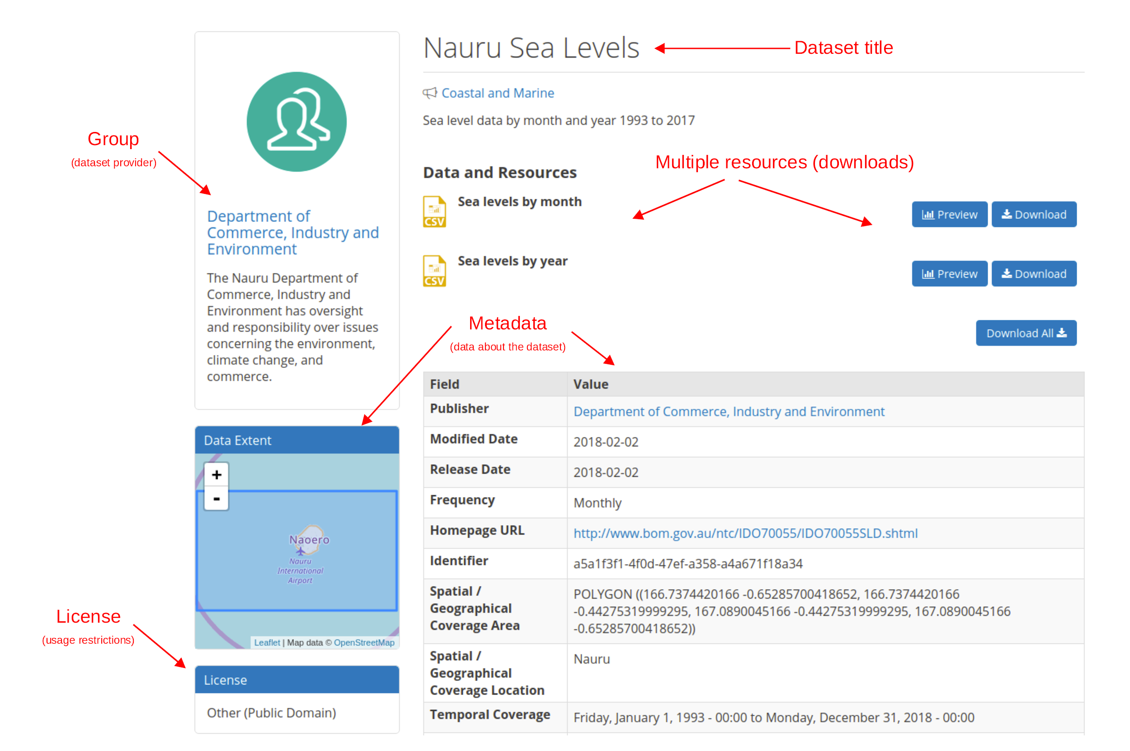
Adding a Dataset
3 step process
1) ADD DATASET
GROUP
2) ADD RESOURCES
3) ADD METADATA
SET LICENSE LEVEL
Notes:
Datasets are “Containers” or “Folders” that hold resources, the actual data itself.
Datasets are given metadata such as author, license type etc, and they can be assigned to Groups.
When you add a dataset, you also set the license level.

