Slide 1

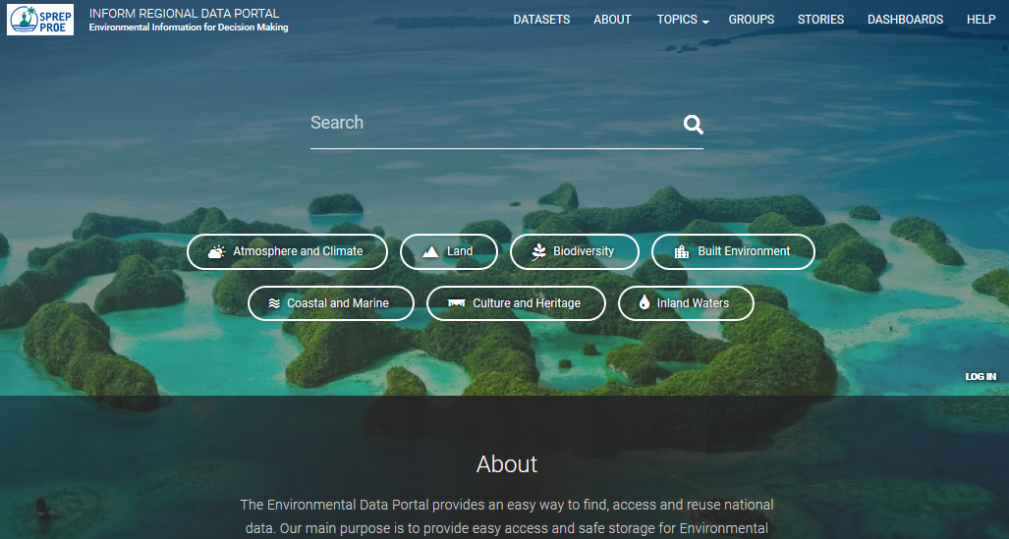
Inform Regional Data Portal
HELP
MENU
SEARCH TOOL
THEMES

Slide 2
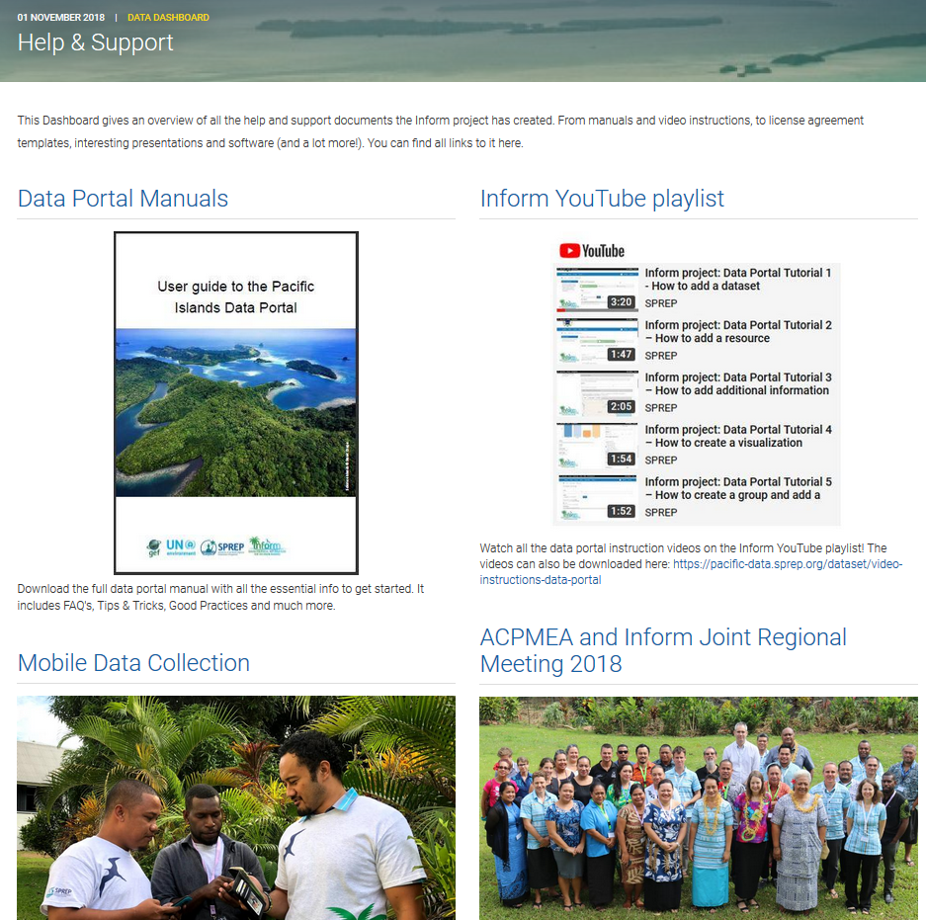
Help & Support Dashboard

Slide 3
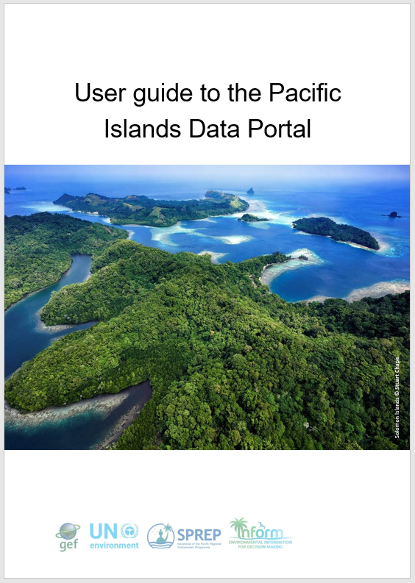

Portal link:
https://pacific-data.sprep.org/dataset/data-portal-manuals

Slide 4
User guide to the Pacific Islands Data Portal
1. Frequently Asked Questions
2. Data portal setup
3. Managing Users and Groups (for Site Managers and Administrators only)
4. Adding a Dataset
5. Editing or deleting a dataset
6. Creating Visualizations
7. Stories and Dashboards
8. Social media
9. Tips and tricks
    Good practices
    Finding data
    Grouping Datasets
    Tagging Datasets
    Working with CSV Files
    Working with GIS Files
10. Video tutorials
Notes:
Content of the user guide

Slide 5
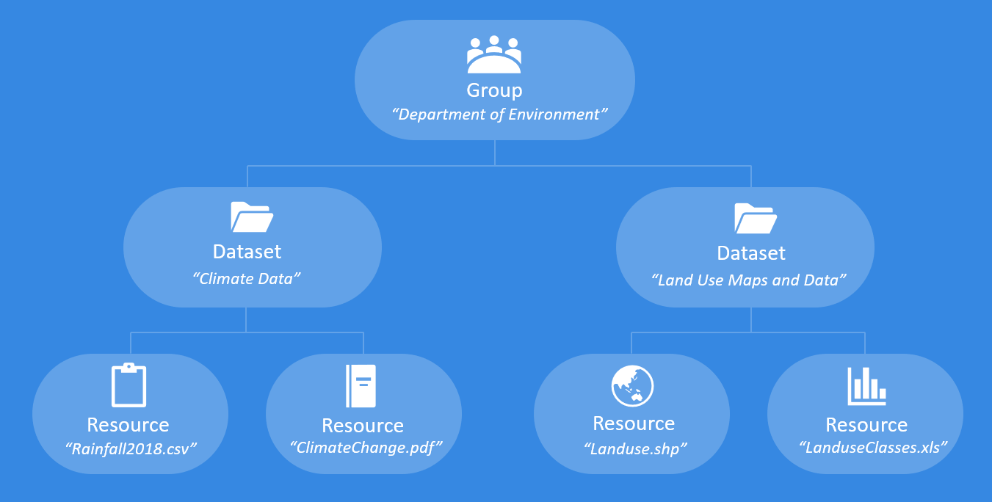
Data portal building blocks
GROUPS
DATASETS
RESOURCES
Notes:
Building blocks of the portal
Group: collection of Users from the same organization, department, agency, etc. Only users from a group are able to upload and edit datasets on the data portal. Users have to be registered to become part of a Group.
Dataset: folder or container that holds Resources, the actual data itself. You have to create a dataset first, before you are able to upload data (resources).
Resource: any type of data, like Word or pdf-reports, csv or Excel files, maps or gis-files etc.

Slide 6




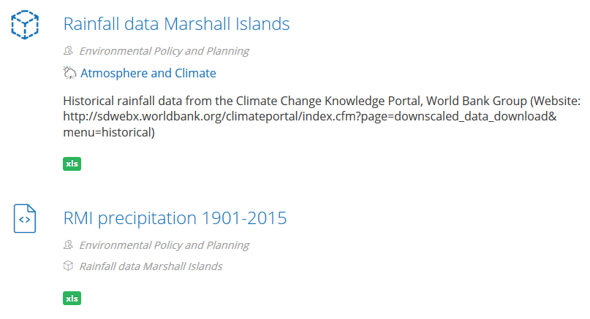
DATASET
RESOURCE
Dataset vs Resource
DATASET
RESOURCE
Notes:
Datasets are folders that hold the data and information or the resources
Resources are the actual data or information

Slide 7



Uploading data
Create dataset
Add data
Add additional data
STEP 1
STEP 2
STEP 3
Add Tags
Set Group
Set license level
Decide with who you want to share
1 or more resources
Add metadata
Not mandatory highly recommended!

Slide 8
Users and Groups
For Site Managers and Administrators only
Every new user needs to be registered and added to a group
User accounts can be blocked or deleted
Roles and permissions
Define what you can do on the portal (viewing data, download data, upload data,…)
Maintain security of the portal
1 user can have multiple roles
Roles
Anonymous User: site visitor who is not logged in
Content Creator: logged in, can upload data
Site Manager: create/manage groups, administer users
Administrator: modify DKAN themes, settings,…

Slide 9
License levels
Public
data accessible to all portal groups and the public
Shared
data shared between ministry portal groups, but not with the public
Private
data for internal use, only accessible within a single portal group

Slide 10
Data about the data
Metadata
Field | Value
Author | Author of the dataset
Spatial Coverage Area | Area that the dataset relates to
Spatial Coverage Location | Name of the area that the dataset relates to
Frequency | How often a dataset is published
Temporal Coverage | Date, or start and end date range encompassing the dataset
Contact Name | Name of the person who can be contacted regarding the dataset
Contact Email | Email address of the person who can be contacted regarding the dataset
Homepage URL | URL of homepage where more info on the dataset can be found
Data standard | Name of the data standard that the dataset conforms to
Language | Language used in the dataset
Resources | List of resources that you added to the dataset
Related content | Internal link or link to an outside resource that provides additional context
Revision information | Explanation of the changes you are making in the Revision log message box. This helps other authors understand your motivations.

Slide 11

What type of data can you upload?
The data portal supports many file types, including:
csv, html, xls, json, xlsx, doc, docx, rdf, txt, jpg, png, gif, tiff, pdf, odf, ods, odt, tsv, geojson and xml.

Slide 12
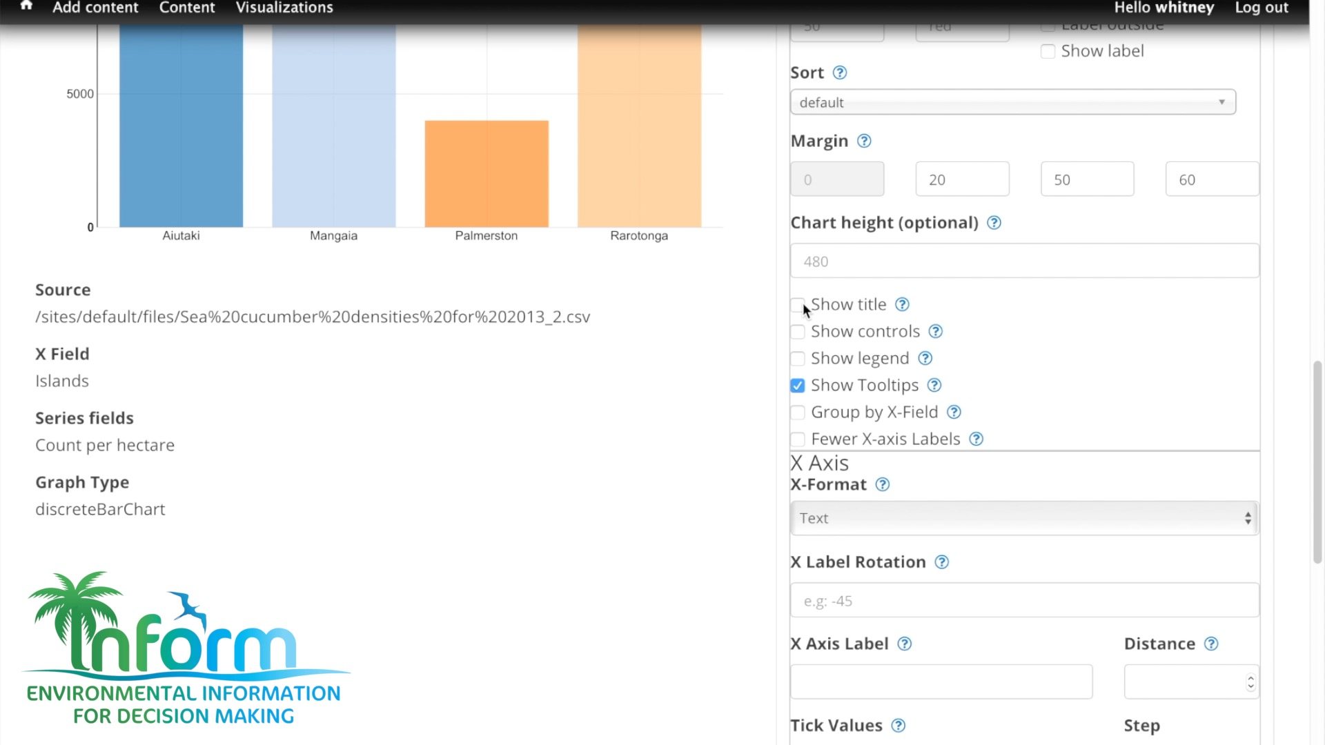
Visualizations

Slide 13
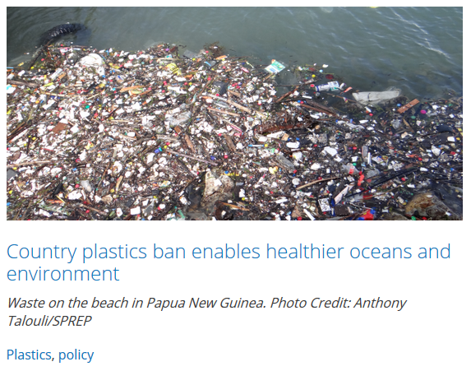
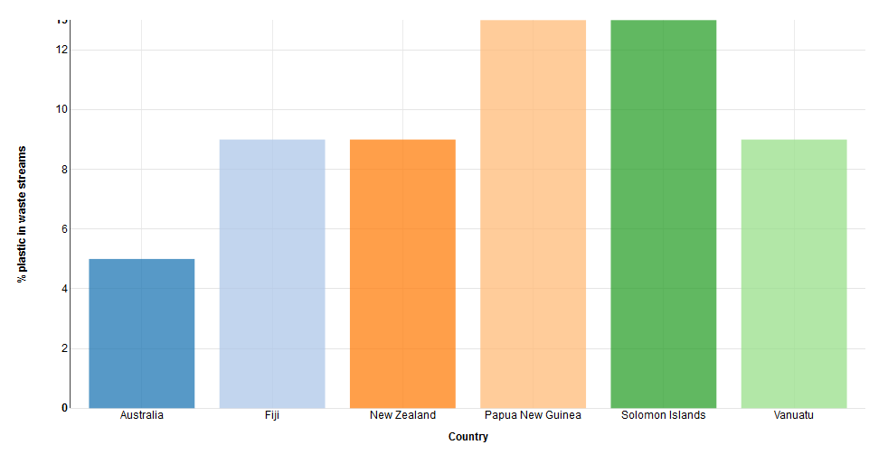
Stories
Example of PNG
Waste on the beach in Papua New Guinea. Photo Credit: Anthony Talouli/SPREP
The Papua New Guinea Government plans to stop the single use of biodegradable plastic shopping bags by 2019, following the ban’s announcement this April.
Hon. John Pundari, Minister of Environment, Conservation and Climate Change, announced the ban, which follows unsatisfactory adherence to a similar one on non-biodegradable plastic bags in 2014.
Studies have found plastic traces in fish, turtles and other marine animals. If the ban is successful, it can reduce both the plastic toxins ingested by these animals and those that seep into the ocean and other water sources in Papua New Guinea.
TAGS

Slide 14
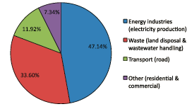
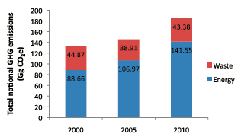

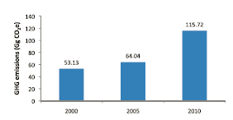
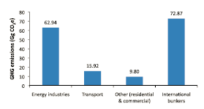
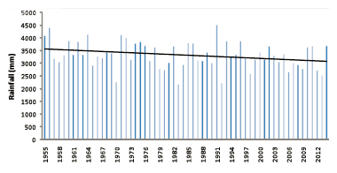
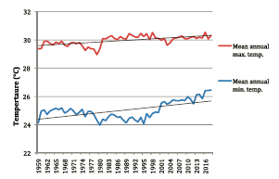
Dashboards
List of different Dashboards, per topic
Greenhouse gas (GHG) emissions stats
Physical Climate

Slide 15
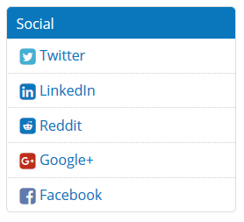
Social media
Public sharing options – dataset level
Be aware of which login you use

Slide 16
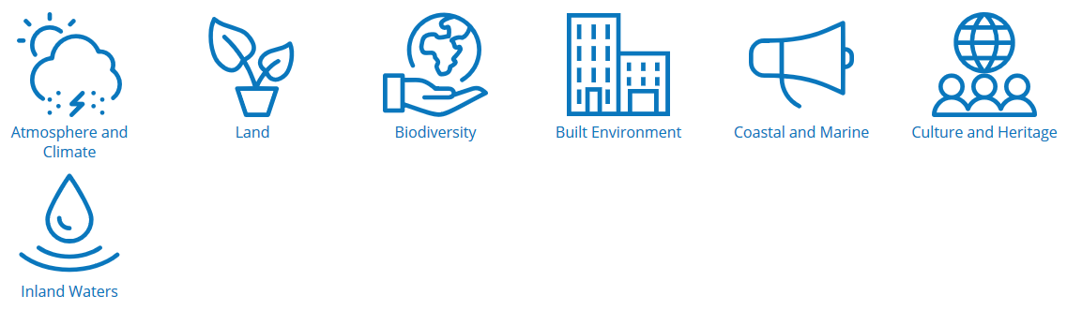
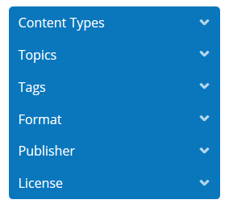

Finding data
shows list of all uploaded formats
allows you to search for images, gis files
shows all Groups that have published data
number of available datasets per group
allows you to see all datasets per group
shows the 3 license levels
number of available datasets per level
allows you to search for public data
Notes:
The Data Portals do not have the structure of a “classic” relational database. The way you upload and find data is by organizing it in themes and tagging it with keywords.
Under datasets, left menu with drop down arrows. Filtering options.
Give examples of all categories.

Slide 17
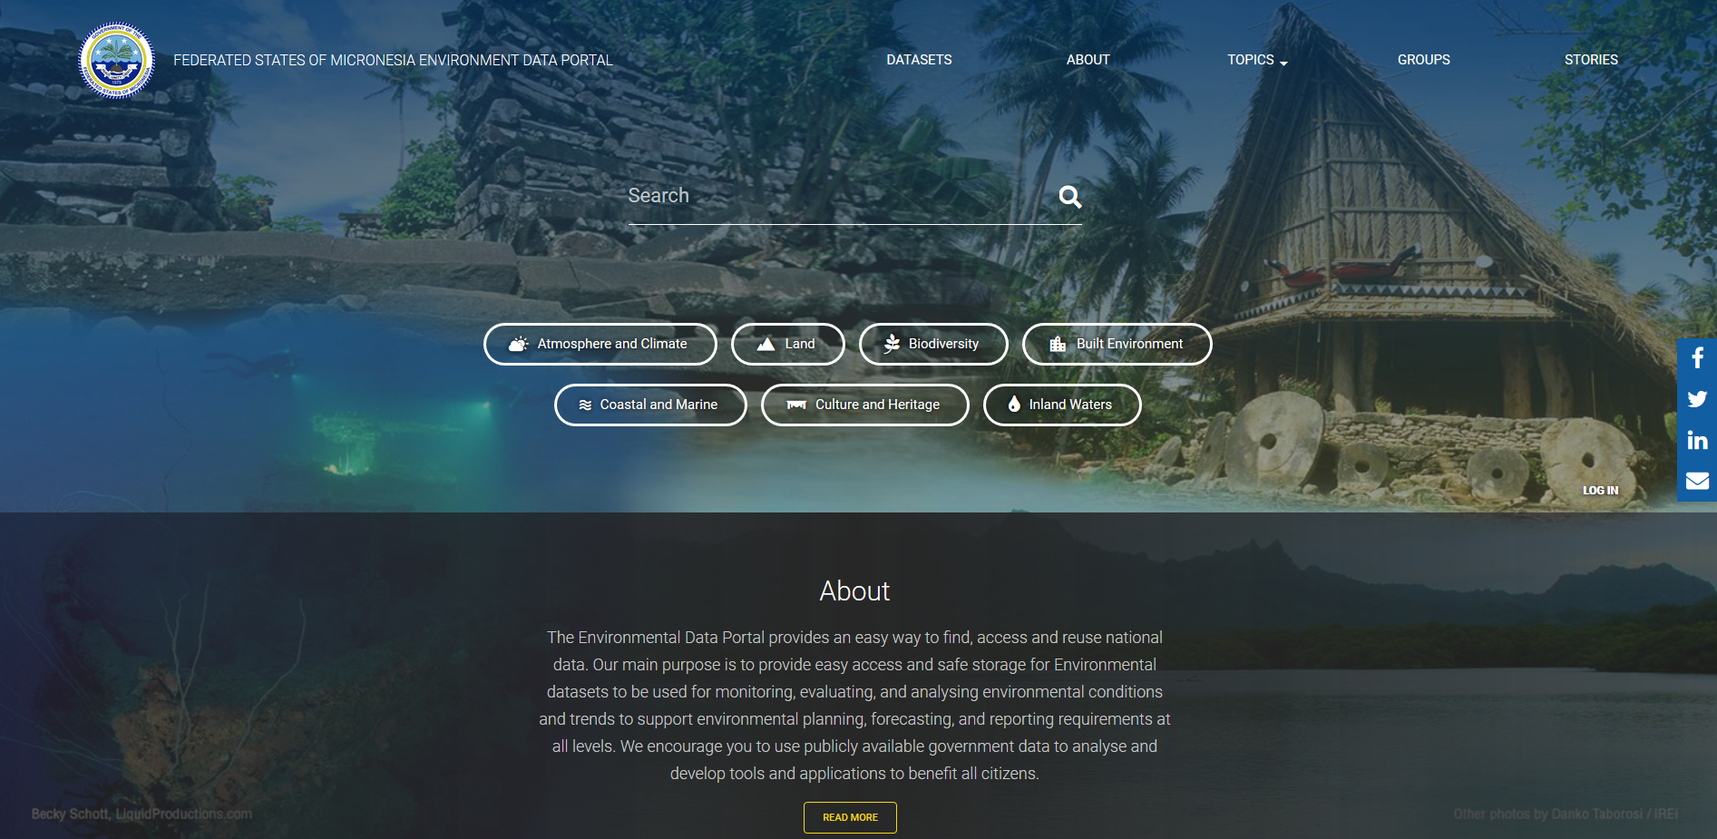
DATA PORTAL LIVE DEMO
https://fsm-data.sprep.org/

