Slide 1
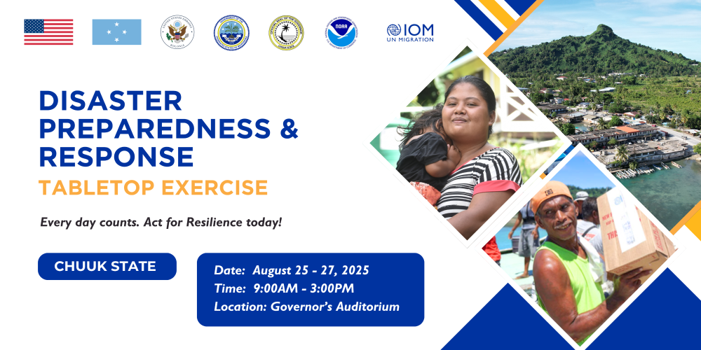

Slide 2

United Nations Development Programme
Pacific Office in the FSM
Countries of coverage: FSM | RMI | Nauru | Kiribati | Palau
States of coverage in FSM: Yap | Chuuk | Pohnpei | Kosrae

Slide 3
Agency Role in Disaster Response
Key Projects
Supporting national leadership: strengthen disaster preparedness, planning, and institutional capacity
Rapid recovery coordination: UNDP helps countries transition from emergency response to early recovery, linking humanitarian relief with long-term development and resilience building
Building back better: UNDP supports communities and governments to recover livelihoods, restore critical infrastructure, and rebuild in ways that reduce future risks and enhance climate resilience
Mobilizing partnerships and financing: UNDP connects governments with international partners, expertise, and financing mechanisms to scale up disaster risk reduction, recovery, and sustainable development solutions
Exploring Solutions for Potentially Polluting Shipwrecks in the Chuuk Lagoon
Long-term Adaptation for Sustainable Development in the FSM
Preparedness for Tsunamis in the Asia Pacific region Phase IV
Enhancing Disaster and Climate Resilience
Water security, resilience, and governance in RMI

Slide 4
Existing Capacities
Chuuk Lagoon: 1-14 Sep Stakeholder Mapping and development of Strategic Partnerships, Information Gathering, Analysis and Risk Prioritization, Mitigation Strategy Development, Reporting and Recommendations
Long-term adaptation: Mapping and data analysis with DECEM
Tsunami Preparedness: regional experience ready for localization in FSM
EDCR: Construction of EOC, prepositioned HF/VHF Radios at 68 sites, water trucks in states and outer islands
Water resilience: outer island water harvesting and ground water well strengthening, drought contingency plans
Coordination Mechanisms
Direct liaison with DECEM at national level
Working through DECEM with State EPAs
Directly with State EPAs with DECEM’s support

Slide 5
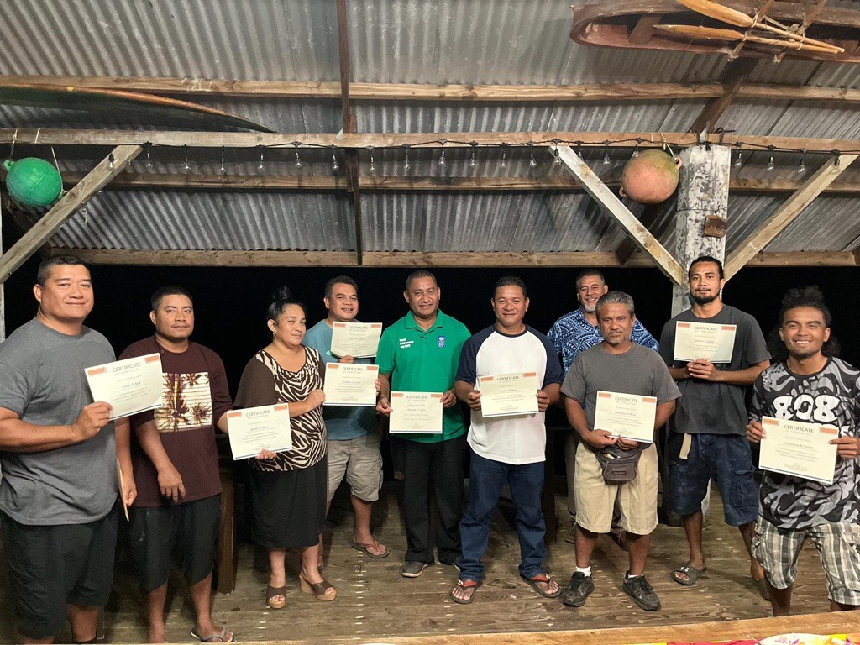
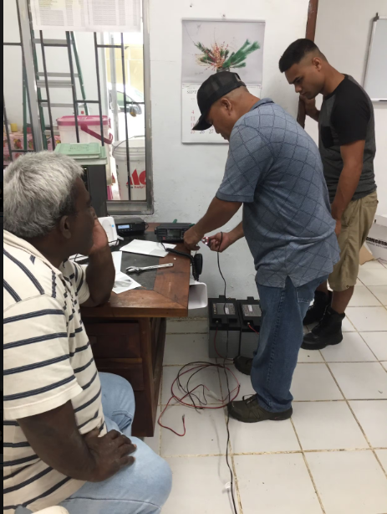
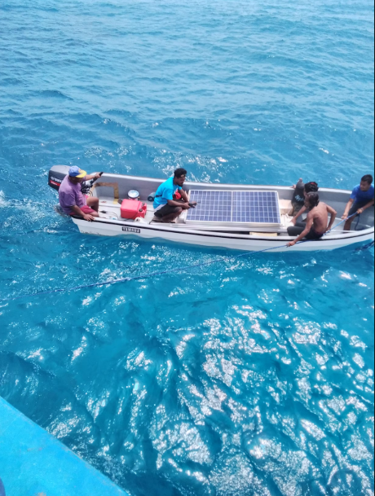
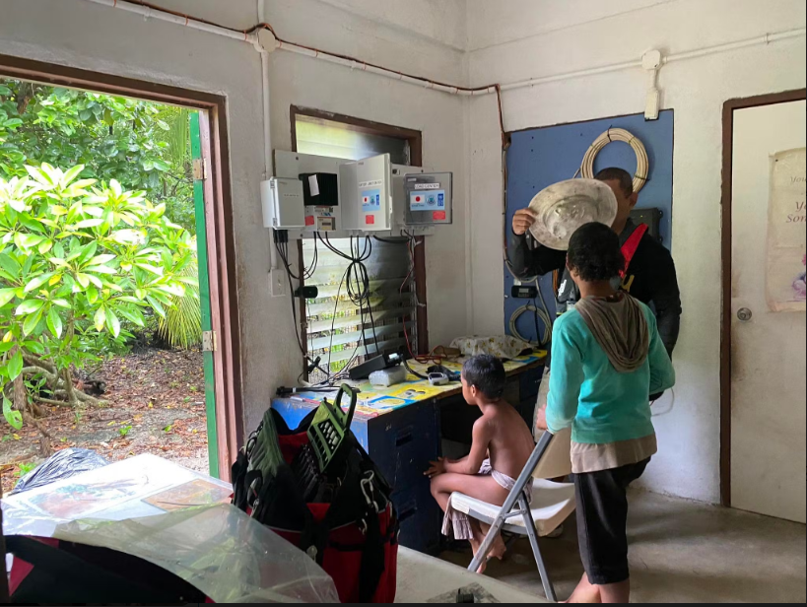
Community Engagement
Lessons from Past Events
Technical capacity building and training of trainers
Technical design and disclosure surveys
Mobilizing community as local builders and installation work based on comprehensive training and skills assessment
Contingency plan that outlines different activities that may be impacted in delivery time by travel restrictions, quarantine and disrupted supply chain
Developing capacity of local counterparts to sustain project results
Coordination with other projects and development partners was important for efficient project activity and increase synergy

Slide 6
Thank you
wanyi.wang@undp.org
lilian.dawha@undp.org

