Slide 1
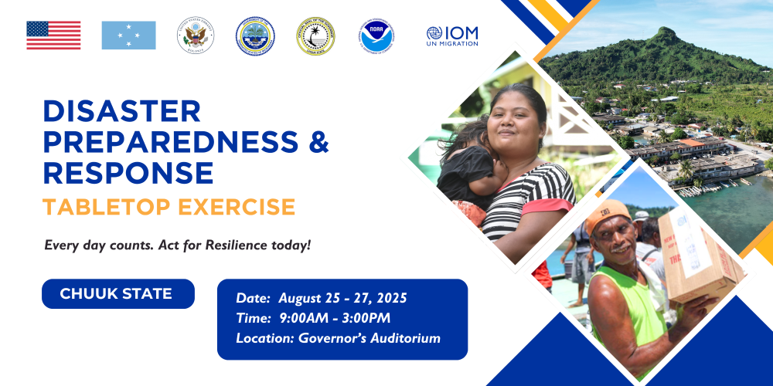

Slide 2

Catholic Relief Services (CRS)
Operational in three of four FSM States:
Yap (2017)
Chuuk (2019)
Pohnpei (2023)

Slide 3
CRS role in disaster response
CRS key projects
Strengthening Opportunities for Adaptive Response ( SOAR)
  3-year project (October 2024 to September 2027)
  Funded by National Oceanic Atmospheric Administration ( NOAA)
  24 target communities
    Chuuk 10
    Yap 14
    ADAPT-Continuation
      2-year project (July 2025 to June 2027)
      10 new targets in Chuuk (TBD)
        DRM and agriculture
      Funded by Margaret A. Cargill Philanthropies ( MACP)
Operational in DRM in Yap and Chuuk states;
Conducts CLDRM in 24 coastal communities to facilitate MDPPs;
Facilitates and trains DMCs/TFs;
Facilitates training on emergency and disaster, e.g., IDA, CPR, First Aid;
Established Collaborative Steering Committee under DEOC/DCO to facilitate partner and stakeholder coordination.

Slide 4
CRS existing capacities
CRS coordination mechanisms
Chuuk office
  5 posts, 4 program and 1 operations;
  3 staff trained on CLDRM
  1 pick-up truck
Yap office
  7 posts, 4 program and 3 operations/finance;
  3 staff trained on CLDRM
  1 four-wheel drive and 1 saloon car
Pohnpei office
  4 posts, 3 program and 1 operations
  CREATE Center
Yap office
  Main coordination via DCO;
  Coordinates directly with traditional leadership ( CoP and CoT);
  Coordinates directly with other partners, IOM, MRCS, WSO;
  Facilitates Collaborative Steering Committee led by DCO for partner coordination under SOAR.
Chuuk office
  Main coordination via DEOC;
  Coordinates directly with mayors and chiefs in target communities;
  Facilitates Collaborative Steering Committee for partner coordination led by DECO under SOAR;
  Coordinates directly with key partners, eg CWC, the Church etc.

Slide 5
CRS community engagement
CRS lessons from past events
Community socialization events;
CLDRM workshops;
Training events;
Drills;
Public awareness outreach ( e.g., WASH, IDDRR events)
Have back up plans for back up plans
  Scheduling and organizing community-level activities around/along community events
  Need for contacts
  Water bottles vs. water containers

Slide 6
CRS inter-operability and support
CRS challenges and recommendations
Support DCO/DEOC to disseminate information using contacts at community level
Support drafting and validation of MDPPs to align with JSAPs
CRS’s current funding does not include any crisis modifier
Challenges
  Trained staff
  Transport to remote communities
Recommendations
  Increased collaboration among agencies
  Clarify roles and responsibilities among agencies, reduce gaps and overlap
  Improved information sharing

Slide 7
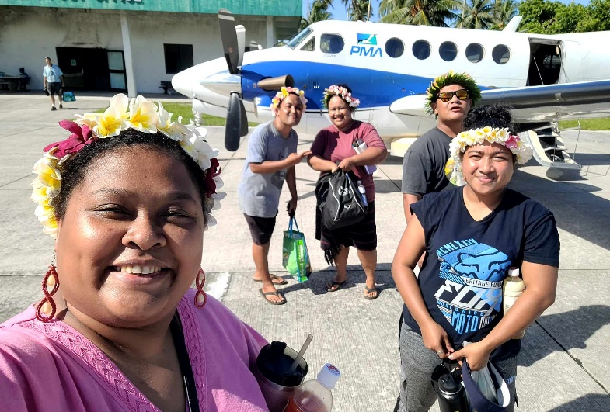
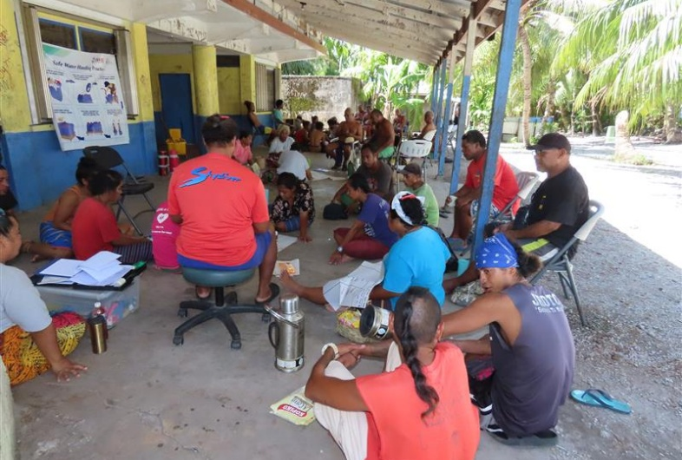
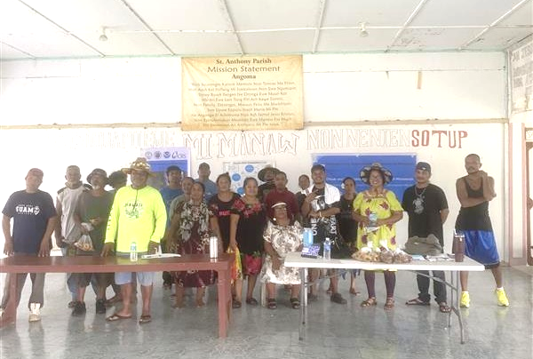
CRS photos
IDDRR event 2023, Ulithi with
DCO, IOM, MRCS and CRS
CLDRM workshop, Yap
Community socialization meeting, Enin, Tonoas

