Slide 1



Notes:
Source: https://www.unisdr.org/files/608_10340.pdf
Disasters happen when people (or their assets, like buildings or homes) are exposed to a hazard they can’t cope with.
Early warning systems (EWS) have been widely recognized as an essential tool to reduce risks and improve preparedness and response to natural hazards.
Early warning is a major element of disaster risk reduction. It prevents loss of life and reduces the economic and material impact of disasters.
To be effective, early warning systems need to actively involve the communities at risk, facilitate public education and awareness of risks, effectively disseminate messages and warnings and ensure there is constant state of preparedness

Slide 2

4 ELEMENTS OF EWS
1
2
3
4
  Warning Dissemination & Communication
  Preparedness & Response or Community Response Capability
  Technical Monitoring & Warning Service
  Describe the basic meteorological tools and their uses.
  Explain the impact of understanding weather patterns on our daily lives.
  Disaster Risk Knowledge
Notes:
The objective of people-centered early warning systems is to empower individuals and communities threatened by hazards to act in sufficient time and in an appropriate manner to reduce the possibility of personal injury, loss of life and damage to property and the environment.
A complete and effective early warning system comprises four inter-related elements, covering knowledge of hazards and vulnerabilities to preparedness and capacity to respond. Best practice early warning systems also have strong inter-linkages and effective communication channels between all the elements.
RISK KNOWLEDGE – Risk assessments and risk mapping should be used to understand both where hazards are likely to occur, and where vulnerable groups and important assets and infrastructures (like hospitals and main roads) are located. Once the knowledge has been developed it’s important that it is shared with those who need it. With the decision makers and officials who are responsible for managing risk, and with the communities themselves.
Questions to ask ourselves particularly our DCOs: Are the hazards and vulnerabilities well known? What are the patterns and trends in these factors? Are risk maps and data widely available?
MONITORING & WARNING SERVICE - Warning services lie at the core of the system. There must be a sound scientific basis for predicting and forecasting hazards and a reliable forecasting and warning system that operates 24 hours a day. Continuous monitoring of hazard parameters and precursors is essential to generate accurate warnings in a timely fashion.
Questions to ask ourselves particularly our DCOs: Do we have sound scientific basis for making forecasts? Can accurate and timely warnings be generated?
DISSEMINATION & COMMUNICATION - Warnings must reach those at risk. Clear messages containing simple, useful information are critical to enable proper responses that will help safeguard lives and livelihoods. Dissemination methods must be tailored to the receivers and multiple methods are likely needed. These can include radio announcements, text messages, mobile apps, and in-person dissemination through loudspeakers, sirens, or color-coded flags. The methods used must consider the most marginalized people specifically, including people who lack access to cell phones and people who cannot read.
Questions to ask ourselves particularly our DCOs: Do warnings reach all of those at risk? Are the risks and warnings understood? Is the warning information clear and useable? The use of
multiple communication channels is necessary to ensure as many people as possible are warned, to avoid failure of any one channel, and to reinforce the warning message.
RESPONSE CAPABILITY - It is crucial that communities understand the risks; respect the warning service and know how to react. Education and preparedness programs play a key role. It is also essential that disaster management plans are in place, well practiced and tested. The community should be well informed on options for safe behaviors, available escape routes, and how best to avoid damage and loss to property.
Questions to ask ourselves particularly our DCOs: Are response plans up to date and tested? Are local capacities and knowledge made use of? Are people prepared and ready to respond to
warnings?

Slide 3
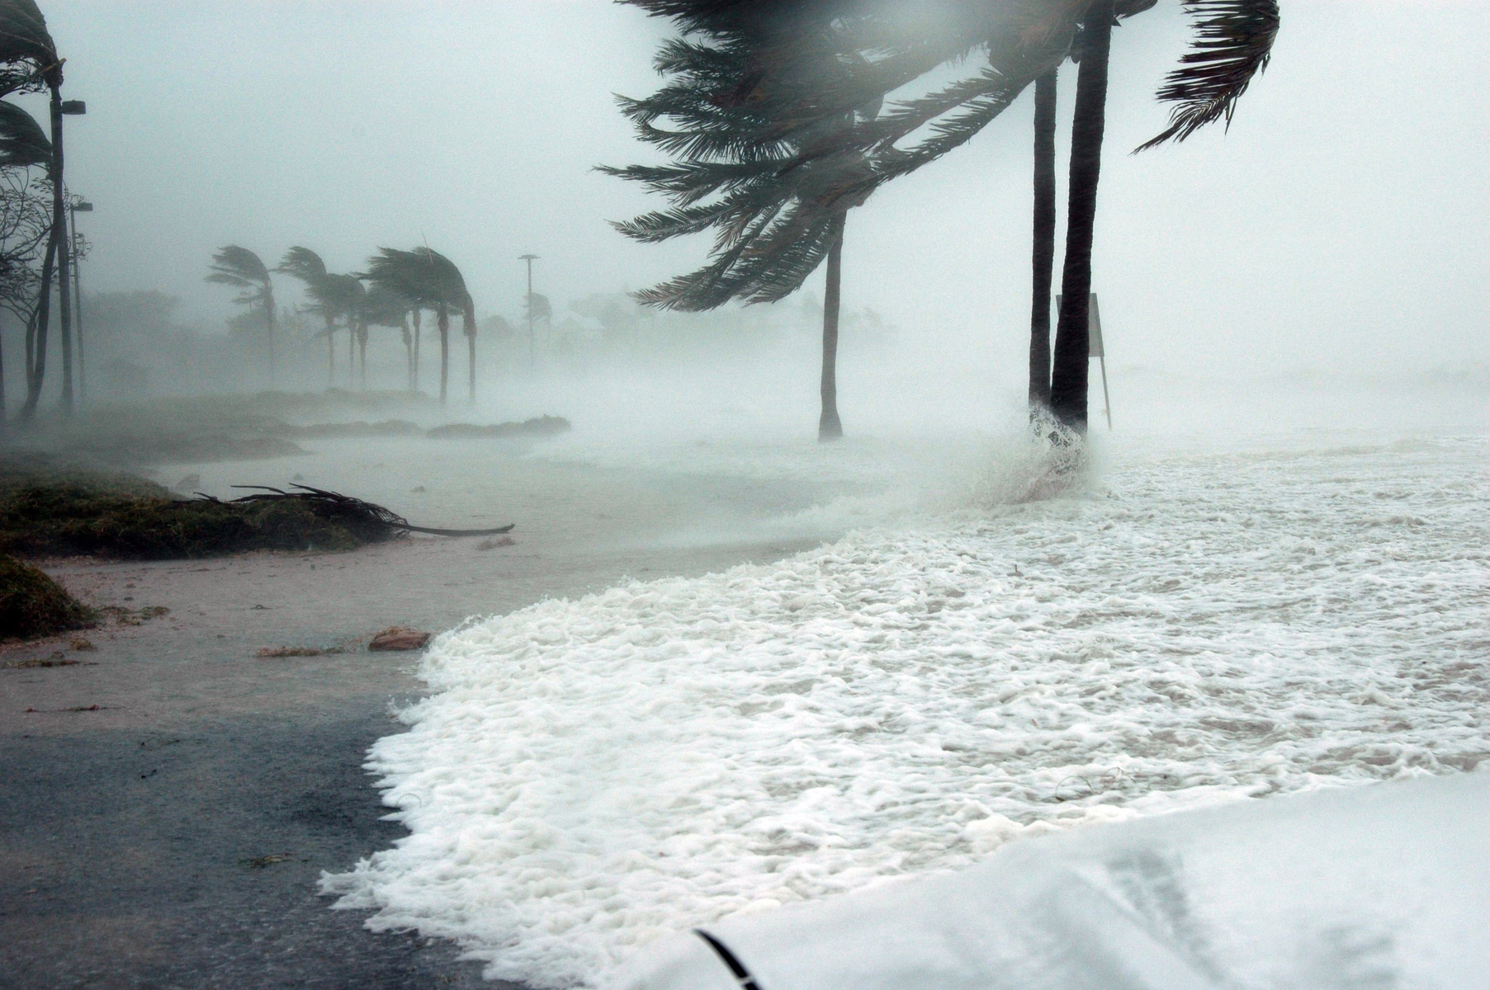
alerts & messages
Notes:
Public notification should consist of two essential components: an alert and a message with instructions.
Alerts demand attention and alarm people.
Messages provide further information.
Note that alerts and messages are not always delivered by the same method or technology

Slide 4

ALERT
  Interrupts people from whatever they are doing
  demands attention
  can be received at any time of the day or night
  can signal people to tune into local radio stations for further guidance
  examples: Siren, Horn, SMS Church Bell, Loudspeaker

Slide 5
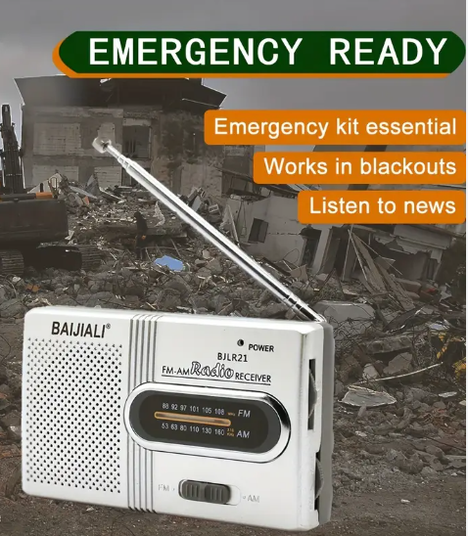
MESSAGE
Provides information about:
  what happens
  when
  severity of hazard
  likeliness of occurrence of hazard
  need of action
  can be delivered audibly & visually
  examples: Radio, Television, FM Radio Data System, Loudspeaker, SMS
Notes:
There is no single early warning method that fits all requirements. Whatever method is used it should consider the special needs of the local population.
To do so one needs to identify and address the specific needs of the community.
Before designing the EWS one needs to know the audience, of which different groups it consists and what these groups might be doing at which time of the day.

Slide 6
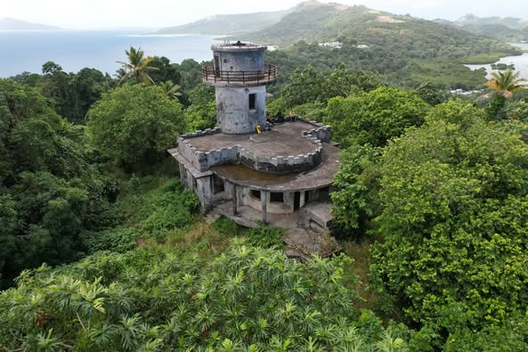
MESSAGE CONTENT
Consist of:
  Informing Agency ex. DCO
  Date and Time
  Is the message an Advisory, Warning or All Clear Message
  Parameters of Hazards
  Advice for Local Decision Makers
Notes:
Different groups have different information needs. Fishermen will require different escape routes and procedures than office workers.
The choice of the applied warning technologies and methods depends on the target audience, its activities, location, available resources and the commitment of the community.
The challenge is how to disseminate the information to the communities at risk and to efficiently implement the SOPs on all levels.
Message content will most likely consist of:
Name of informing agency (Ex. DCO)
Date and Time
Advisory or Warning or All Clear
Parameters of Hazards
ex. Earthquake parameters: location, magnitude, depth
ex. Tsunami Parameters: effected areas, estimated tsunami arrival time, expected wave height etc.
Advice for local decision makers

Slide 7
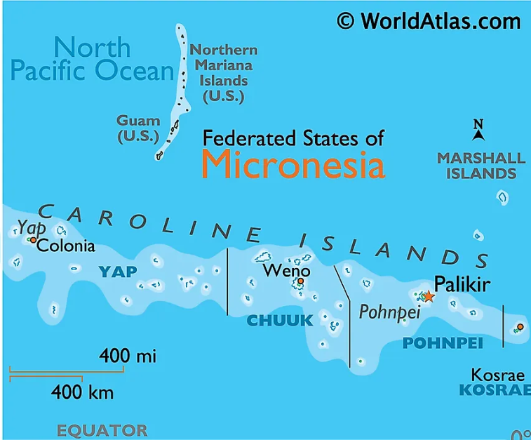
  INFORMATION DISSEMINATION FROM A LOCAL PERSPECTIVE
Notes:
The dissemination of warning messages is always a challenge, especially for emergency managers at the local level with limited resources.
Dissemination technologies and methods can be adapted to the local situation, requirements and capacities to be effective. There is no single best method of warning dissemination that fits all.

Slide 8
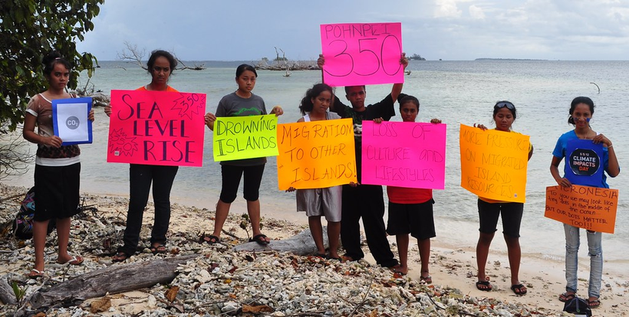

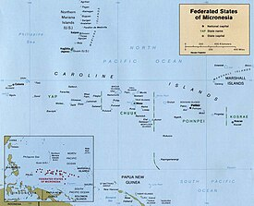
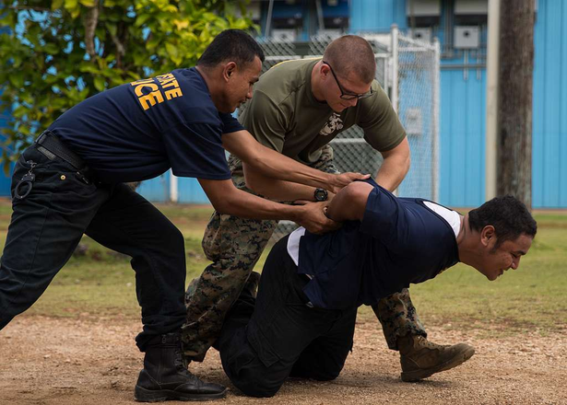
  who
  WHAT
  WHERE
  HOW
  Who needs to be informed
  What specific needs do recipients have
  Where are recipients located
How will people understand and respond to warning
Factors and questions which need to be considered before the technical setup of a warning message dissemination system
Notes:
There are many factors and questions which need to be considered before the technical setup of a warning message dissemination system. Key factors and questions are:
who needs to be informed
where are recipients located
what are they doing at what time of the day/night
what specific needs do recipients have – are there persons with disability (type of disability) ex. for those visually impaired consider ways to reach them with the warning message
how will people understand and react to a warning
season (can fishing, harvesting/planting taro in their taro patch, tourist season)
what happens in the case of an electric power failure etc. – are there alternative ways to get the warning message out to the public
do people have access to radio, cellular phones (SMS), internet, etc
For the public it is not only important to know from which institution to expect what kind of message (Alert / Warning of an Impending Hazard, Evacuation Advisory, All Clear) but also through which technologies those messages are delivered (SMS, radio, FB page, sirens, etc.)
If using sirens, ensure that the public are able to understand what it means and what are the actions they need to do.

Slide 9

DRAFTING OF EARLY WARNING MESSAGES
  Drafting of Early Warning Messages
  These templates will be pre-approved and will be incorporated into the SOP.
  Can be translated to local languages for easy dissemination

Slide 10

Sample:
PUBLIC INFORMATION ALERT MESSAGES - YAP STATE SOP
  Warning! There has been a hazardous material incident at X LOCATION. Please stay indoors, close all windows and turn-off heating and air-condition systems. Please tune in to V6AI Radio Station for more information.
  Warning! A severe weather watch is in effect. Please tune in to your V6AI Radio Station for more information.
  All clear has been issued. Repeat. All clear has been issued. Please resume your normal activities.
  Warning! There has been a hazardous materials incident at X LOCATION. An evacuation order has been issued. Please tune in to V6AI Radio Station for more information
  Warning! There is an incoming typhoon estimated to impact Yap State from X HOURS. An evacuation order has been issued. Please tune in to V6AI Radio Station for more information.

Slide 11
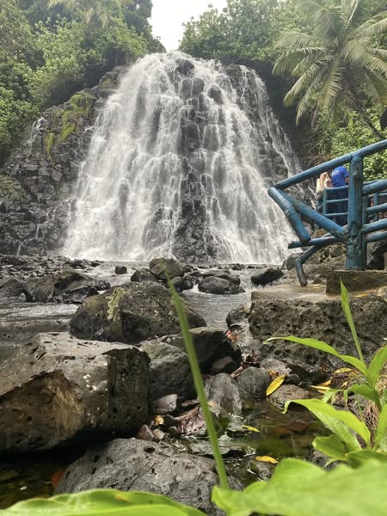
DRAFTING OF TEMPLATES FOR EACH HAZARD COMMON IN FSM
Notes:
Activity:
Divide the participants into 4 groups. Each group is lead by the State DCOs of Pohnpei, Chuuk, Yap and Kosrae
Refer to the printed samples of Early Waring Messages
DCOs with assistance from group members will draft a template for each hazard/risk
DECEM, other DCOs and the rest of the participants will review and check the drafted early warning messages
The reviewed template will be submitted to their respective GDC/SDCT and once approved will be incorporated into the SOP

Slide 12
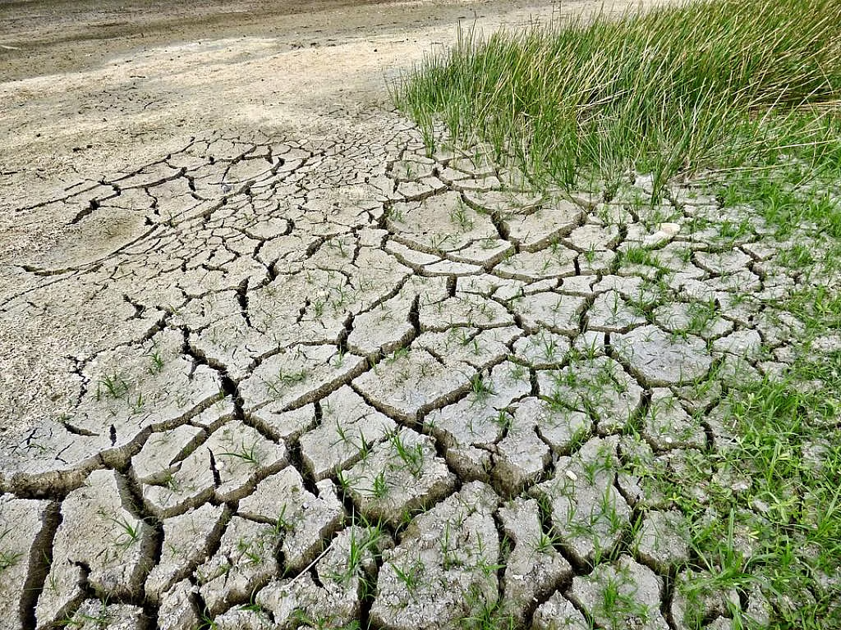
DROUGHT
  General Public - Public Awareness - Drought Warning
- Drought Alert

Slide 13
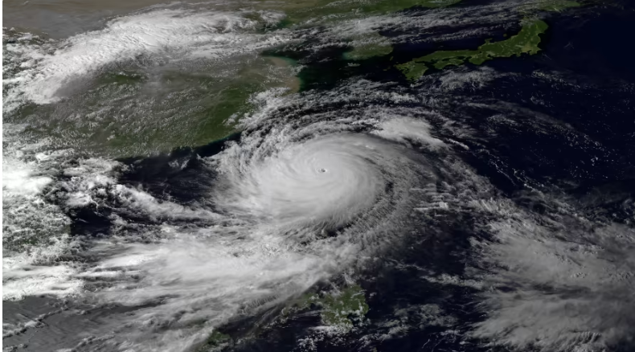
TYPHOON
  General Public - Public Awareness - Typhoon Watch
- Typhoon Alert

Slide 14
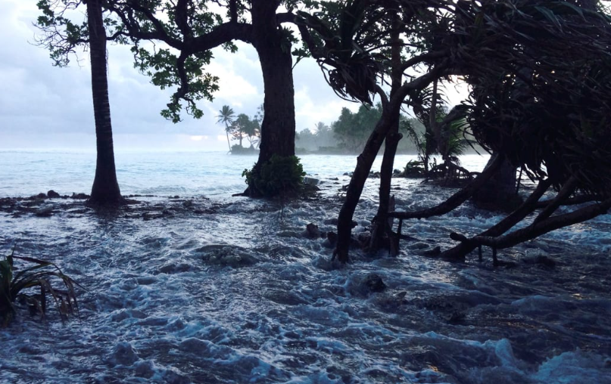
KING’S TIDE
  General Public - Public Awareness - King Tide Alert
- King Tide Flood Warning
  Coastal and Flood-Prone Areas Advisory

Slide 15

TSUNAMI
  General Public - Public Awareness - Tsunami Alert, Warning
- Evacuation Notice
  Coastal and Low-lying Areas Advisory

Slide 16


THANK YOU!

