Slide 1
PTWC/JTWC
FSM WSOs SOP FLOWCHART
ISSUE PRODUCTS
FSM
WSOs
No
NO ACTION TAKEN/INFORMATION ONLY
ANALYZE PRODUCT/DETERMINE HAZARD
EMBASSIES
Yes
DIPLOMATIC MISSIONS
NOTIFICATION OF POTENTIAL THREAT (WATCH/WARNING)
NATIONAL GOVERNMENT (OEEM)
ISSUE NOTIFICATION
NATIONAL AGENCIES
ACTIVATES GOVERNOR’S EMERGENCY TASK FORCE/COLLABORATE WITH STATE ETFs
ACTIVATES PRESIDENT’S EMERGENCY TASK FORCE/COLLABORATE WITH STATE ETF
INTERNATIONAL/REGIONAL AGENCIES
STATE GOVRNMENT (DCOs)
ISSUE WATCH/WARNING MORE ANALYSIS
RADIO STATIONS
TV STATION
PUBLIC SAFETY
HF RADIO TO OI
FSMTC
MUNICIPAL OFFICES
GENERAL PUBLIC

Slide 3
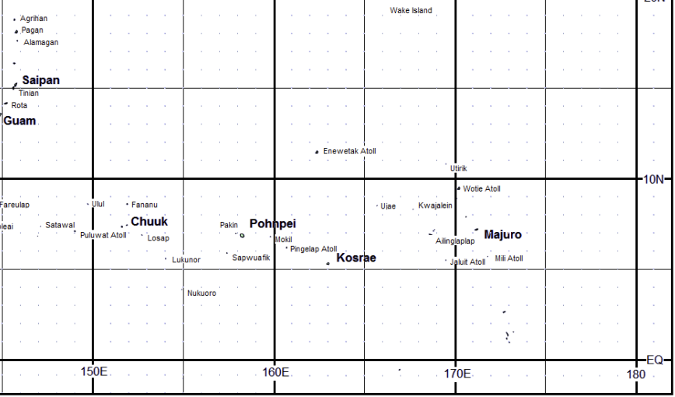
Scenario 72 hrs: Typhoon Watch
TD 96W
Tropical Depression 96W
October 24, 2023 7pm – Advisory 1
Current Location: just passing South of Majuro heading toward Kosrae
Max Sustained Wind 20mph Current Movement 15mph West
Advisory 1: A Tropical Depression (96W) has been developed south of Majuro.
96W is slowly developing and moving West including winds of 20mph are possible within 48 – 72 hrs of Kosrae. At 7pm Kosrae LST .. 96W is currently moving at 15mph. Maximum sustained winds are estimated to be 20mph, intensification is expected in the next 48 to 72 hours. Next advisory will be issued in 12 hours or sooner if there is any sudden changes in forecast.

Slide 4
Discussion Questions: 72 hours
Based on your Department’s SOP what steps will your agency undertake to respond to the information received?
What preparations need to be done?

Slide 5
Scenario 48hrs: Typhoon Warning
TS 16W
Tropical Storm (16W)
October 25, 2023 7am – Advisory 2
Current Location: just passing Southeast
of Jaluit heading toward Kosrae
Max Sustained Wind 37mph Current Movement 15mph West
Advisory 2 : Tropical Storm (16W) is now developed around RMI and moving towards the State of Kosrae. Tropical Storm watch is now in effect for the State of Kosrae. 16W is still developing and expected to intensify within the next 12 hours. Please be advised that the forecasted track puts 16W right south of Kosrae within the next 48 hours. Next advisory will be issued in 12 hours or sooner if any changes are made to forecast.

Slide 6
Discussion Questions: 48 hours
What information should be communicated to the public at this time?
Course of action you think is very critical/important at this point of time but is not listed in your SOP.
Notes:
Pre-approved EWS messages?
MOU with telecom for bulk messages?

Slide 7
Scenario 12hrs: Typhoon Warning
TS Sinlaku
Tropical Storm Sinlaku
October 25, 2023 7pm – Advisory 3
Current Location: East of Kosrae
Max Sustained Wind 44mph Current Movement 15mph West Northwest
Advisory 3: Tropical Storm 16W has now been upgraded to Tropical Storm Sinlaku and a tropical storm WARNING is now in effect for the State of Kosrae. Tropical Storm Sinlaku is now located 150 miles East and continuing its forward movement towards Kosrae. Tropical Storm Sinlaku is expected to make landfall on Kosrae within the next 12-24hrs Maximum sustained winds are still estimated at 44mph. Next immediate update and advisory will be issued in 8 hours or sooner if any changed are made to forecast.

Slide 8
Discussion Questions: 12 hours
Landfall is expected within 12 hours. What are the immediate priorities your agency will undertake based on your SOP.
If applicable, what are the things that should be done differently.

Slide 9
Scenario update: Hit
TS Sinlaku
Tropical Storm Sinlaku
October 26, 2023 7am – Advisory 4
Current Location: 150 miles East of Kosrae
Max Sustained Wind 69mph Current Movement 5mph West Northwest
Advisory 4: Tropical Storm Sinlaku is rapidly moving West. Tropical Storm Sinlaku is now located10 miles South of Kosrae. Tropical Storm Sinlaku is now moving slowly at 5mph with sustaining winds of 69mph and is expected to get stronger within the next 12 hours. All residents of Kosrae are strongly advised to please remain indoors and in the designated shelters.

Slide 10
TY Sinlaku
Typhoon Sinlaku
October 26, 2023 7pm – Advisory 5
Current Location: 75 miles West of Kosrae
Max Sustained Wind 75mph Current Movement 10 mph West Northwest
Typhoon Sinlaku is West of Kosrae and SE of Sapwuafik. All residents of Kosrae are encouraged to remain indoors and in safe shelters, strong tropical storm winds are still within our vicinity until notified conditions are updated by Kosrae DCO.

Slide 11
Scenario: ALL CLEAR! Outside the 300mile radius.
TY Sinlaku
Typhoon Sinlaku
October 26, 2023 7pm – Advisory 6
Current Location: 300 miles West of Kosrae
Max Sustained Wind 85mph Current Movement 10 mph West Northwest
All Clear issued from DCO. PRAY for Kosrae!

Slide 12
Discussion Questions: “All Clear”
What resources does your agency have available to respond to the situation and how quickly can they be deployed?
Are mutual aid agreements in effect?

Slide 13
New Challenges:
DCO
It was reported that Lelu and Malem municipalities have a shortage of critical supplies such as food, fuel and water.
How will your agency prioritize its resource allocation to ensure that the most critical needs are met first?

Slide 14
New Challenges:
Kosrae Utilities Authority
The typhoon has caused widespread power outages in the area, affecting several communities. Discuss the necessary steps to be undertaken to ensure that power will be restored the soonest time possible.

Slide 15
New Challenges:
FSM Telecom
The typhoon has damaged the communication infrastructure resulting in partial / complete loss of phone lines, mobile networks and internet connectivity. Discuss the necessary steps to be undertaken to ensure that communication will be restored the soonest time possible.

Slide 16
New Challenges:
Health
It was reported that Tafunsak and Utwe are experiencing a diarrhea outbreak, with many residents affected. Discuss ways to manage the health situation.

Slide 17
New Challenges:
DCO
Due to continuous heavy rain _________ municipality with steep areas experienced landslides, displacing 5 families. Discuss ways for their relocation and recovery assistance.

Slide 18
Wrap –up Questions:
We hope that this exercise has highlighted the strengths, weaknesses and gaps in your department’s SOP on disaster response.
Considering the outcomes of this exercise, how can we better prepare for unexpected events in the future?

