Slide 1
3rd Joint Environment and Risk Management Platform
“Enhancing Synergies for a Resilient Tomorrow”
8.5 GCF – FSM Food Security Project
Mark Kostka, Project Manager, GCF SAP020
August 30-September 1, 2023
Weno, Chuuk

Slide 2
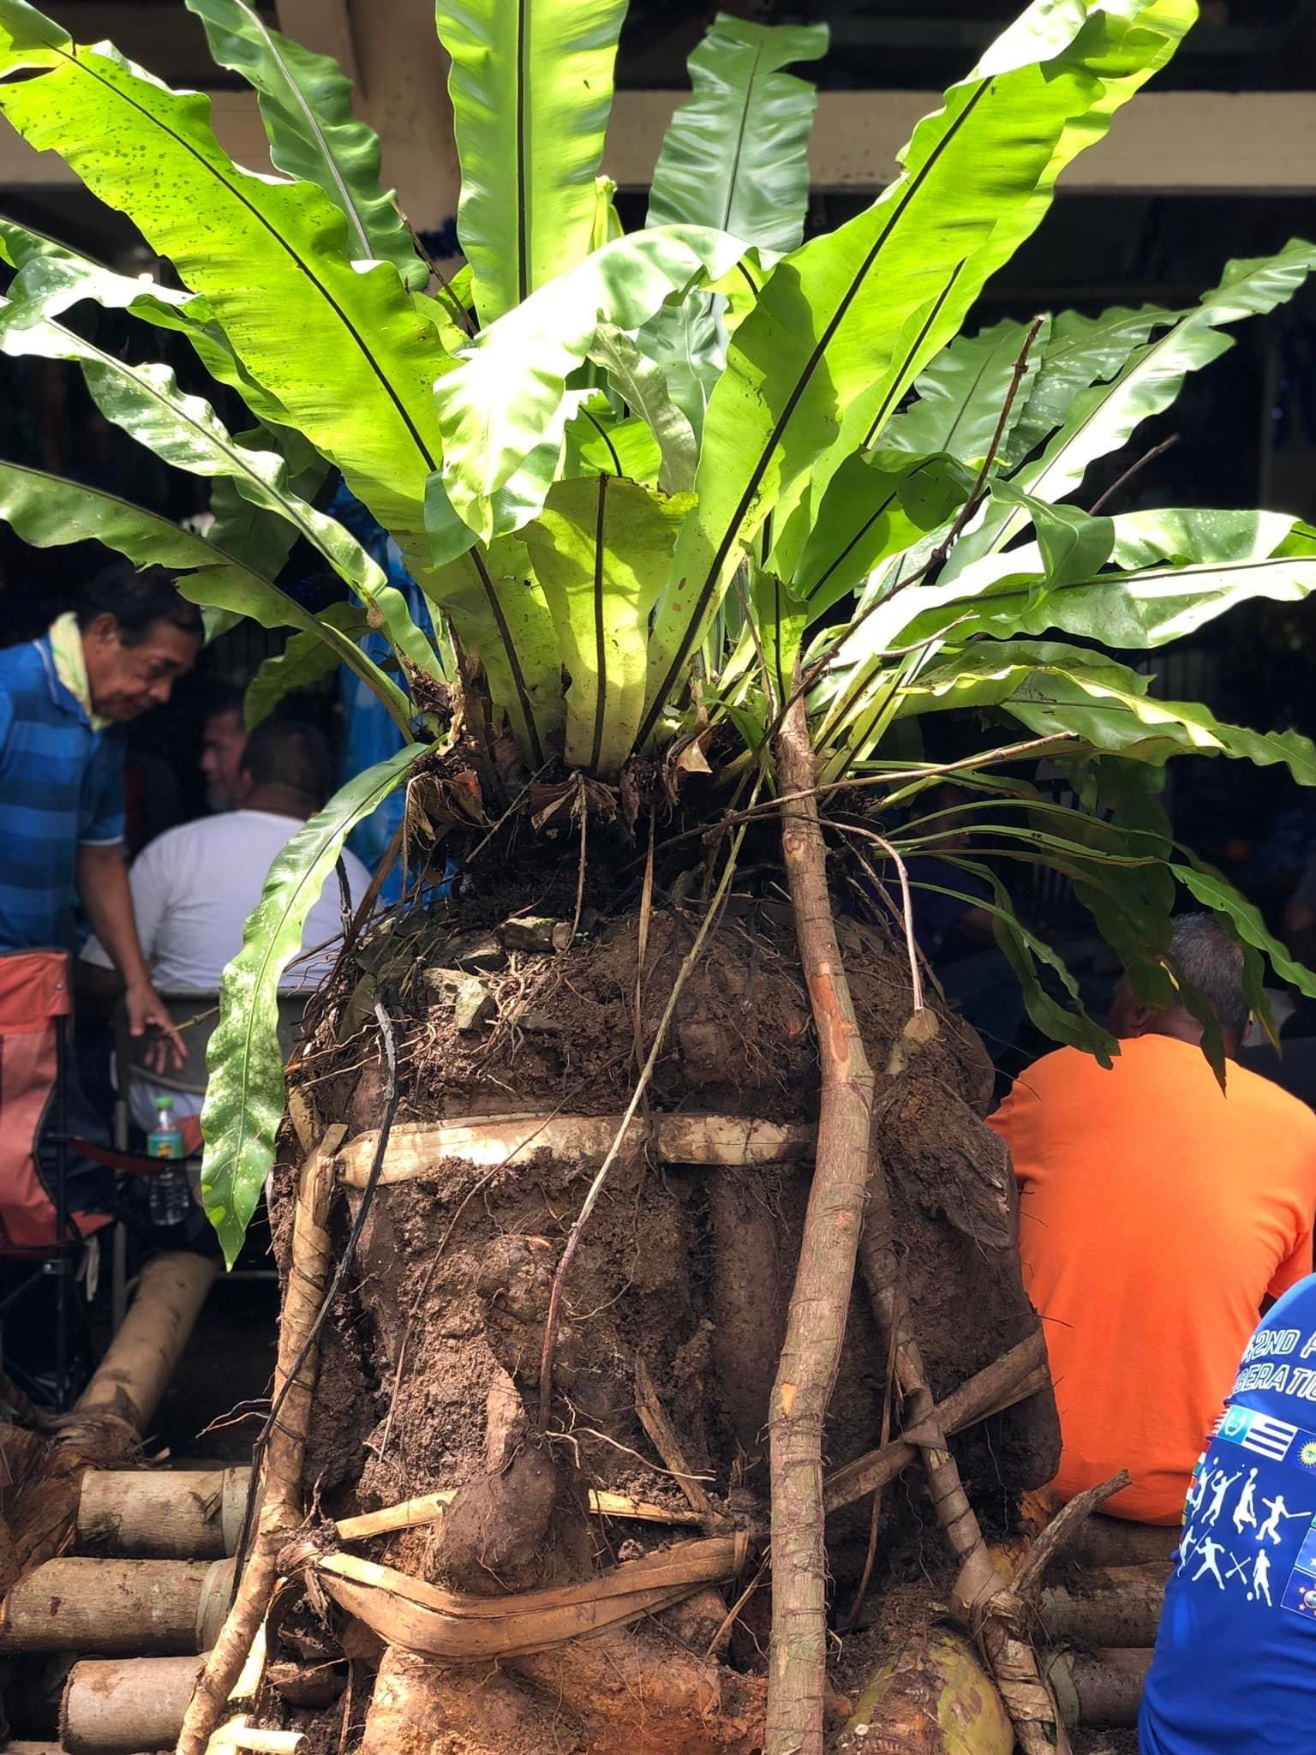
Project Introduction
“Climate-resilient food security for farming households across the Federated States of Micronesia”
approved by the Green Climate Fund Board at its B.28 meeting (March 2021).
5 years duration
Total funded by GCF: $8,583,350.00; Total Project funds: $9,393,350 (co-financing & GCF)

Slide 3
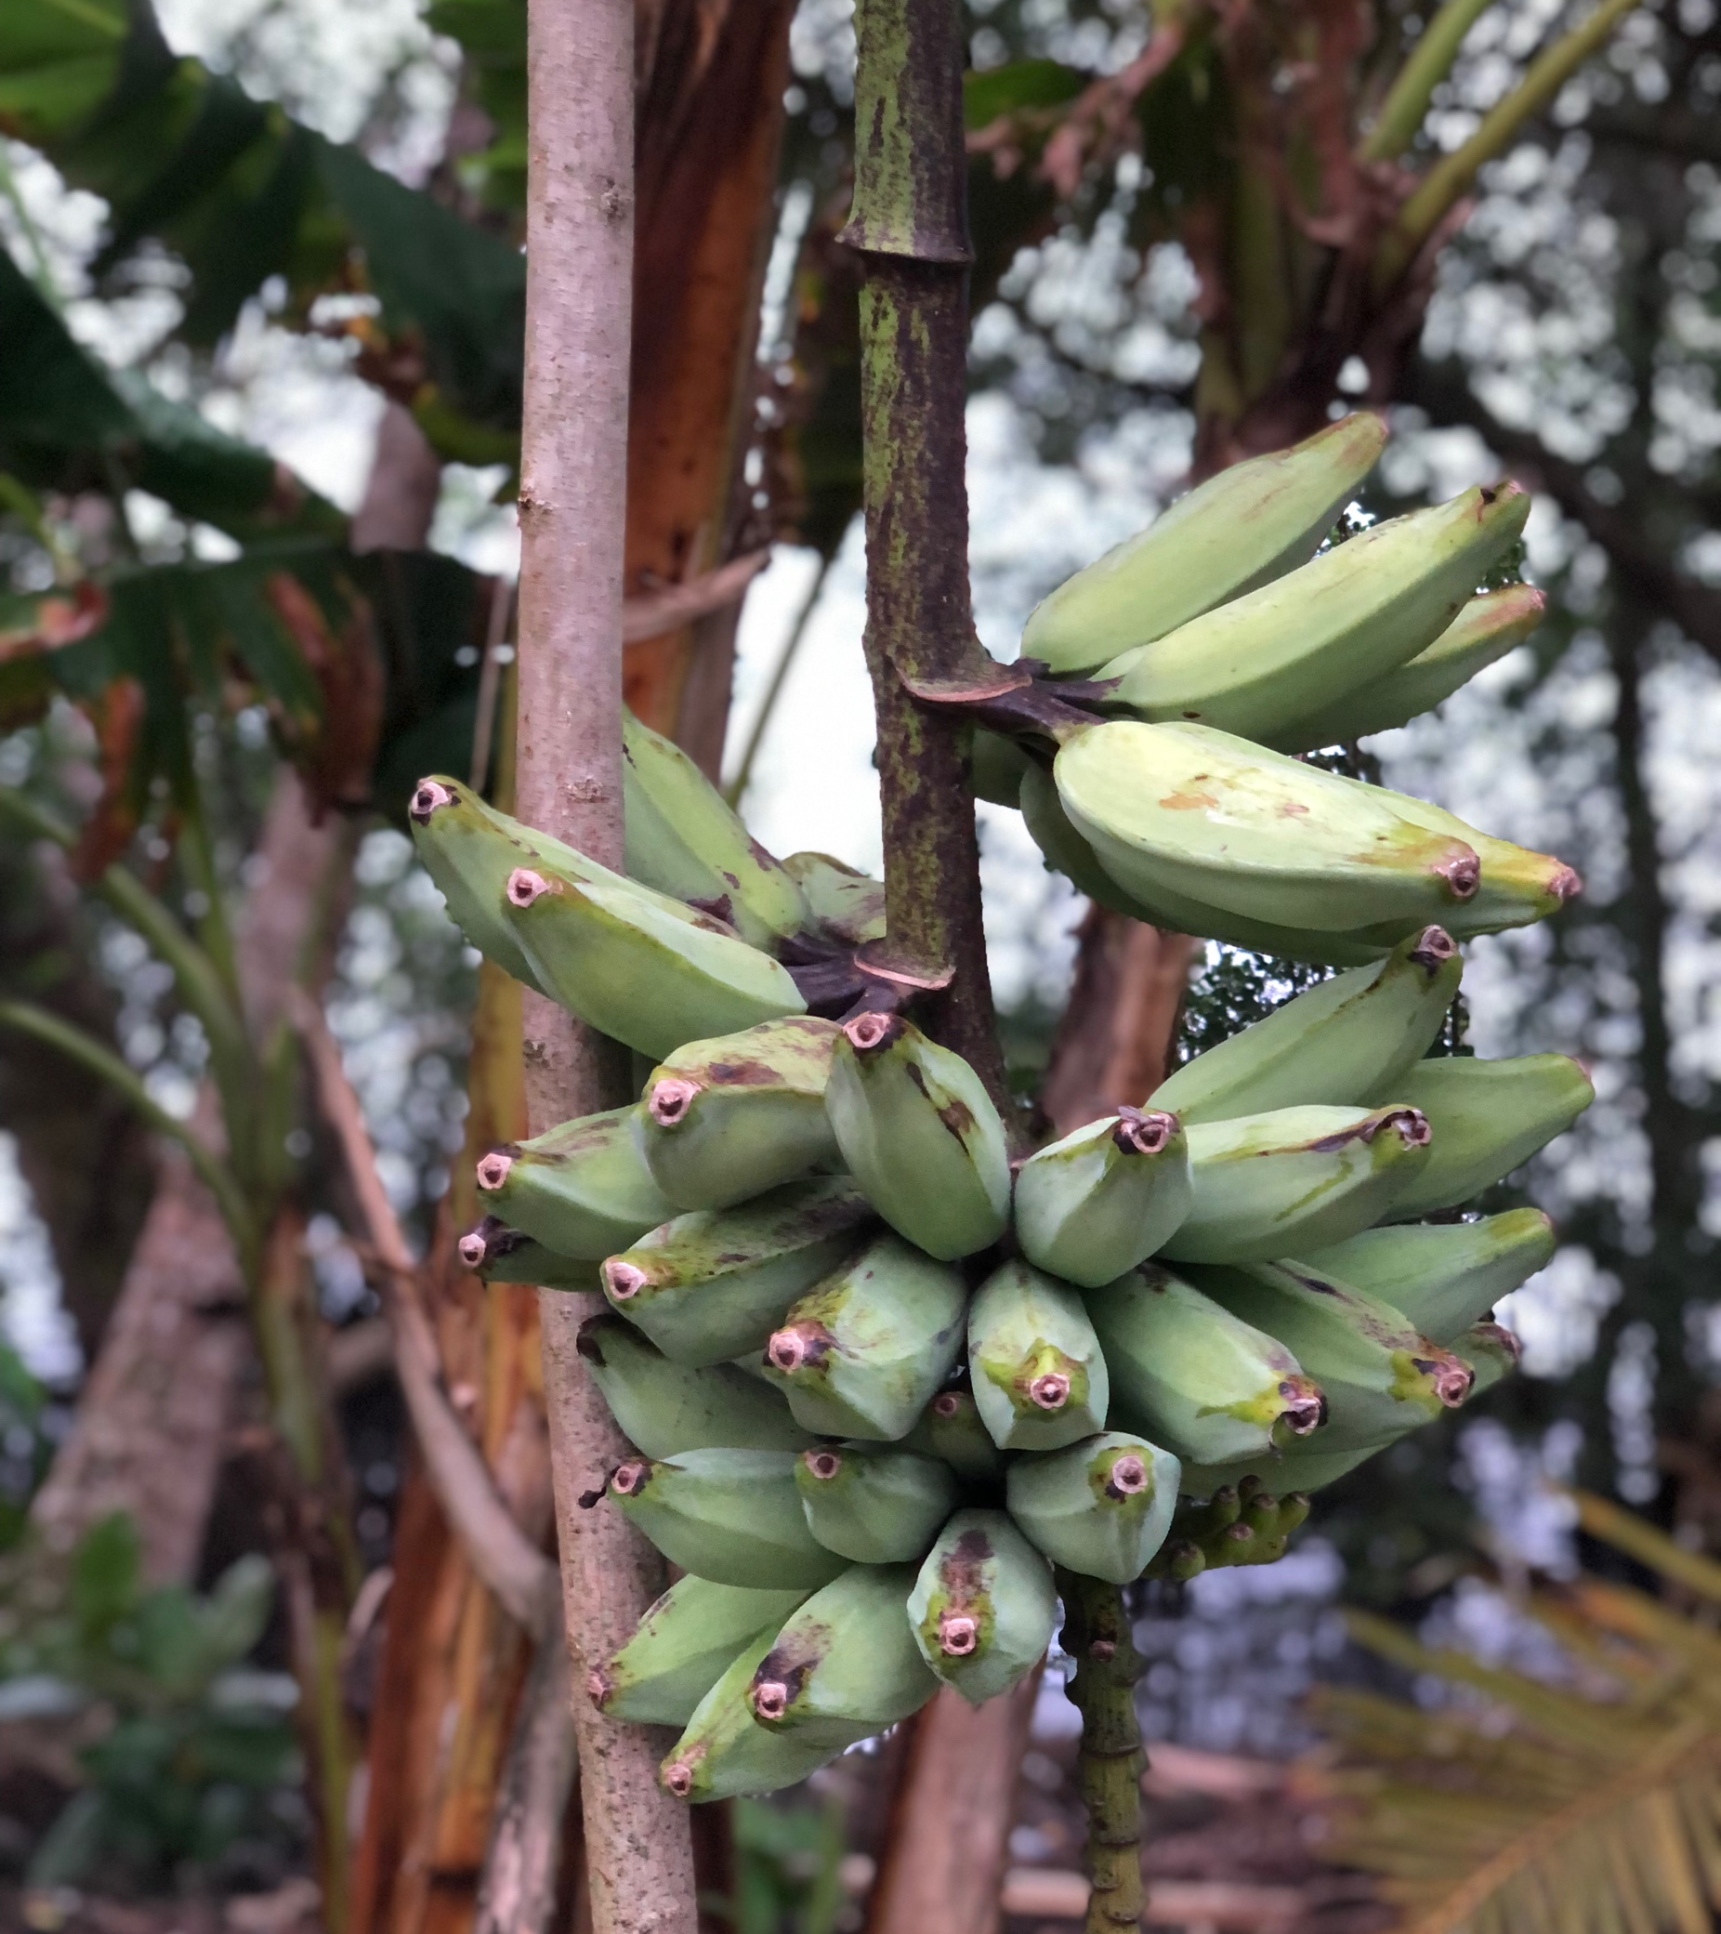
Implementation Arrangements
FSM National Government: Executing Entities (EEs) -Resources and Development -Department of Environment, Climate Change and Emergency Management -College of Micronesia-FSM *Project Management Unit (PMU) Micronesia Conservation Trust – manages funds and ensure project management milestones are managed and completed. Project Steering Committee (members listed next page-oversees project implementation, review annual workplans and reports

Slide 4
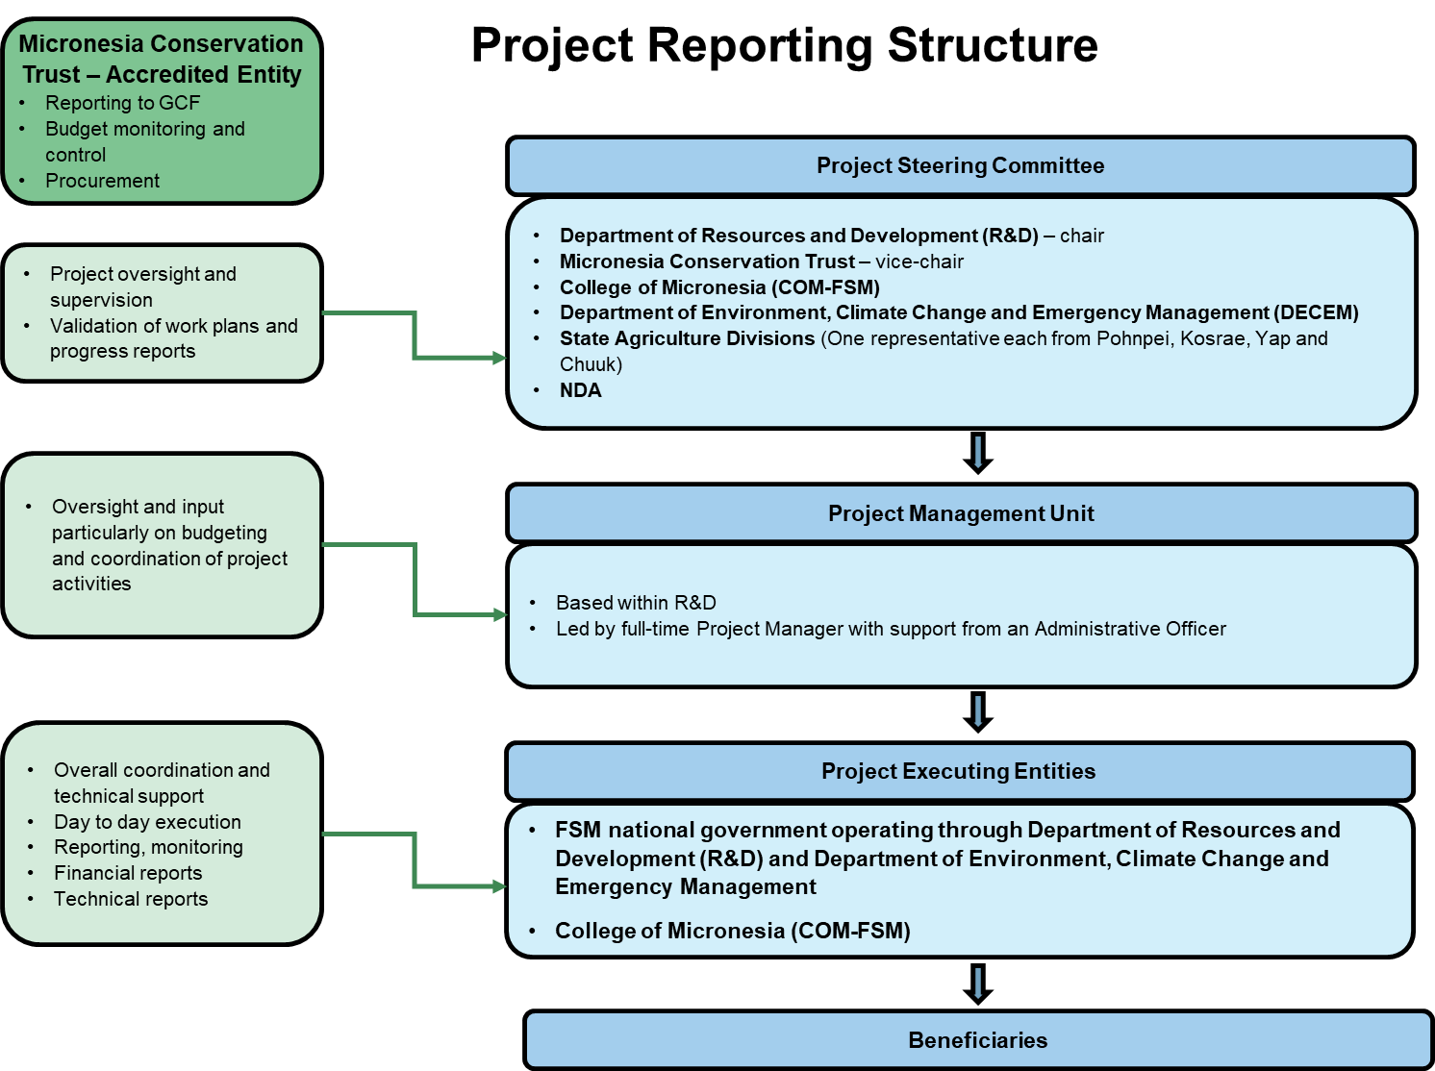
Notes:
This is how the project is set up. MCT is responsible for overseeing the implementation, financial management, evaluation, reporting and closure of the project in coordination with the Executing Entities, Project Steering Committee, and the Project Management Unit.
-Executing Entity (EE) An EE can be a developing country that is a Party to the United Nations Framework Convention on Climate Change and/or any entity that possesses a legal personality. An AE may also carry out the functions of an EE. The GCF requires the AEs to evaluate the capacity of and engage the relevant EE based on their ability to channel or use GCF proceeds and/or implement the GCF funded activity in accordance with GCF policies and requirements.
-As EEs, the national government and COM-FSM have overall responsibility for the effective delivery of required inputs in order to achieve the expected project outputs.

Slide 5
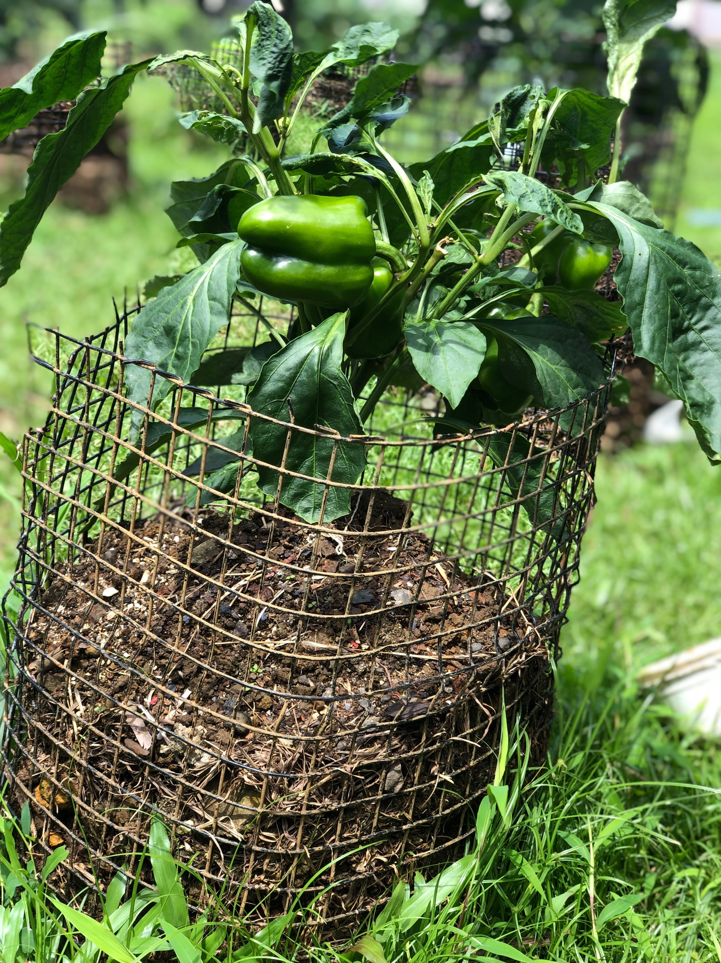
Project Overview
The project is the “first comprehensive national effort” to focus on increasing the resilience of FSM’s most vulnerable communities to food insecurity in the face of climate change.
The project targets all households in the FSM high islands undertaking some form of farming approximately 68,250 direct beneficiaries (across the Federated States of Micronesia (FSM)
Targeting 63% of HHs conducting some form of agriculture and forestry).
The project specifically works to improve:
-technical capacity
-coordination for Climate Smart Agriculture (CSA) planning and policy
-support improved decision-making for agriculture through downscaled climate information
-increase availability, stability, and accessibility of locally grown food for food security
-improve nutritional outcomes for vulnerable households
-develop new opportunities for income and household productivity, and strengthen climate resilient value chains across the agriculture sector by implementing three interrelated components:

Slide 6
Three Main Components of the Project
1. Establishing an enabling environment for adaptive action and investment
2. Enhancing the food security of vulnerable households by introducing CSA practices
3. Strengthening climate-resilient value-chains and market linkages across the agriculture sector

Slide 7
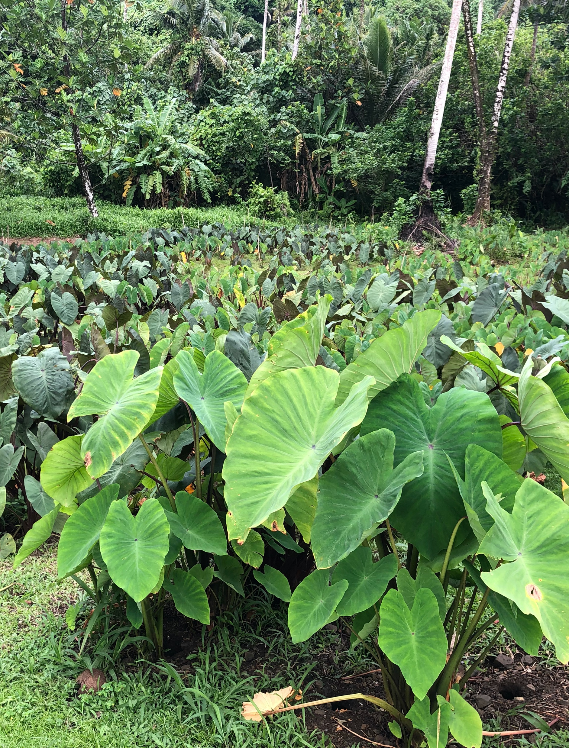
Component 1. Establishing an enabling environment for adaptive action and investment
Institutional coordination mechanism
undertaking descaled integrated vulnerability assessments
Incorporation of climate change into state and national planning and policy
Developing a network of farmer associations
Disseminating tailored communications for informed decision-making
Notes:
These outputs will specifically help to better target adaptation investments based on community-level vulnerabilities, improve technical capacity for climate smart planning and policy, solidify political commitment and accountability for CSA, and drive informed decision-making for farmers, all of which will increase the adaptive and anticipatory capacity of FSM and lay the foundation for improved strategic planning for food security and climate resiliency.

Slide 8
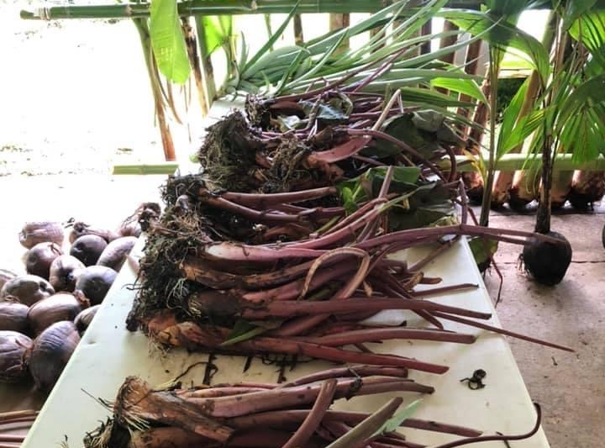
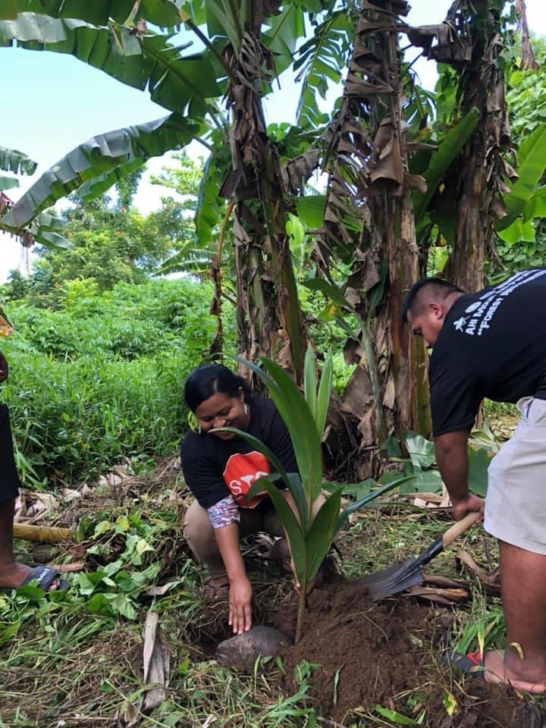
Component 2. Enhancing the food security of vulnerable households by introducing CSA practices
This includes establishing agroforestry systems
Capacity building for extension agents
Awareness building and training for FSM households
Developing reserve capacity for climate disruption.
Notes:
This will increase availability, stability, and accessibility of locally grown food for food security, improve nutritional outcomes for vulnerable households, develop new opportunities for income and household productivity, and drive a national change in awareness and utilization of CSA for improved resiliency.

Slide 9
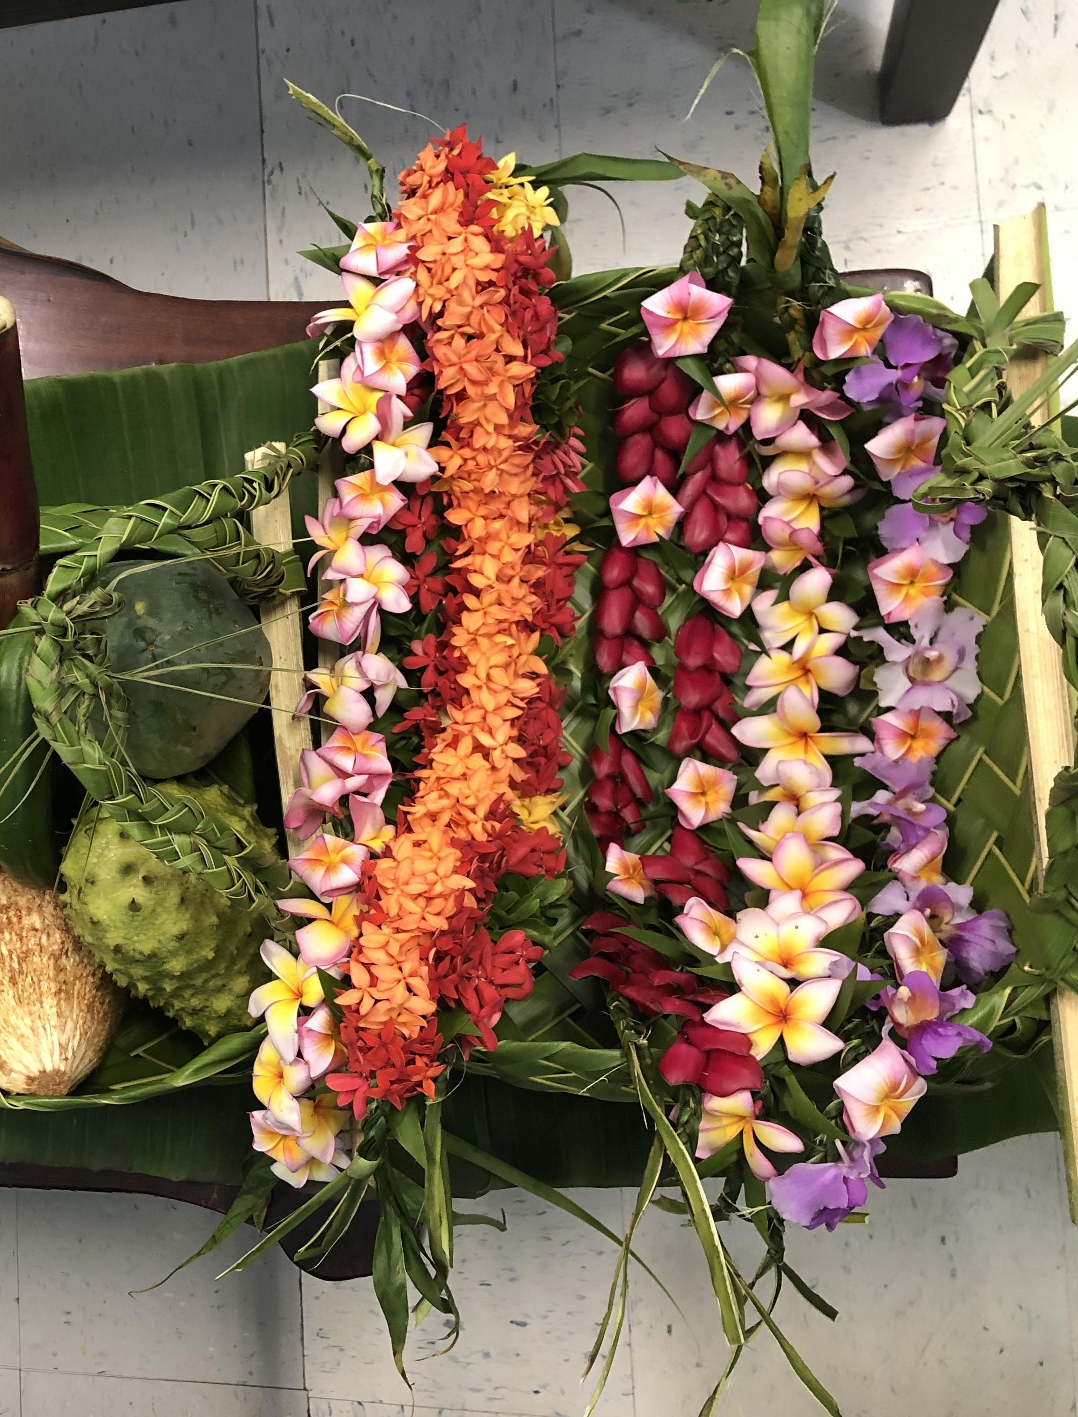
Component 3. Strengthening climate-resilient value-chains and market linkages across the agriculture sector
Development of new markets for local agriculture
Enhanced food processing and preservation
Increasing awareness and consumption of local food
Notes:
This will strengthen climate resilient value chains across the agriculture sector, improve food security gaps through storage and processing, significantly transform opportunities for improved livelihoods thereby driving increased adaptive capacity. Further it will create a strong incentive framework for local farmers to leverage CSA packages beyond the life of the project to secure a long-term shift towards improved climate resiliency with regards to food security.

Slide 10
“Enhancing Synergies for a Resilient Tomorrow”
Progress since project effectiveness date 22 July 2021
Hiring of the Project Management Unit (PMU)
Stakeholders Inception Workshops
National Coordination Mechanism
Completion of the FSM baseline report for staple crops
Hiring of Coordinators for Yap, Pohnpei, and Kosrae
Identification of climate-resilient agroforestry practices for the FSM

Slide 11
“Enhancing Synergies for a Resilient Tomorrow”
Ongoing and upcoming projects and activities
National Coordination Mechanism
Integrated Vulnerability Assessment on the Agriculture sector
De-scaled assessment of the vulnerable communities across the four FSM states
Farmers Cooperative Associations at the state-level
Set of criteria development to prioritize the deployment and implementation of climate-resilient agroforestry practices across the nation.
Climate-smart agriculture (CSA) and poultry production training of trainers
Initial training sessions at the community demonstration gardens on processing, packaging, and storage techniques

Slide 12
“Enhancing Synergies for a Resilient Tomorrow”
Challenges
Prolonged project proposal process
Change in Government Administration
Limited interested individuals to fill project staff
Outbreak of COVID – 19
Multiple Executing Entity

Slide 13
“Enhancing Synergies for a Resilient Tomorrow”
Opportunities for Collaboration
Institutional Coordination Mechanism
Food Security Policy
National
State
Communication Plan

Slide 14
“Enhancing Synergies for a Resilient Tomorrow”
Recommendations
Each department/partner to develop a list of projects with main objectives to avoid duplication efforts but to ensure projects either complement/supplement each other
External evaluator to share project’s mid-term evaluation results with relevant stakeholders (specifically participants from the inception workshops)

