Slide 1






3rd Joint Environment and Risk Management Platform
“Enhancing Synergies for a Resilient Tomorrow”
8.3 FSM Invasive Alien Species Project
Jorg Y. Anson, Project Manager, FSM R&D
August 30-September 1, 2023
Weno, Chuuk

Slide 2





“Enhancing Synergies for a Resilient Tomorrow”
Project Objective: To safeguard biodiversity in terrestrial and marine ecosystems and in agricultural and fisheries production systems from the impacts of invasive alien species in the FSM.
4 Components:
Institutionalizing a governance framework for IAS prevention, control and enforcement across member states and in collaboration with other Micronesian nations
Raising awareness and strengthening capacity in IAS prevention and management
Demonstrating best practices in safeguarding biodiversity and food production systems from IAS
Knowledge management, monitoring and evaluation

Slide 3
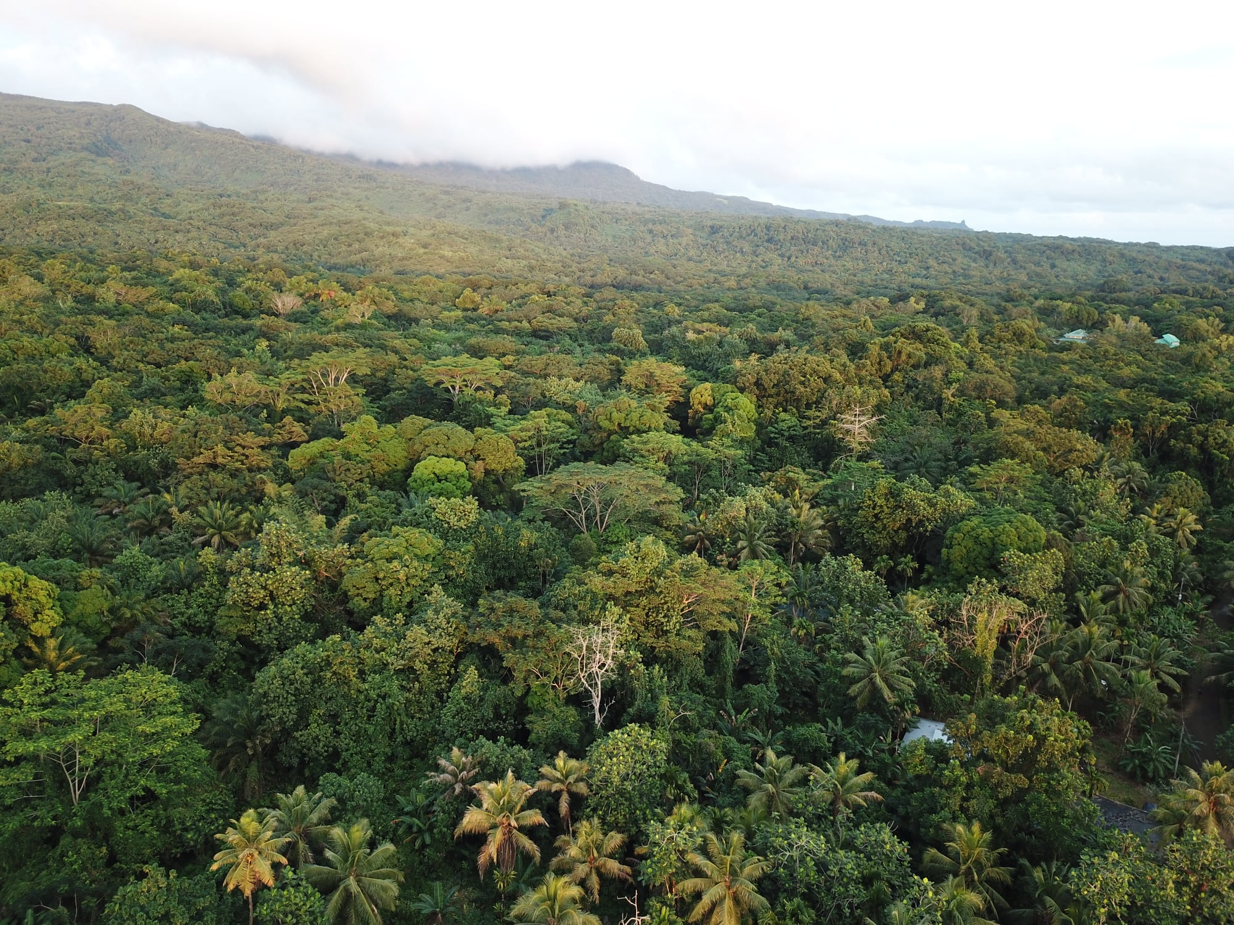
“Enhancing Synergies for a Resilient Tomorrow”
Progress since 2018
2018
2020
2022
2024
May 2020
Approved for implementation
September 2021
Inception Workshop
May 2023
Project Team recruitment completed
August 2021
Disbursement of 1st tranche
August 2023
Mid-Term Review
February 2022
Recruitment of 1st Project Staff
July 2023
Most recent Project Steering Committee Meeting (5th SC Mtg)
November 2021
1st Project Steering Committee Meeting

Slide 4
“Enhancing Synergies for a Resilient Tomorrow”
Ongoing and upcoming projects and activities
  Review, update and implement National Invasive Strategy and Action Plan and State IAS Taskforce Strategic Action Plans.
  Procurement of Biosecurity equipment for FSM Air/Sea Ports
  Renovation/refurbishment of biosecurity facilities
  Biosecurity Modular Training Program with the College of Micronesia-FSM
  Development of a Biosecurity Information System with UNCTAD
  Drafting of Rules and Regulations to operationalize Biosecurity Act of 2017
  IAS awareness and outreach at demonstration sites

Slide 5
“Enhancing Synergies for a Resilient Tomorrow”
Challenges
  Delayed project inception and commencement of implementation
  Border restrictions for Inter-State Travel during Covid-19 lockdown
  Lack of Technical Support pertaining to Biosecurity in the FSM
  Financial Systems/Modalities (UNDP vs. FSM)

Slide 6
“Enhancing Synergies for a Resilient Tomorrow”
Opportunities for collaboration
  Partnership Agreement with COM-FSM to develop and implement Biosecurity Training Program [Project Outcome 2.2]
  Engage Small Grants Program/Micronesia Conservation Trust to support implementation of livelihood funding scheme [Project Outcome 3.2]
  Partnership with SPC/UNCTAD to develop and implement the Biosecurity Information System [Project Outcome 4.1]

Slide 7
“Enhancing Synergies for a Resilient Tomorrow”
Recommendations
  Expand UN Spot Check threshold requirement from $50,000 to $500,000.
  Replicate World Bank Central Implementation Unit under FSM DOFA
  Allocate funds for salary from the General Fund as co-financing to ensure timely Project inception and kickoff in Year 1 of Project life
  Design multi-year contract agreements with Project Staff, if legally applicable, to ensure long term commitment

Slide 8

“Enhancing Synergies for a Resilient Tomorrow”
KakaKiKu!

