Slide 1






3rd Joint Environment and Risk Management Platform
“Enhancing Synergies for a Resilient Tomorrow”
8.2 FSM Adaptation Fund (AF) Project
Jason Louis, Communications Officer, DECEM
August 30-September 1, 2023
Weno, Chuuk

Slide 2
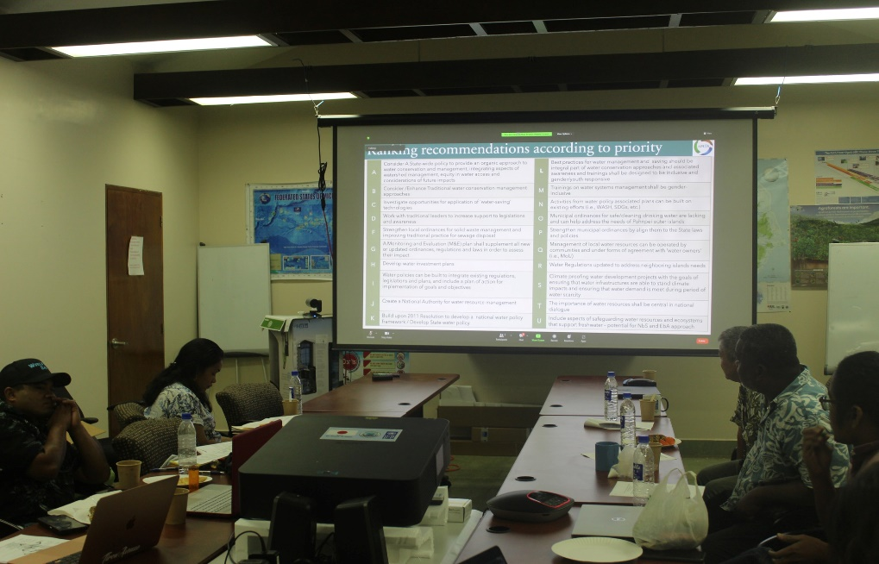
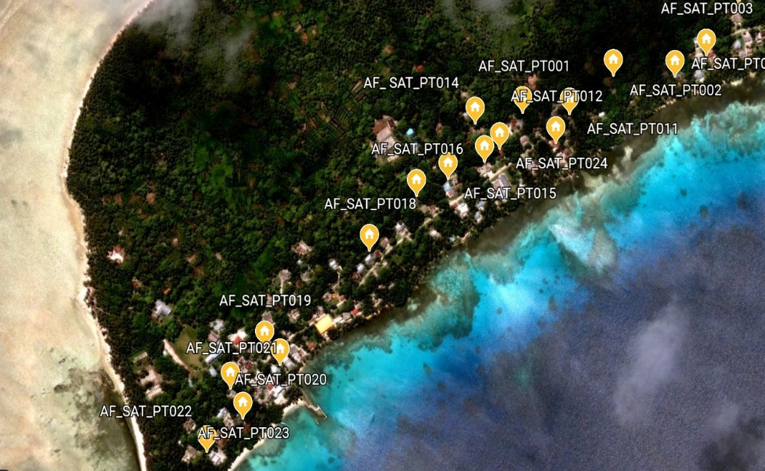
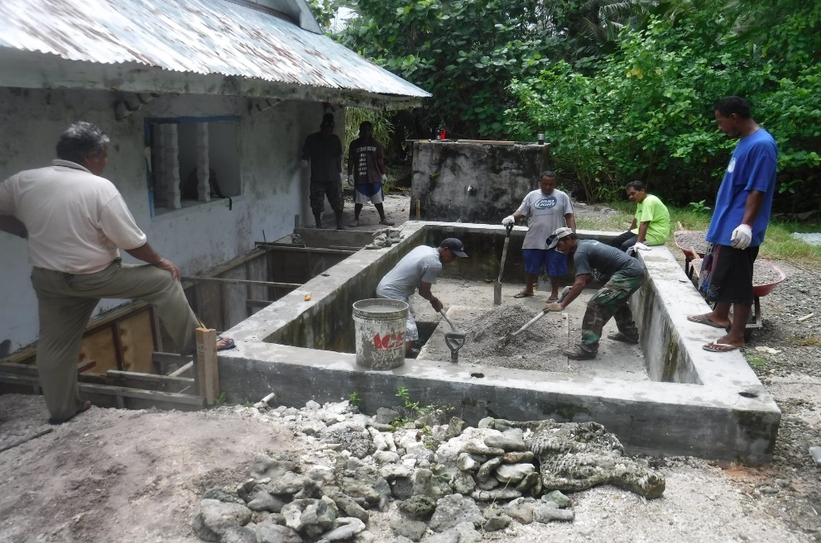
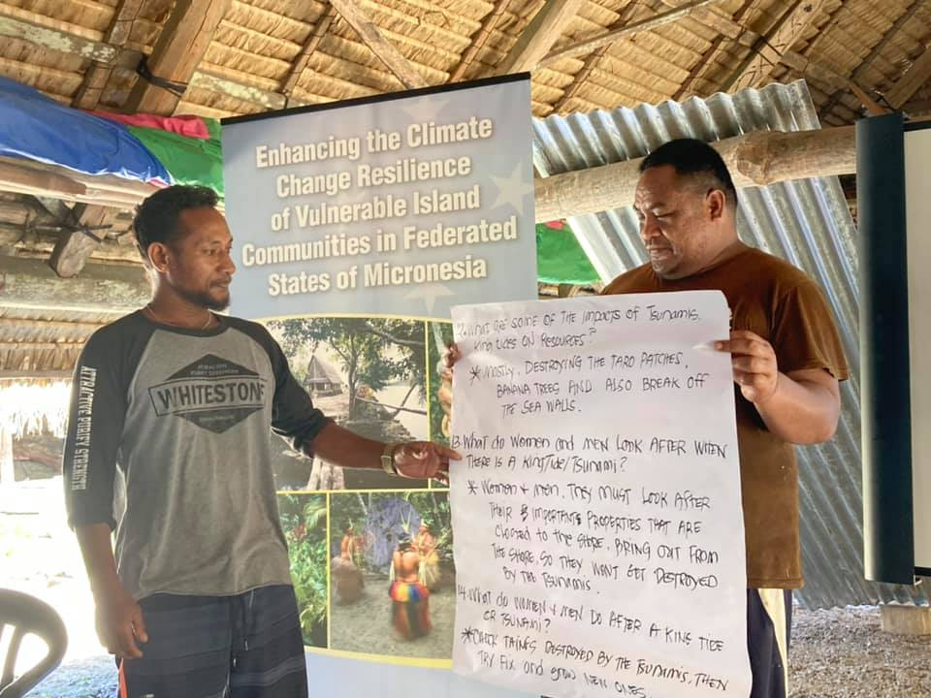
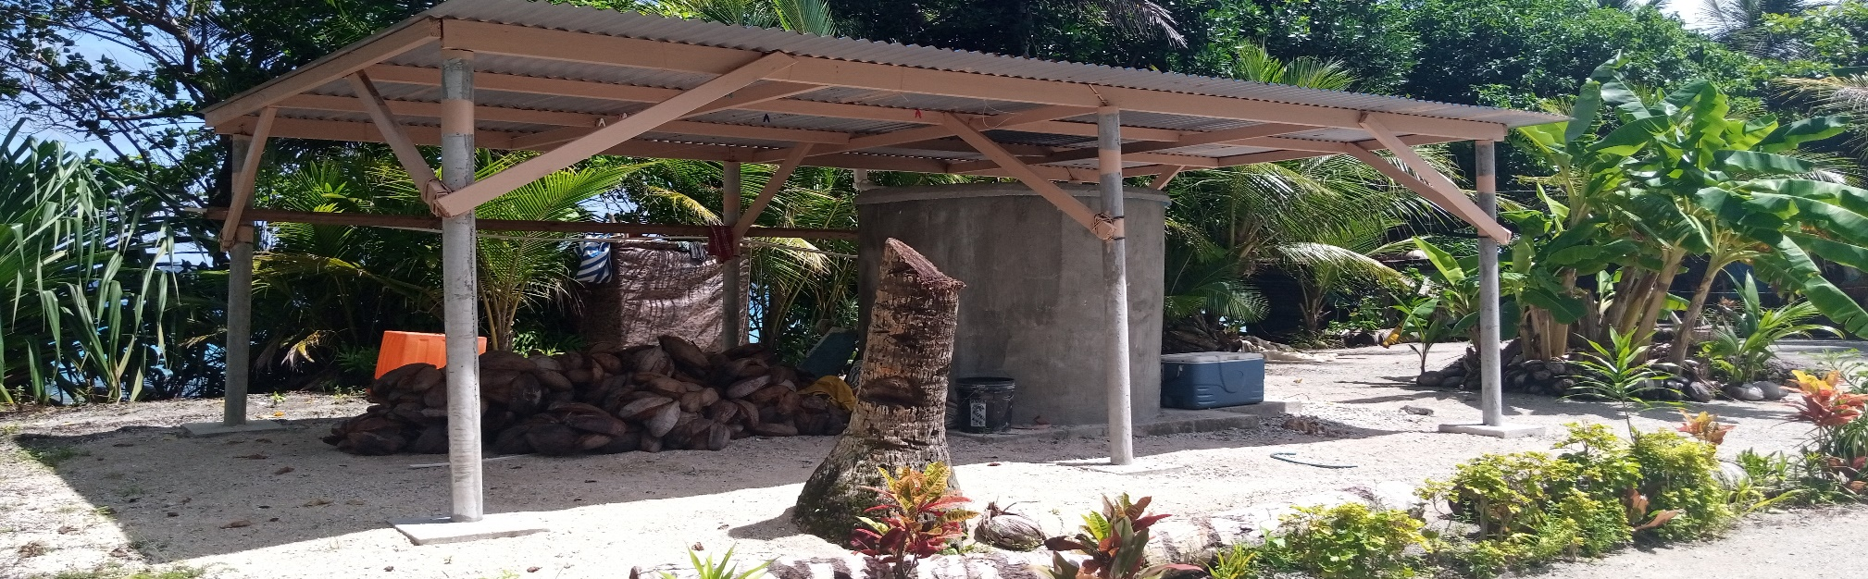
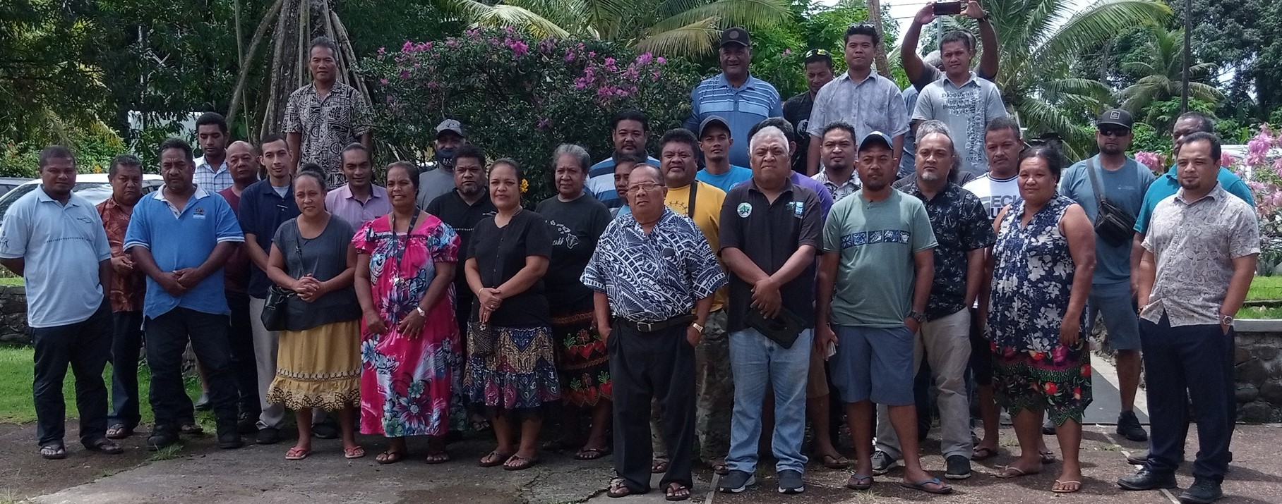
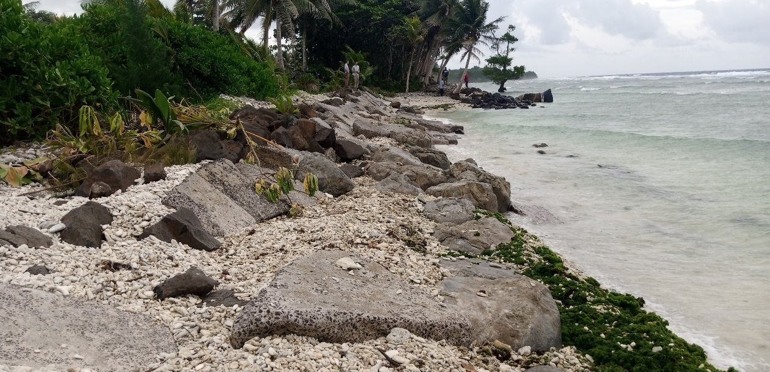




Progress since 2018
“Enhancing Synergies for a Resilient Tomorrow”
Achievements and Progress
  Legislative review for national and state institutional and policy frameworks
  AF Project
    sites registered on GIS/GPS
    Community involvement
  YAP, CHUUK, POHNPEI
    WATER INFRASTRUCTURE improvement, renovations, and repairs.
  POHNPEI
    WATER MANAGEMENT PLAN for Kapingamarangi and Nukuoro completed
  KOSRAE
    Environment & Social Impact Assessment (ESIA) for coastal protection work drafted
    Inland road design in final stages of completion

Slide 3
“Enhancing Synergies for a Resilient Tomorrow”
Ongoing and upcoming projects and activities
  (ON-GOING) Repairs and improvements to Water Harvesting and Storage Systems (WHSS) in Woleai & Eauripik (YAP), Satowan & Lekinioch (CHUUK), and Nukuoro & Kapingamarangi (POHNPEI)
  (ON-GOING) New installations of WHSS at AF Project target sites of Yap, Chuuk, and Pohnpei
  (UPCOMING) Coastal protection work for Mosral & Paal in Kosrae
  (UPCOMING) Self Composting Toilets for target sites of Yap, Chuuk, and Pohnpei
  (UPCOMING) Target sites visits to monitor and evaluate progress of project

Slide 4
“Enhancing Synergies for a Resilient Tomorrow”
Challenges
  COVID-19
    Travel restrictions
      Limited travel to target sites
      Restricted travel into the FSM
  Limited in-country suppliers/supplies
    Local vendors run out of supplies required by the project
      Next regular shipment takes time
      Special orders take time
  Sea transportation
    Travel opportunities are tied to the availability of sea vessels

Slide 5
“Enhancing Synergies for a Resilient Tomorrow”
Opportunities for collaboration / Next Steps
  Collaborate with Kosrae stakeholders for the coastal protection work
  Collaborate with Department Of Education (DOE) of Yap, Chuuk, and Pohnpei for the installation/construction of Self-Composting Toilets (SCT) at elementary school locations of AF Project’s target communities
  Increase the involvement of relevant agencies/partners/department members to perform tasks specific to their technical expertise during target site visits.

Slide 6
“Enhancing Synergies for a Resilient Tomorrow”
Recommendations
  Joint stakeholders project sites visit
  Encourage and strengthen community involvement in project activities
  Governments and communities to adopt and sustain projects that address the effects of Climate Change

Slide 7
“Enhancing Synergies for a Resilient Tomorrow”
Thank you

