Slide 1
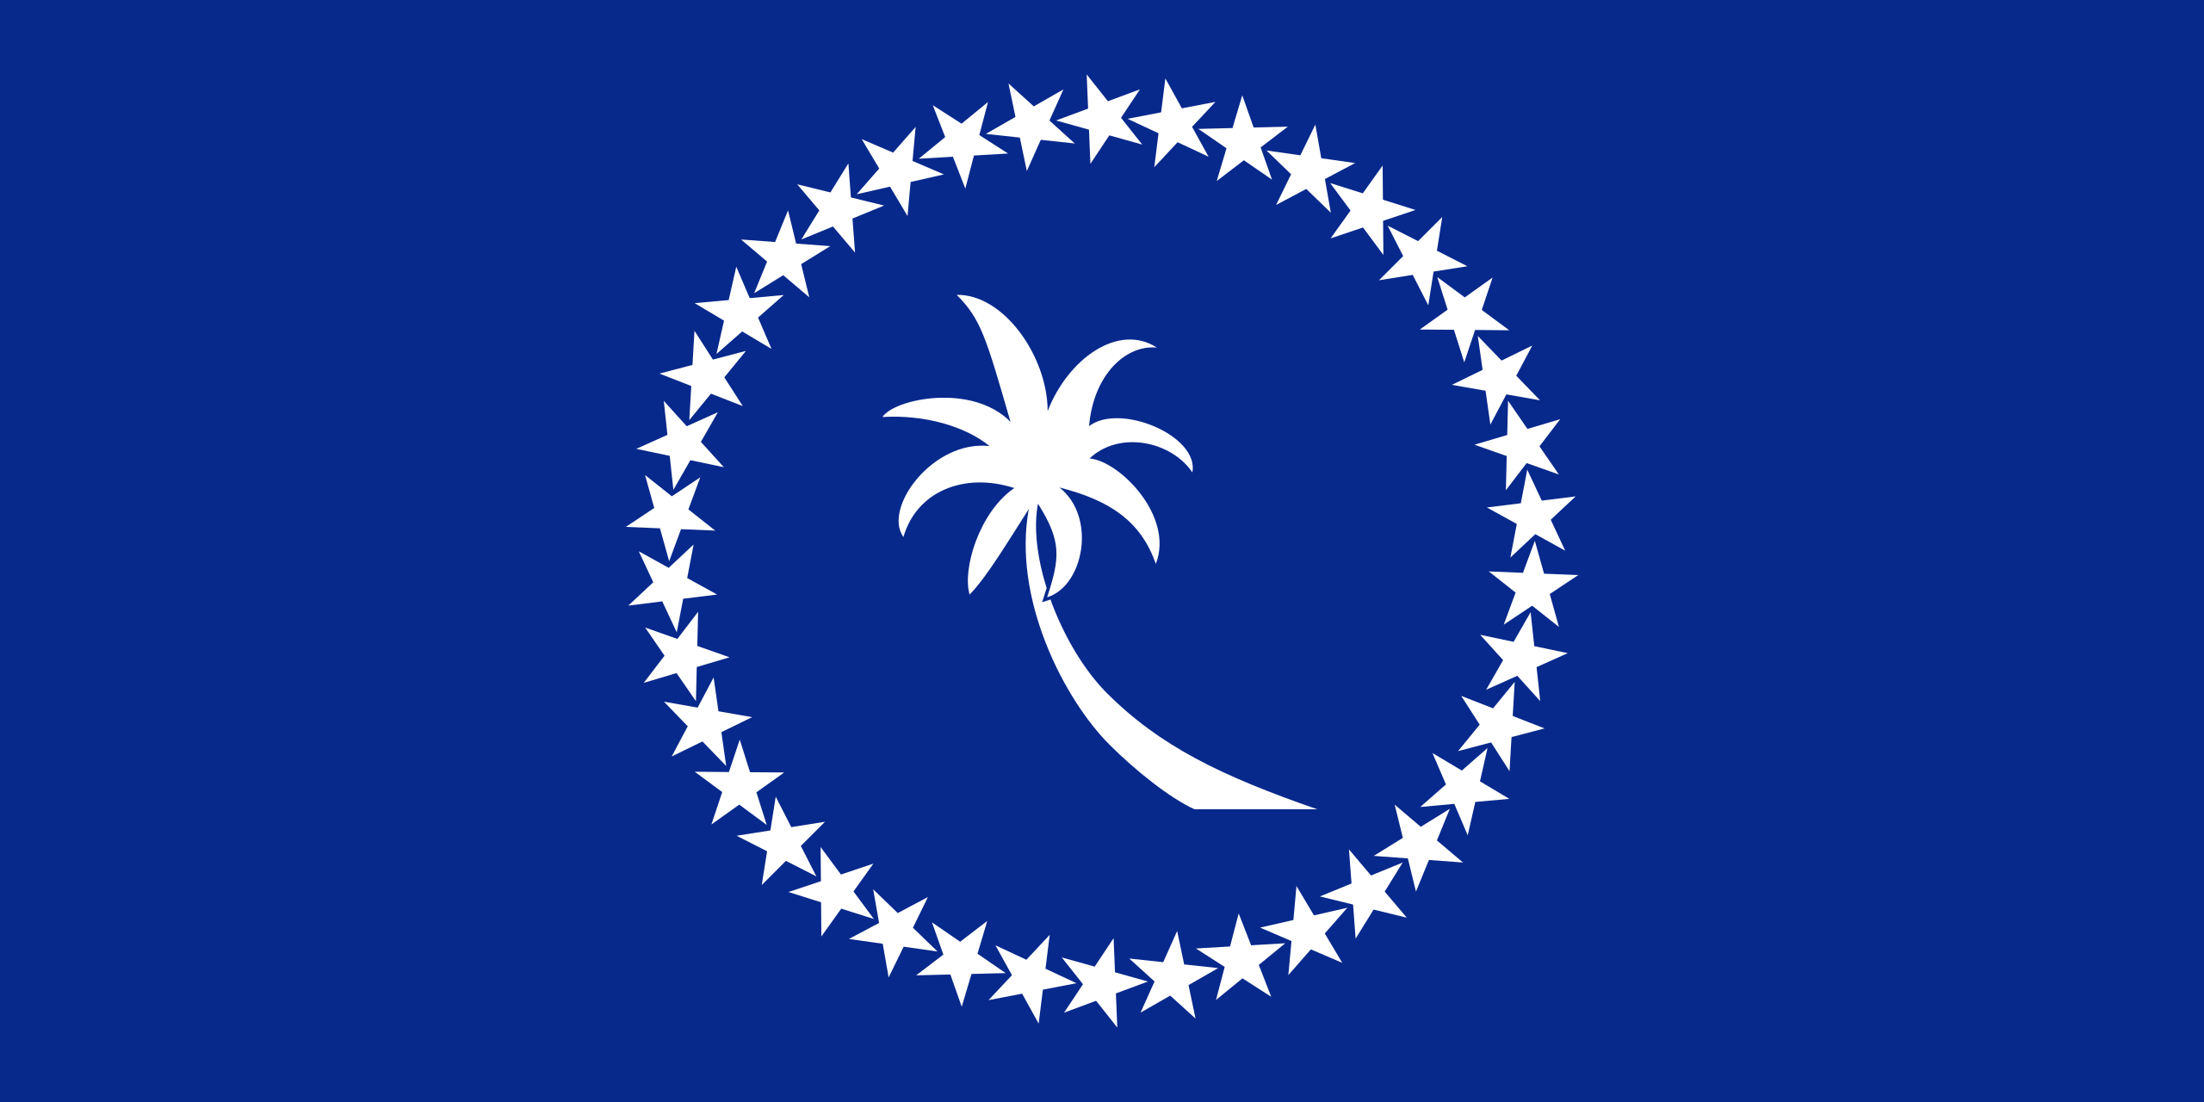
3rd Joint Environment and Risk Management Platform
“Enhancing Synergies for a Resilient Tomorrow”
8.1 Micronesia Challenge 2030
Dave Mathias, Marine Conservation Management Specialist, FSM R&D
August 30-September 1, 2023
Weno, Chuuk

Slide 2
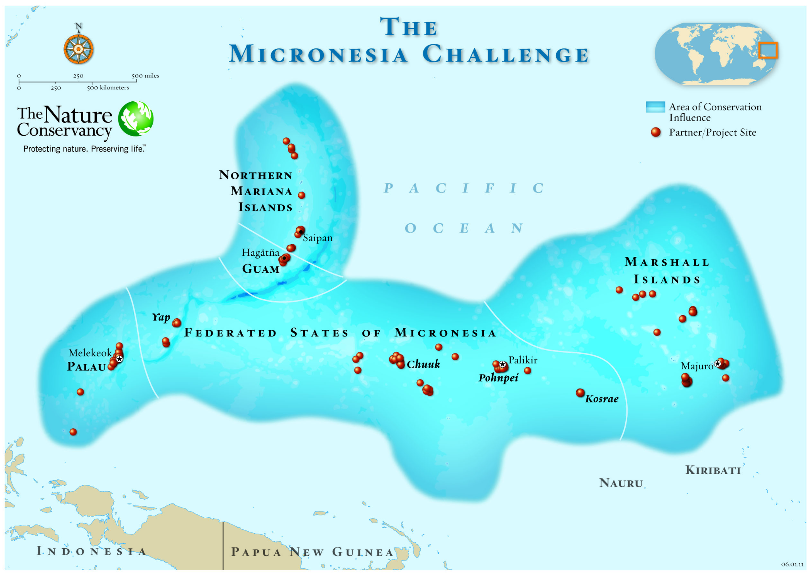
“Enhancing Synergies for a Resilient Tomorrow”

Slide 3
“Enhancing Synergies for a Resilient Tomorrow”
Progress since 2018
MC Measures – Standardized databases and monitoring protocols across the region
MC Evaluation completed in 2020
Recommitted to the Micronesia Challenge 2030
FSM Endowment Contribution - $5.4 million to date
Target goal – $29 million
Notes:
REGIONAL ACCOMPLISHMENTS OF THE MC:
3,000+ locals trained
72 management and climate adaptation plans developed
65 socio-economic assessments completed
70+ new areas for conservation
20 new fisheries management policies enacted
Standardized monitoring protocols
New MC targets:
Effectively manage 50% marine resources and 30% terrestrial resources
Sustainable livelihoods
Climate change resilience
Reduction of invasive species
Enforcement and compliance
Fisheries management

Slide 4
“Enhancing Synergies for a Resilient Tomorrow”
Ongoing and upcoming projects and activities
New regional coordinator hired in 2022 – Ms. Lincy Lee Marino, based in Palau
GEF7-IWP MC 2030 project ”Strengthening and Enabling the Micronesia Challenge Regional Office”
Subgrants to FAS jurisdictions to carry out national project outcomes
FSM – Operationalization of FSM PAN, MC 2030 Strategic Plan development
MCRO Strategic Action Plan Workshop to be held September 2023
MC Communications Plan – in progress (September 2023)
Capacity Building Efforts
MIC Re-launch, learning exchanges

Slide 5
“Enhancing Synergies for a Resilient Tomorrow”
Challenges
Fully operationalizing the MCRO
Institutionalize the MC into job TORs and have designated personnel working on MC
Political focal points need to be formally appointed
Building and maintaining local technical capacity for conservation across the region
New MC 2030 Measures and target definitions

Slide 6
“Enhancing Synergies for a Resilient Tomorrow”
Opportunities for collaboration
Implementation of Protected Area Network (PAN) and Blue Prosperity Micronesia (BPM)
FSM PAN / MC National Coordinator
Implementation of grants supporting operationalization of FSM PAN and planning for MC 2030
Continued support for capacity building efforts
Academic and technical
Fellowships/internships

Slide 7
“Enhancing Synergies for a Resilient Tomorrow”
Recommendations
Collaborate/support on launch and operationalization of FSM Protected Area Network
Collaborate/support and continue planning and implementation of MC 2030
Collaborate/support and continue implementation of BPM and Marine Spatial Planning process

Slide 8
“Enhancing Synergies for a Resilient Tomorrow”
Thank you

