Slide 1
3rd Joint Environment and Risk Management Platform
“Enhancing Synergies for a Resilient Tomorrow”
7.5 SUPA IA
Kohsak Keller Jr., Program Manager for Adaptation, DECEM
August 30-September 1, 2023
Weno, Chuuk

Slide 2
“Enhancing Synergies for a Resilient Tomorrow”
Impact Analysis Methodology:
Based on profiling the history of adaptation, detailed data collection
and analysis to make sense of impact.
Checklist Rating
Field Observation
Social Surveys
Spatial Analysis

Slide 3
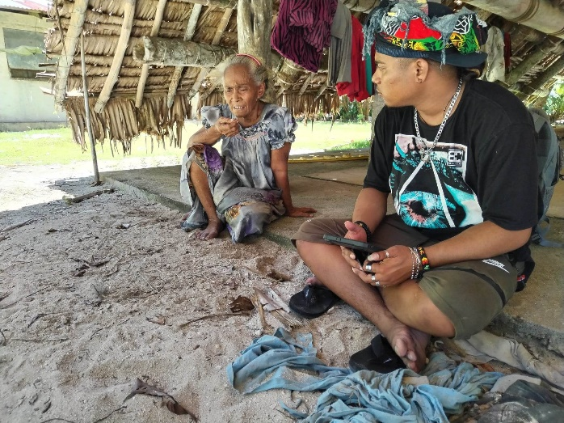
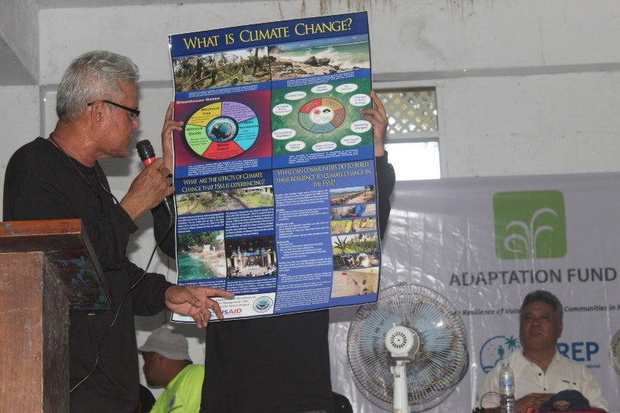
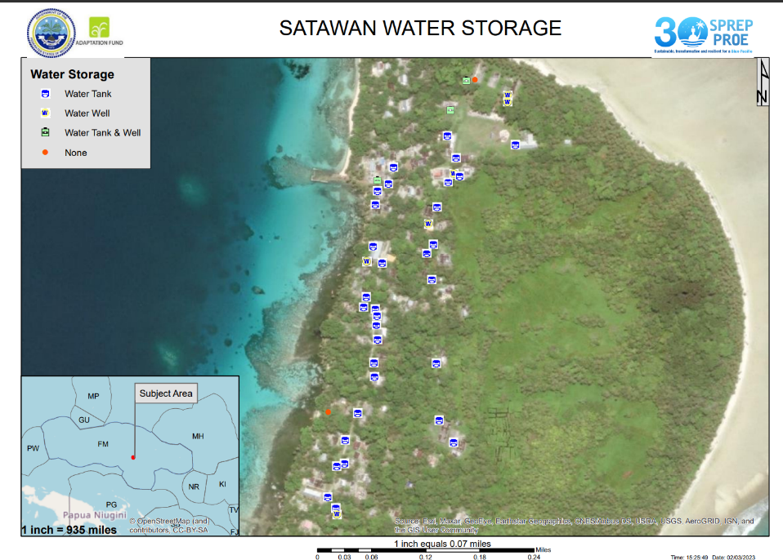
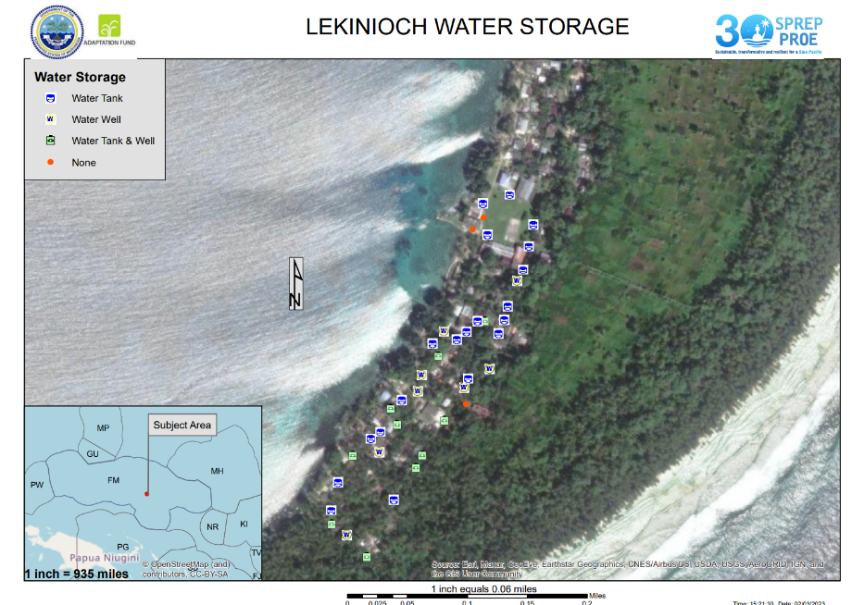
“Enhancing Synergies for a Resilient Tomorrow”
Impact Assessments
Surveys:
Focus Group Discussion
Household Survey
Spatial Analysis
Mapping of all the sites

Slide 4
“Enhancing Synergies for a Resilient Tomorrow”
Challenges
Transportation
Community Functions
Availability of the household owners
Notes:
2. Delays due to community functions

Slide 5
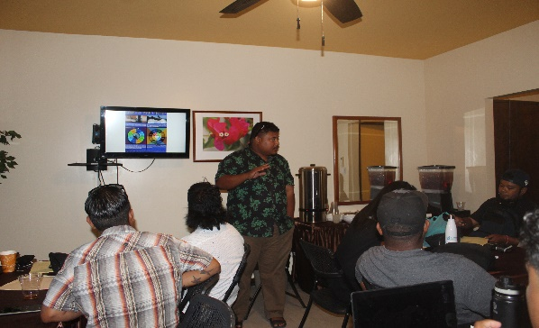
“Enhancing Synergies for a Resilient Tomorrow”
Opportunities for collaboration
Can be applied to any project
Project documents stored online
Past project interventions
Database repository

Slide 6
“Enhancing Synergies for a Resilient Tomorrow”
Thank you

