Slide 1






3rd Joint Environment and Risk Management Platform
“Enhancing Synergies for a Resilient Tomorrow”
7.3 FSM NAP Proposal to the GCF
Correy Abraham, DAS for Adaptation, DECEM
August 30-September 1, 2023
Weno, Chuuk

Slide 2




“Enhancing Synergies for a Resilient Tomorrow”
Brief Background on FSM National Adaptation Plan (NAP) Proposal
  The NAP process was developed under the United Nations Framework convention on Climate Change to help countries conduct comprehensive medium and long term adaptation planning
  It is a flexible process that builds on our existing adaptation activities and helps integrate climate change into national decision making processes
  We expect that our NAP will lead to increased coordination and investments in climate adaptation with the ultimate objective to reduce FSM’s vulnerability to climate impacts, therefore
  The Federated States of Micronesia(FSM) has decided to submit a NAP proposal to the GCF valued at an amount of USD 3 million and implemented over a 5 year period thereafter
Notes:
To keep in mind that our National Adaptation Plan builds on existing Adaptation planning and will feed into our National and State Prioritites

Slide 3
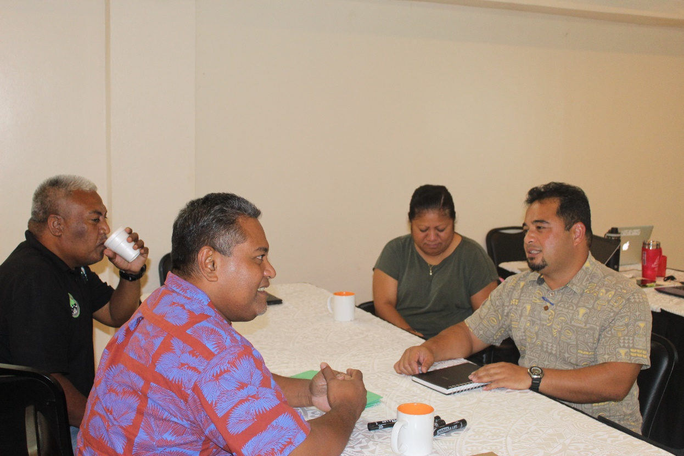
Progress since 2019
“Enhancing Synergies for a Resilient Tomorrow”
  In April 2019, the Government of FSM through FSM DECEM officially requested SPREP to be their delivery partner for the development and implementation of our National Adaptation Plan Proposal to the GCF
  In October 2019, a consultation stakeholder meeting was held in Pohnpei. The mission was designed to plan for and inform the preparation of the NAP proposal
  In April 2022, the FSM NAP Proposal was submitted to the GCF board for review
  In September 2022, second resubmission
  In April 2023, third resubmission

Slide 4
“Enhancing Synergies for a Resilient Tomorrow”
Challenges encountered during the development of the NAP Proposal
  COVID 19
    Travel Restrictions
    During the development stages of the proposal, key partners were operating in reduced capacity therefore causing delays of draft submission of the proposal
  New GCF Guidelines
    The NAP Log-Frame and Proposal needs to be revised due to new GCF guidelines resulting in back and forth consultations with FSM and SPREP

Slide 5
“Enhancing Synergies for a Resilient Tomorrow”
Opportunities for collaboration/ next steps
  In May 3, 2023, the GCF Secretariat as approved the Readiness Proposal for the FSM with SPREP as the delivery partner.
  As of this month, the LoA between SPREP and FSM DECEM is underway and the signing of the LoA is expected to be signed during SPREP’s mission to FSM in September 2023.
  SPREP will be working closely with FSM DECEM along with state focal points on the NAP Project team including state-based climate change coordinators.

Slide 6
“Enhancing Synergies for a Resilient Tomorrow”
Recommendations
  Coordination at all levels, awareness raising and capacity building are seen as a high priority
  Ensure a State and Municipal focus, aiming for community participation and ownership
  Strengthen partnership at all levels to maintain and improve coherence between key partners and stakeholders
Notes:
So, as we look forward to the sign off of our Agreement and kick start on our implementation phase of the NAP, we feel the urge to share key recommendations that not only will help better understand what we need to do, but to also fill in the gaps as we move forward in this NAP implementation.

Slide 7
“Enhancing Synergies for a Resilient Tomorrow”
Thank you!

