Slide 1






3rd Joint Environment and Risk Management Platform
“Enhancing Synergies for a Resilient Tomorrow”
7.1 UNFCCC/TNCBUR
Chandra Legdesog, Climate Change Advisor
August 30-September 1, 2023
Weno, Chuuk

Slide 2
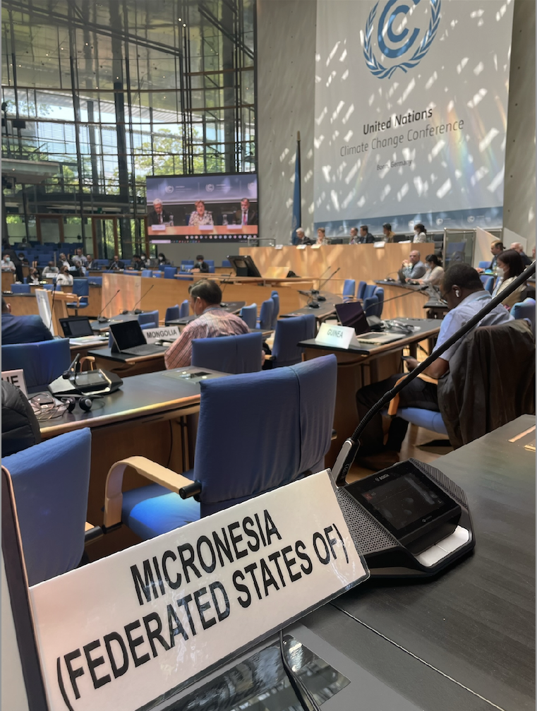




UNFCCC
“Enhancing Synergies for a Resilient Tomorrow”
The United Nations Framework Convention on Climate Change is an international treaty that seeks to stabilize concentrations of greenhouse gases to prevent dangerous human interference with the climate system (1994)
FSM is a Party to the Convention
FSM is not a major emitter however we are at the forefront of climate change impacts

Slide 3
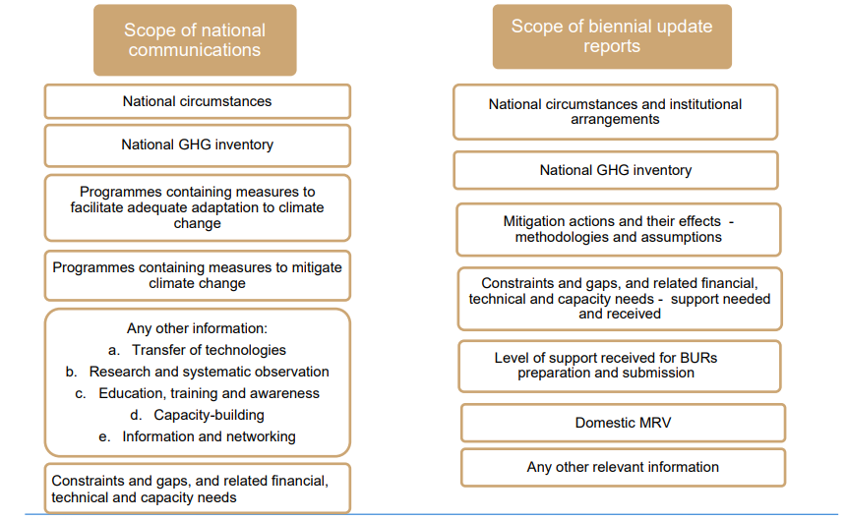
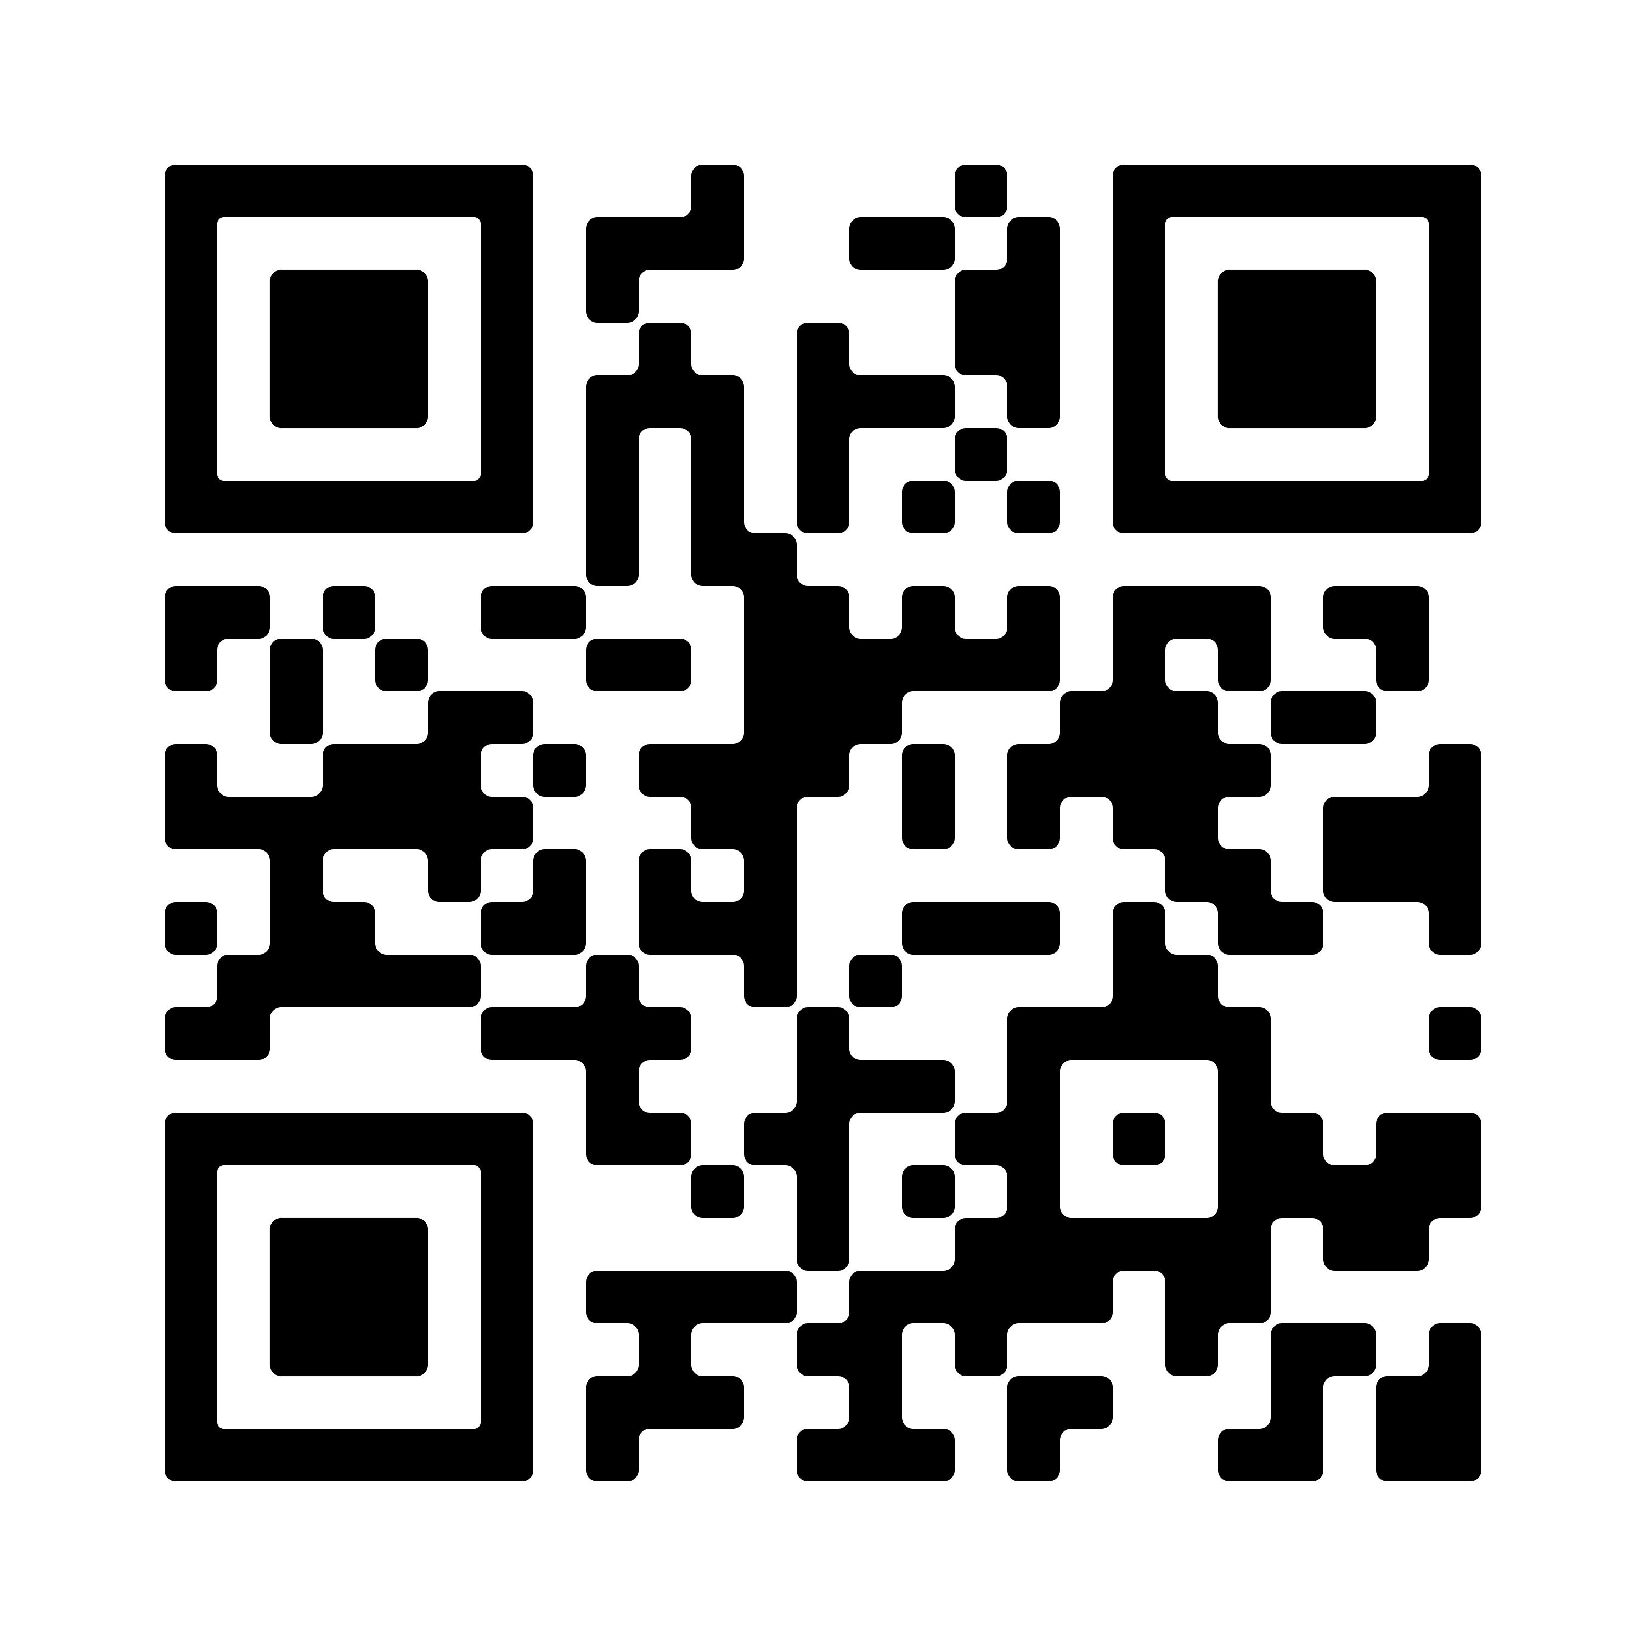


“Enhancing Synergies for a Resilient Tomorrow”
Progress since 2018
  Third National Communication to the UNFCCC (2023)
  First Biennial Update Report to the UNFCCC (2023)

Slide 4
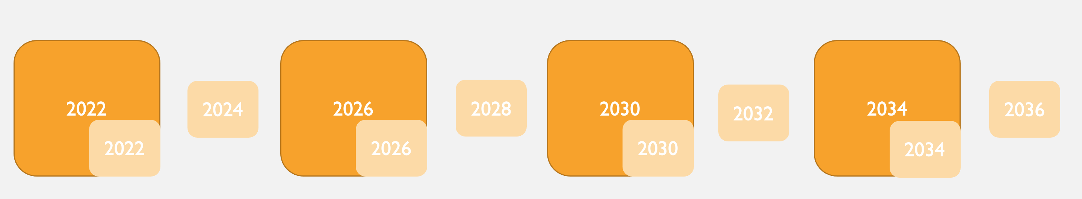
“Enhancing Synergies for a Resilient Tomorrow”
Ongoing and upcoming projects and activities
  National Communications (every 4 years)
  Biennial Update Reports (every 2 years)

Slide 5
“Enhancing Synergies for a Resilient Tomorrow”
Challenges
  Covid-19
  Data availability
  Turnover
  Institutional arrangements

Slide 6
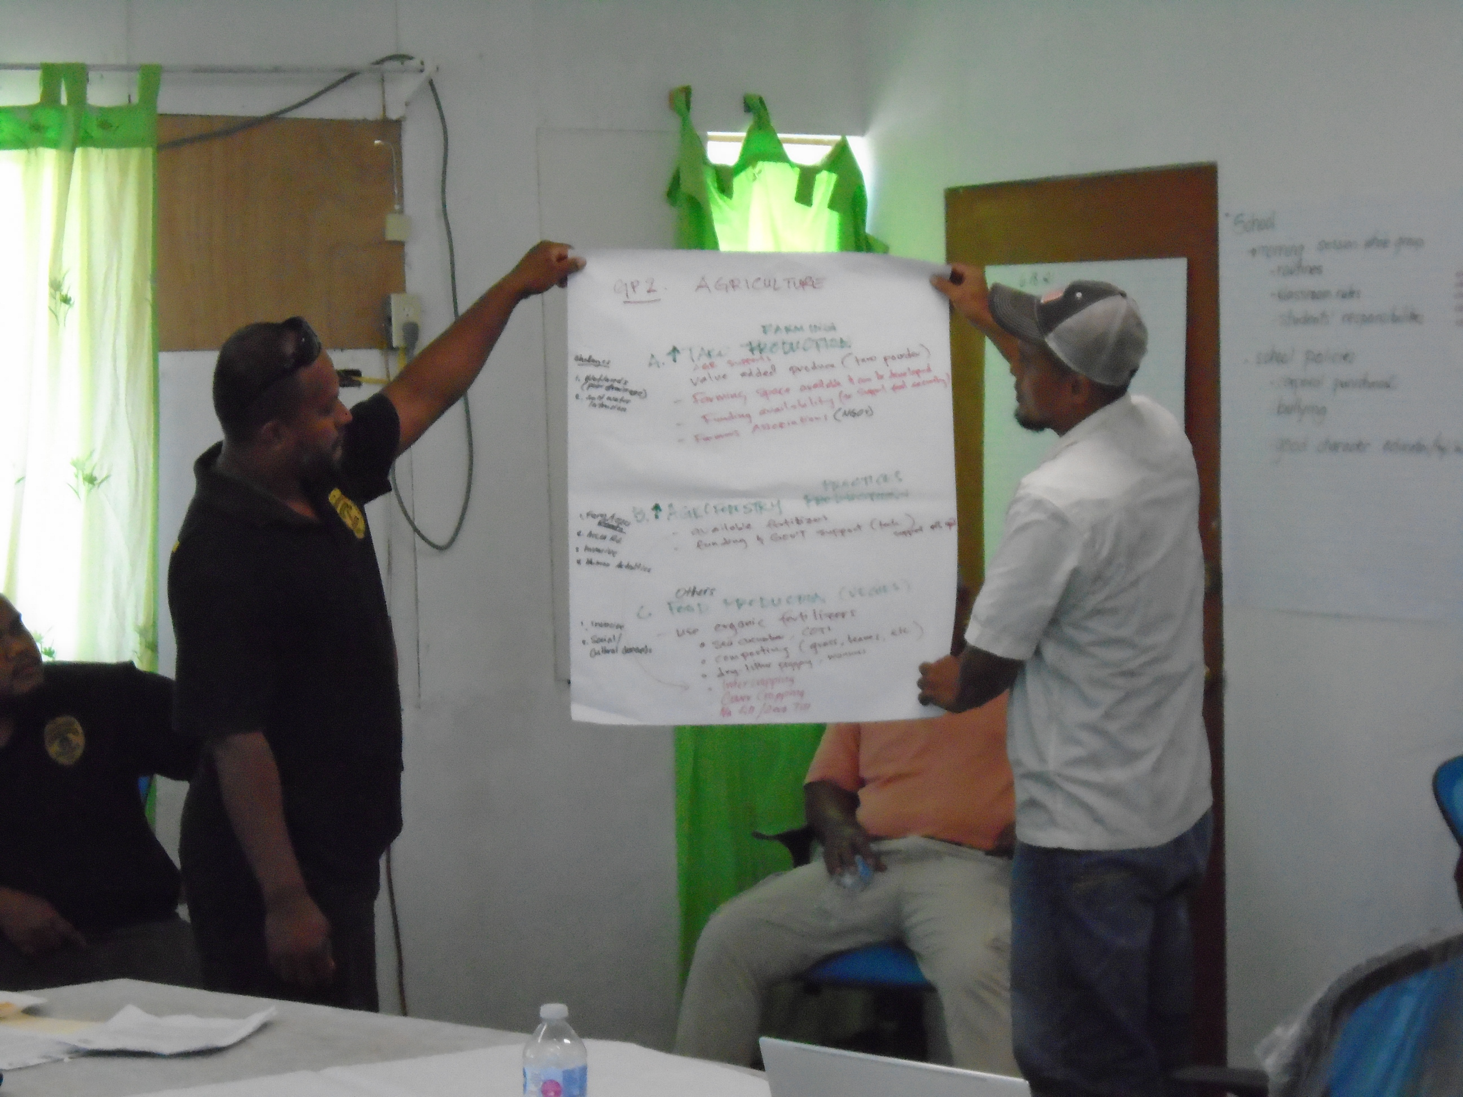
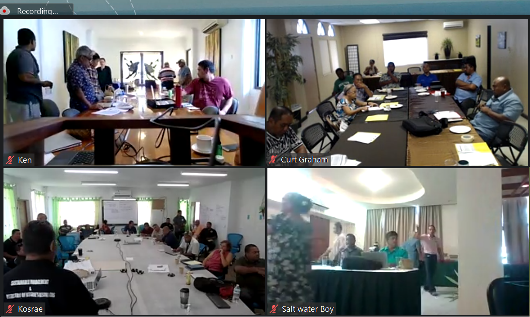
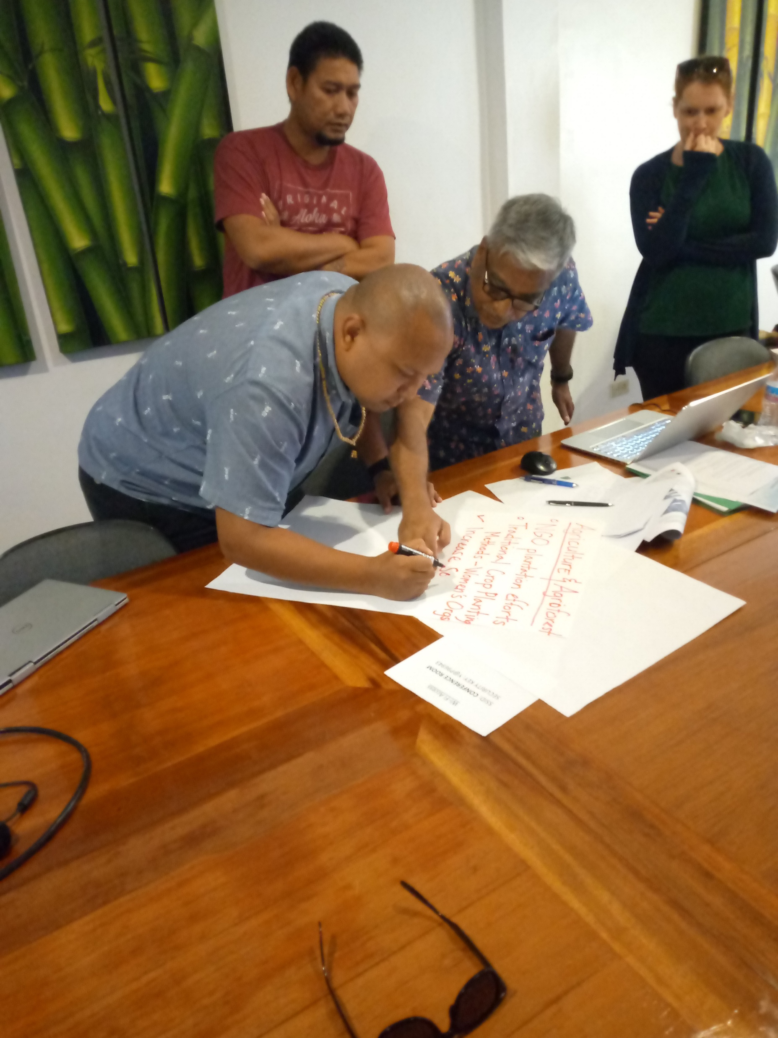
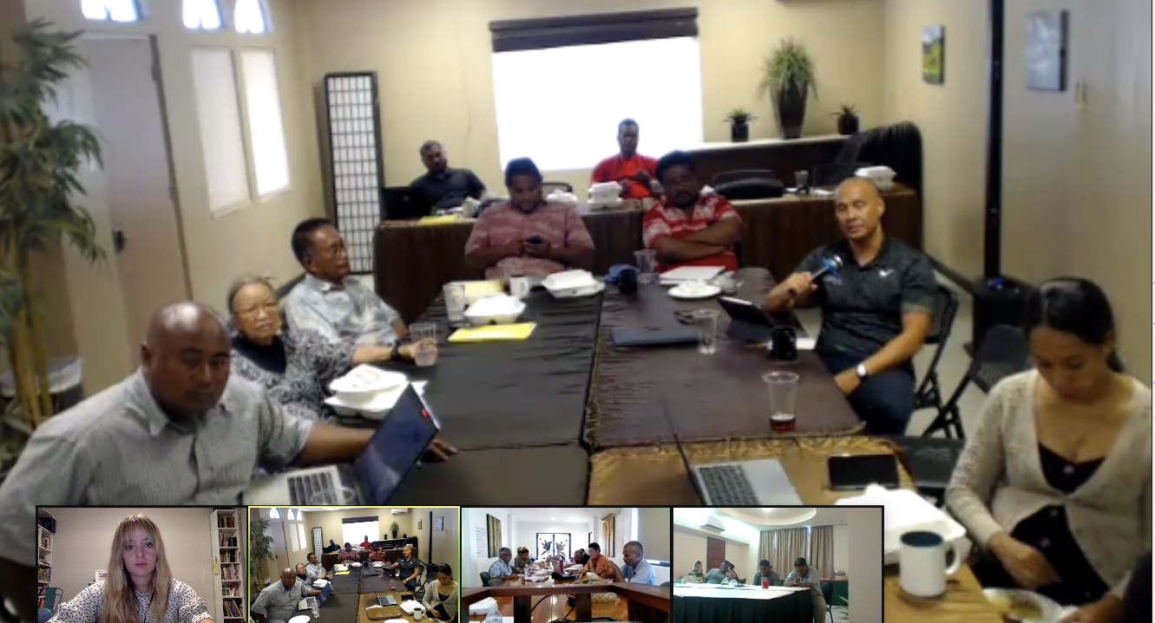
“Enhancing Synergies for a Resilient Tomorrow”
  Opportunities for collaboration
  Consultations, workshops, assessments, trainings, interviews
  State-level engagement
    FSM’s Greenhouse Gas Inventory (2006 IPCC Guidelines) consultations
    2.5-day Mitigation Workshop
    Vulnerability and Adaptation Assessments
    2-day MRV Workshop
    2 half-day Gender Trainings [and] Gender Surveys [and] Gender Interviews
    4 half-day National Circumstances and Institutional Arrangements Workshop

Slide 7
“Enhancing Synergies for a Resilient Tomorrow”
Recommendations
  Establish Central Archive for data storage for future inventories
  Establish renewable energy focal points
    largest emissions sector – Energy - Fuel combustion for electricity generation
    public utilities companies and private sector – supply and demand for EE appliances
    nature-based solutions that have co-benefits - land use planning that protect carbon sinks such as seagrasses, mangroves and ocean.
  Compile vulnerability and adaptation assessments from all sectors in preparation for the NAP
    Infrastructure, environment, agriculture, fisheries, health, education, social/cultural, private sector/economic resilience

Slide 8
“Enhancing Synergies for a Resilient Tomorrow”
Thank you!

