Slide 1
3rd Joint Environment and Risk Management Platform
“Enhancing Synergies for a Resilient Tomorrow”
6.1 GEF 8
Cynthia H. Ehmes, Acting Secretary, DECEM
August 30-September 1, 2023
Weno, Chuuk

Slide 2
Global Environment Facility
“Enhancing Synergies for a Resilient Tomorrow”
The GEF was established in 1991 to forge international cooperation and finance actions to address critical threats to the global environment

Slide 3
“Enhancing Synergies for a Resilient Tomorrow”
CONVENTIONS
COUNCIL
ASSEMBLY
32 Members :
Provides Guidance on Policy & Programme Issues
All 185
18 Recipients
14 Donors
Participants
GEF Council meets every 6 months to review and approve all projects, Work Programmes, Business Plans, policies.
GEF Assembly meets every 4 years to review general policies, operations, and amendments to the GEF Instrument.
14 Pacific Countries plus Philippines, Indonesia and Timor Leste Constituency meets once a year
Current council member: Solomon Islands
FSM Operational Focal Point: Secretary Andrew Yatilman
Political Focal Point: Ambassador Jeem Lippwe

Slide 4
“Enhancing Synergies for a Resilient Tomorrow”

Slide 5
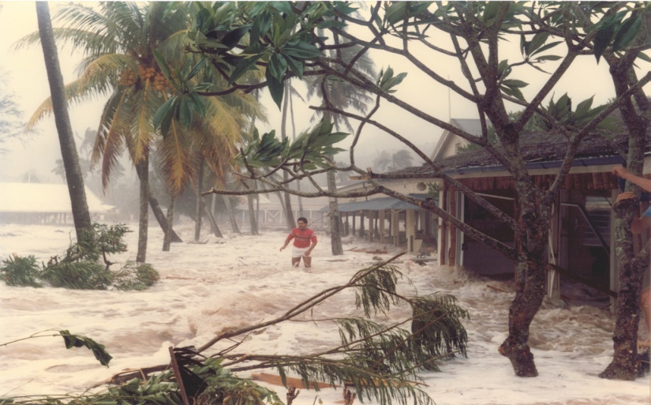
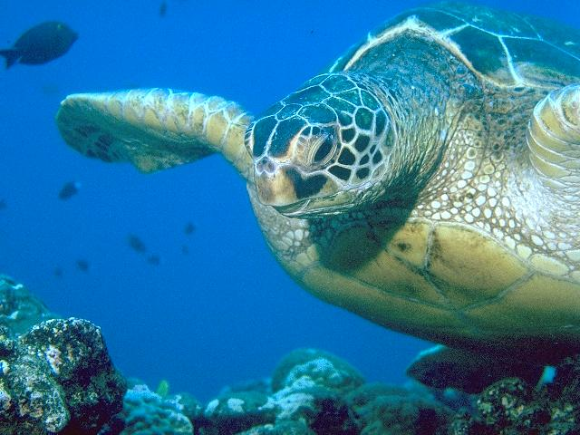
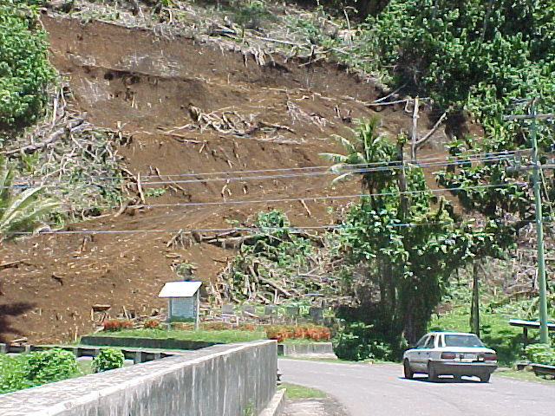
“Enhancing Synergies for a Resilient Tomorrow”
GEF8 STAR ALLOCATION by Country:
(Global benefit, performance index)
9.15M FOR FSM FOR THE 4yr PERIOD
(PNG 29, SI 13, FJ 11) 8M other PICs
2.0m climate change
5.15m biodiversity
2.0m land degradation
FLEXIBILITY RULE ELIGIBLE

Slide 6
GEF 8 STAR $9.15M
“Enhancing Synergies for a Resilient Tomorrow”
Blue Green Islands 3M
Project concept approved (June)
Project sites – Yap and Kosrae
Progressing the work from R2R Project on MPAs and bringing Tourism to support Biodiversity Conservation
IA is IUCN (FSM approached IUCN with a Concept Note to build on R2R)
PPG development (November)
Remaining 6.15M (TBD)
Preliminary consultation on focal area project/concept (now till Dec 2023)
Encourage counterparts and stakeholders to begin internal consultations

Slide 7
“Enhancing Synergies for a Resilient Tomorrow”
Issues:
Timely submission to council meeting
Continued state involvement/ownership
Country driven vs. IA driven
GEF 8 PROJECT (6.15M) | BLUE GREEN ISLANDS (3M)
Identify PROJECT FOCUS by December 2023 | CONSULTANT Contracting by IUCN
Identify the Implementing Agency (currently UNDP) | PPG Phase October…Consultations
PIF by January 2024 Submission of PIF to COUNCIL June 2024 | Submit PROPOSAL for CEO June 2024
PPG Phase after approval (18 months max) PROPOSAL to CEO after Proposal development IMPLEMENTATION could be 2025 | IMPLEMENTATION Target October 2024

Slide 8
“Enhancing Synergies for a Resilient Tomorrow”
BREAKOUT SESSION
GEF8 INTERVENTIONS: 6.15M
Biodiversity: To improve conservation, sustainable use and restoration of natural ecosystems. To effectively implement the Cartagena and Nagoya protocols. To increase mobilization of domestic resources for biodiversity
Climate Change Mitigation: Innovation, technology transfer and enabling policies for mitigation options. Implement FSM NDC
Land Degradation: Sustainable land management, land restoration, address land degradation and drought, improving the enabling policy and institutional framework for land degradation neutrality

Slide 9
“Enhancing Synergies for a Resilient Tomorrow”
Thank you!

