Slide 1
3rd Joint Environment and Risk Management Platform
“Enhancing Synergies for a Resilient Tomorrow”
Center For Excellence in Disaster Management and Humanitarian Assistance (CFE-DM)
James Kenwolf
August 30-September 1, 2023
Weno, Chuuk

Slide 2
Mission
“Enhancing Synergies for a Resilient Tomorrow”
Secretary of Defense
USINDOPACOM
CFE-DM builds crisis response capacity, enhances coordination and collaboration, and strengthens relationships to save lives and alleviate human suffering before, during, and after humanitarian crises. Vision
The Joint Force, allies, and partners are fully prepared to conduct and support foreign humanitarian assistance.
Regional Organizations
Center for Excellence in Disaster Management and Humanitarian Assistance
Other Combatant Commands
US Military Universities and Colleges
UN and other International Humanitarian Organizations
US Civilian Universities
and Colleges
Foreign Civilian Universities and Colleges
Foreign Military Universities and Colleges

Slide 3
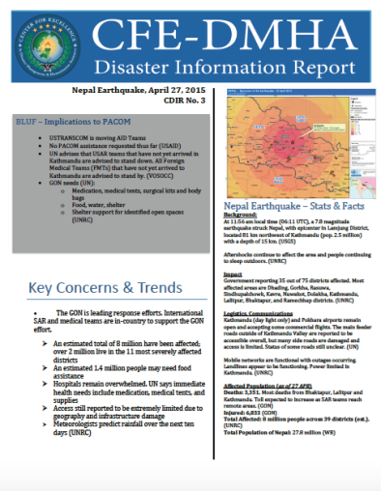
Advise & Assist
“Enhancing Synergies for a Resilient Tomorrow”
Advise USINDOPACOM leaders in disaster management and humanitarian assistance decision-making
Assist commanders with the integration of disaster management and humanitarian assistance capacities and resources
Work collaboratively throughout the joint interagency, intergovernmental, and international communities
Support of U.S. Agency for International development Bureau for Humanitarian Assistance (USAID/BHA)
Execute CFE-DM SOP for Disaster Response in real-world events

Slide 4
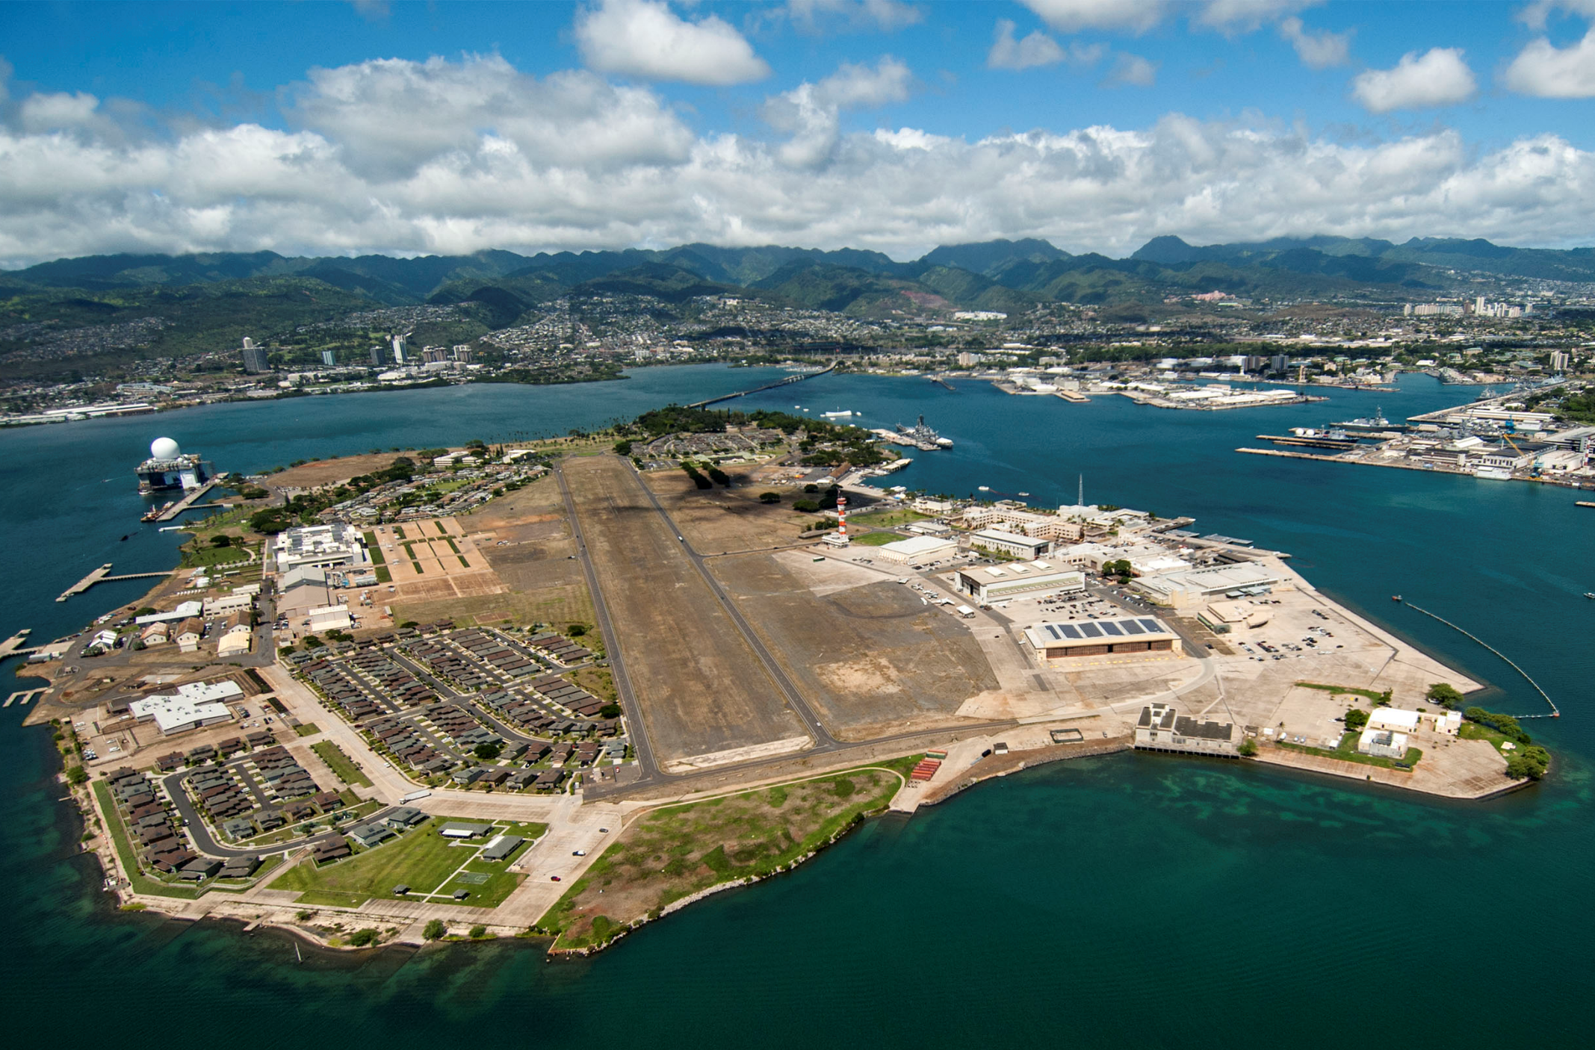
“Enhancing Synergies for a Resilient Tomorrow”
CFE-DM STRUCTURE
Activities enhance the awareness, understanding, and capabilities that help both military and civilian partners plan and conduct operations that support and facilitate disaster response, humanitarian assistance, climate change and strengthen civil-military coordination.
Training & Engagements
Plans, Programs, & Analysis
Applied Research & Information Sharing
Climate Change Impact Program
Quick Facts
Located at Pearl Harbor, HI
DoD organization
Global mandate
All civilian staff

Slide 5
“Enhancing Synergies for a Resilient Tomorrow”

Slide 6
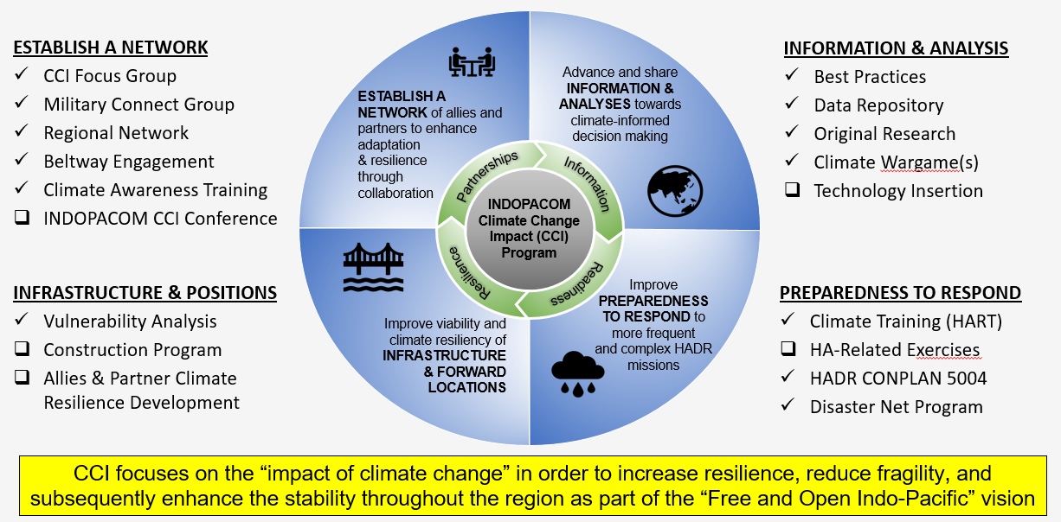
Climate Change Impact Program - CCI

Slide 7
“Enhancing Synergies for a Resilient Tomorrow”

Slide 8
“Enhancing Synergies for a Resilient Tomorrow”

Slide 9
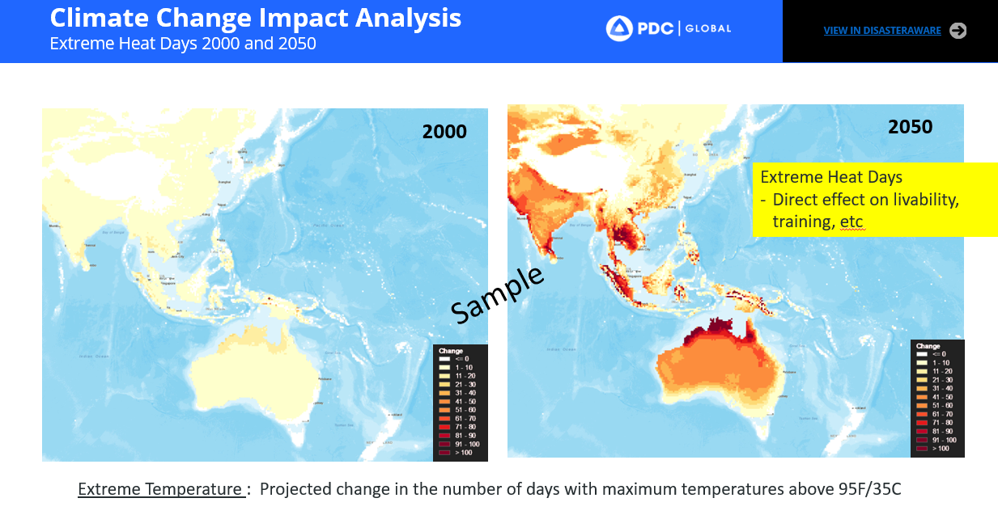
“Enhancing Synergies for a Resilient Tomorrow”

Slide 10
“Enhancing Synergies for a Resilient Tomorrow”

Slide 11
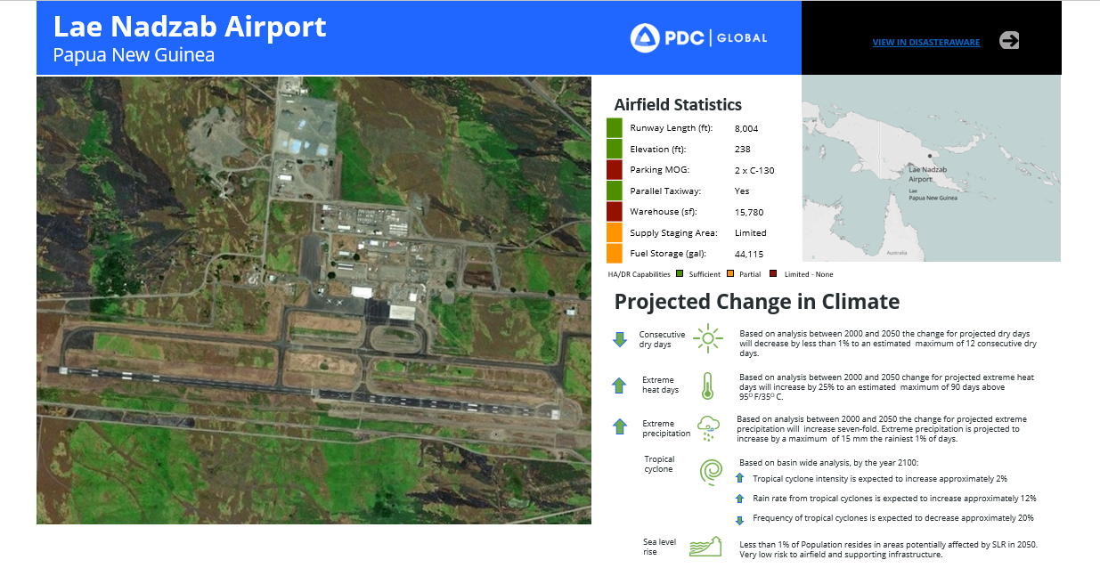
“Enhancing Synergies for a Resilient Tomorrow”

Slide 12
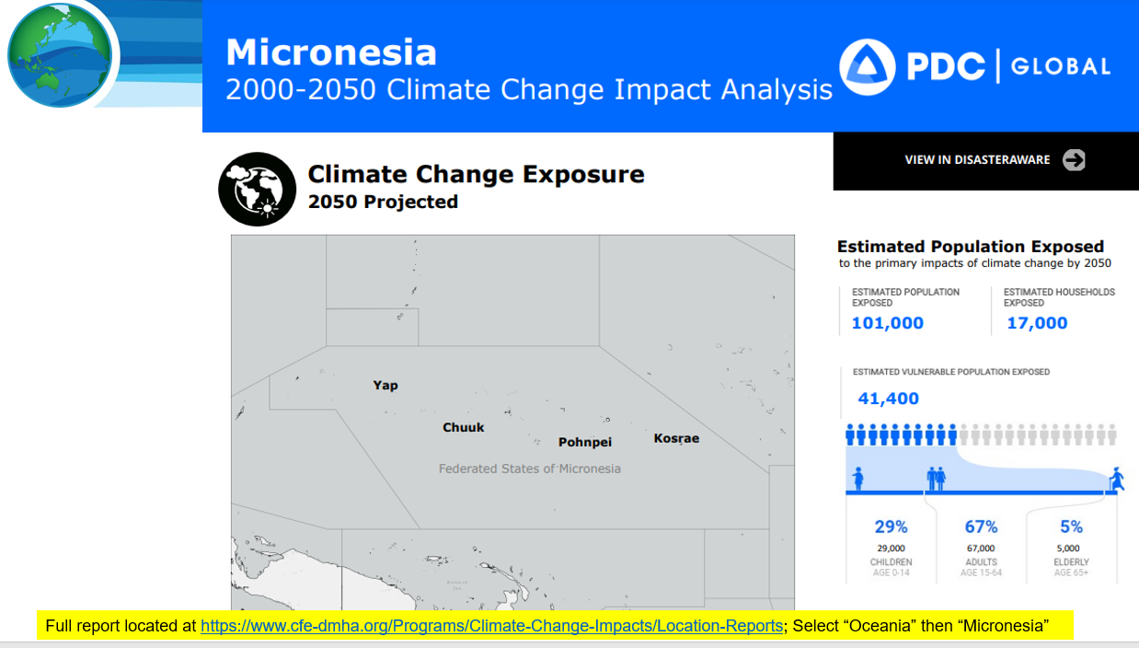
“Enhancing Synergies for a Resilient Tomorrow”

Slide 13
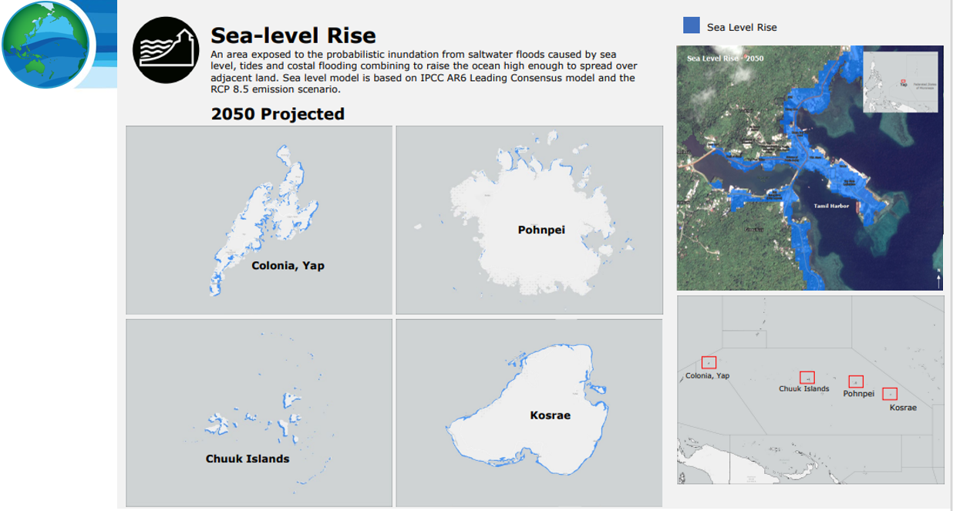
“Enhancing Synergies for a Resilient Tomorrow”

Slide 14
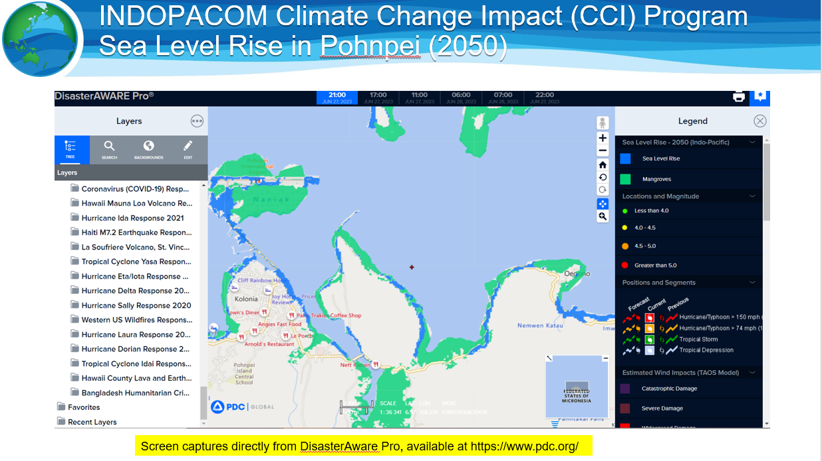
Sea Level Rise in Pohnpei (2050)
“Enhancing Synergies for a Resilient Tomorrow”

Slide 15
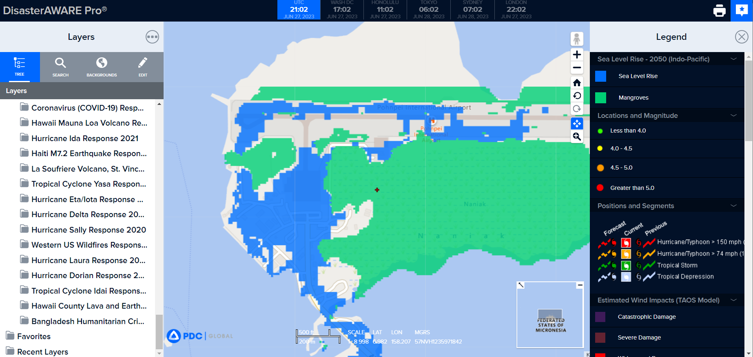
Sea Level Rise in Pohnpei (2050)
“Enhancing Synergies for a Resilient Tomorrow”

Slide 16
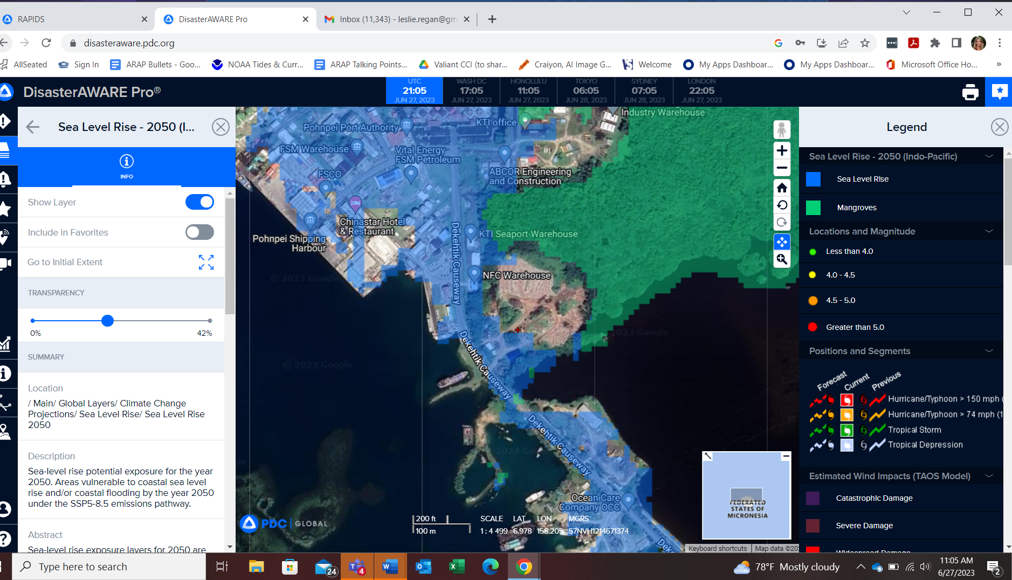
Sea Level Rise in Pohnpei (2050)
“Enhancing Synergies for a Resilient Tomorrow”

Slide 17
“Enhancing Synergies for a Resilient Tomorrow”
How to access CFE-DM Climate Change Impact information
Homepage: https://www.cfe-dmha.org/
Publications: https://www.cfe-dmha.org/Publications
Disaster Reference Handbooks (28 total):
https://www.cfe-dmha.org/Publications/Disaster-Management-Reference-Handbooks
FSM-Specific Disaster Reference Handbook:
https://www.cfe-dmha.org/LinkClick.aspx?fileticket=JW1yRA1G7MU%3d&portalid=0
Climate Change Impact Program: https://www.cfe-dmha.org/climate-change-impacts
Location Reports (select Oceania, then Micronesia for series of reports and products)
https://www.cfe-dmha.org/Programs/Climate-Change-Impacts/Location-Reports

Slide 18
“Enhancing Synergies for a Resilient Tomorrow”
Way Ahead with FSM
In response to ADM Aquilino visit in March
Disaster Response Preparedness
Supporting USAID-sponsored IOM program
Directed efforts to FSM and DECEM
Climate work with USAID and DECEM
User-access to produce Location Specific analytics (airports, seaports, etc)
Resilience Workshops starting with Pacific Partnership 2024 and beyond

Slide 19
“Enhancing Synergies for a Resilient Tomorrow”
THANK YOU!
Questions/Comments

