Slide 1






3rd Joint Environment and Risk Management Platform
“Enhancing Synergies for a Resilient Tomorrow”
5.2 COORDINATION UNIT
Cynthia H. Ehmes, Acting Secretary, DECEM
August 30-September 1, 2023
Weno, Chuuk

Slide 2
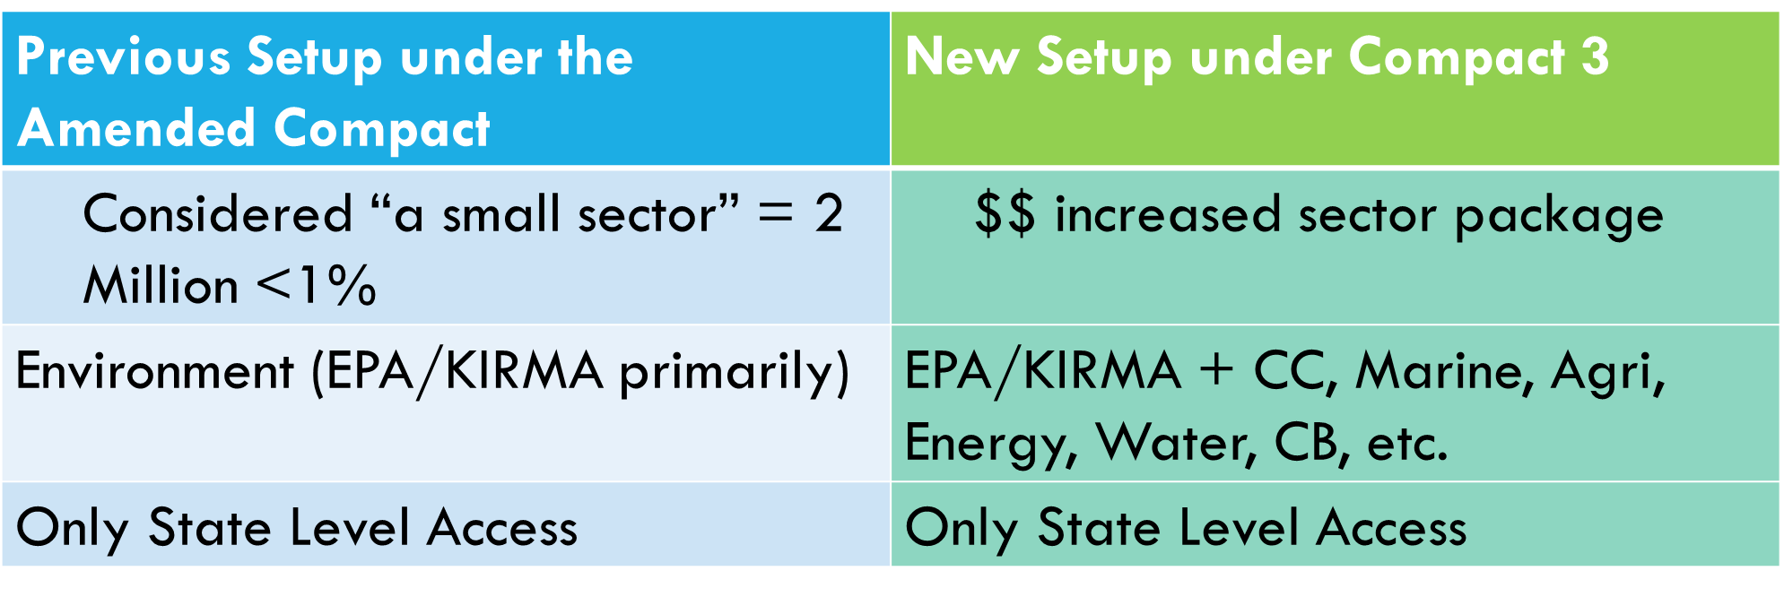




“Enhancing Synergies for a Resilient Tomorrow”
Compact changes for environment sector
Expanded sector/increased $/across 4 states =
packaging, Coordination, reporting, m&E, national alignment
(support for new setup)

Slide 3
“Enhancing Synergies for a Resilient Tomorrow”
“NEW COMPACT” SUPPORT STRUCTURE with national COORDINATION/REPORTING UNIT
YAP Work Group & Focal point/State Coordinator
CHUUK Work Group & Focal Point /State Coordinator
POHNPEI Work Group & Focal Point /State Coordinator
KOSRAE Work Group & Focal Point /State Coordinator
PMU
FSM National Working Group & Focal Point/Coordination Unit
COMPACT Management
THIRD PARTY REPORTING UNIT

Slide 4
“Enhancing Synergies for a Resilient Tomorrow”
Main Functions of the Coordination unit
Provide support to the development of State workplans
  Package budget proposal
Capacity Building of state personnel
M&E
  Timely monitoring
Reporting
  Quarterly/Annual progress reports
National Alignment
  Sustainable Development Goals/SDP/State Of Environment Report/Climate Change Policy/Solid Waste Management Plans
  Global Environment Facility, Green Climate Fund, Adaptation Fund, Other donors
  Unit can expand or dissolve depending on the need as implementation progressed

Slide 5
“Enhancing Synergies for a Resilient Tomorrow”
Thank you!
Notes:
So, as we look forward to the sign off of our Agreement and kick start on our implementation phase of the NAP, we feel the urge to share key recommendations that not only will help better understand what we need to do, but to also fill in the gaps as we move forward in this NAP implementation.

