Slide 1






3rd Joint Environment and Risk Management Platform
“Enhancing Synergies for a Resilient Tomorrow”
3.7 Enhancing Disaster and Climate Resilience in the FSM
Yoko Ebisawa, Project Manager, UNDP
August 30-September 1, 2023
Weno, Chuuk

Slide 2




“Enhancing Synergies for a Resilient Tomorrow”
Enhancing Disaster and Climate Resilience through Improved Disaster Preparedness and Infrastructure (EDCR) project
Donor: Government of Japan Total Resource: USD 7,400,000 Duration: Mar 2029 – Sep 2023
Partner: DECEM, DCOs, Pohnpei Department of Safety, Kosrae Fire Department, Kosrae Public Safety, CPUC, SYWA
Objectives:
To effectively address the consequences of, and responses to, geo-physical and climate-related hazards to protect lives, sustain livelihoods, preserve the environment and safeguard the economy
Components:
1. Strengthened gender sensitive disaster communication and climate monitoring system
2. Enhanced gender sensitive national and state disaster responders readiness capacity
3. Enhanced community disaster resilience through improved water resource management, and integrated gender and social inclusion awareness

Slide 3
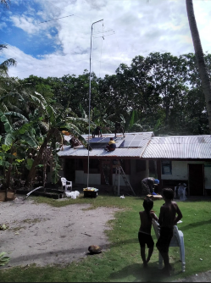
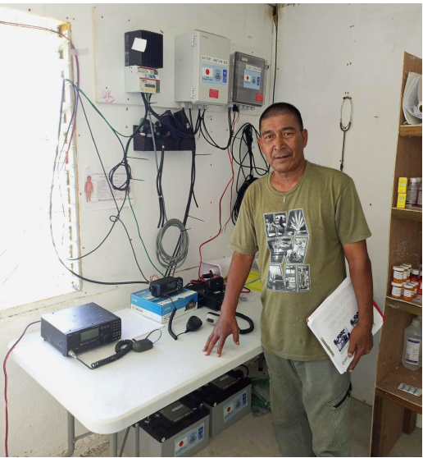
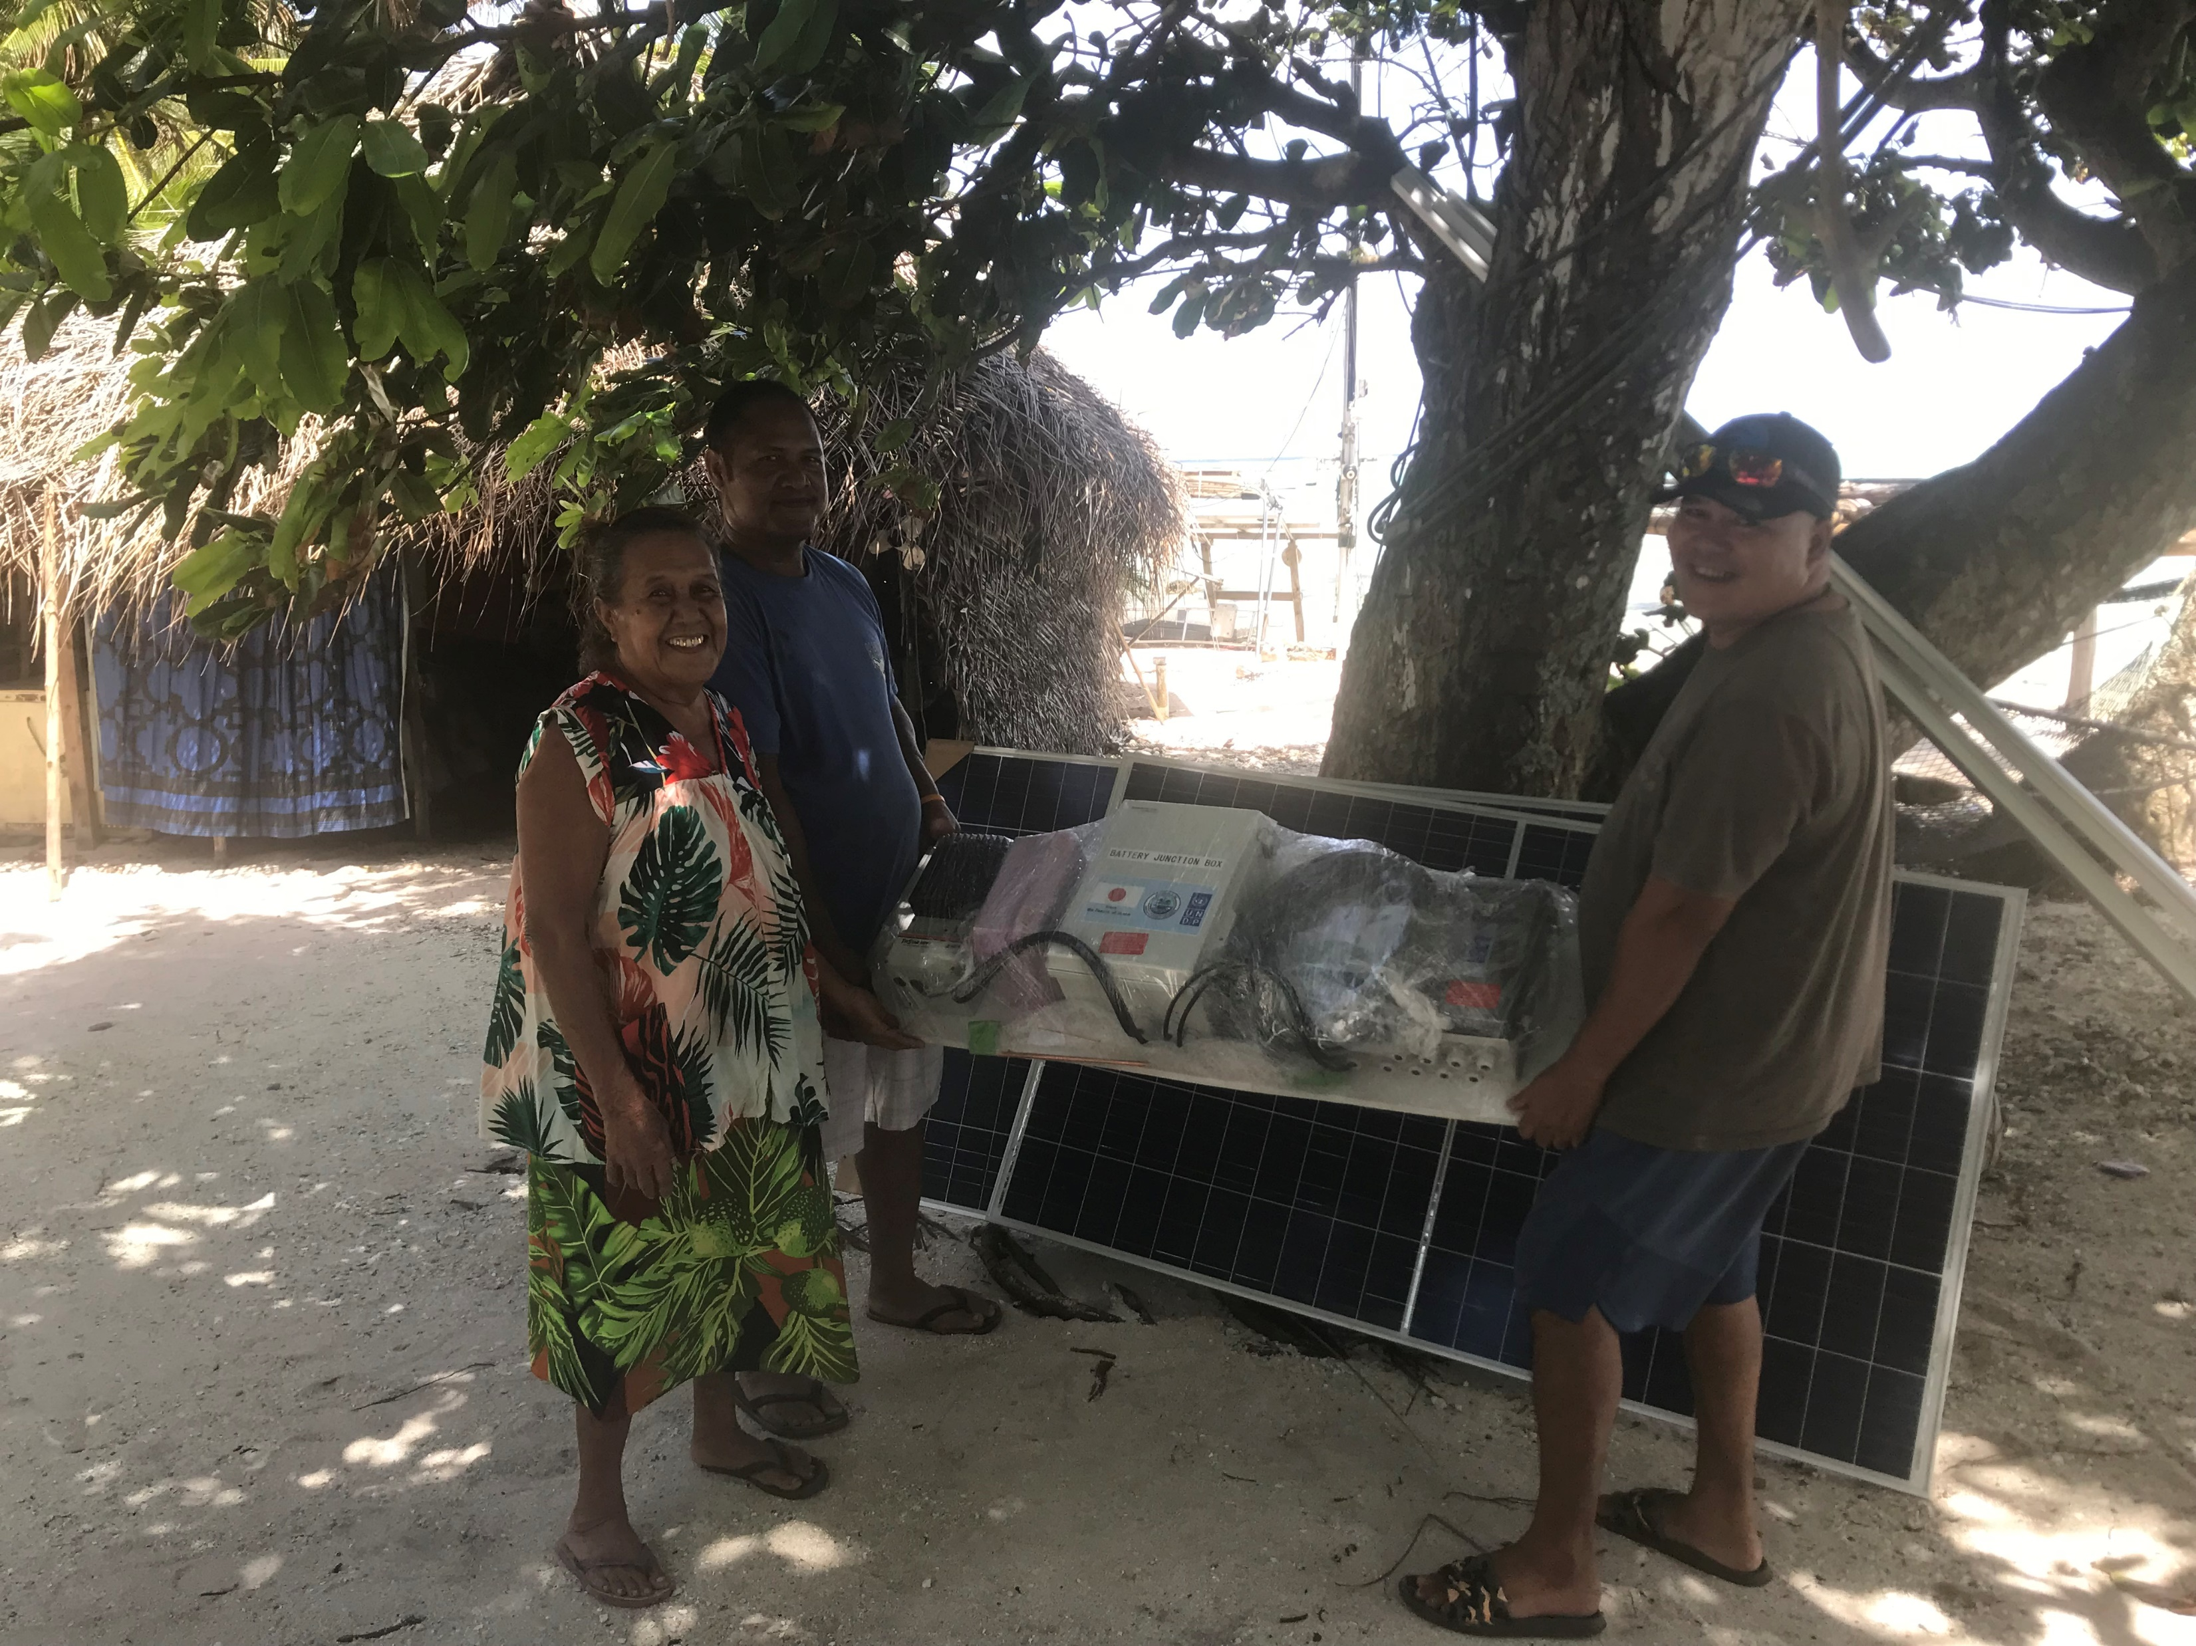
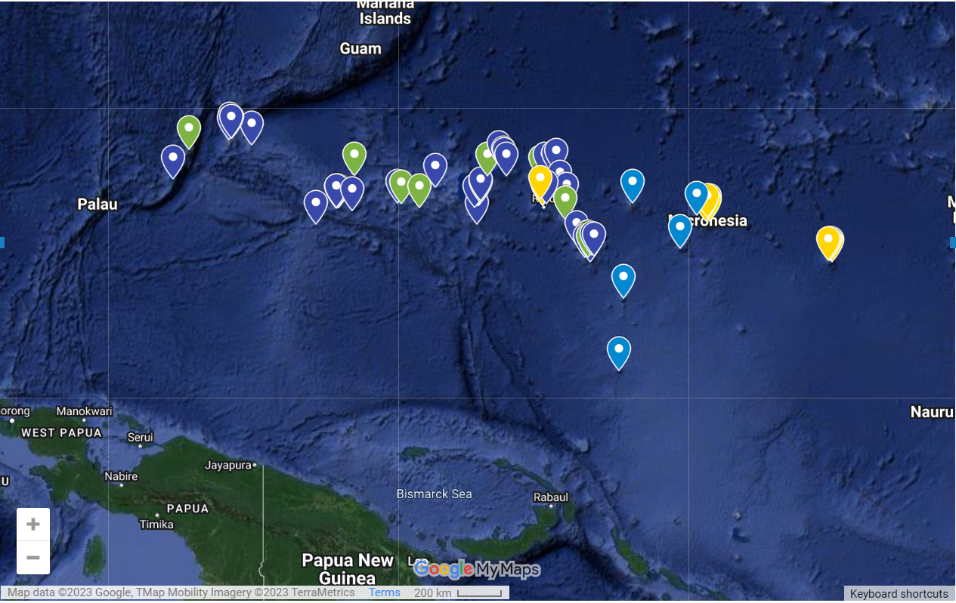
“Enhancing Synergies for a Resilient Tomorrow”
Key Results:
Disaster communication was upgraded at all planned 68 sites in National government, Pohnpei, Kosrae, Chuuk and Yap states by installing/upgrading HF/VHF radios and solar system to power radios, which will be indirectly benefitted approximately 73,155 people (36,945 men and 36,210 women).
Notes:
Chuuk: Onou
Chuuk: Ettal
Pohnpei Oroluk

Slide 4
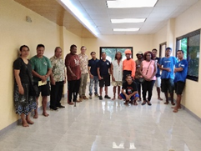
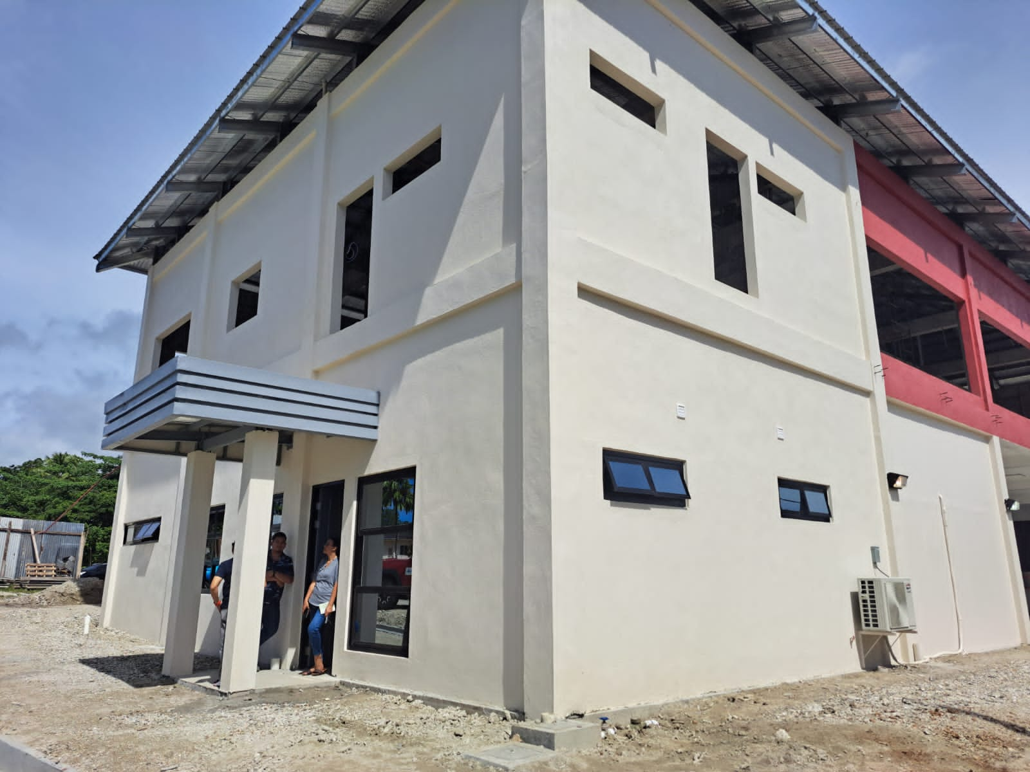
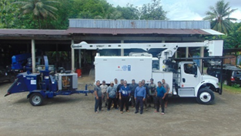
“Enhancing Synergies for a Resilient Tomorrow”
Key Results:
Technical and operational capacity of the National Emergency Operation Center was improved by completing extension of the NEOC building in May 2022. An official handover ceremony was concluded in December 2022.
Construction of Pohnpei State Emergency Operation Center (NEOC) has completed in May 2023 to enhance Pohnpei State Disaster Readiness Capacity.
The project has also supported Kosrae State Government to reinstate fire department capabilities and improve debris management by supplying a fire truck, a bucket truck for tree clearing, a woodchipper, rescue equipment and three chainsaws between November 2019 and November 2021.

Slide 5
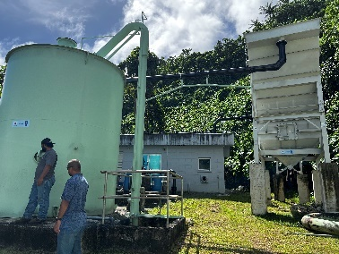
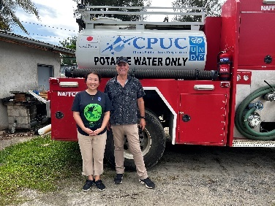
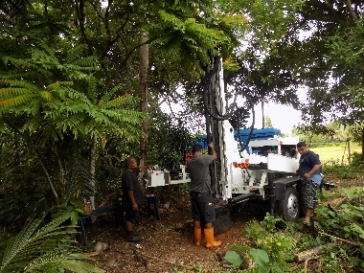
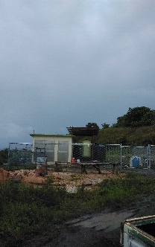
“Enhancing Synergies for a Resilient Tomorrow”
Key Results:
513 registered customers which represents a population of around 3,898 people (estimated 1,976 men and 1,922 women) are benefited from improved water resource management in Chuuk State with an increased production rate by 25 percent. CPUC has rehabilitated 14 deep wells and a water treatment plant which provided an opportunity to increase water production from surface water by up to 50%. The project has also supplied a portable water tanker to CPUC in May 2021. Which has delivered more than 2 million gallons of portable water to resident in the outer villages that do not have access to water by February 2023.
314 connections estimated 2031 people (893 men and 1138 women) are benefitted from improved water resource management in Yap State. The project supported South Yap Water Authority to supply a drilling rig, rehabilitation of wells, storage tank, water filtration and securing additional water sources which was completed in March 2023.
The project contributed to increase capacities of 111 persons (60 men and 51 women) in Gender Equality and Social Inclusion (GESI) and the Post Disaster Needs Assessment (PDNA) by organizing trainings in October 2020 and July 2021 respectively.

Slide 6
“Enhancing Synergies for a Resilient Tomorrow”
Ongoing and upcoming projects and activities
EDCR Project will be closed by 30 September 2023.

Slide 7
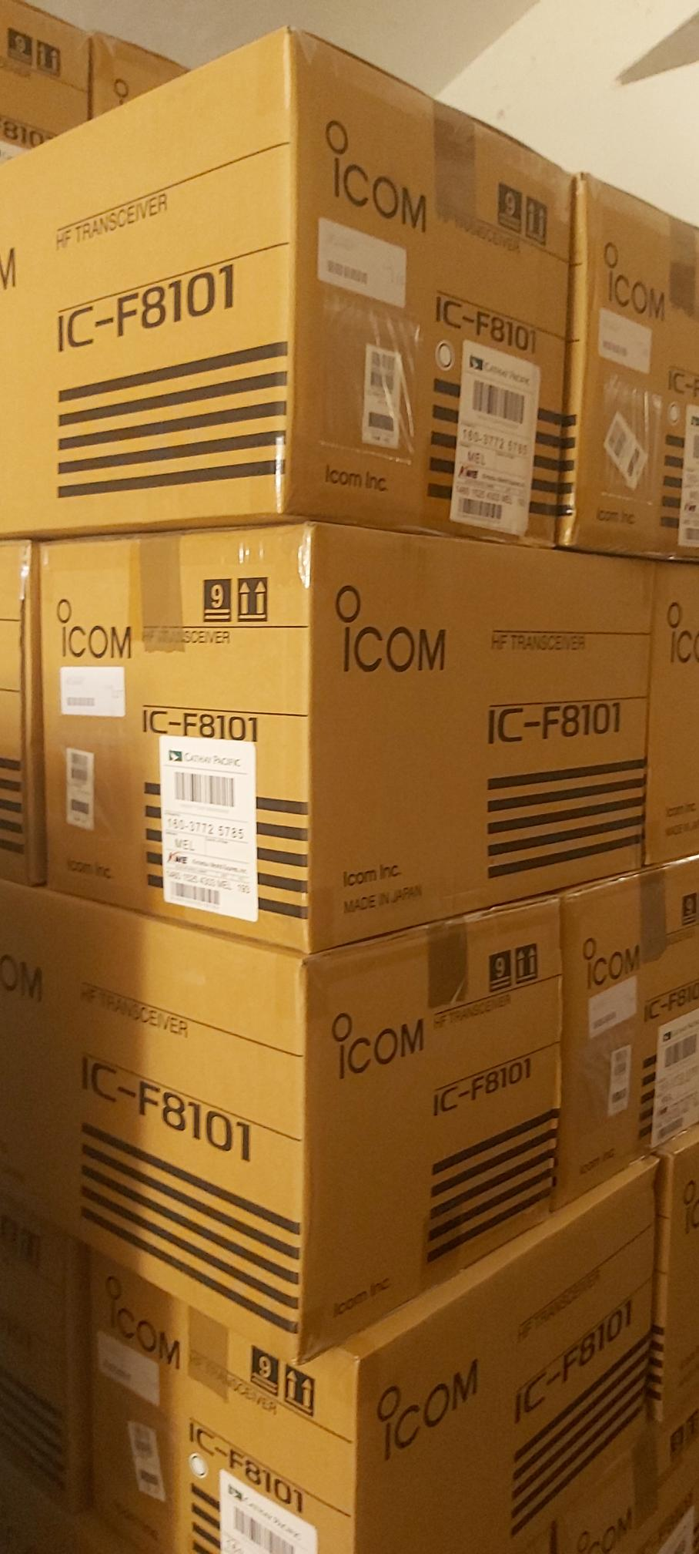
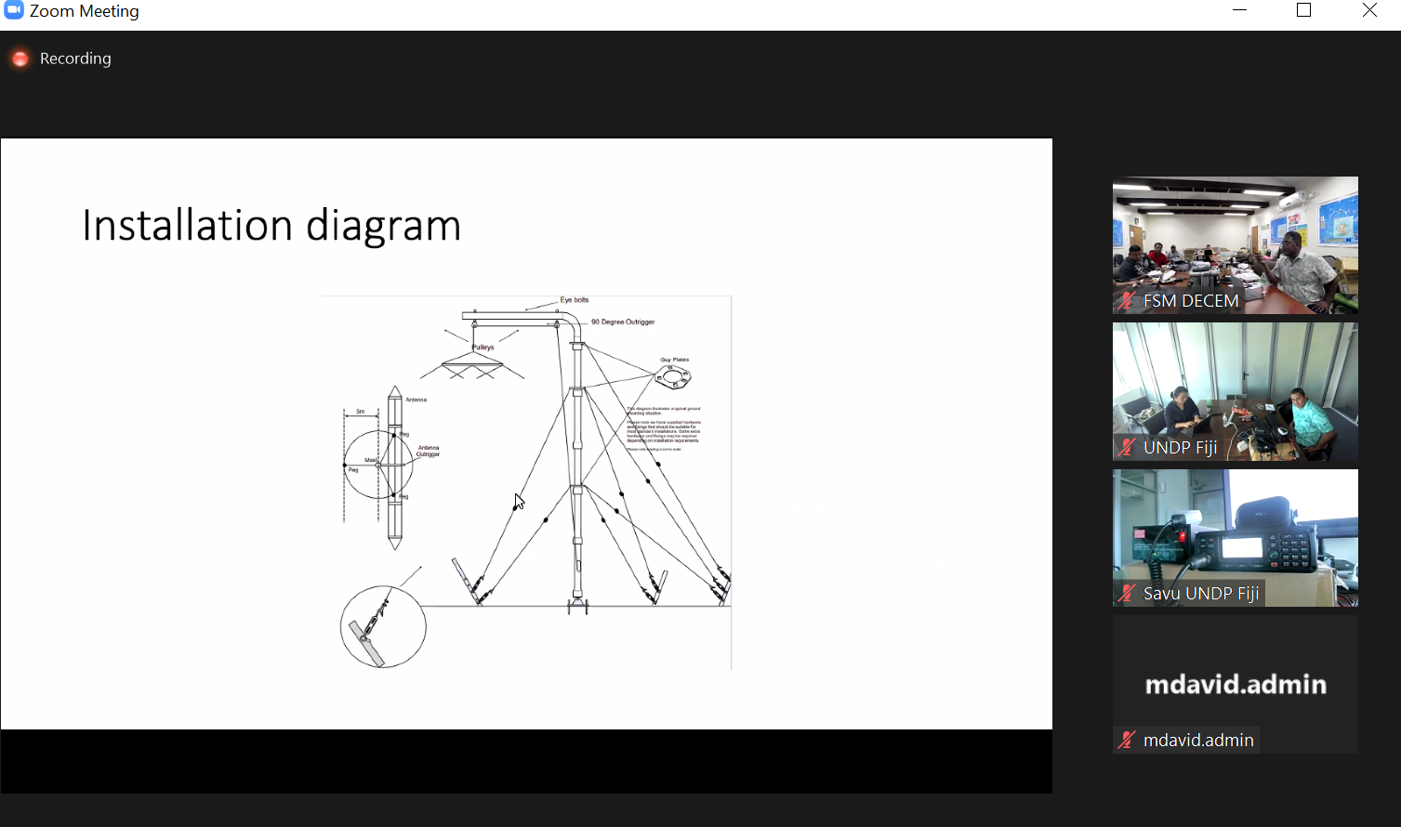
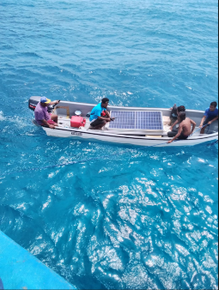
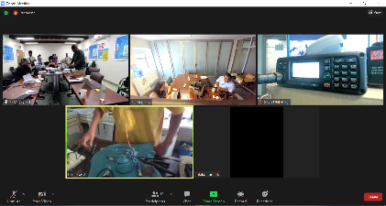
“Enhancing Synergies for a Resilient Tomorrow”
Challenges
  COVID-19 Pandemic
  Logistics to Outer Islands
  Availability of local resources
  Short timeframe
Notes:
Chuuk Makur

Slide 8
“Enhancing Synergies for a Resilient Tomorrow”
Opportunities for collaboration
  Compliment for upgrading radios
  Community outreach and drill more wells
  EOC management
  Programming joint mission to the outer islands

Slide 9
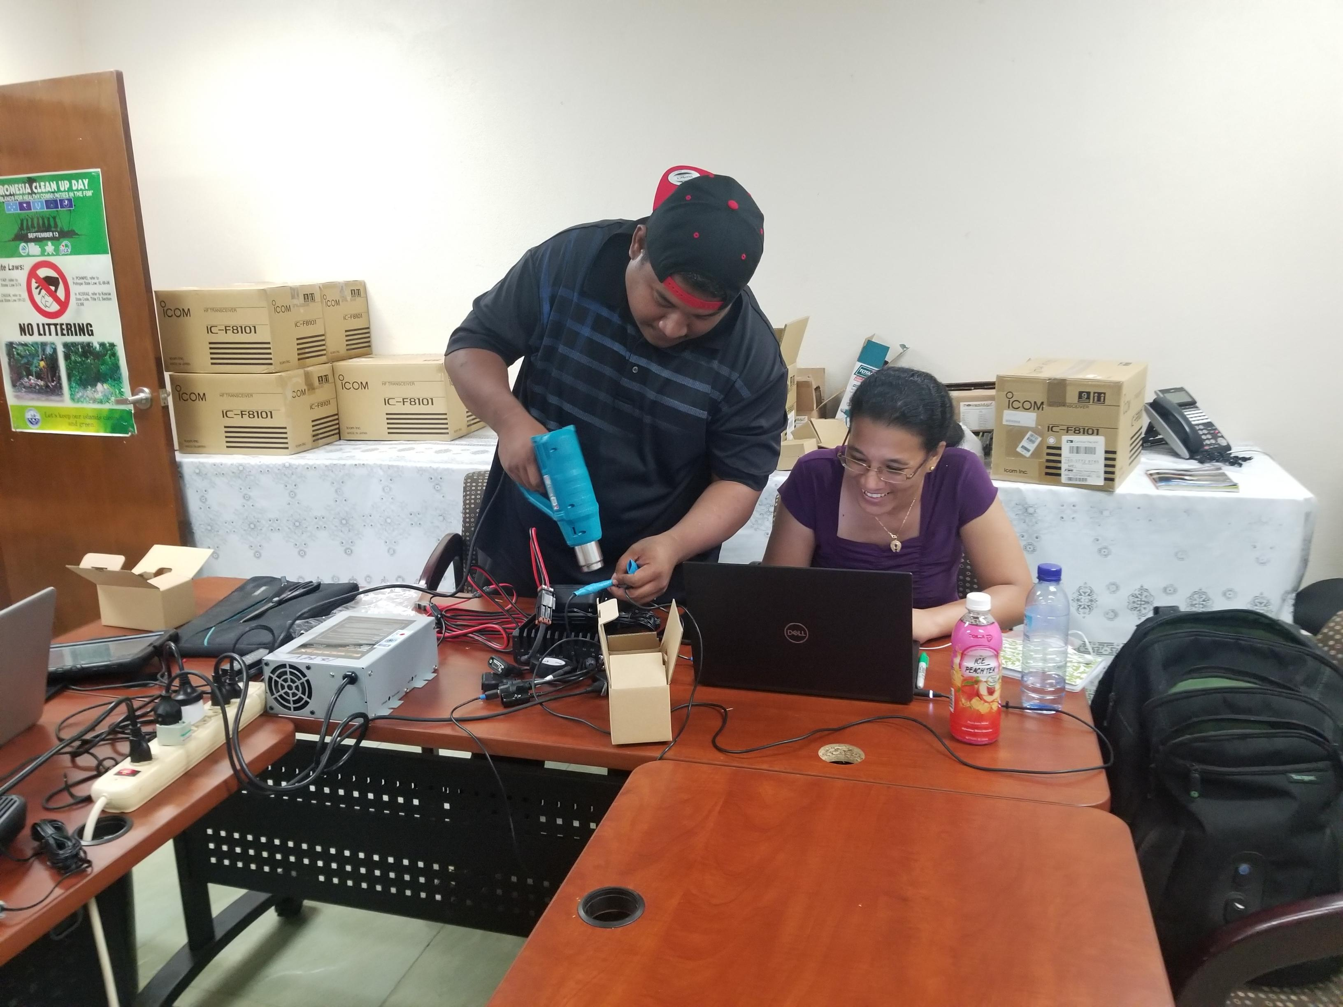
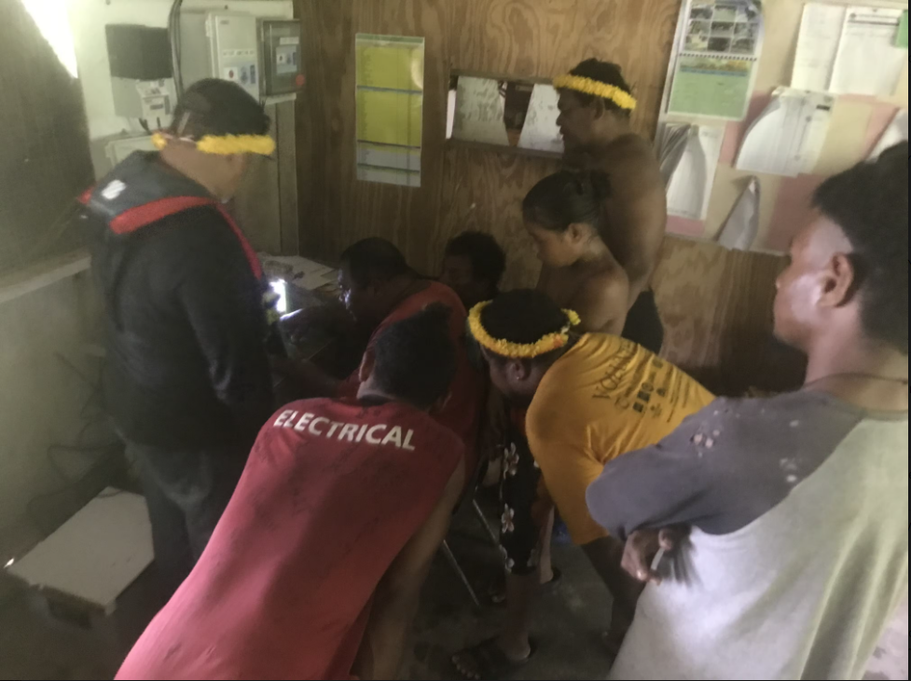
“Enhancing Synergies for a Resilient Tomorrow”
Recommendations
  Trainings
  Maintenance
Notes:
Yap Falaulap

Slide 10
“Enhancing Synergies for a Resilient Tomorrow”
Thank you!
Notes:
So, as we look forward to the sign off of our Agreement and kick start on our implementation phase of the NAP, we feel the urge to share key recommendations that not only will help better understand what we need to do, but to also fill in the gaps as we move forward in this NAP implementation.

