Slide 1






3rd Joint Environment and Risk Management Platform
“Enhancing Synergies for a Resilient Tomorrow”
3.4 Emergency Management
Michael Yarofaitoar- Deputy Assistant Secretary ( Response & Recovery)
Morthy Solomon- Deputy Assistant Secretary (Mitigation)
August 30-September 1, 2023
Weno, Chuuk

Slide 2
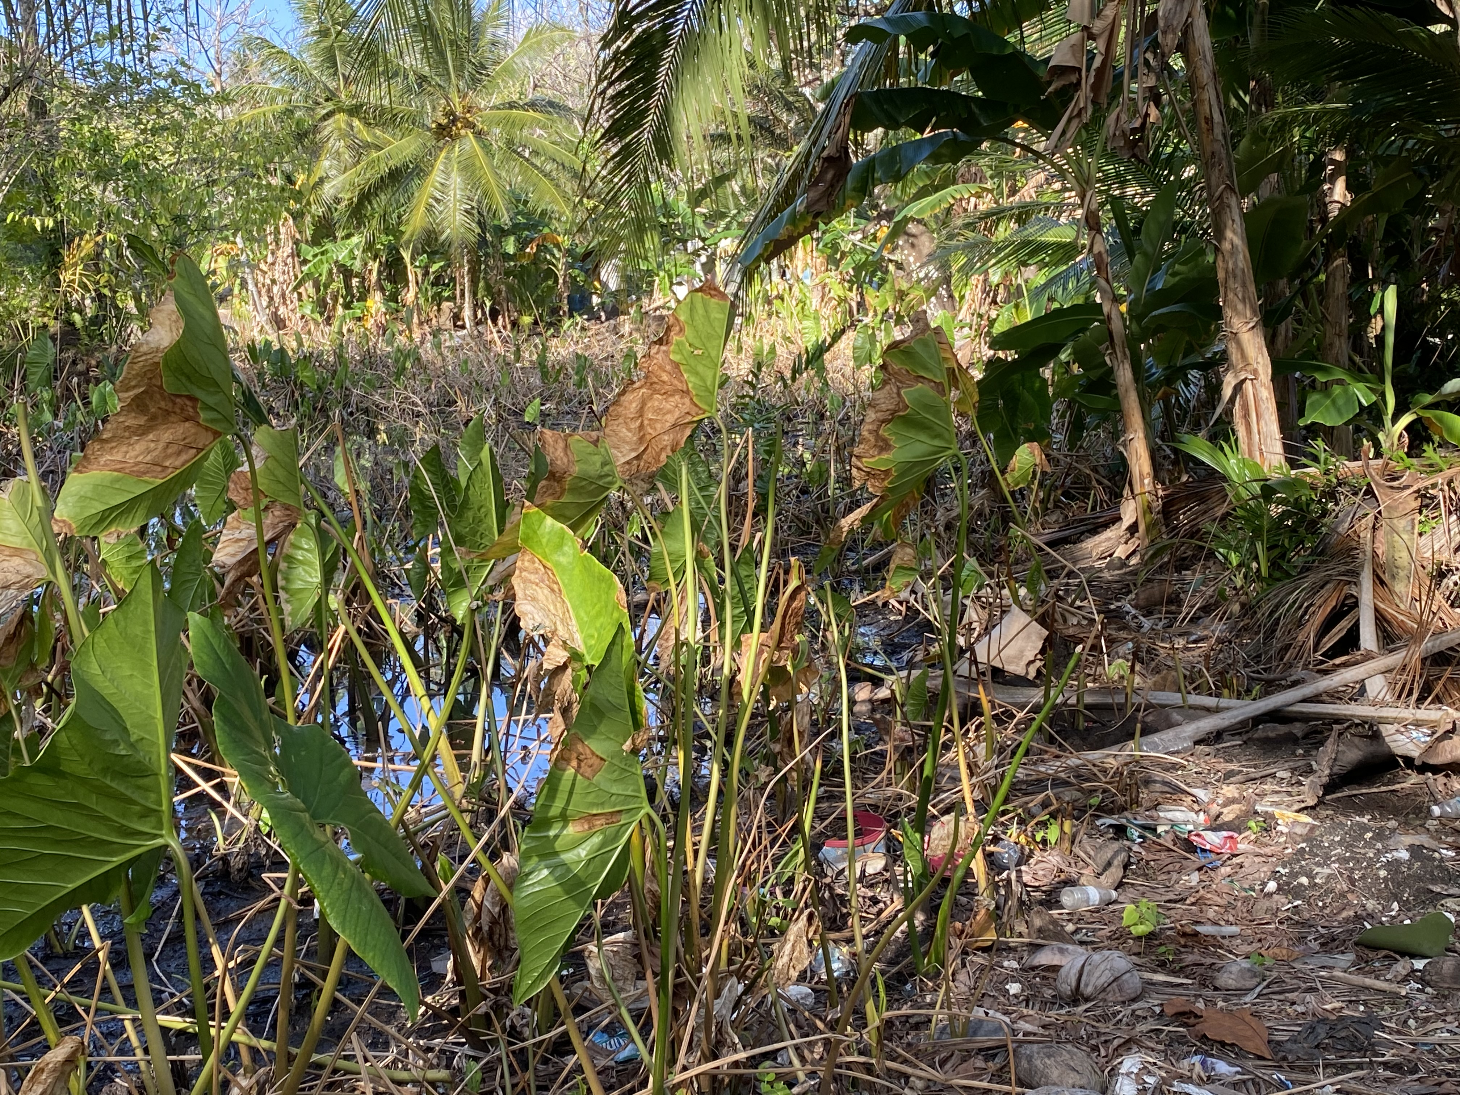
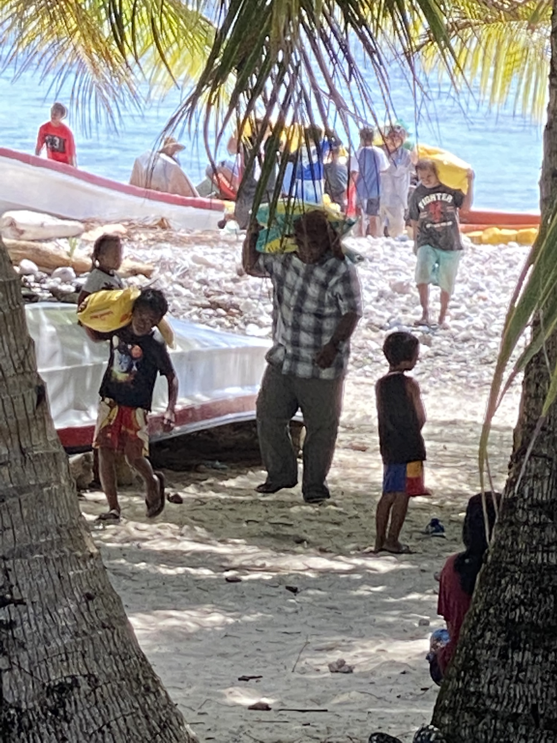
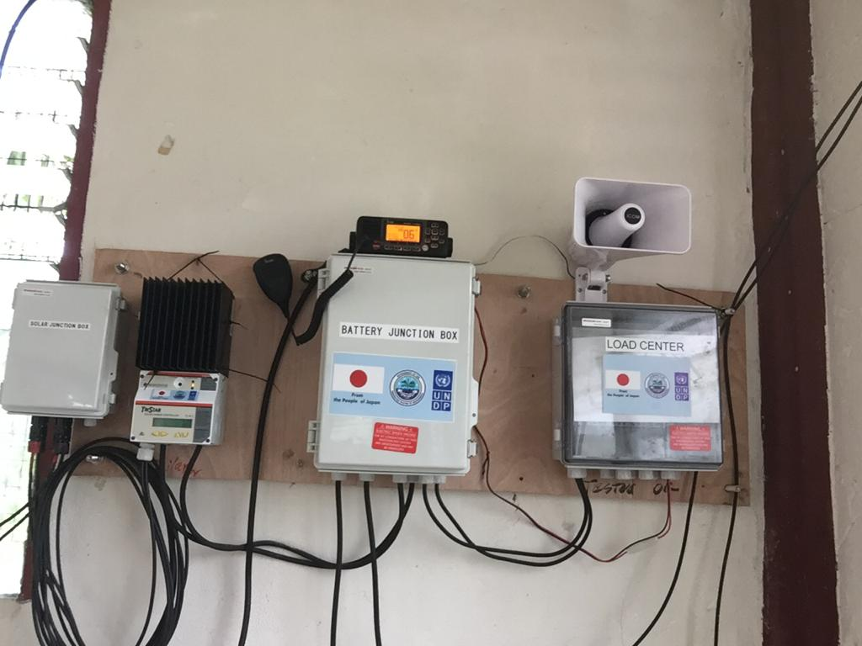




“Enhancing Synergies for a Resilient Tomorrow”
Progress since 2018:
  National Standard Operation Procedures Updated
  Development of Several Municipal Disaster Preparedness Plans
  National Response to Typhoon Wutip and King Tide
  Enhancing Disaster and Climate Resilience project

Slide 3
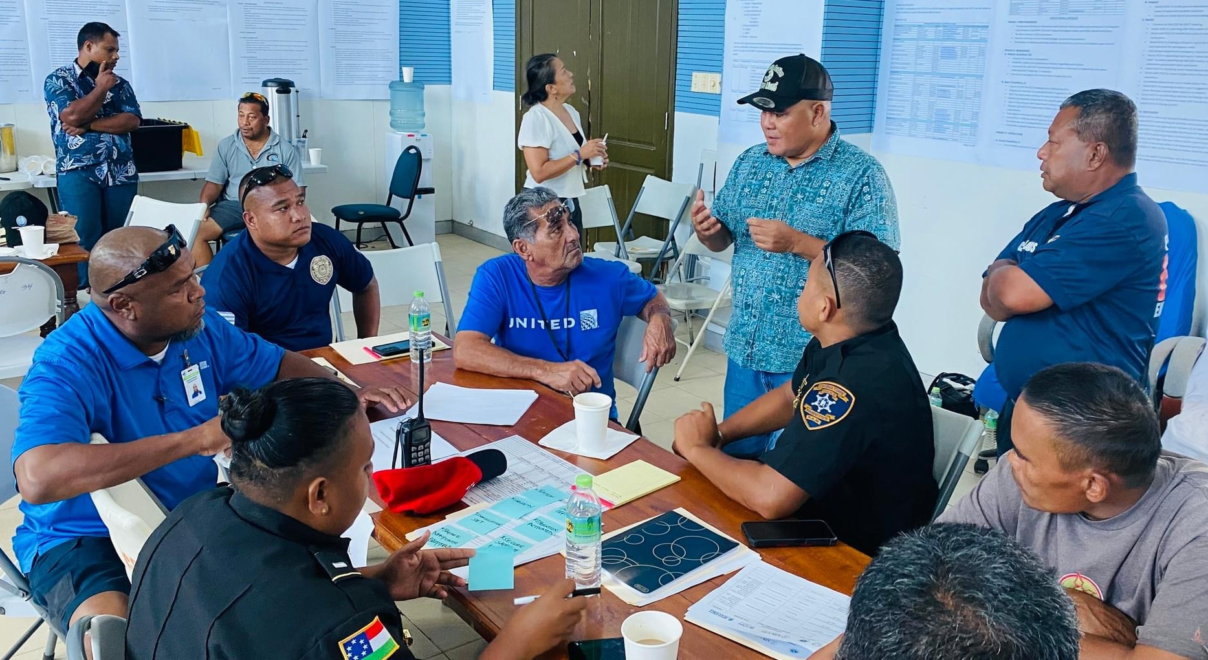
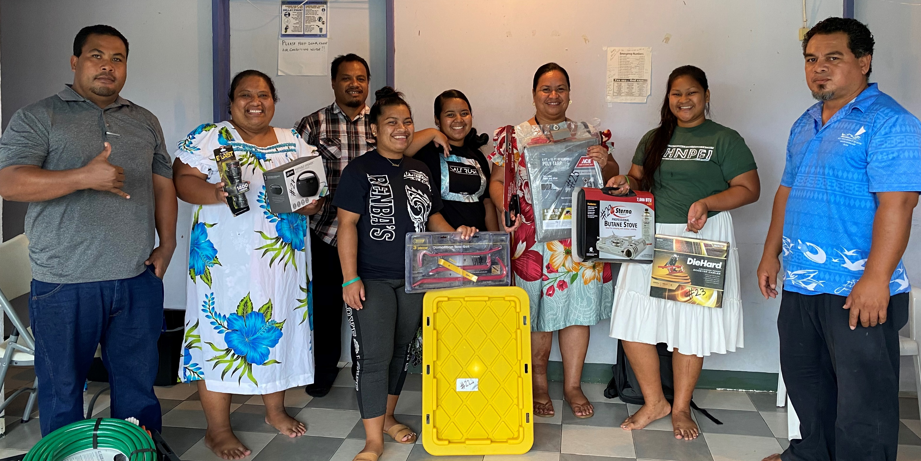
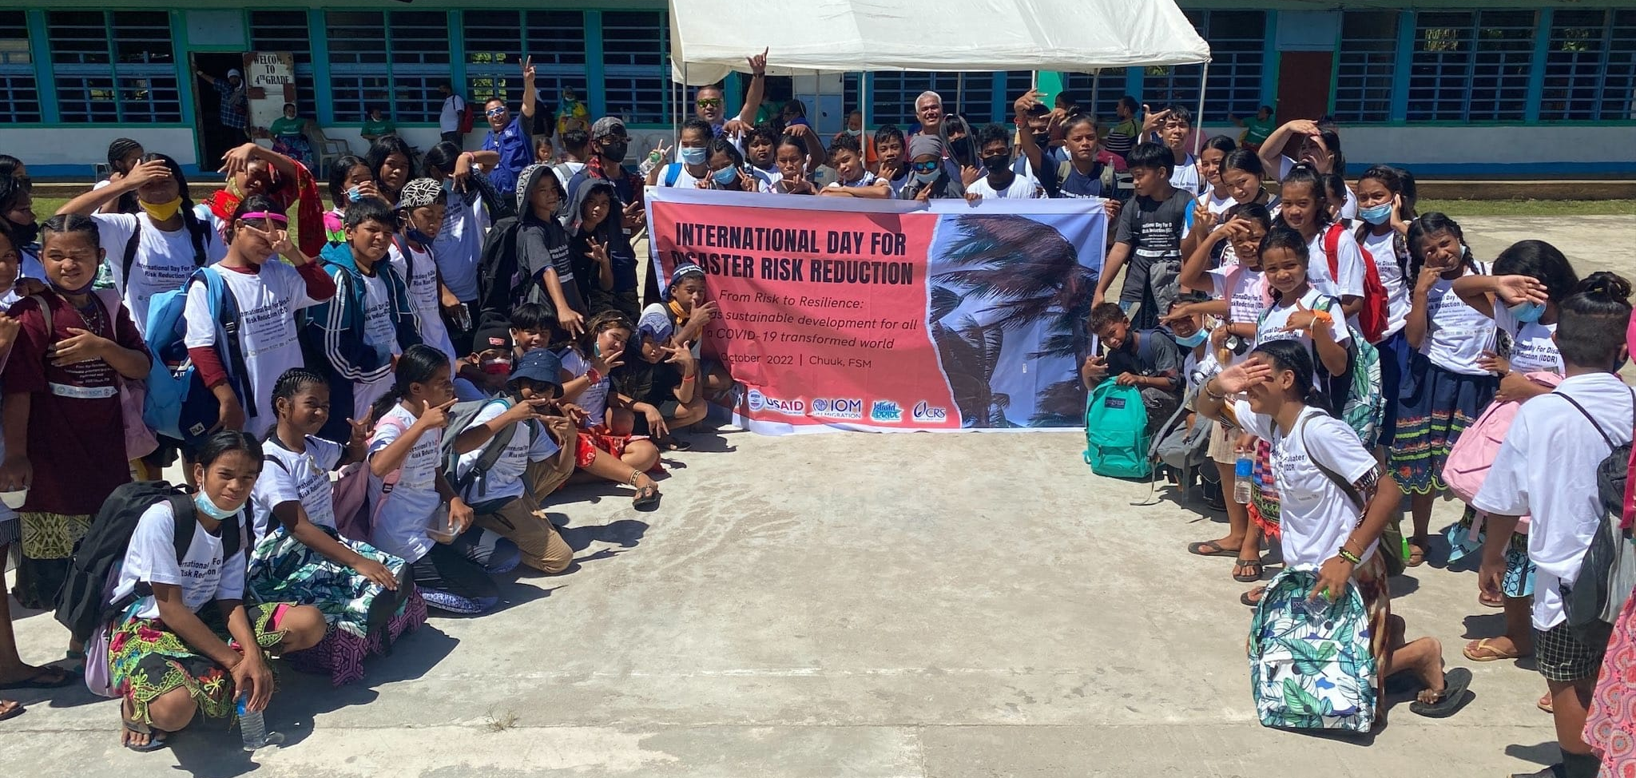
“Enhancing Synergies for a Resilient Tomorrow”
Ongoing and Upcoming Projects & Activities:
  Table Top Exercise for all States
  Awareness on International Day of Disaster Risk Reduction and World Tsunami Day
  Support in assisting the development of Municipal Disaster Preparedness Plan for all local governments and communities
  Implementation of Building Safety and Resilience in the Pacific (BSRP II project)

Slide 4
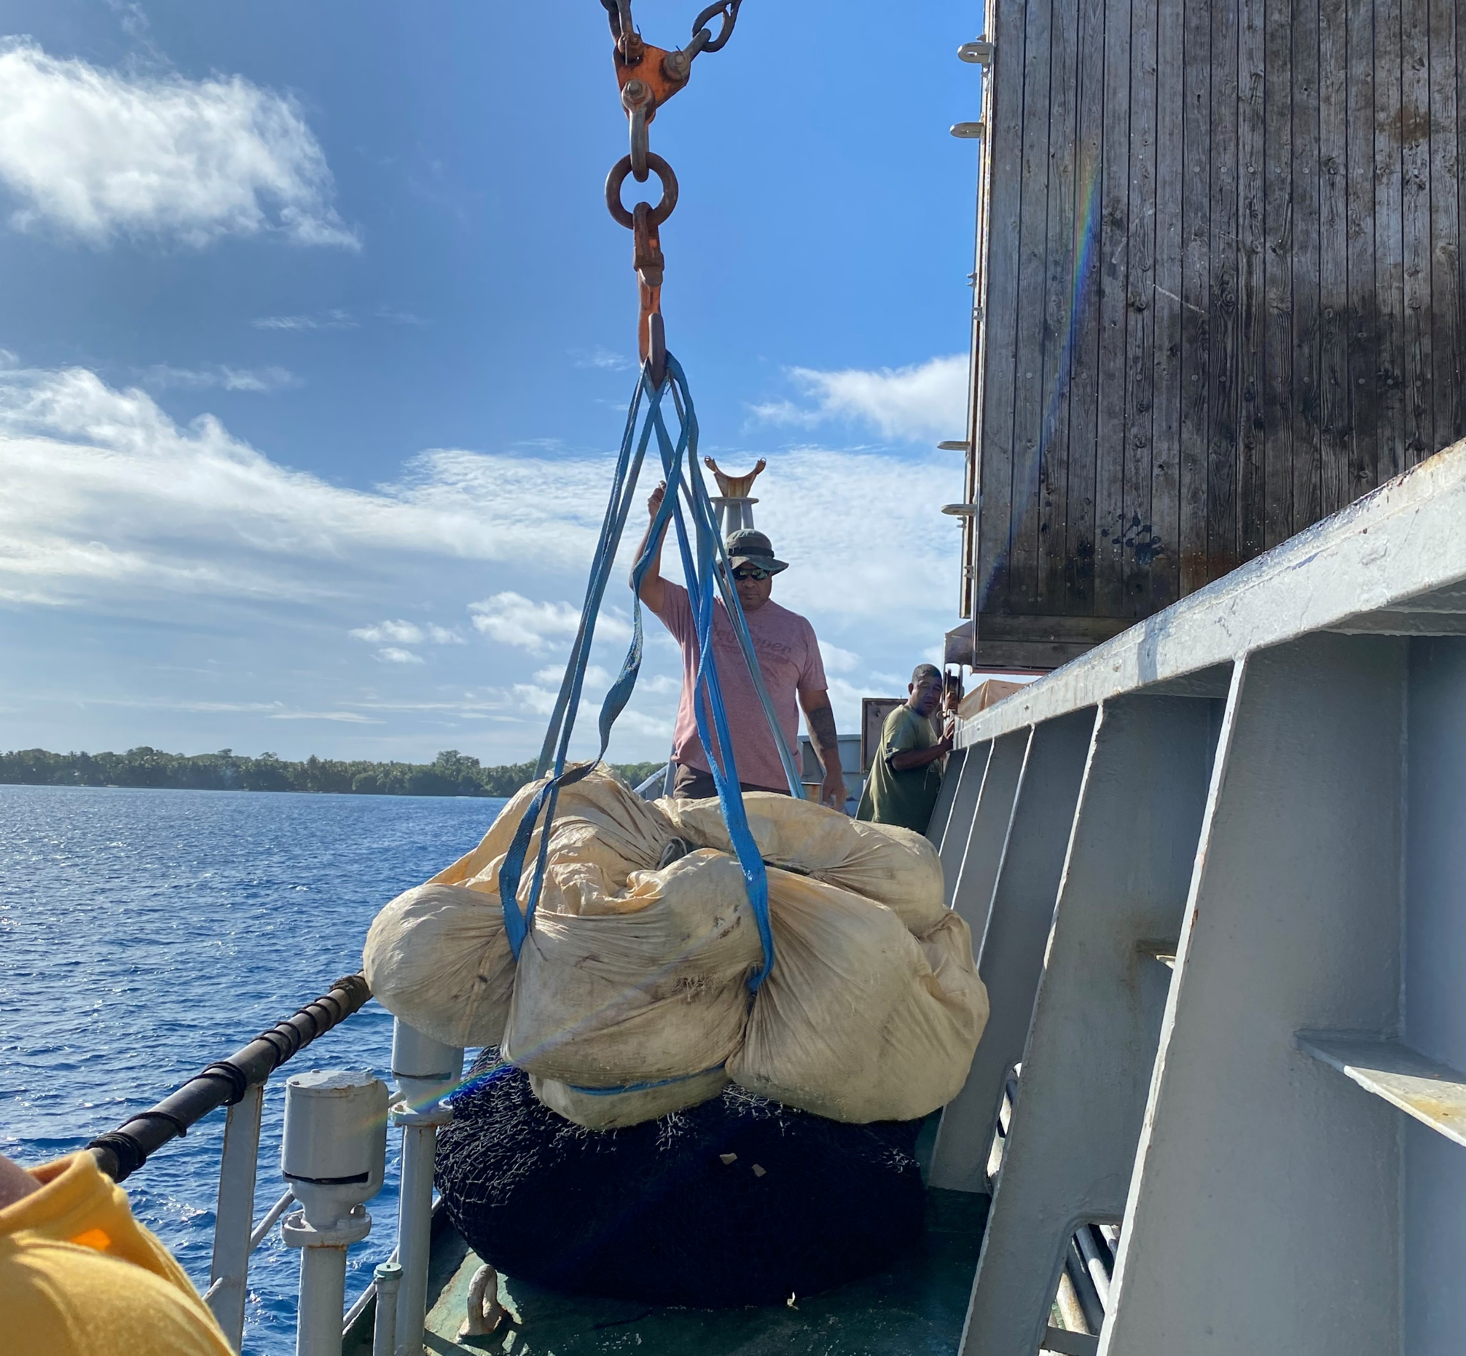
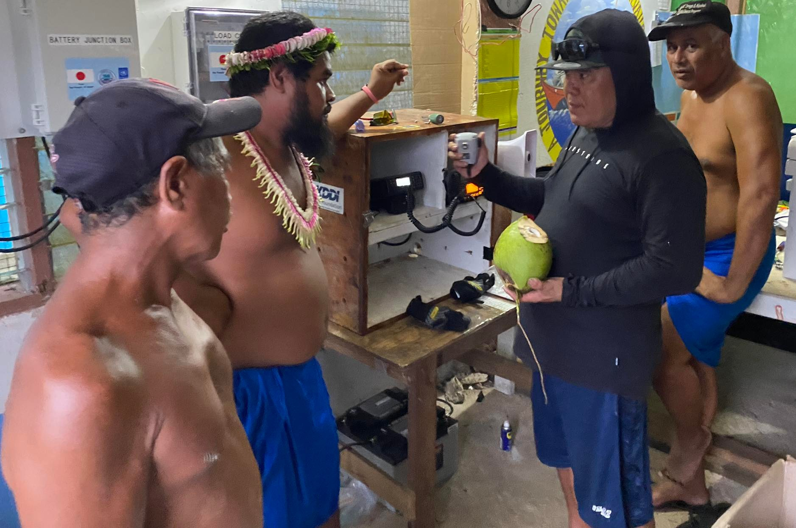
“Enhancing Synergies for a Resilient Tomorrow”
Challenges:
  Transportation and logistics mechanism.
  Limited Funding support for Outreach Awareness Program and development of Municipal Disaster Preparedness Plans.
  State DCOs holds multiple roles
  Lack of dedicated staff to manage the Information Management System for all Emergency Division activities and disaster related data.

Slide 5
“Enhancing Synergies for a Resilient Tomorrow”
Opportunities for collaboration:
  Include Center for Excellence and other international partners in tabletop exercises.
  State DCOs share their priorities and annual activities with DECEM to identify funding support.
  Grant management training for DECEM (EM Division) to identify other sources of funding.
  Sharing disaster related data for the Information Management System (Municipal, State and National).

Slide 6
“Enhancing Synergies for a Resilient Tomorrow”
Recommendations:
  DECEM identify trainings in disaster management/response and recovery from international partners for National and State counterparts.
  State SOPs and Disaster Response Plans must be updated
  State DCO, DECEM, FSM TC&I (Infrastructure Division), FSM R&D (Agriculture Division) work together to Standardized Formula/Estimation for recovery efforts.
  State DCOs to develop Crisis Communication Plans & MOU with FSMTC for mass texting before & during disasters.

Slide 7
“Enhancing Synergies for a Resilient Tomorrow”
Thank you

