Slide 1
Pacific Catastrophe Risk Insurance Company
Consultation with Vital Energy - FSM
July 2023

Slide 2
PCRAFI Insurance Program
The Pacific Catastrophe Risk Insurance Program aims to:
Provide PICs with a quick injection of cash following a major natural disaster
Act as a form of direct budget support to the government to finance the immediate relief needs post disaster
It is not designed to cover ALL losses faced by the government following a disaster
Originally coverage was offered by the World Bank. PCRIC was established in Cook Islands in 2016 to take over management of the program
Currently PCRIC offers parametric insurance cover for i) Tropical Cyclone events and ii) Earthquake and/or Tsunami events

Slide 3
Parametric vs traditional insurance
 | Traditional insurance | Parametric insurance
Trigger for payout | Actual loss incurred | Natural hazard event exceeding a defined threshold (e.g windspeed or earthquake magnitude) or modelled loss
Risk of payout not covering losses | No risk as payout is based on loss | Risk that the index used is not well-correlated with the actual losses sustained (basis risk)
Speed of payout | Can be very slow | Usually within 2 weeks
Use of payout | Intended to cover only the loss sustained | No restrictions on use
Loss adjustment and claims process | Loss adjustment process can be lengthy and complicated | No loss adjustment process
Policy flexibility | Few policy options | Very flexible structure

Slide 4
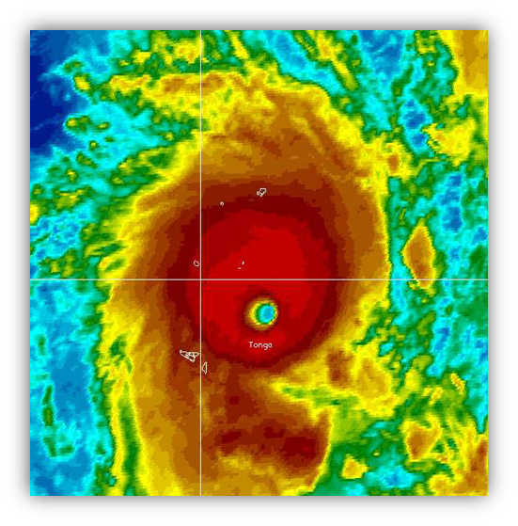
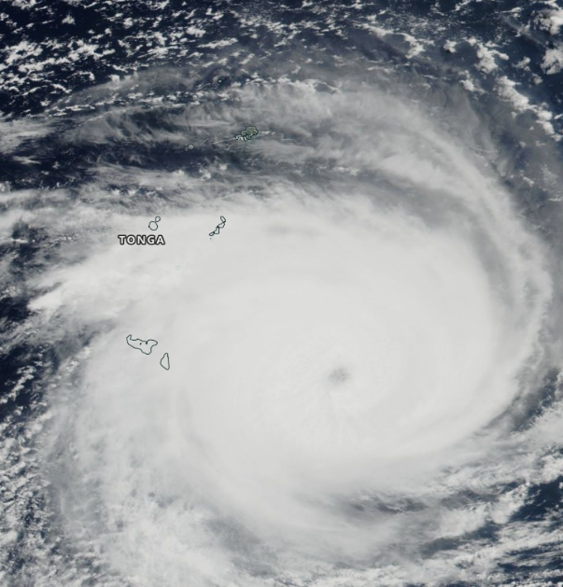
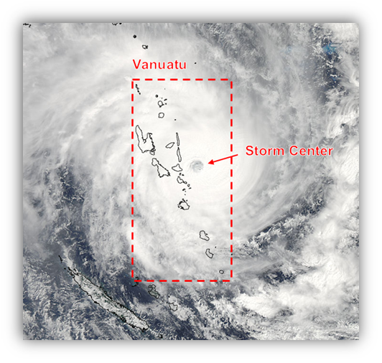
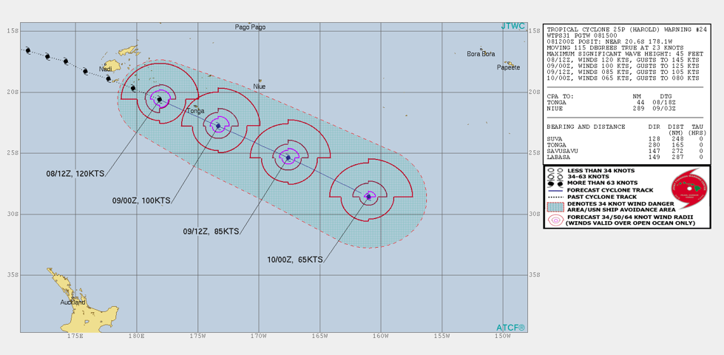
Claims paid to date
2014: TC Ian
Tonga
Payout of US$1.27m
2018: TC Gita
Tonga
Payout of US$3.5m
2015: TC Pam
Vanuatu
Payout of US$1.9m
2020: TC Harold
Tonga
Payout of US$4.5m

Slide 5
Guiding questions
What are the key assets that Vital Energy are seeking insurance coverage for?
What are the key risks that Vital Energy are looking to protect against?
Does Vital Energy have any insurance coverage in place at the moment? If yes, what kind of insurance coverage and against which assets?

Slide 6
Potential product design
PCRIC could design a product that provides a specified payout if a specific natural disaster occurred in a pre-specified area, limited to:
earthquake/tsunami
tropical cyclone
excess rainfall
drought
The pre-specified area can be over sea, over land, or both
However, any payout would not be linked to any specific damages caused, and so Vital Energy may not be fully covered for damages caused after a natural hazard event
As PCRIC can only provide a parametric policy for specific perils, other types of events (e.g. fire, fuel spillage, workplace accidents etc) would not be covered

