Slide 1
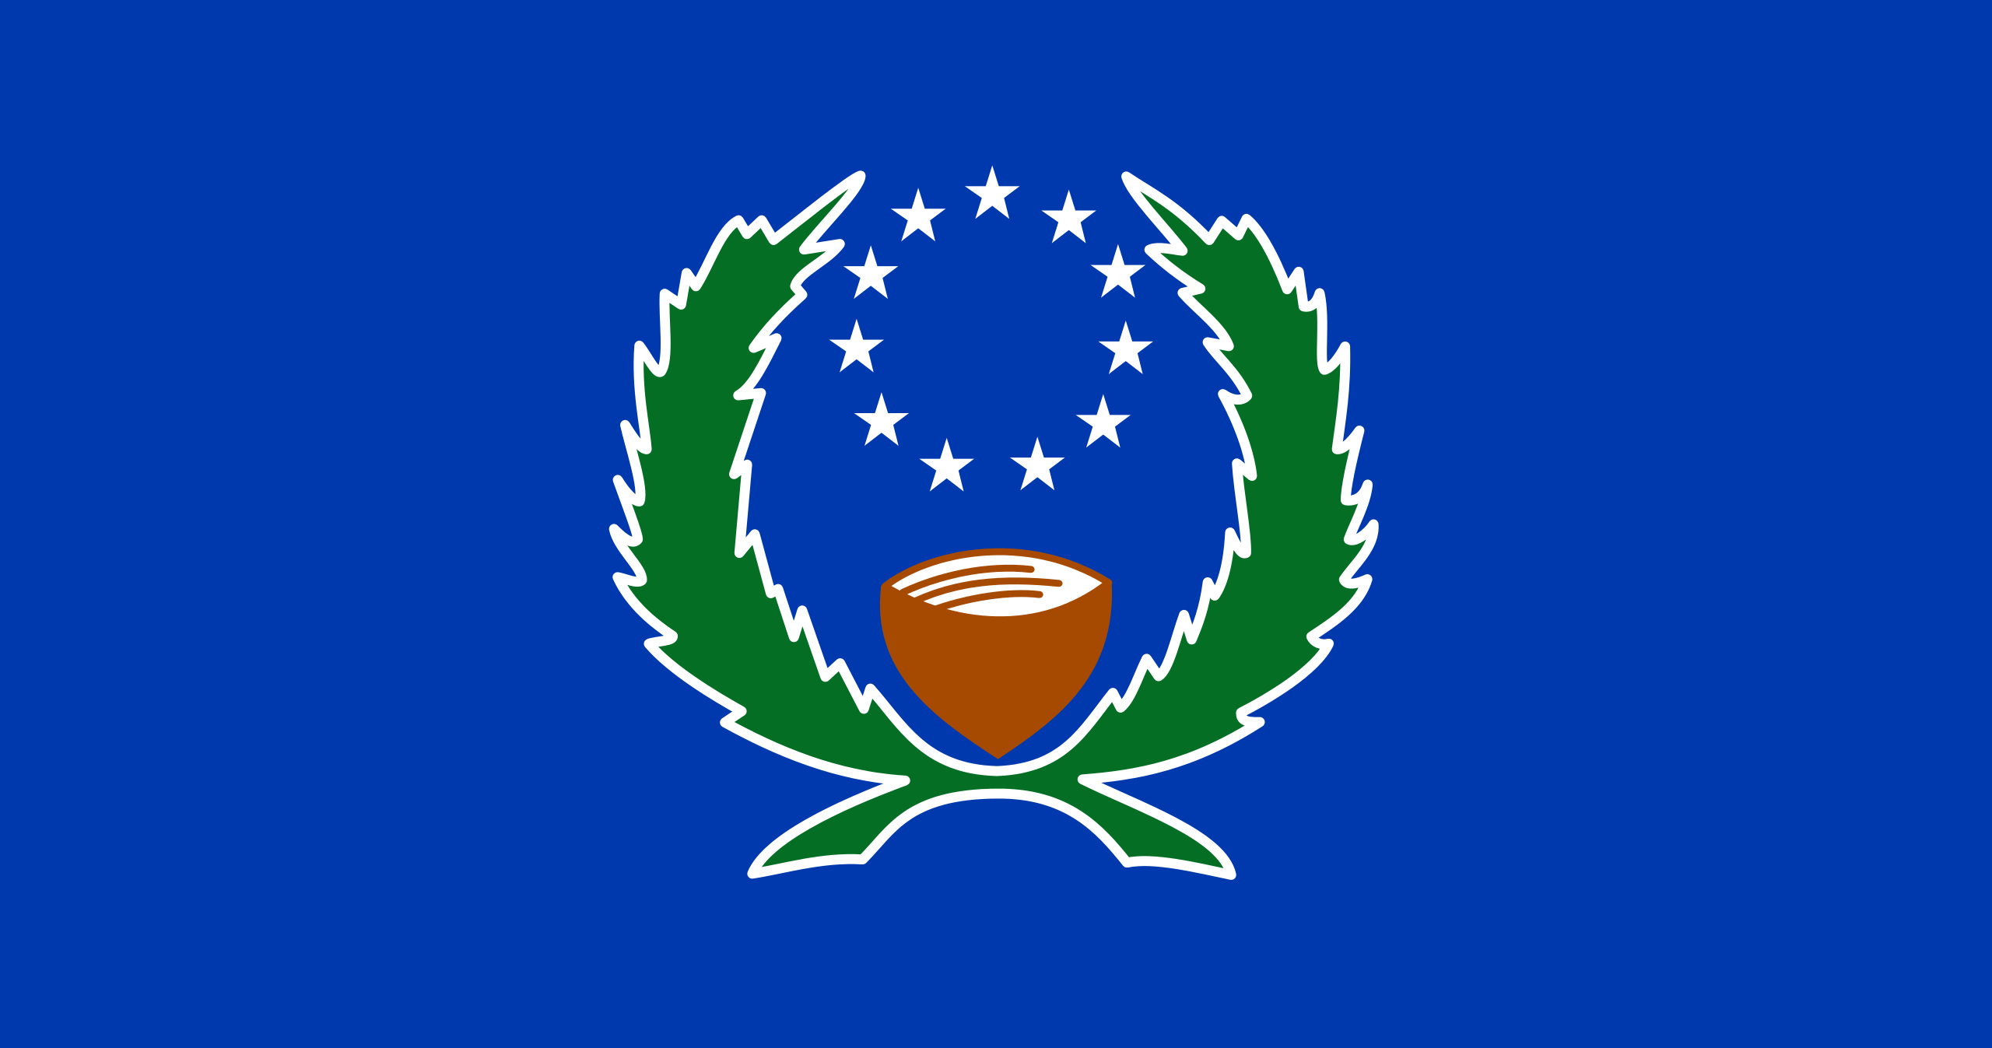
3rd Joint Environment and Risk Management Platform
“Enhancing Synergies for a Resilient Tomorrow”
The Nature Conservancy
Liz Terk
Microneisa Conservation Director
August 30-September 1, 2023
Weno, Chuuk

Slide 2
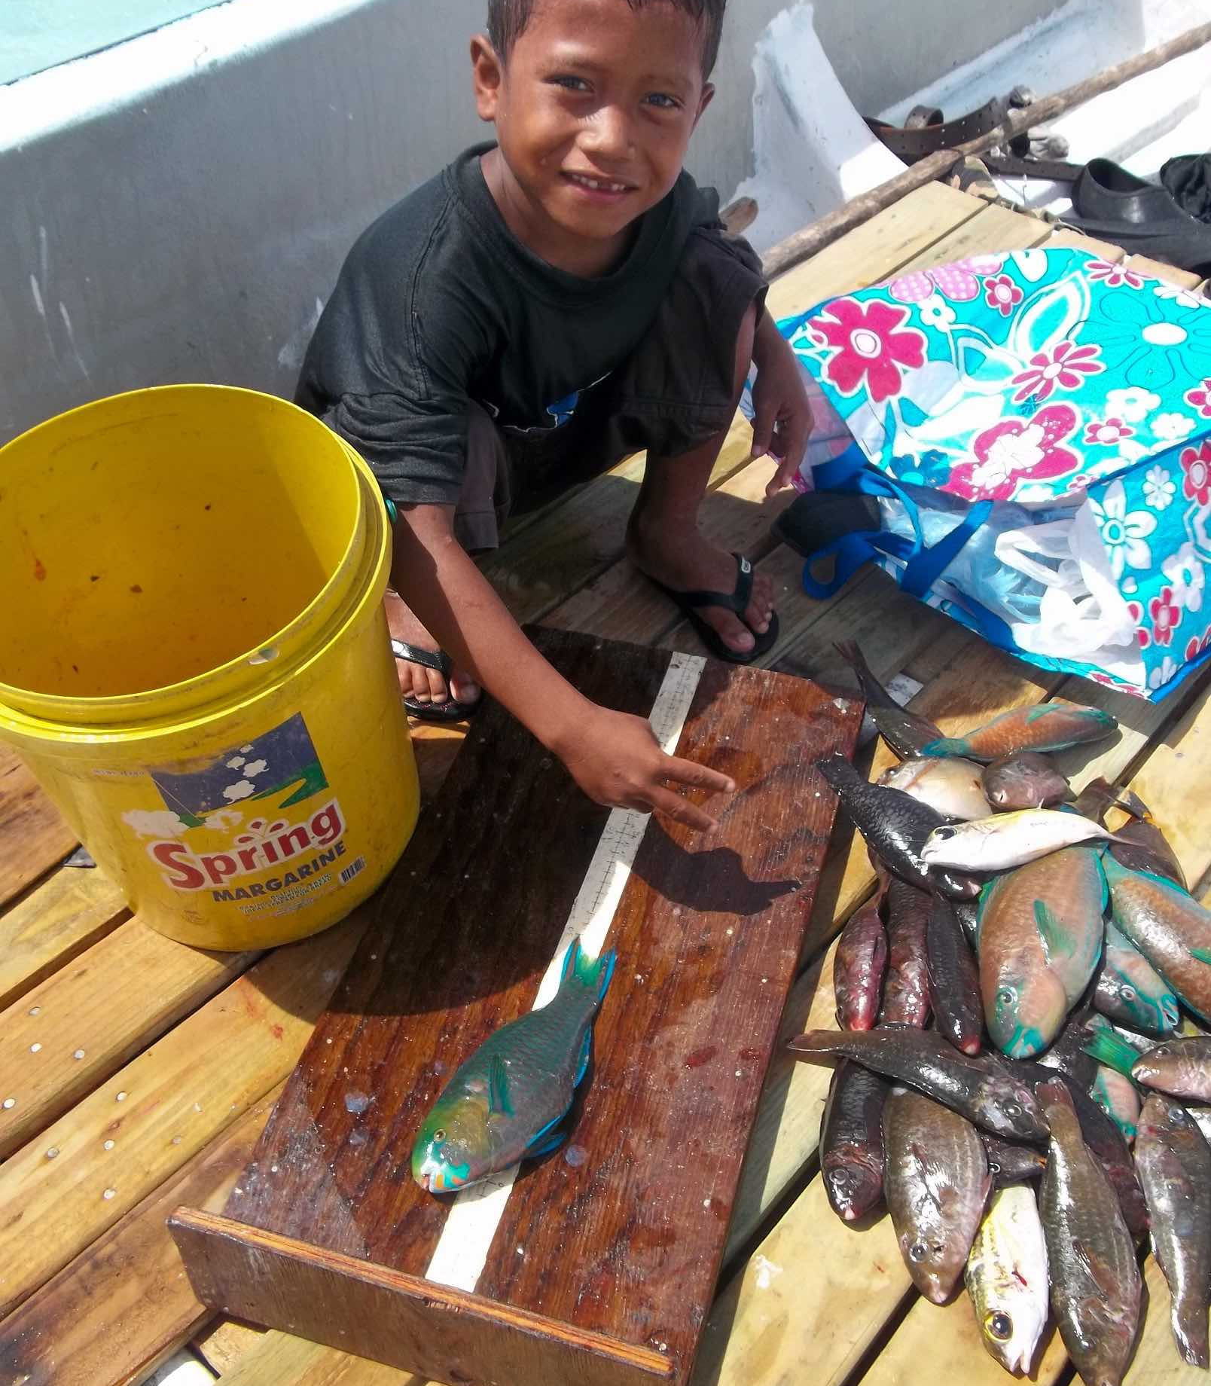
“Enhancing Synergies for a Resilient Tomorrow”
Progress since 2018
Nature Protecting People: Blue Guide for Disaster Risk Management
Development and Implementation of Local Early Action Plans
Supported EPA with amendment of Pohnpei State CC Policy to include NbS

Slide 3
“Enhancing Synergies for a Resilient Tomorrow”
Ongoing and upcoming projects and activities
Continue increase the capacity of women, youth and most vulnerable communities to implement NbS and increase food security (3 projects)
Improved resilience of coral reef ecosystems

Slide 4
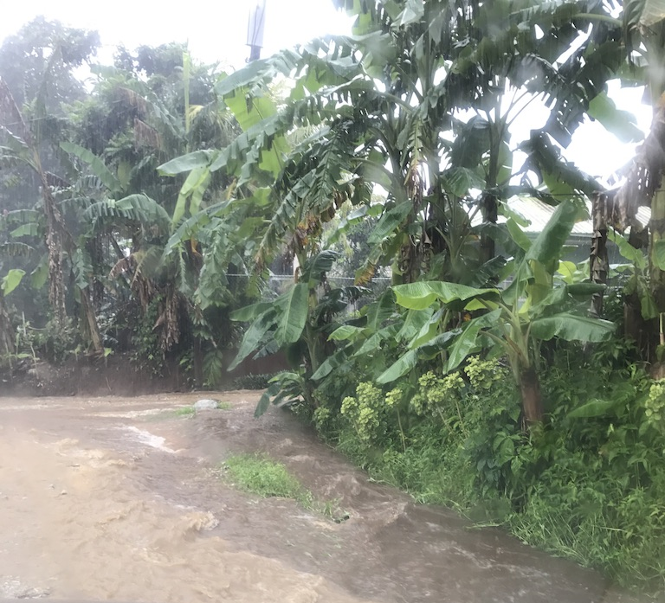
“Enhancing Synergies for a Resilient Tomorrow”
Challenges
Capacity
Lack of coordination/ inefficient use of resources/effort duplication

Slide 5
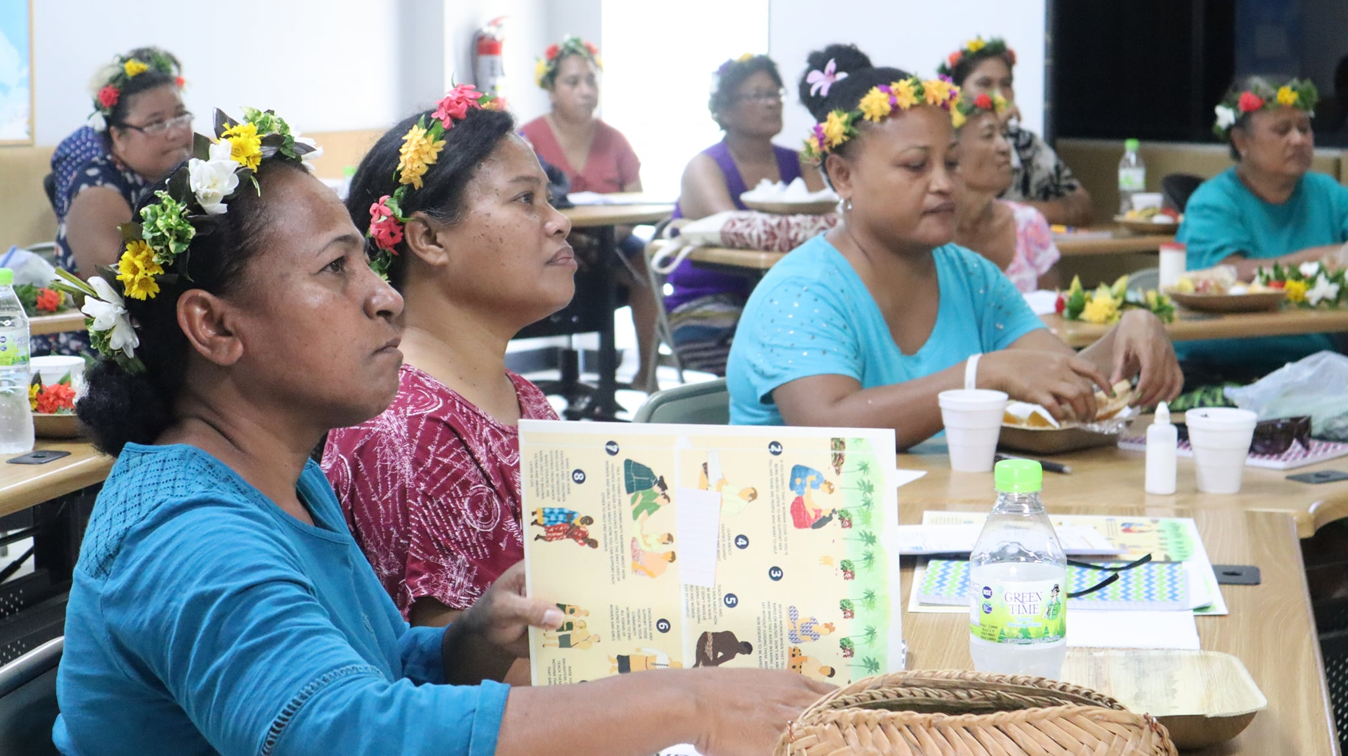
“Enhancing Synergies for a Resilient Tomorrow”
Opportunities for collaboration
Partner participation in Women’s Group Learn Exchanges
Shared technical support

Slide 6
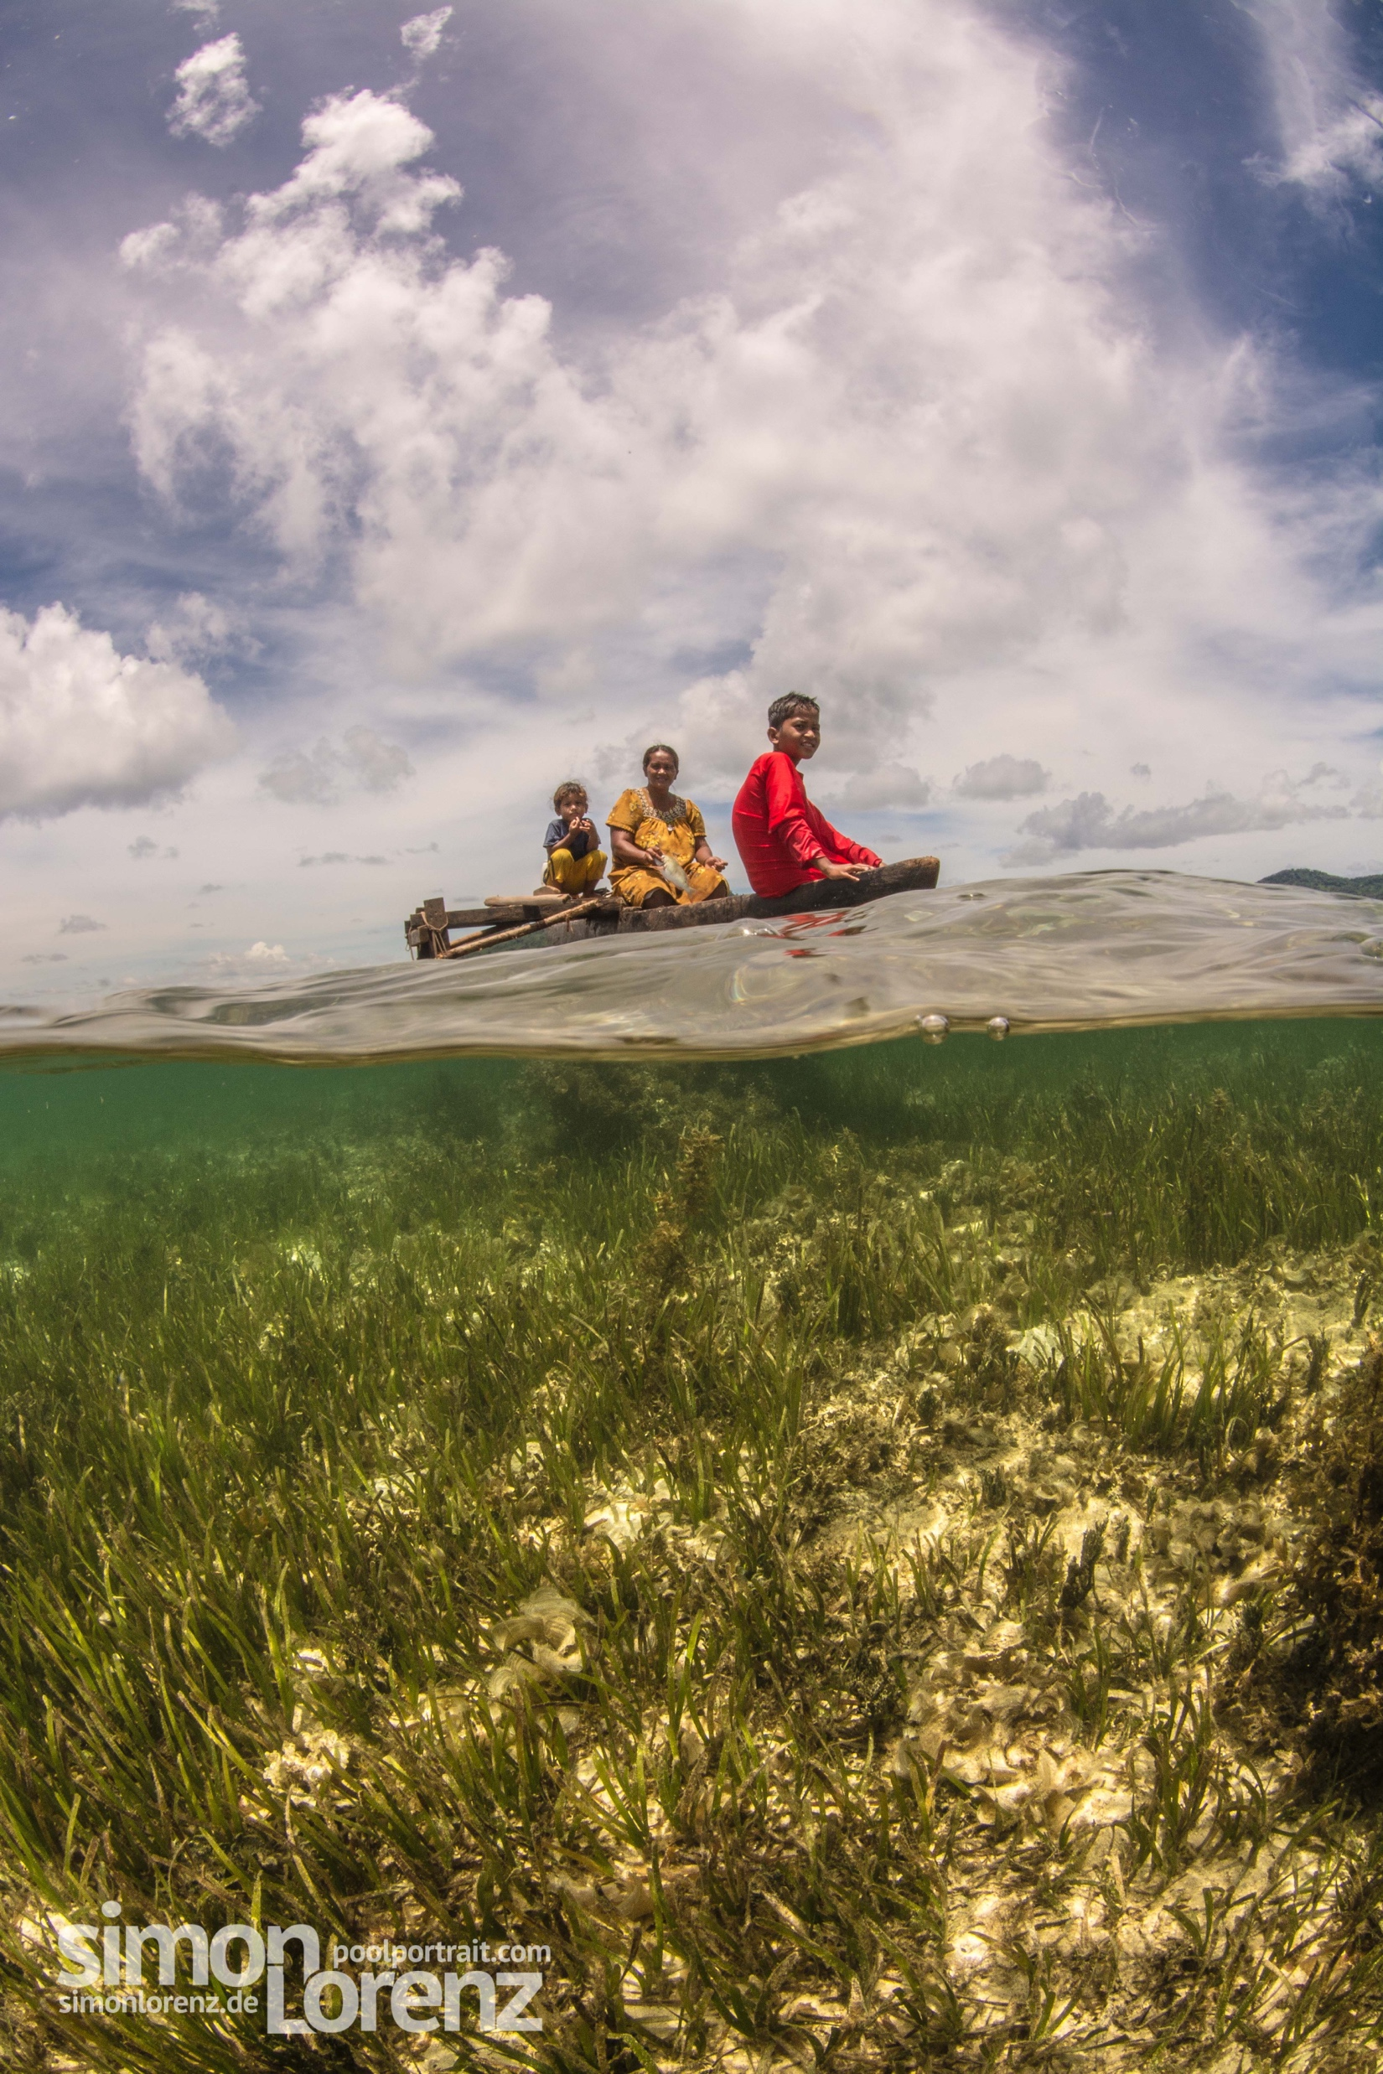
“Enhancing Synergies for a Resilient Tomorrow”
Recommendations
Development of CCA/NbS/DRR curriculum for schools (at all levels)
Improved coordination –DRR/CCA working group
Standardized content/requirements for DRR or CCA planning

Slide 7
“Enhancing Synergies for a Resilient Tomorrow”
Thank you!
Notes:
So, as we look forward to the sign off of our Agreement and kick start on our implementation phase of the NAP, we feel the urge to share key recommendations that not only will help better understand what we need to do, but to also fill in the gaps as we move forward in this NAP implementation.

