Slide 1
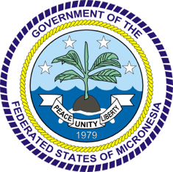
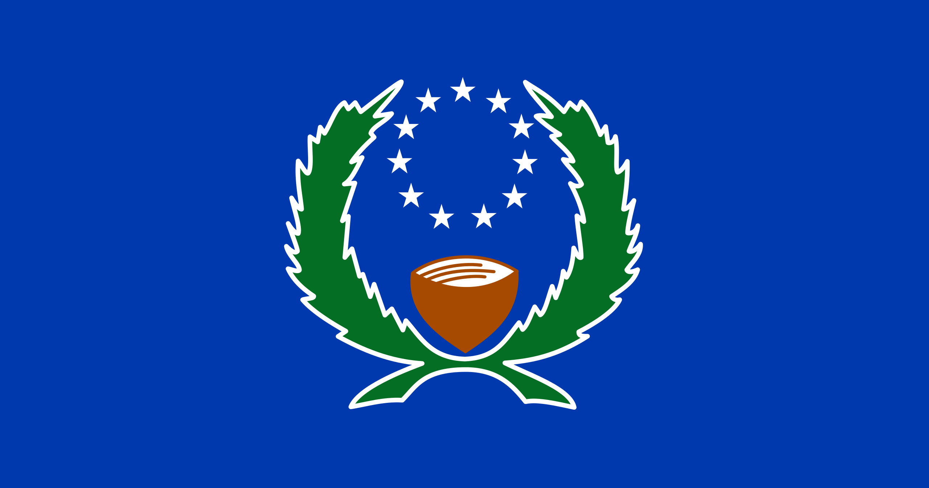
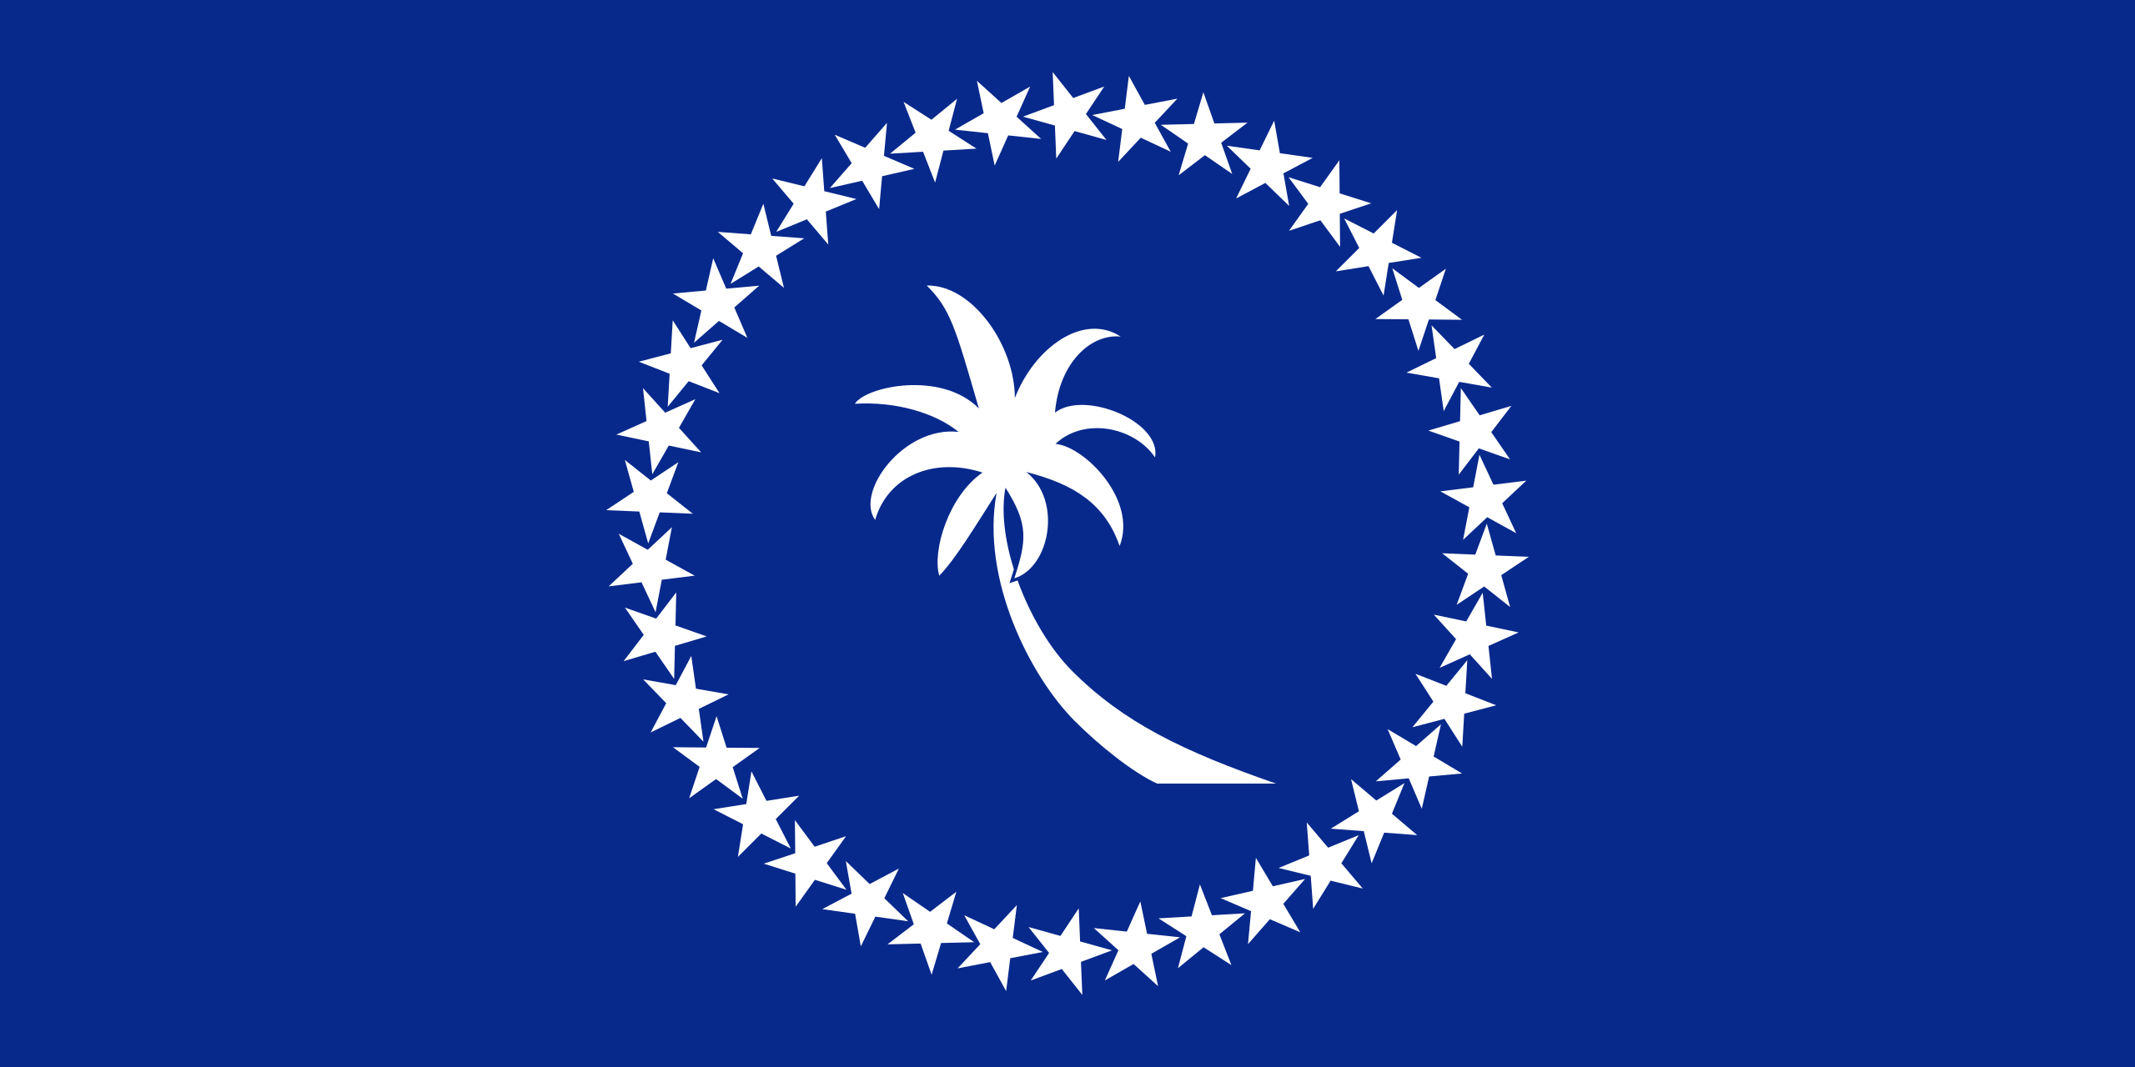
3rd Joint Environment and Risk Management Platform
“Enhancing Synergies for a Resilient Tomorrow”
Micronesia Conservation Trust
Winfred Mudong
August 30-September 1, 2023
Weno, Chuuk

Slide 2
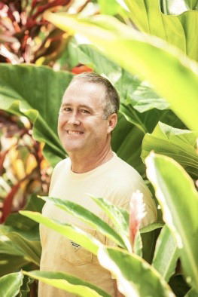
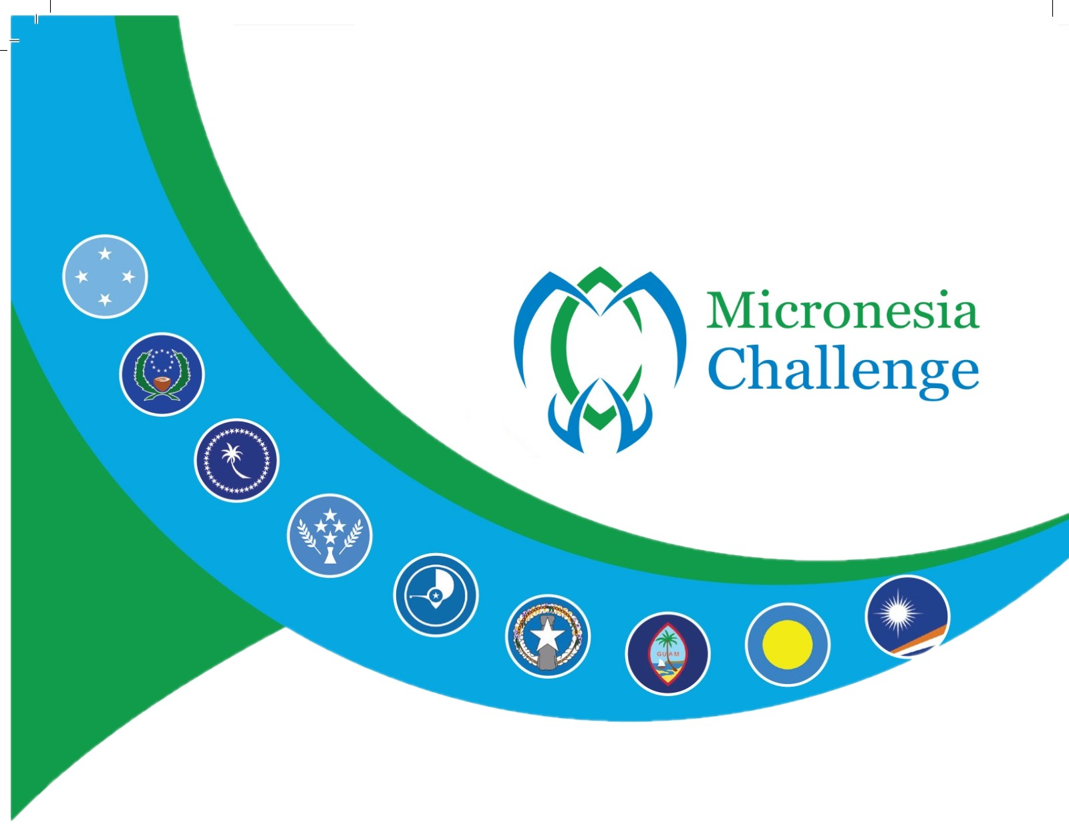
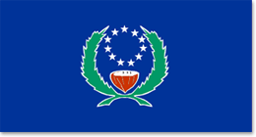
“Enhancing Synergies for a Resilient Tomorrow”
Bill Raynor Micronesia Challenge Scholarship Fund
Progress since 2018
Notes:
Implemented in 2017
Supports Graduate/Doctoral students
Two students selected each year
Up to $30,000 for each student up to 2 years Masters or 3 years Doctorate
MC mentorship network
Post-graduate placement into permanent positions in conservation/resources management

Slide 3
“Enhancing Synergies for a Resilient Tomorrow”
Ongoing and upcoming projects and activities
21 Scholars
13 Master’s Degrees
2 Doctorates
6 Currently enrolled in School
Scholars by Jurisdiction
FSM – 11 Scholars
CNMI – 3 Scholars
Palau – 3 Scholars
RMI – 3 Scholars
Guam – 1 Scholar

Slide 4
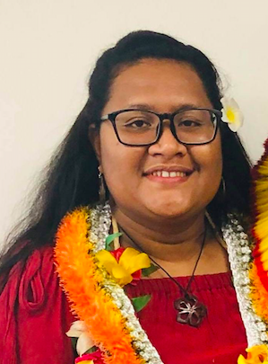
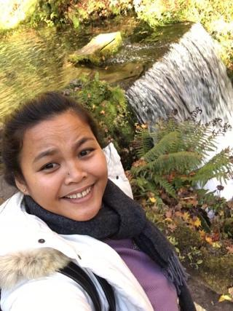
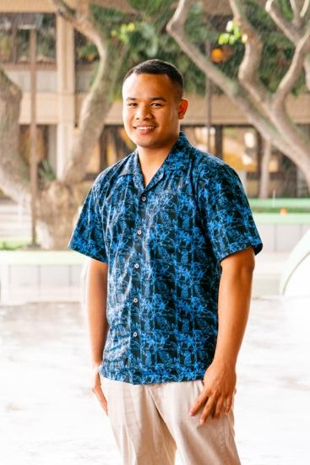
“Enhancing Synergies for a Resilient Tomorrow”
Bertha Reyuw (Yap)
Tamae E. Waguk (KSA)
Rockner Hadley (PNI)
Sophia University, Tokyo Japan
Class of 2019
MA Global Environmental Studies
Capacity Building Program Manager, MCT
Sophia University, Tokyo Japan
Class of 2020
MA Global Environmental Studies
Technical Officer, R2R
UH Manoa
Class of 2020
JD Environmental Law
Maui Court

Slide 5
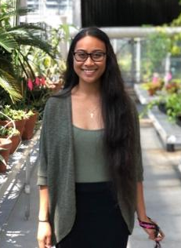
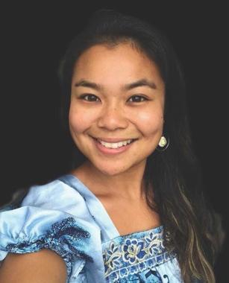
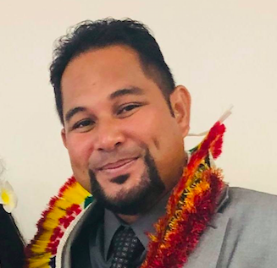
“Enhancing Synergies for a Resilient Tomorrow”
Dr. Harmony Yomai (CHK)
Dr. Nicole Yamase (PNI)
Bradford Mori (CHK)
University of Tennessee
Class of 2021
PhD Ecology & Evolution Bio
Co-develop HS Science programs
UH Manoa
Class of 2022
PhD Marine Biology
Science Advisor
Sophia University, Tokyo Japan
Class of 2022
MA Global Environmental Studies
Executive Director Chuuk EPA

Slide 6
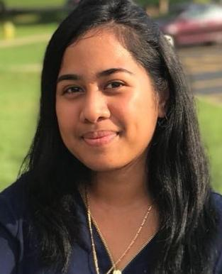
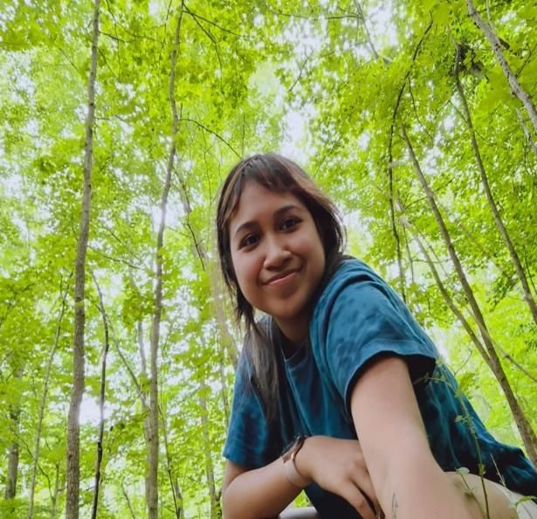
“Enhancing Synergies for a Resilient Tomorrow”
Darla Yatilman (Yap)
Annette Ludwig (PNI)
Natasha Gorong (Yap)
Sophia University, Tokyo Japan
Class of 2022
MA Environmental Studies
Technical Coordinator (CSP)
Sophia University, Tokyo Japan
Class of 2022
Masters Degree
Researcher Land Use
Sophia University, Tokyo Japan
Class of 2023 (expected)
Masters Degree
Researcher Policy

Slide 7
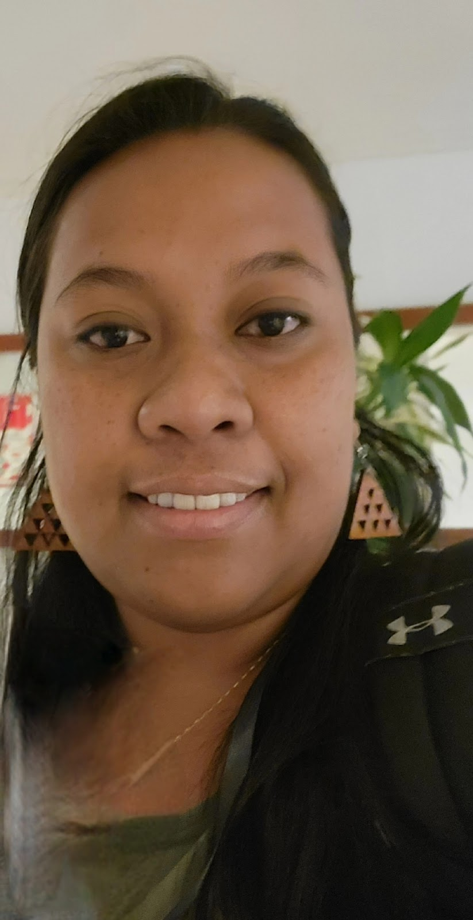
“Enhancing Synergies for a Resilient Tomorrow”
Shaniah Arnold (CHK)
Maybeleen Apwong (PNI)
Sophia University, Tokyo Japan
Class of 2023 (expected)
Masters Degree
Researcher Solid Waste
UH Hilo
Class of 2023 (expected)
Masters Degree
Researcher Mangrove Forest

Slide 8
“Enhancing Synergies for a Resilient Tomorrow”
Challenges/Opportunities
Recruiting BRMC Scholars for higher education
Maintaining Scholars in our region

Slide 9
“Enhancing Synergies for a Resilient Tomorrow”
Opportunities for collaboration
Fund raising for the BRMC endowment

Slide 10
“Enhancing Synergies for a Resilient Tomorrow”
Recommendations
Enroll all scholars in the MIC
Mentors to be active in the scholar's program and career path
Continue to highlight our scholars and their contributions

Slide 11
“Enhancing Synergies for a Resilient Tomorrow”
Thank you!
Notes:
So, as we look forward to the sign off of our Agreement and kick start on our implementation phase of the NAP, we feel the urge to share key recommendations that not only will help better understand what we need to do, but to also fill in the gaps as we move forward in this NAP implementation.

