Slide 1
3rd Joint Environment and Risk Management Platform
“Enhancing Synergies for a Resilient Tomorrow”
2.6 Chemical Waste Management Project
Yota Oue, Consultant, OCEA
August 30-September 1, 2023
Weno, Chuuk

Slide 2
“Enhancing Synergies for a Resilient Tomorrow”
Background – DECEM Chemical Management Institutional Strengthening Project
Purpose of the project - Bolster FSM’s capacity to monitor and evaluate chemical use by sector; provide policy recommendations to improve state and national legislative and regulatory frameworks on chemical management; establish a central database for chemical imports to meet reporting requirements under the Basel and Stockholm Convention
Donor/Budget – UNEP $180,000
Timeline – June to December 2023 (Yes very small implementation window!)

Slide 3
“Enhancing Synergies for a Resilient Tomorrow”
Institutional arrangements – Contracted Firm
Project Manager
Climate & Environment Advisor
Policy & Strategic Planning Advisor
Finance Officer
Yap Officer
Chuuk Officer
Kosrae Officer
Database Engineer
DECEM
Admin
Environment
Climate Change
Emergency Management
Chemical & Waste Management
OCEA Project Team

Slide 4
“Enhancing Synergies for a Resilient Tomorrow”
Ongoing Project Activities
National Chemical Profile & Updated Chemical Inventory – Drafting
National Chemical Management Policy & Action Plan – Planning/Research
Review of Policy and Regulatory Framework on Chemical Management – Drafting
Policy Recommendations for State and National Frameworks on Chemical Management - Drafting
National Chemical Database & Reporting System – Soft Launch
Planned Activities
Stakeholders Meetings to review draft NCP, NCPM&AP, & Policy Recommendations
User Access Testing of National Chemical Database – 8 to 10- users

Slide 5
“Enhancing Synergies for a Resilient Tomorrow”
Opportunities for collaboration
Developing Databases and Reporting Mechanisms – consolidating quantitative data derived from surveys or customs imports to increase ease of reporting, fulfill reporting requirements to depts, implementing agencies, donors, etc.
Using technology tools to automate reporting and communications with stakeholders
Strategic Planning for State EPAs – generate ideas and explore avenues for the EPA to engage with new funding opportunities under Compact III
Policy Development & Technical Training

Slide 6
“Enhancing Synergies for a Resilient Tomorrow”
Recommendations
Improve the quality and frequency of data collection, especially with projects/programs that depend on customs import data to derive baselines on chemicals, vehicles, fuel, refrigerants, etc.
Establish Standard Operating Procedures for chemical imports
Explore ways to collect data to improve current operational or reporting processes – you cannot improve what you cannot measure!

Slide 7
Preview of Preliminary Findings of DECEM’s Chemical Imports from 2019 -2021
“Enhancing Synergies for a Resilient Tomorrow”

Slide 8
“Enhancing Synergies for a Resilient Tomorrow”
Chapter 28 Inorganic chemicals; organic or inorganic compounds of precious metals, of rare-earth metals, of radioactive elements or of isotopes
Chapter 29 Organic chemicals
Chapter 30 Pharmaceutical products
Chapter 31 Fertilisers
Chapter 32 Tanning or dyeing extracts; tannins and their derivatives; dyes, pigments and other colouring matter; paints and varnishes; putty and other mastics; inks
Chapter 33 Essential oils and resinoids; perfumery, cosmetic or toilet preparations
Chapter 34 Soap, organic surface-active agents, washing preparations, lubricating preparations, artificial waxes, prepared waxes, polishing or scouring preparations, candles and similar articles, modelling pastes, “dental waxes” and dental preparations with a basis of plaster
Chapter 35 Albuminoidal substances; modified starches; glues; enzymes
Chapter 36 Explosives; pyrotechnic products; matches; pyrophoric alloys; certain combustible preparations
Chapter 37 Photographic or cinematographic goods
Chapter 38 Miscellaneous chemical products- pesticides and related chemicals
Chapter 39 - Plastics and Articles Thereof
Chapter 40 - Rubbers and Articles Thereof

Slide 9
“Enhancing Synergies for a Resilient Tomorrow”
Nominal Value of Chemical Imports per Chapter per State in 2019 - 2021

Slide 10
“Enhancing Synergies for a Resilient Tomorrow”
Chemical Chapters as % of Annual Imports per State & Year

Slide 11
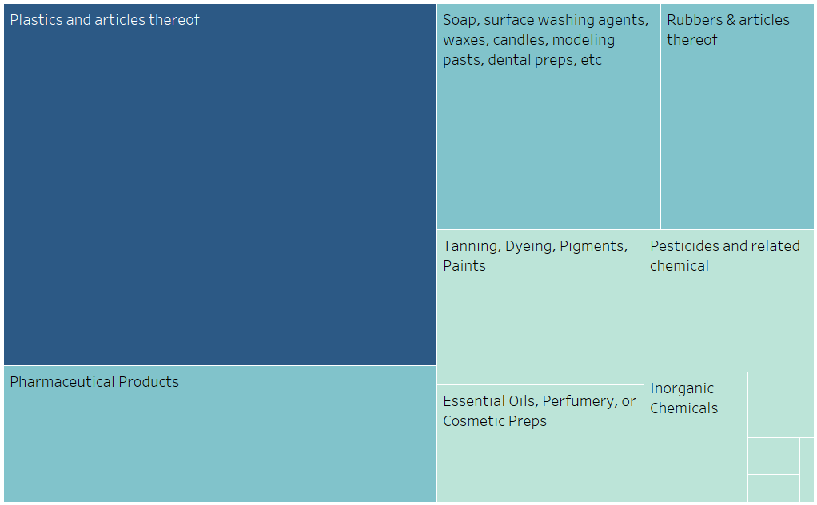
“Enhancing Synergies for a Resilient Tomorrow”
2019 – 2021 Imports of Chemicals and Chemical-related Products into FSM

Slide 12
“Enhancing Synergies for a Resilient Tomorrow”
Kalahngan, Kinisou Chapur, Kammagar, Kulo
Any Questions?

