Slide 1
3rd Joint Environment and Risk Management Platform
“Enhancing Synergies for a Resilient Tomorrow”
2.7 FSM DATA PORTAL
Skiis Dewey, IT & Communications Officer, DECEM
August 30-September 1, 2023
Weno, Chuuk

Slide 2
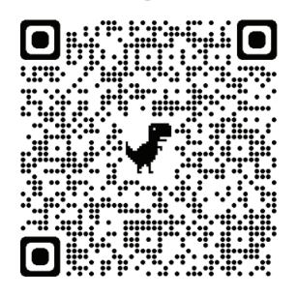
“Enhancing Synergies for a Resilient Tomorrow”
https://fsm-data.sprep.org
Data Portal Background
FSM Environmental Data Portal implemented by SPREP INFORM project in 2018.
Upgraded to EKAN data portal platform in 2021.
Climate change and disaster risk management features incorporated in 2023
Notes:
Ran Anim, Kaselehlie, Mogethin and Lenwo
Inform Portal
FSM Environment, Climate Change and Disaster Risk Management Data Portal
Department implemented the climate change portal features on the Inform(Environment Portal)

Slide 3
“Enhancing Synergies for a Resilient Tomorrow”
FSM Environment, Climate Change and Disaster Risk Management Data Portal Main Menu

Slide 4
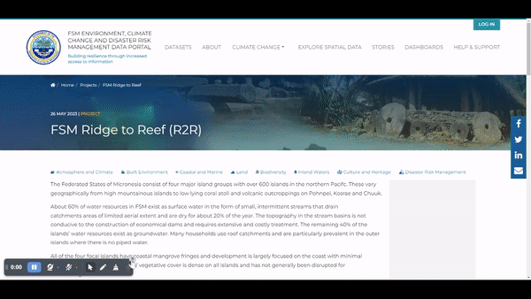
“Enhancing Synergies for a Resilient Tomorrow”
Searchable Information Repository
Projects and Funding Page
Notes:
Projects and Funding Database
Find the information on current, future and past projects
Projects updates, resource documents, news and events.

Slide 5
“Enhancing Synergies for a Resilient Tomorrow”
Climate Change and Disaster Risk Management
Notes:
Climate Change Focussed Landing Page
Ability to search items within climate and disaster risk management topics
Navigate to
General information on climate change impacts
Climate projects list
Legislation and policies landing page
Education landing page
Access latest news items related to climate / disaster risk management
Find a curated list of resources related to climate / disaster risk management
Stats panel highlighting the number of following items on the portal related to climate / disaster risk management
Projects
Resources
Dashboards
News items
Access a list of active projects related to climate / disaster risk management

Slide 6
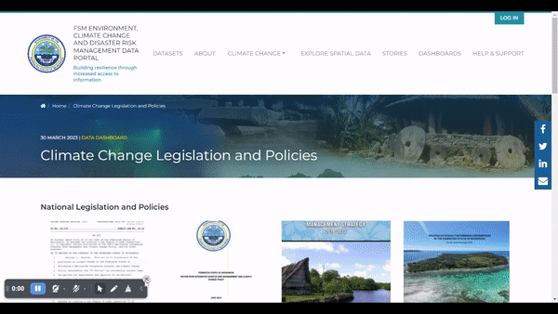
“Enhancing Synergies for a Resilient Tomorrow”
Education Resources Landing Page
Legislation and Policies Landing Page
Notes:
Benefits of Legislation and Policies Landing Page
Access a list of national legislation and policy resources
Access a list of state based legislation and policy resources

Slide 7
“Enhancing Synergies for a Resilient Tomorrow”
Thank you!
Notes:
So, as we look forward to the sign off of our Agreement and kick start on our implementation phase of the NAP, we feel the urge to share key recommendations that not only will help better understand what we need to do, but to also fill in the gaps as we move forward in this NAP implementation.

