Slide 1






3rd Joint Environment and Risk Management Platform
“Enhancing Synergies for a Resilient Tomorrow”
2.3 Chuuk Environmental Protection Agency
Joyce Sewell, Solid Waste Management Manager, EPA
August 30-September 1, 2023
Weno, Chuuk

Slide 2
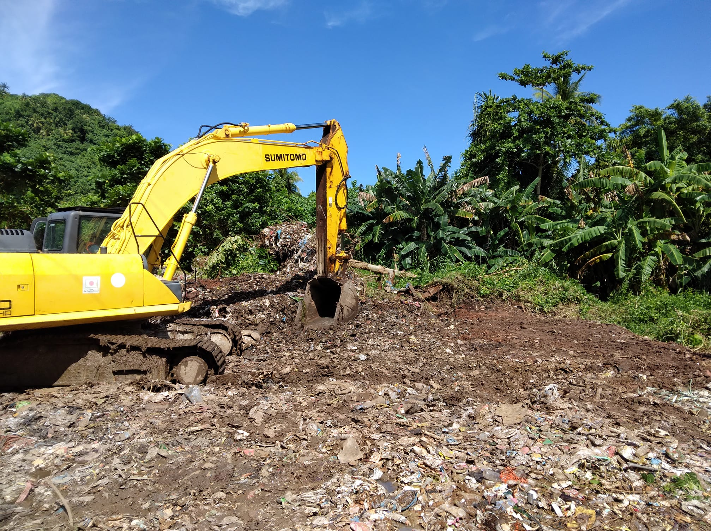




“Enhancing Synergies for a Resilient Tomorrow”
Progress since 2018
  Rehabilitation of Neauo Dumpsite – 90% complete
  JMAS – used oil removal from sunken vessels in the lagoon - # gals??
  Ridge 2 Reef Projects
    Kuop LEAP (local early action plan)
    Witipon Mgmt Plan
    SOU (Sopo, Oror, Ununo) Forest Stewardship Plan
  Removal of sunken vessels at Penta Dock (Public Works/EPA) Rehabilitation of Neauo Dumpsite – 90% complete
  Recycling Program – 2 Baler machine donated by EOJ. Recycling operator identified
  Chuuk State Clean Environment Act of 2018 – ban on, plastic shopping bags, plastic straws, etc
  Collection of junk cars ongoing

Slide 3
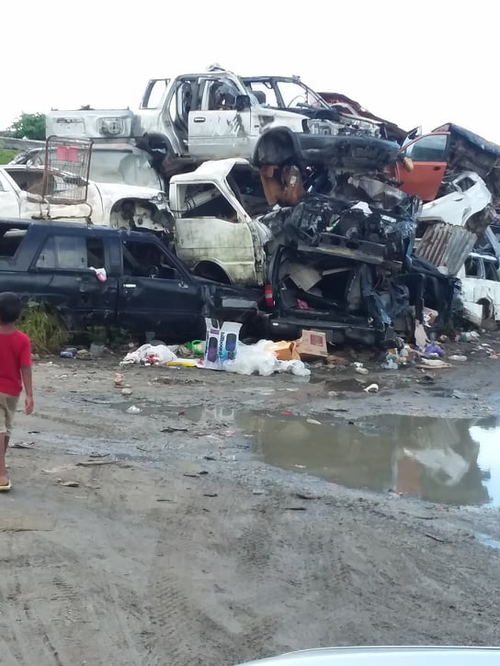
“Enhancing Synergies for a Resilient Tomorrow”
Ongoing and upcoming projects and activities
  Removal of Micro Dawn – US Military Team
  Renovation of Bio Security facility for agriculture
  JMAS – continuous used oil collection( on break)
        Australia group to help JMAS
  Transition of dumpsites – Reopening of Neauo Dumpsite and Closure of Marina Dumpsite
  Coral Reef Monitoring Program since 2007 established, monitoring 2008 – data base with UOG Marine Lab – yearly assessment by DMR
  Monthly clean-up by CWC and collaborating offices/DPS daily clean-up ongoing
  Construction of a Compost Facility at Neauo Dumpsite – Recent waste audit conducted on Weno last month of July funded by European Union
  27 Earth Moving Projects received: 2 major projects, 14 new permits, 11 pending due to incomplete documents
  Water Testing of water bottling companies, CPUC, hospital

Slide 4
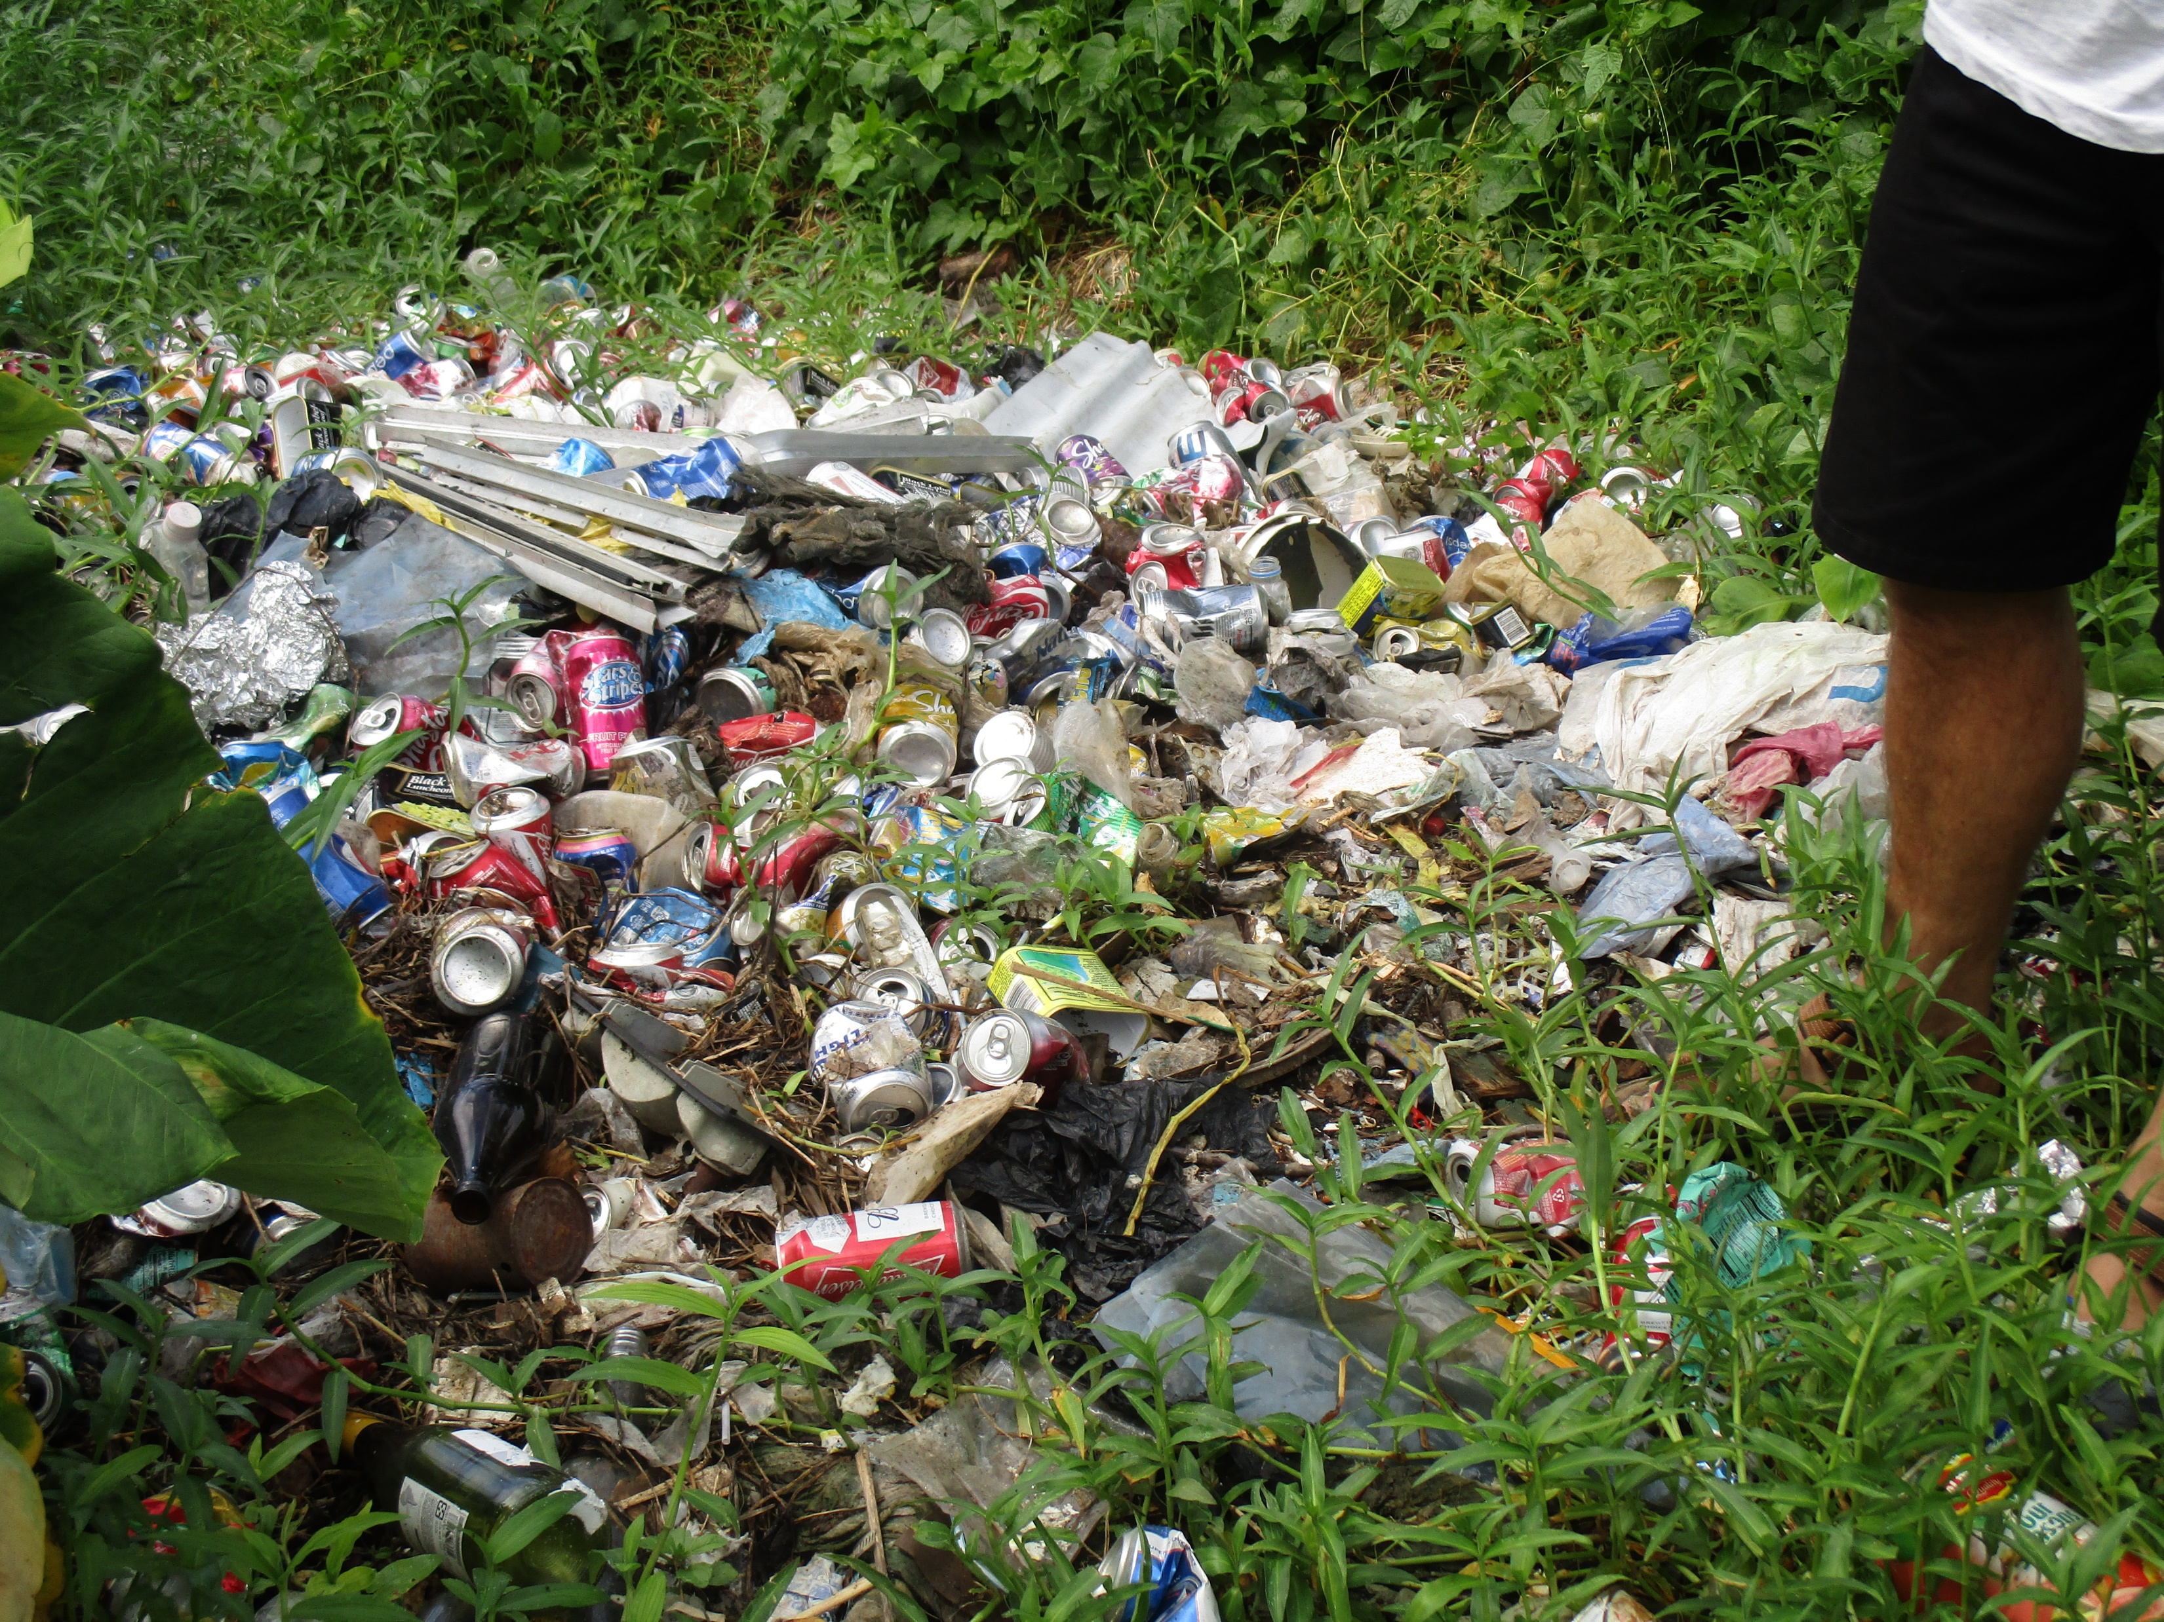
“Enhancing Synergies for a Resilient Tomorrow”
Challenges
  Technical
        Man power –
        Capacity – technical expertise,
  Geographic distance of islands
  Financial Resources
  Cost sharing of used oil collected – transferring and shipping
  Climate change
        Water security
        Food Security
  Over Capacity of Marina Dumpsite
  Illegal Dumping

Slide 5
“Enhancing Synergies for a Resilient Tomorrow”
Opportunities for collaboration
  US EPA Region9 - direct assistance
  Enhance Data Collection and awareness between collaborating offices/departments – inter agency collaboration – cost sharing
  Proper, Blue Prosperity, GEF 6 (Invasive & 7 ) – multiple state, national, donors collaboration and etc.
  Collaboration with municipal governments, traditional leadership and resources owners

Slide 6
“Enhancing Synergies for a Resilient Tomorrow”
Recommendations
  1. Capacity training opportunities
  2. Policies and Legislations
        Funding be provided
        New approve policies with budget
        Speed up Recycling Law
  3.

