Slide 1
3rd Joint Environment and Risk Management Platform
“Enhancing Synergies for a Resilient Tomorrow”
7.1 UNFCCC/TNCBUR
Chandra Legdesog, Climate Change Advisor
August 30-September 1, 2023
Weno, Chuuk

Slide 2
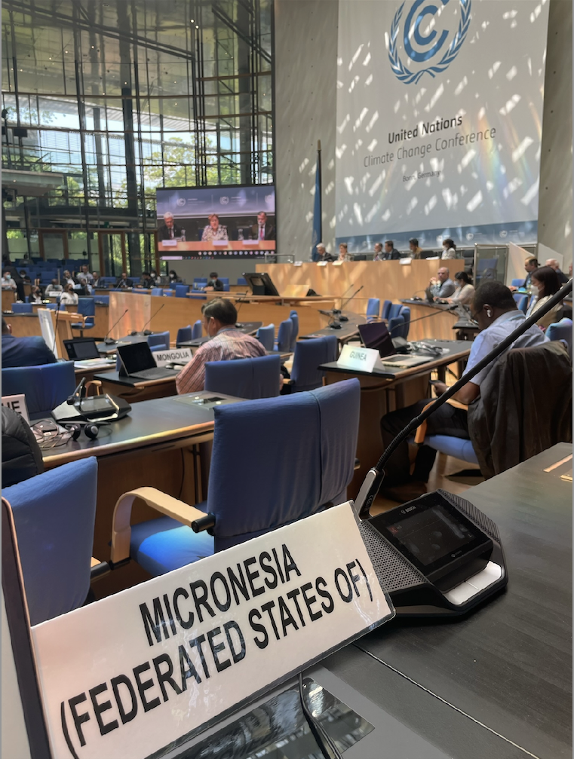
UNFCCC
“Enhancing Synergies for a Resilient Tomorrow”
The United Nations Framework Convention on Climate Change is an international treaty that seeks to stabilize concentrations of greenhouse gases to prevent dangerous human interference with the climate system (1994)
FSM is a Party to the Convention
FSM is not a major emitter however we are at the forefront of climate change impacts

Slide 3
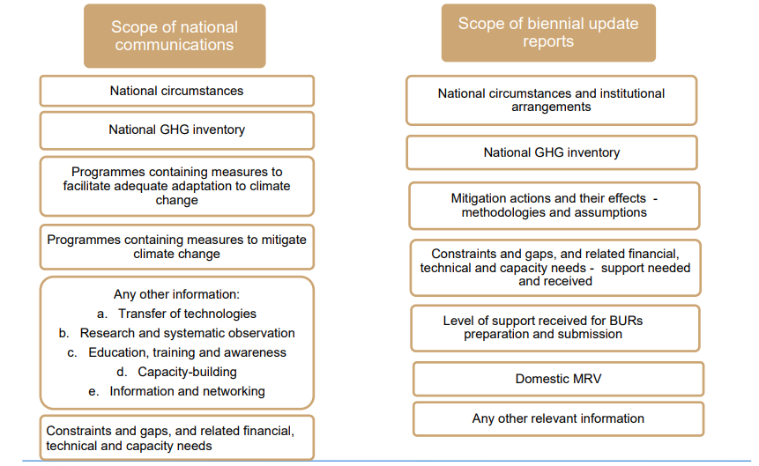
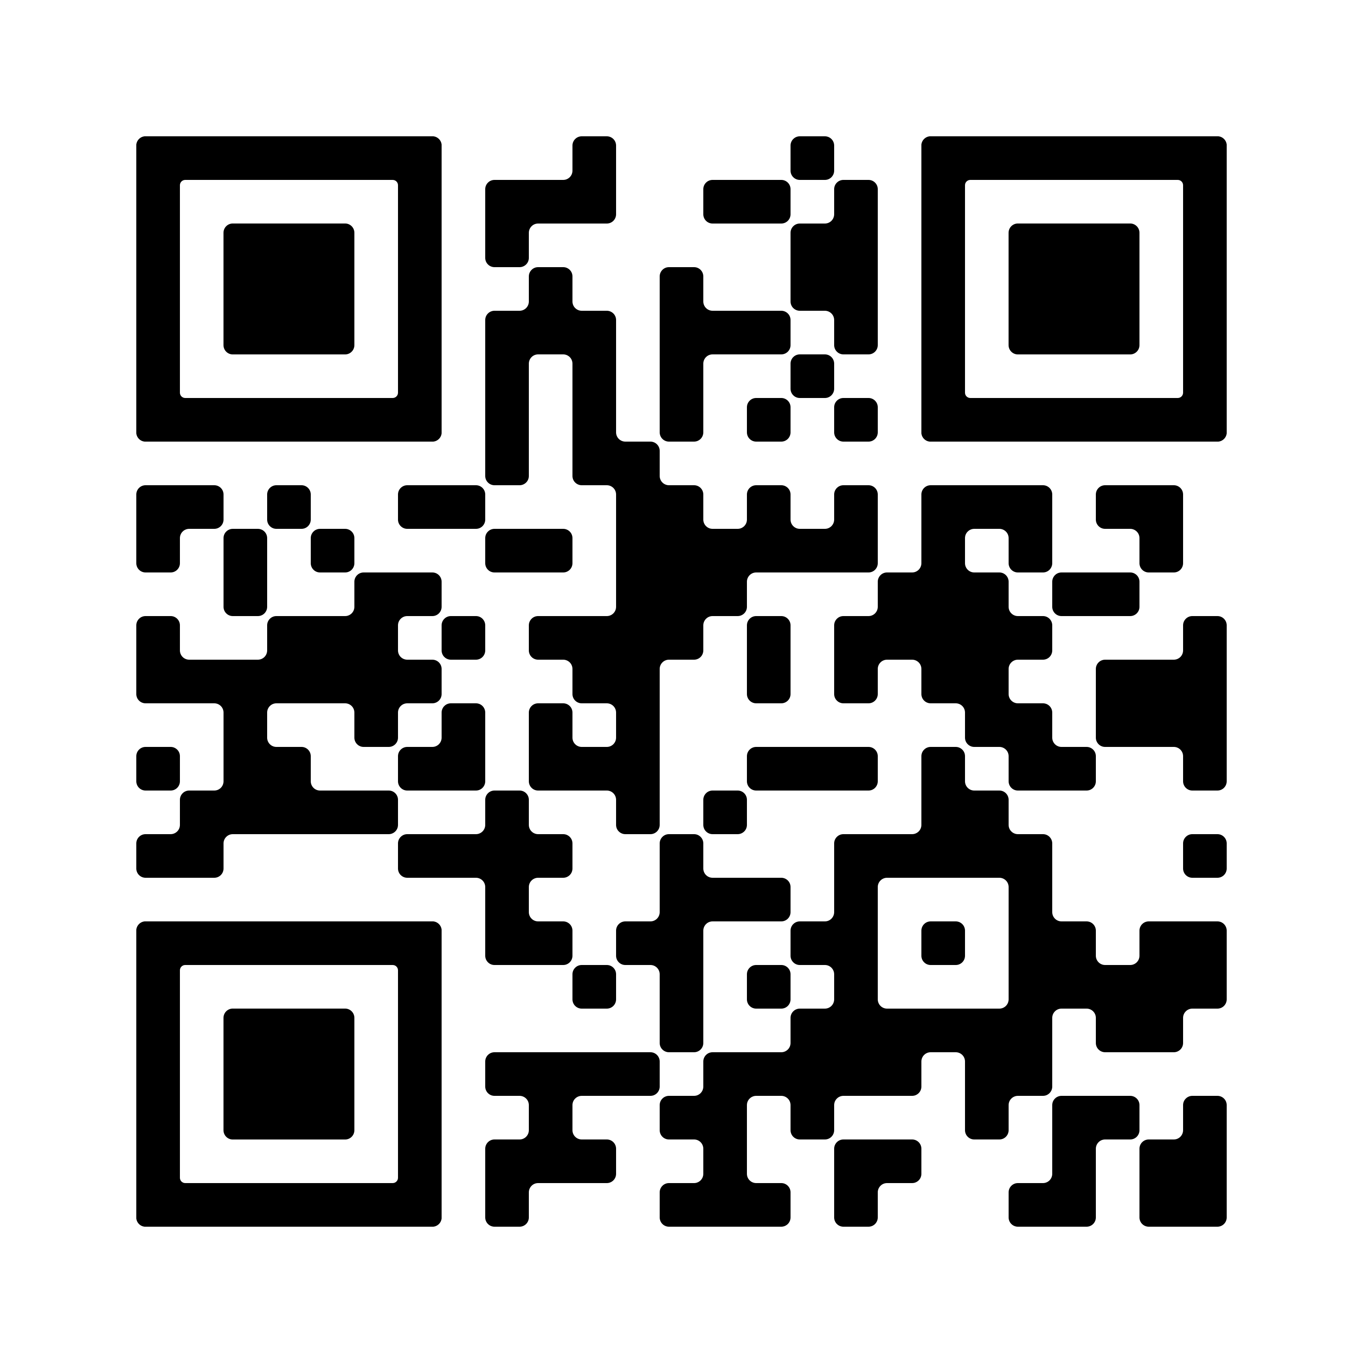
“Enhancing Synergies for a Resilient Tomorrow”
Progress since 2018
Third National Communication to the UNFCCC (2023)
First Biennial Update Report to the UNFCCC (2023)

Slide 4
“Enhancing Synergies for a Resilient Tomorrow”
Ongoing and upcoming projects and activities
National Communications (every 4 years)
Biennial Update Reports (every 2 years)

Slide 5
“Enhancing Synergies for a Resilient Tomorrow”
Challenges
Covid-19
Data availability
Turnover
Institutional arrangements

Slide 6
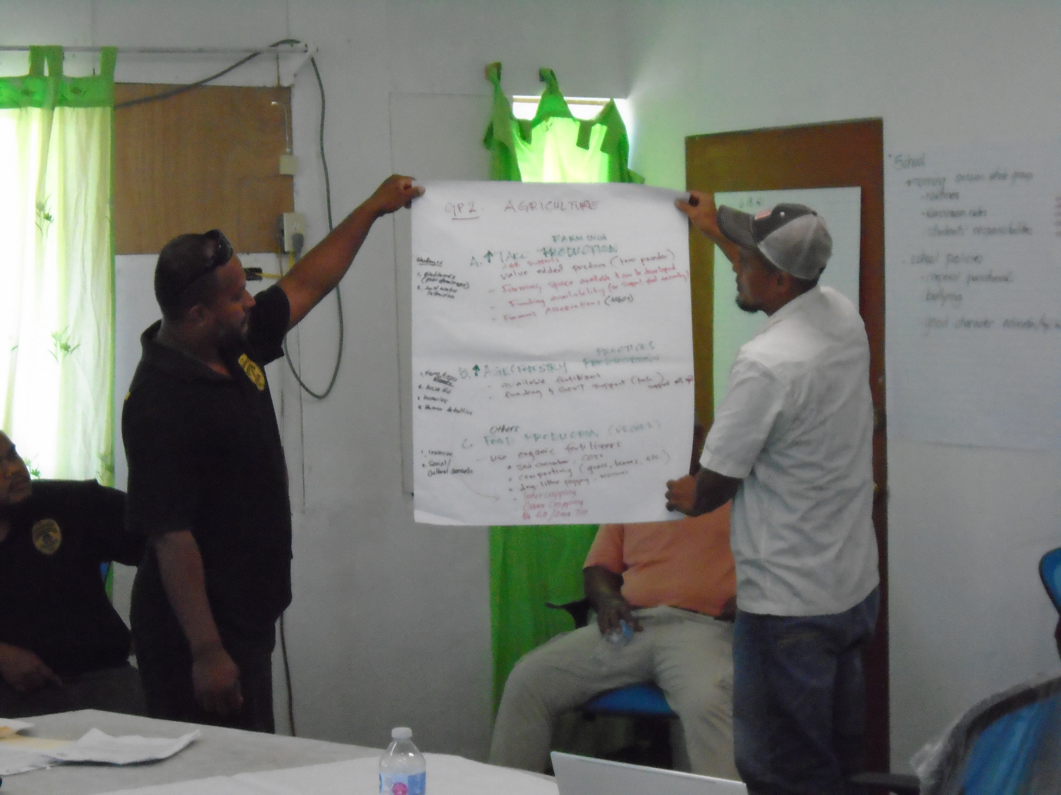
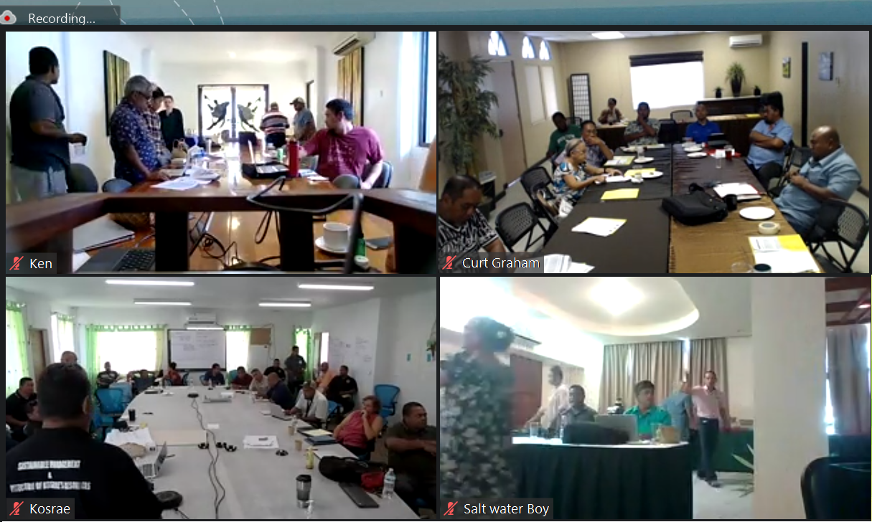
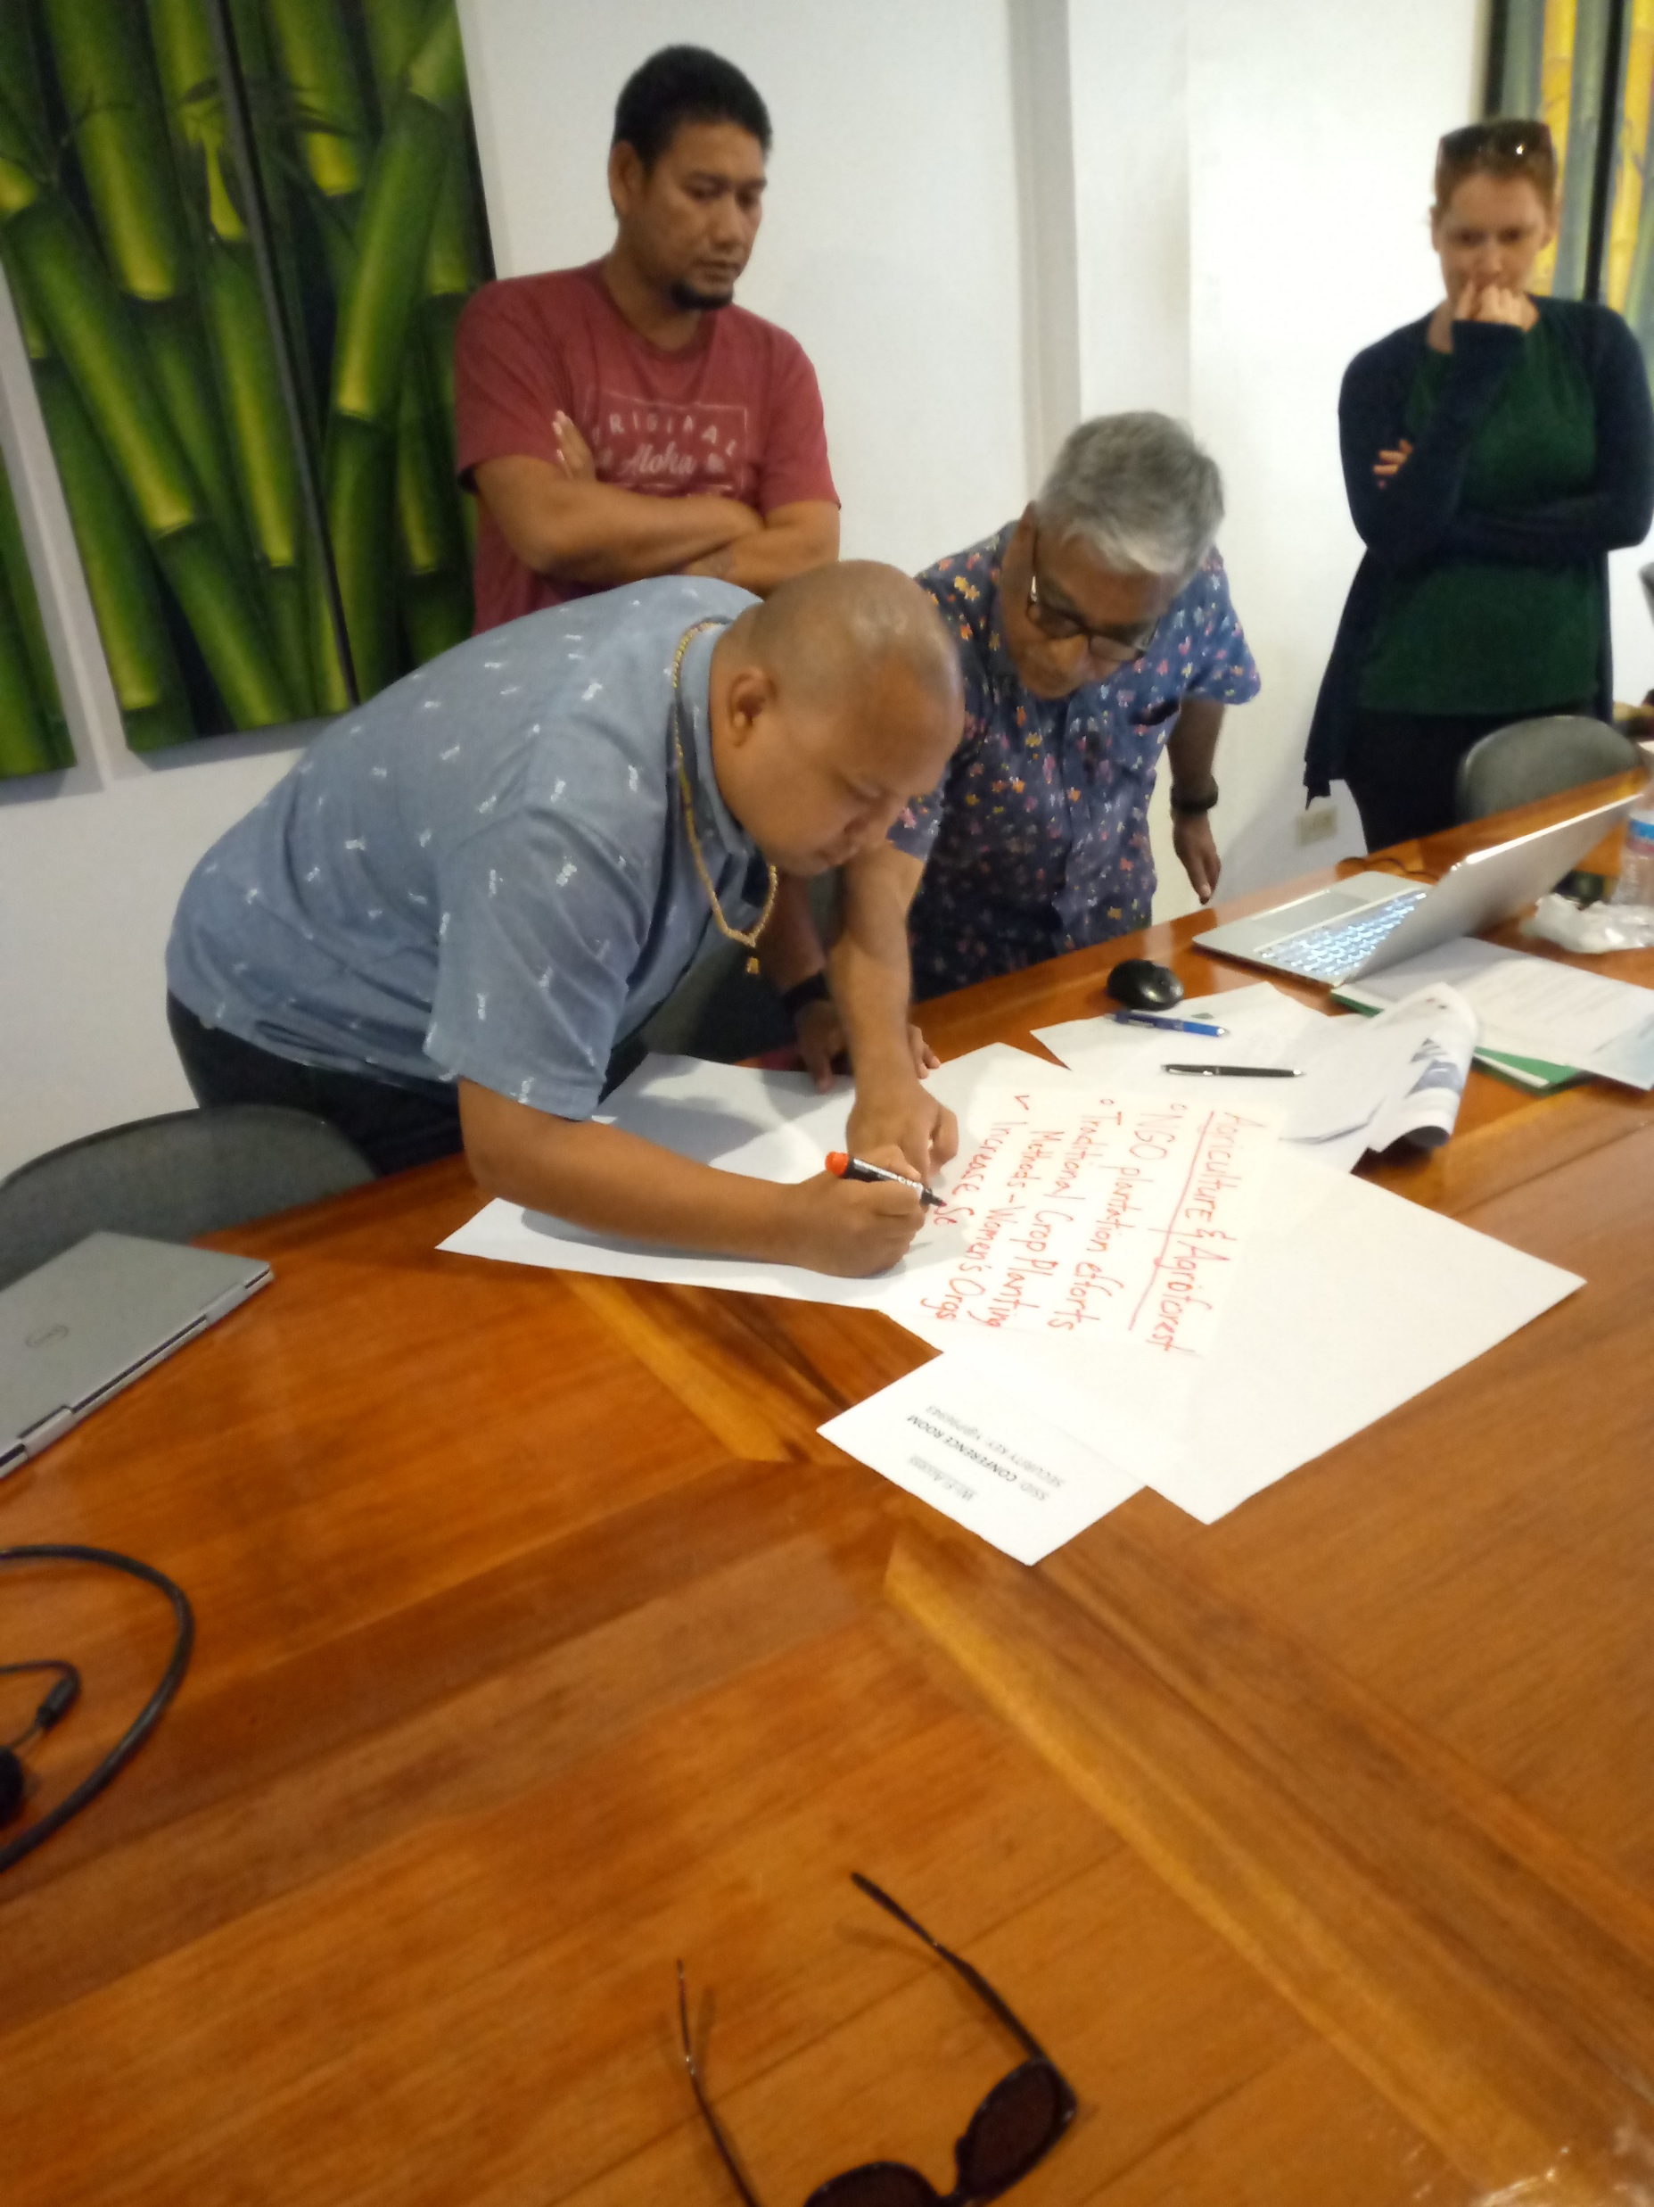
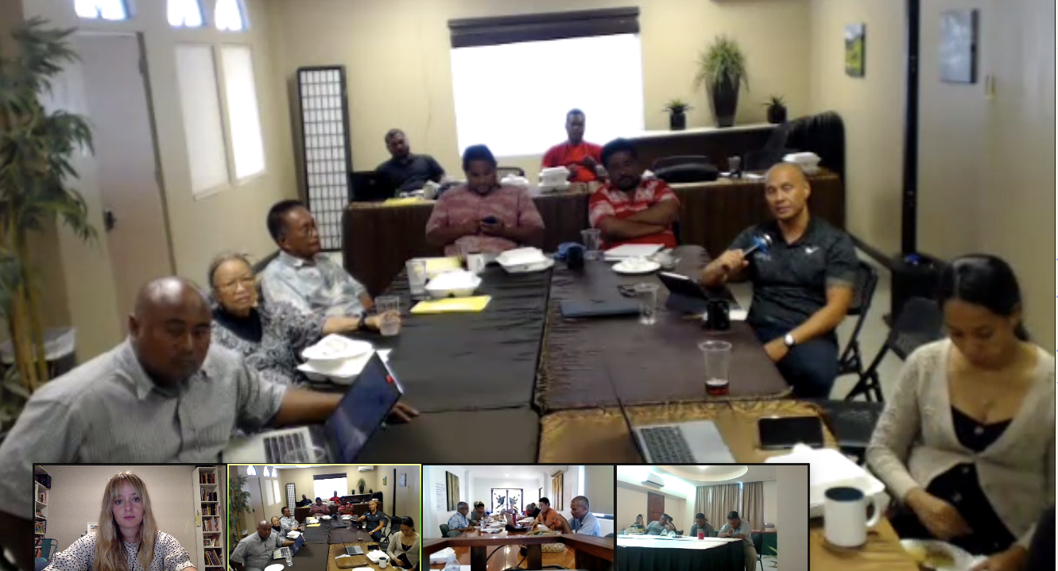
“Enhancing Synergies for a Resilient Tomorrow”
Opportunities for collaboration
Consultations, workshops, assessments, trainings, interviews
State-level engagement
FSM’s Greenhouse Gas Inventory (2006 IPCC Guidelines) consultations
2.5-day Mitigation Workshop
Vulnerability and Adaptation Assessments
2-day MRV Workshop
2 half-day Gender Trainings [and] Gender Surveys [and] Gender Interviews
4 half-day National Circumstances and Institutional Arrangements Workshop

Slide 7
“Enhancing Synergies for a Resilient Tomorrow”
Recommendations
Establish Central Archive for data storage for future inventories
Establish renewable energy focal points
largest emissions sector – Energy - Fuel combustion for electricity generation
public utilities companies and private sector – supply and demand for EE appliances
nature-based solutions that have co-benefits - land use planning that protect carbon sinks such as seagrasses, mangroves and ocean.
Compile vulnerability and adaptation assessments from all sectors in preparation for the NAP
Infrastructure, environment, agriculture, fisheries, health, education, social/cultural, private sector/economic resilience

Slide 8
“Enhancing Synergies for a Resilient Tomorrow”
Thank you!

