Slide 1
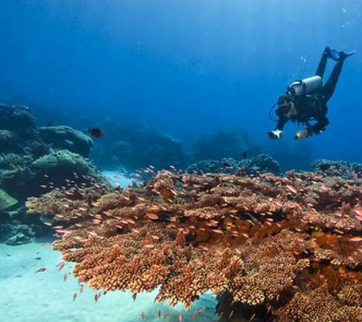
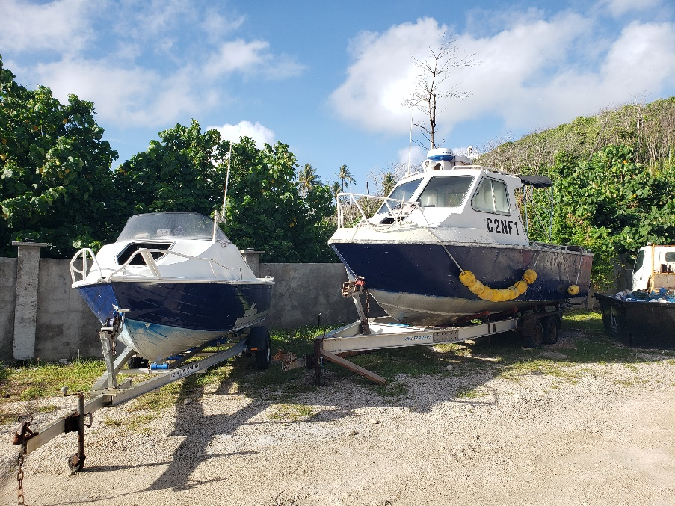
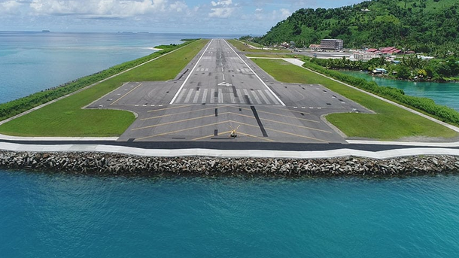
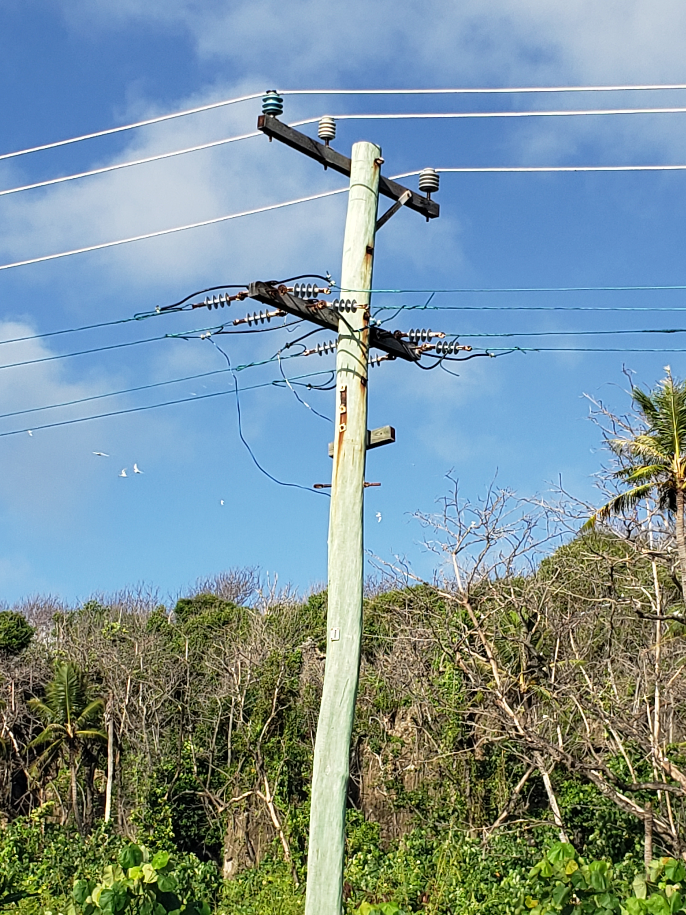
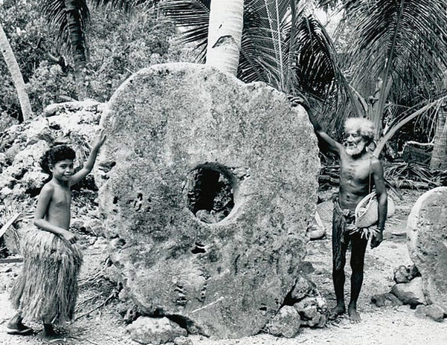
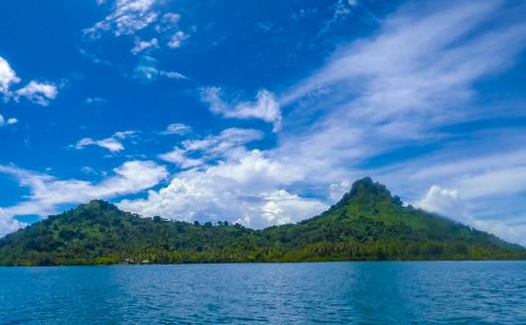
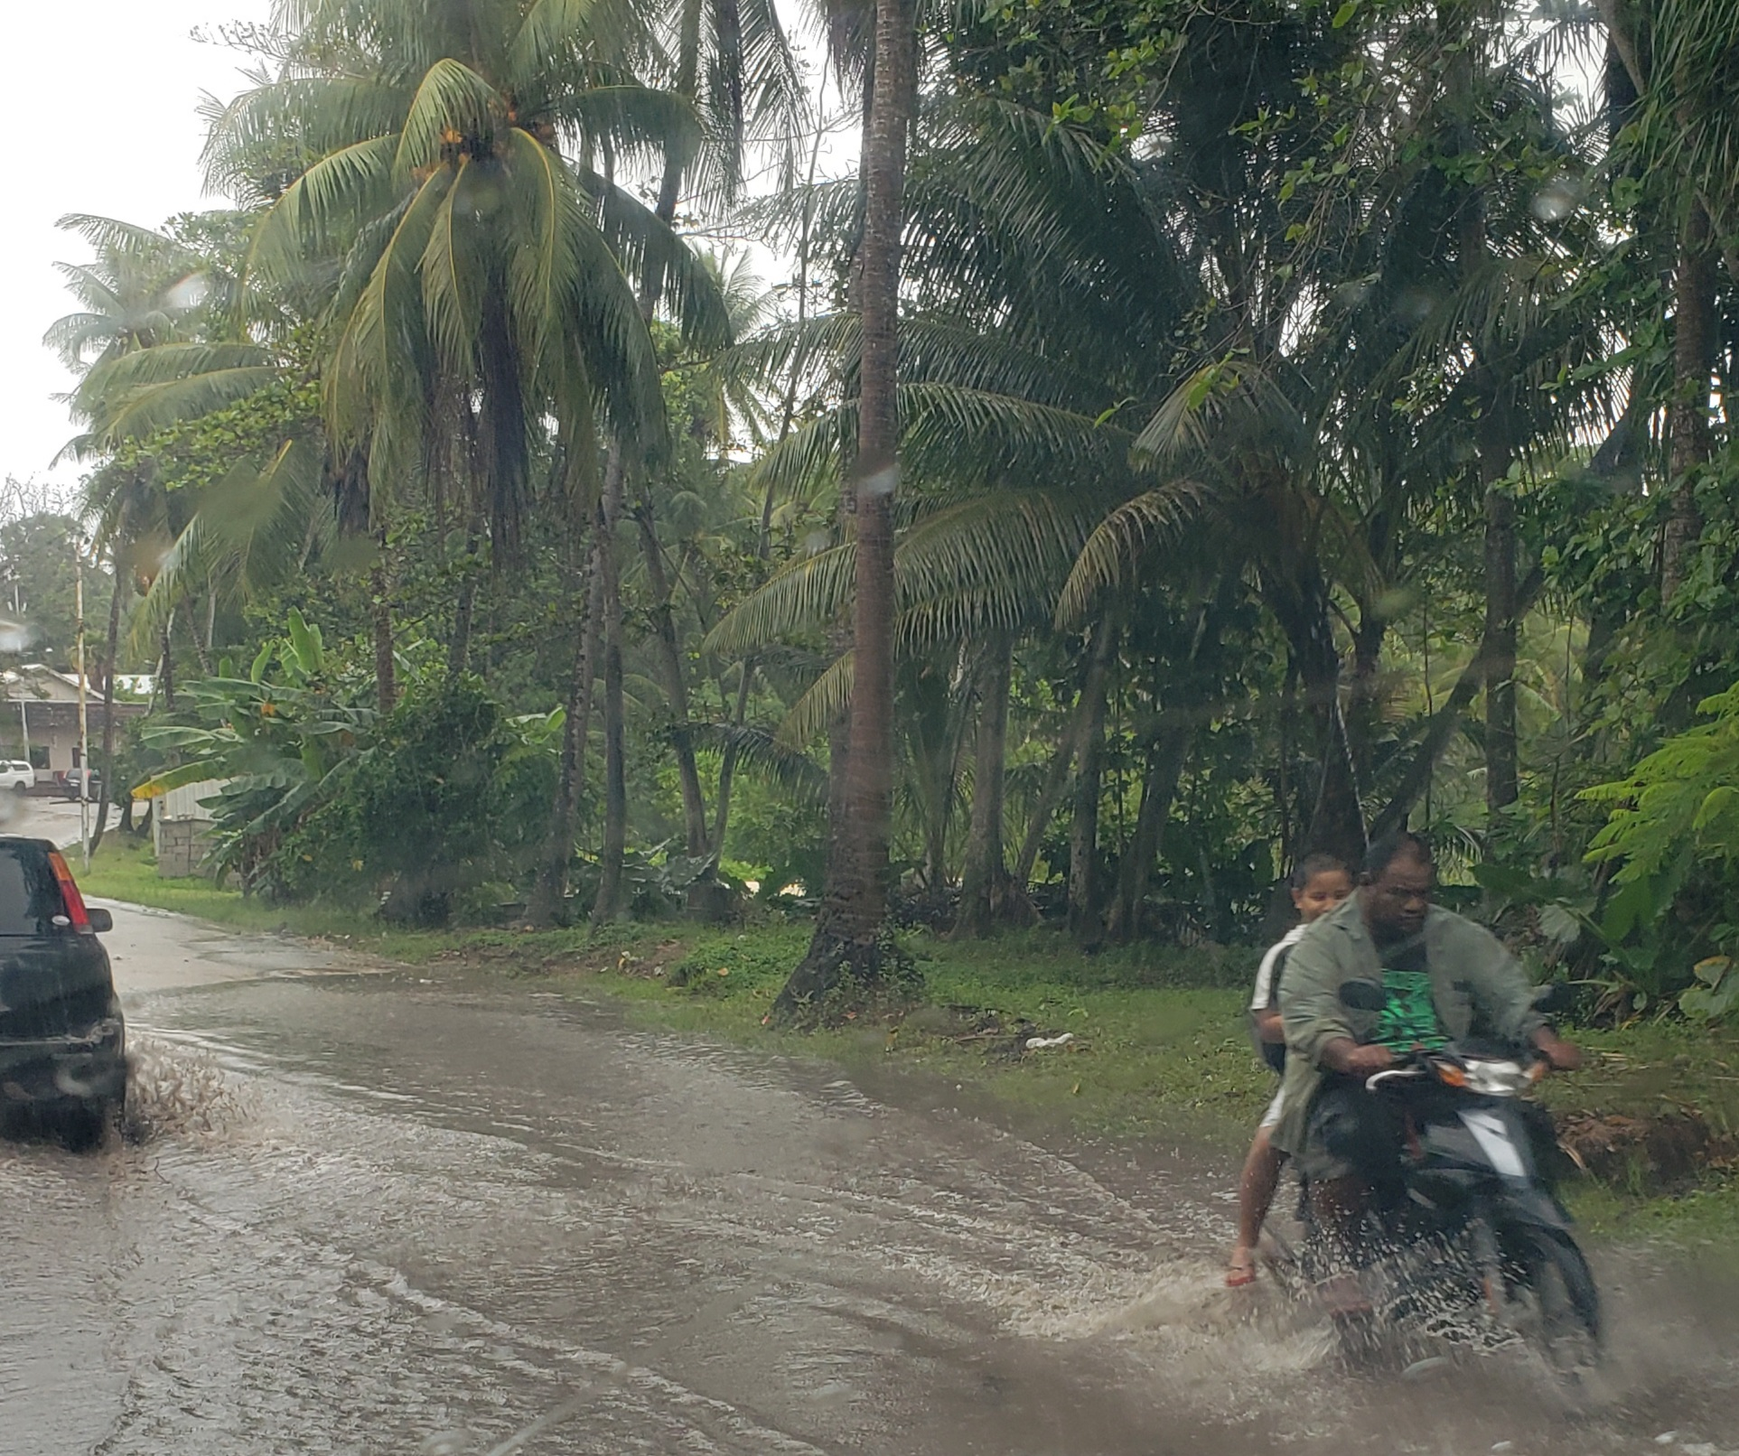
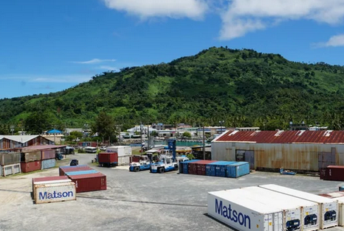
Climate impacts, vulnerability, and risk assessment for FSM Leanne Webb, Alexei Trundle and Marian Sheppard

Slide 2
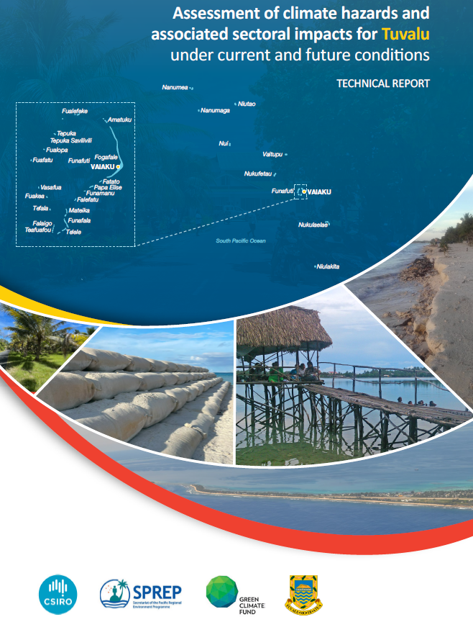
Climate Impact and Vulnerability Risk Assessment (CIVRA) informing the National Adaptation Plan (NAP)
Climate Impacts, Vulnerability and Risk Assessments (CIVRA) are being prepared on behalf of SPREP for Tuvalu, Nauru, FSM, and Niue.
The assessment components comprise:
Climate hazards (CSIRO)
Vulnerability (University of Melbourne)
Exposure (included with hazard and vulnerability)
Risk (Deloitte)
Together, these will inform each countries National Adaptation Plan (NAP) updates.

Slide 3
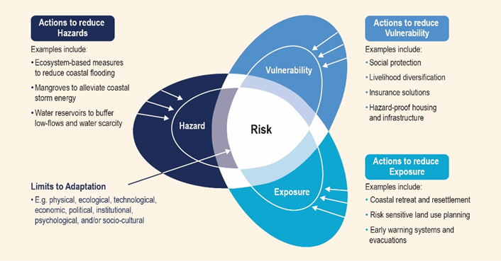
Components of risk
Risk is derived from the combination of hazard, exposure and vulnerability.
Adaptation e.g. coastal inundation
Mangroves can reduce storm surges
Hazard proof housing
Coastal retreat and resettlement
Loss and Damage

Slide 4
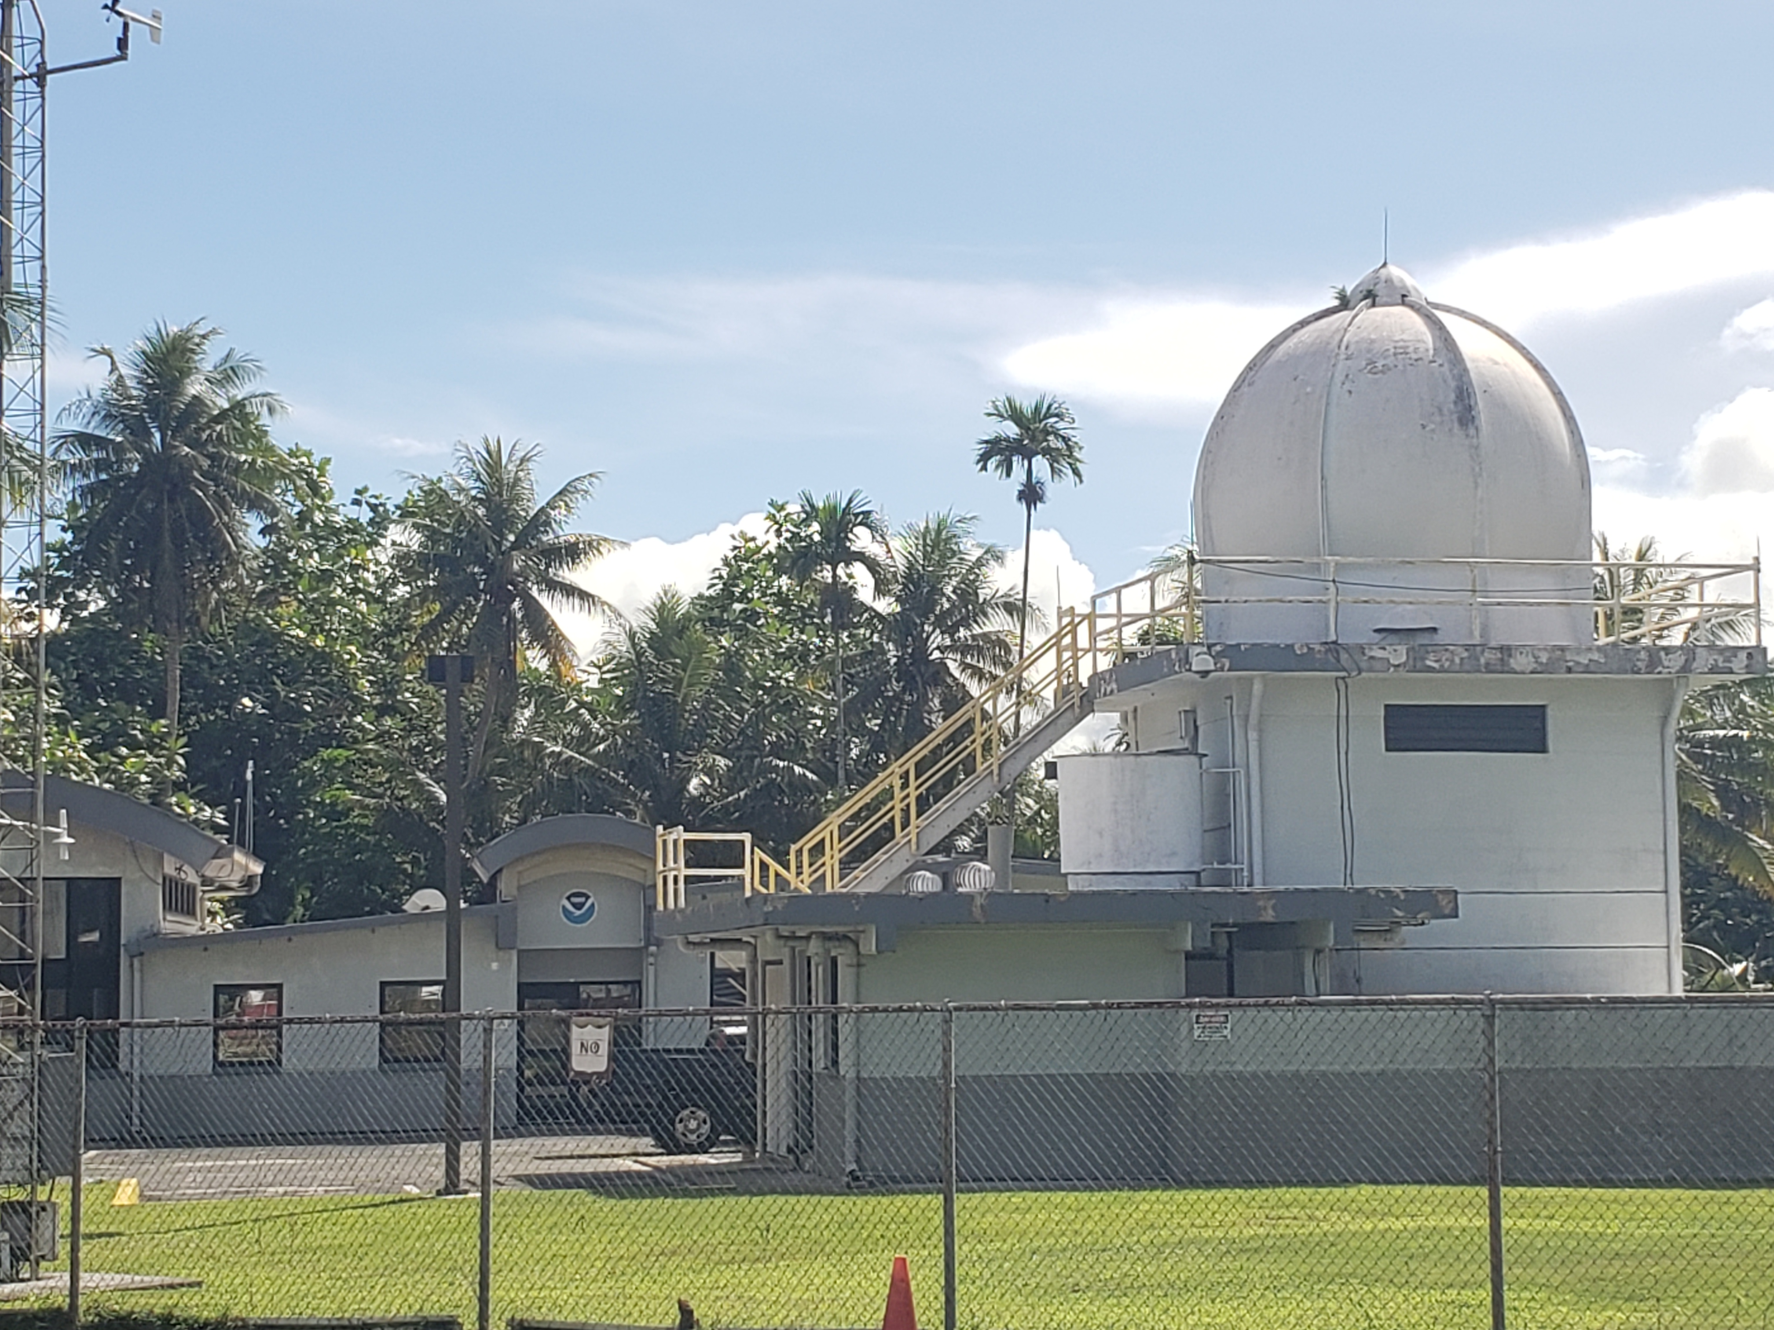
FSM CIVRA: Climate hazards component
Observed climate
Recent trends
Future Projections
2030, 2050 (planning decision horizons)
Low emissions & high emissions
Average and extreme temperature
Average and extreme rainfall
Drought
Typhoons and wind
Fire weather
Sea level and coastal inundation (tides/ waves)
Average sea surface temperature (SST)
Extreme SST: marine heatwaves and degree heating weeks
Ocean acidification

Slide 5
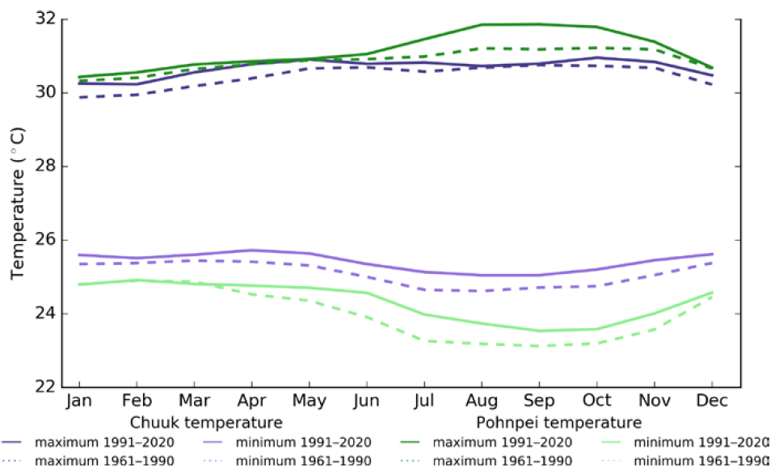
Temperature: averages and variability
Chuuk (purple) and Pohnpei (green)
1975 (1961-1990) (dotted lines)
2005 (1991-2020) (solid lines)
Average maximum daily temperatures are 30-31 ºC (~86-88 ºF)
Average minimum daily temperatures are 24-25ºC (~75-77 ºF)
According to McGree et al (2022)

Slide 6
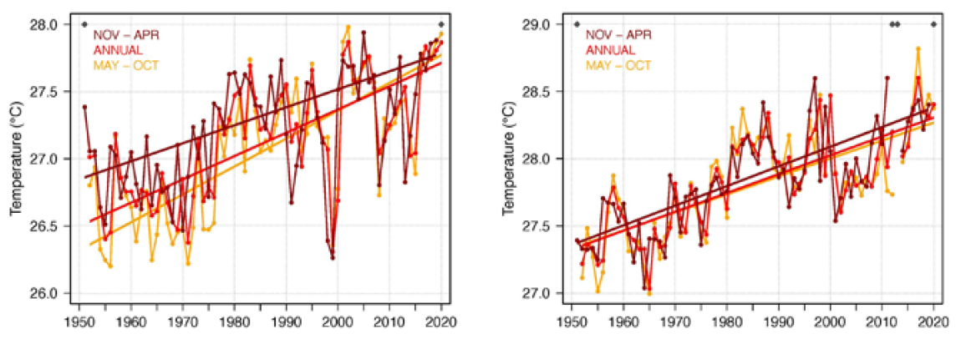
Temperature: trends
28 deg C = 82.4 deg F
Pohnpei
Average annual and seasonal temperatures have increased significantly
May–October temperatures are warming faster than November–April temperatures
Chuuk
Average annual and seasonal temperatures have increased significantly
Seasonal warming trends are similar
According to McGree et al (2022)

Slide 7
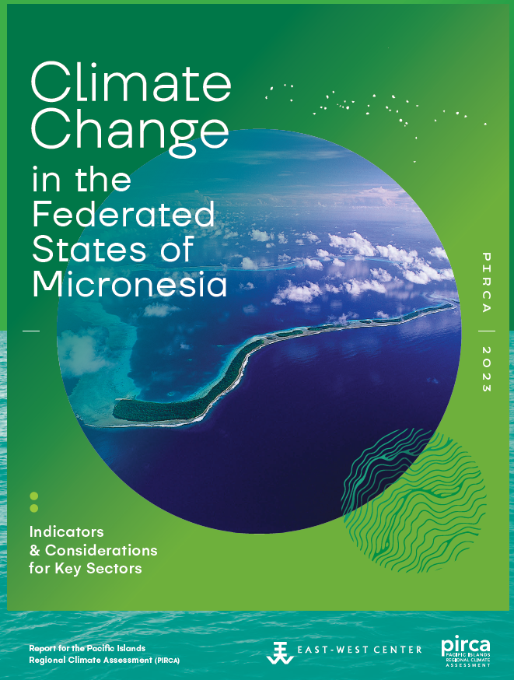
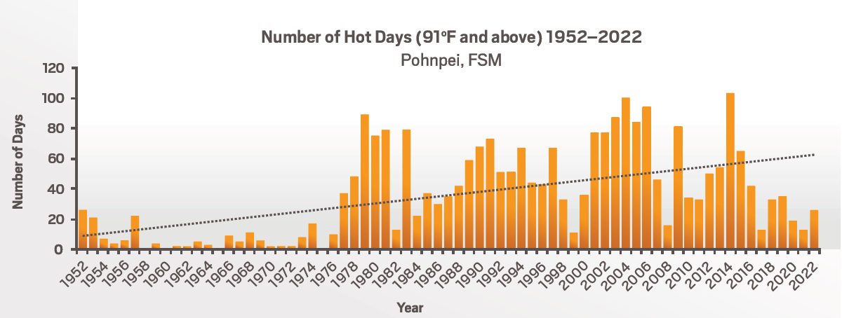
Extreme temperature: trends
The annual number of days with maximum temperature of 91°F (33°C) or hotter (1952 to 2022)
Source: Grecni, Z., C. Bryson, and E. Chugen, 2023

Slide 8
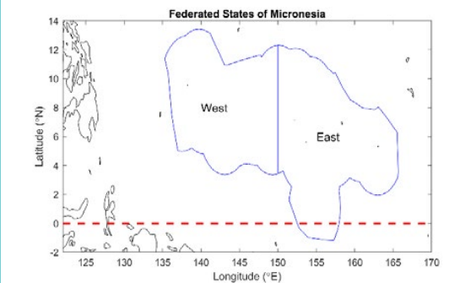
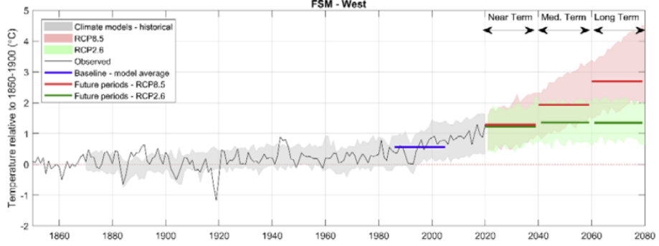
Temperature projections
Future temperature projections
(High emissions)
(Low emissions)
2070
2050
2030
(Source: FSM Country Report_Updated.pdf (rccap.org) CSIRO and SPREP, 2021)

Slide 9
FSM CIVRA: Climate hazards component
Observed climate
Recent trends
Future Projections
2030, 2050 (planning decision horizons)
Low emissions & high emissions
Average and extreme temperature
Average and extreme rainfall
Drought
Typhoons and wind
Fire weather
Sea level and coastal inundation (tides/ waves)
Average sea surface temperature (SST)
Extreme SST: marine heatwaves and degree heating weeks
Ocean acidification

Slide 10
Vulnerability
Adaptation

Slide 11
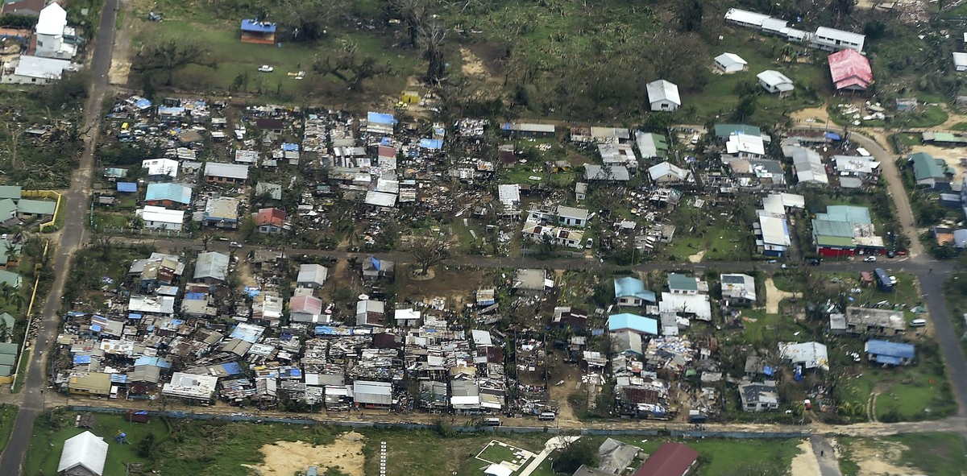
Vulnerability: an example from Port Vila, Vanuatu
Vulnerability is defined as “the propensity or predisposition to be adversely affected” as a function of “sensitivity, susceptibility to harm, and a lack of capacity to cope and adapt” (IPCC 2023)
Damage to houses in Port Vila, Vanuatu, is seen from the air in the aftermath of Cyclone Pam on March 16, 2015. (Dave Hunt/AP)

Slide 12
Climate vulnerability within the CIVRA approach
Average vulnerability
Average thresholds impacting consequence level
Relevant external comparison to accepted norms
Trends, disruptions
Vulnerability ‘hotspots’
Spatial sensitivity hotspots
Sociocultural (e.g. gender)
Institutional (govt, church)
Vulnerability Profile
Historical changes
Evident/projected trends
Possible structural shifts
External dynamics
Uncertainties & external factors
Data gaps, outdated data
Missing data (e.g. traditional knowledge)
Key external impacts (policy, trade, etc.)

Slide 13
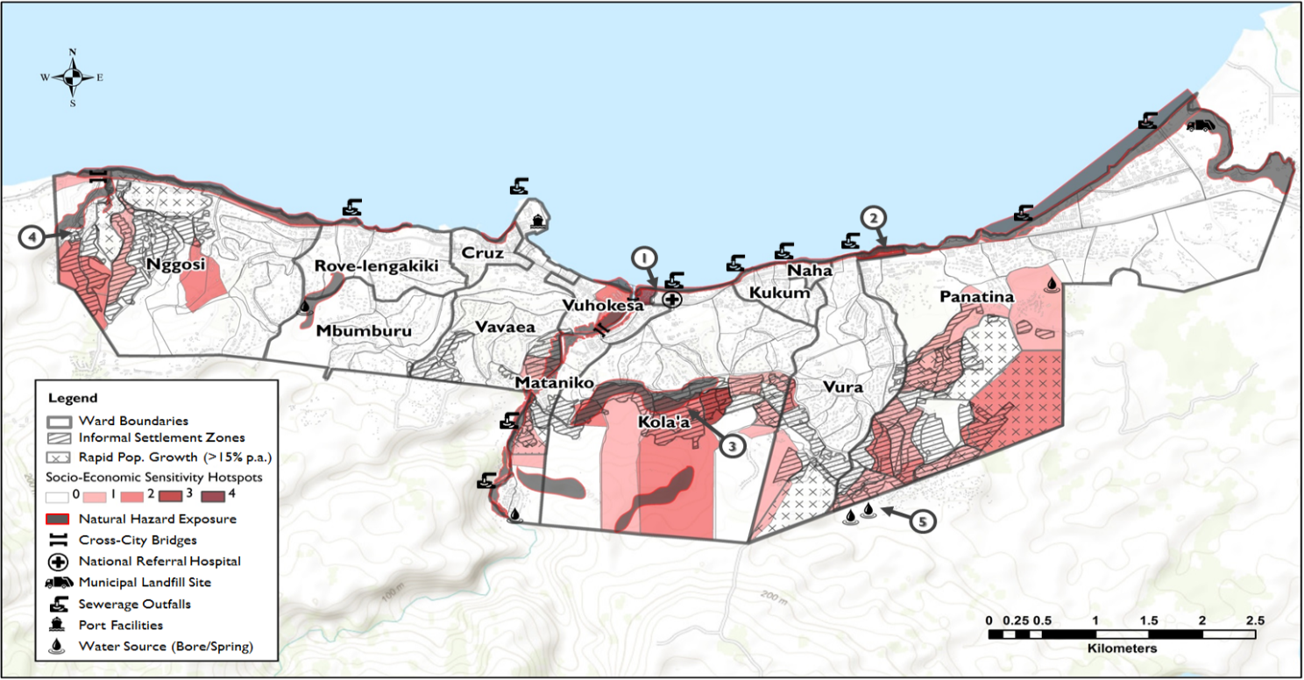
Example of spatial vulnerability from Honiara, Solomon Isl.

Slide 14
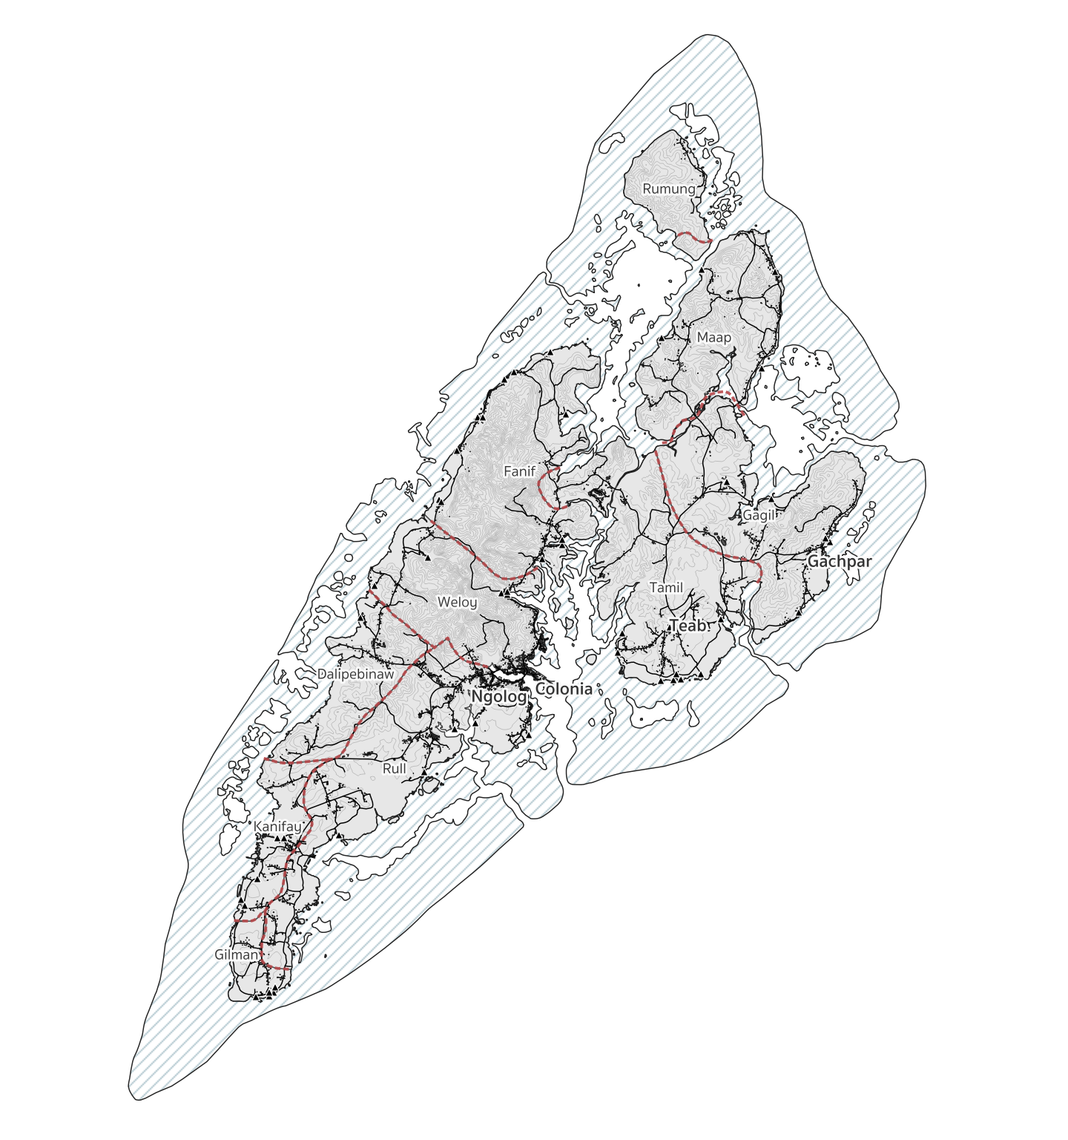
For discussion: FSM’s Climate Vulnerability Assessment:
Average vulnerability
Divided by sector – e.g. agriculture, health (to be discussed)
Vulnerability hotspots
Can be done by both state and by municipality using census & other spatial information
Digital Atlas of Micronesia: previously hosted by DECEM at www.islandatlas.org – data partially extracted so far
Trends & disruptions
Census data for 1994, 2000, 2010, but 2023 will be critical to making sure our analysis is current, particularly post the COVID-19 pandemic
Uncertainties & external factors
‘Ground truthing’ data (through you!) as key – vulnerability assessments are only as good as their inputs & often bias towards western knowledge systems, socioeconomic norms (e.g. ignoring traditional knowledge)
Yap Island divided by municipal
Enumeration Areas (red dashed lines)
Nb: excluding Yap State’s outer islands

Slide 15
Risk
Adaptation

Slide 16
Example risk statement for agriculture
Vulnerability
Subsistence farming is key to food security
Local economic & health impacts
Climate hazard (e.g. increasing temperatures and extreme heat)
Hazard
Risk
Exposure
Crop and livestock production
Flow-on impacts to farming workforces and evaporation
Resulting risk statement
Chronic and acute climate hazards will increasingly impact the suitability of crop and livestock agriculture on the island, which is important for food security, the local economy health and wellbeing.

Slide 17
Discussion
Question 1: Have we included all the important climate variables relating to FSM?
(Average and extreme temperature, average and extreme rainfall, drought, typhoons and wind, fire weather, sea level and coastal inundation (tides/ waves), average sea surface temperature (SST), extreme SST: marine heatwaves and degree heating weeks, ocean acidification)
Question 2: Which of these climate variables or hazards affects you the most?
In groups
Question 3: In the last 10 years have you experienced negative events relating to climate and how did these affect you/ your state/ your community?
Question 4: What aspects of FSM geography/ culture/ society influenced (increased/ decreased) your vulnerability? For example, location, governance, gender, traditional knowledge etc.

Slide 18
Previous sectors used for FSM climate change assessments
Example 1 (JSAP 2015) | Example 2 (2017 GCF Country Program) | Example 3 (GCF Proposal 2023)
Tourism & economic development | Private sector development | Economic resilience
Agriculture (agroforestry and food security) | Agriculture | Food
Water & utilities | Water resources and sanitation | Water & energy
Biodiversity | Infrastructure | Infrastructure & settlements
Coastal resources development | Transportation | Waste management & sanitation
Health | Health | Health & social protection
Disaster management | Education | Education
Culture and community development | Social and cultural | Traditional culture
Fisheries | Fisheries
 | Environment (coastal ecosystem and biodiversity)

Slide 19
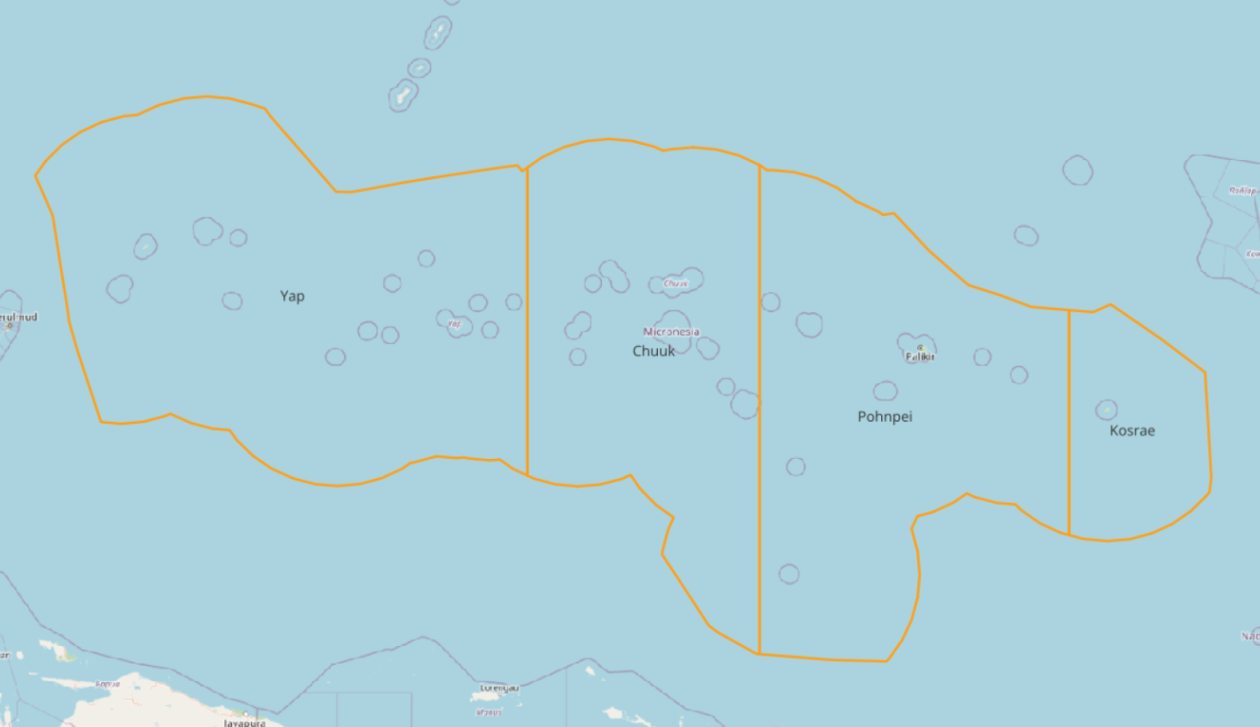
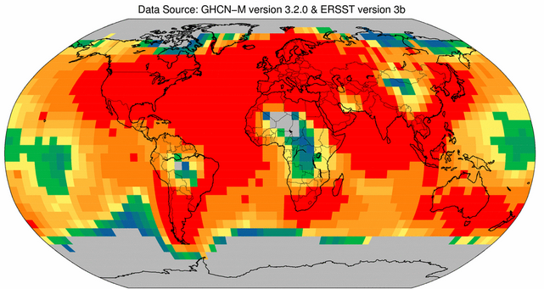
Four states: Exclusive Economic Zone (EEZ regions)
Yap
Chuuk
Pohnpei
Kosrae
Global grid of coloured squares representing temperature data on interactive map

Slide 20
Project partners
Thankyou
Any Questions?
Notes:
Sources:
CIH_BusinessPlansSlides_draft_20230814

